Slide 1
ONLINE FOOD DELIVERY SYSTEM LAB 02
GROUP 01
Presented By
Arun Jyoti Mondal - 2020-3-60-064
Md Sifatullah Sheikh - 2022-1-60-029
Nuzath Tabassum Arthi - 2022-1-60-185
Urmi Kirtonia - 2022-1-60-184
Presented To
Dr. Shamim H. Ripon
Professor
East West University

Slide 2

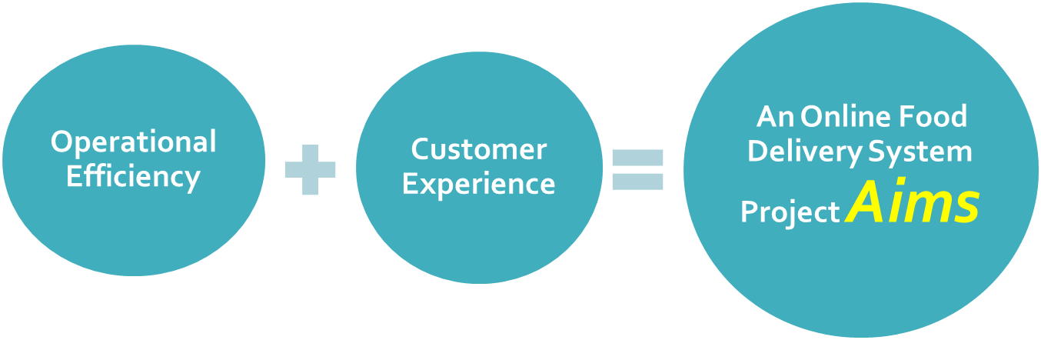
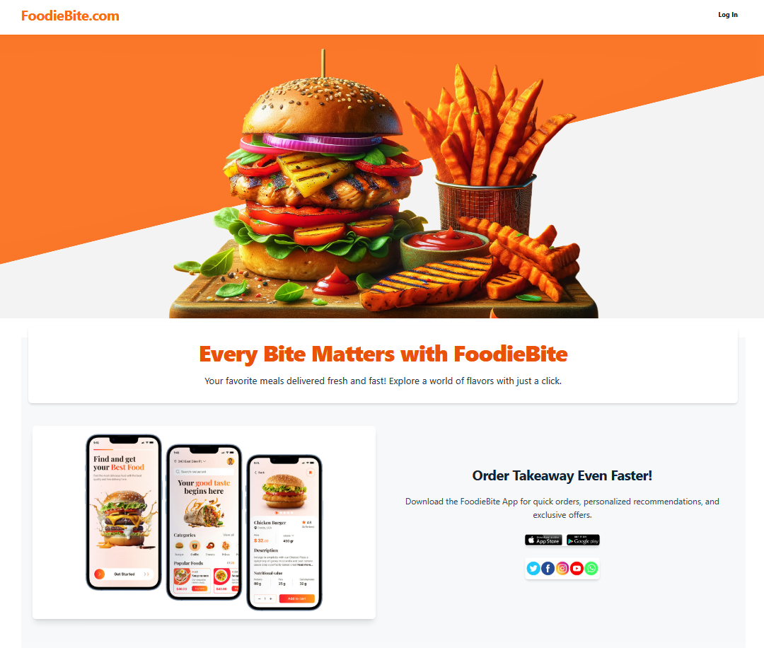

Slide 3




Types of User
Administrator
Customer
Restaurant Owner
Delivery Rider

Slide 4
Customer
Account Management
Search & Browse
Order Placement
Payment integration
Order Tracking
Feedback & Ratings

Slide 5

Restaurant Manager
Profile Management
Menu Management
Order Management
Inventory Management
Promotion & Discounts
Sales & Analytics

Slide 6
Rider Personnel
Account Management
Order Assignment
Navigation & Tracking
Delivery History
Earnings Tracker

Slide 7
Administrator
User Management
Order & Payment Management
Analytics & Reporting
Promotion
Customer Support

Slide 8
Conclusion
The Online Food Delivery System enhances convenience, efficiency, and accessibility for users by streamlining the process of ordering and delivering food. This system benefits customers through an easy-to-use interface, restaurants by expanding their reach, and administrators by simplifying order management.

Slide 9
CPM Question Table
No. | Task | Predecessor | Duration
A | Homepage | … | 4
B | Customer Dashboard | A | 7
C | Restaurant Menu | B | 3
D | Shopping Cart | C | 2
E | Order Payment & Confirmation | D | 1
F | Order Status | B,G,H,I | 5
G | Restaurant Dashboard | A | 5
H | Rider Dashboard | A | 3
I | Admin Dashboard | A | 5
J | Terms & Condition; Contact Us | A | 1

Slide 10
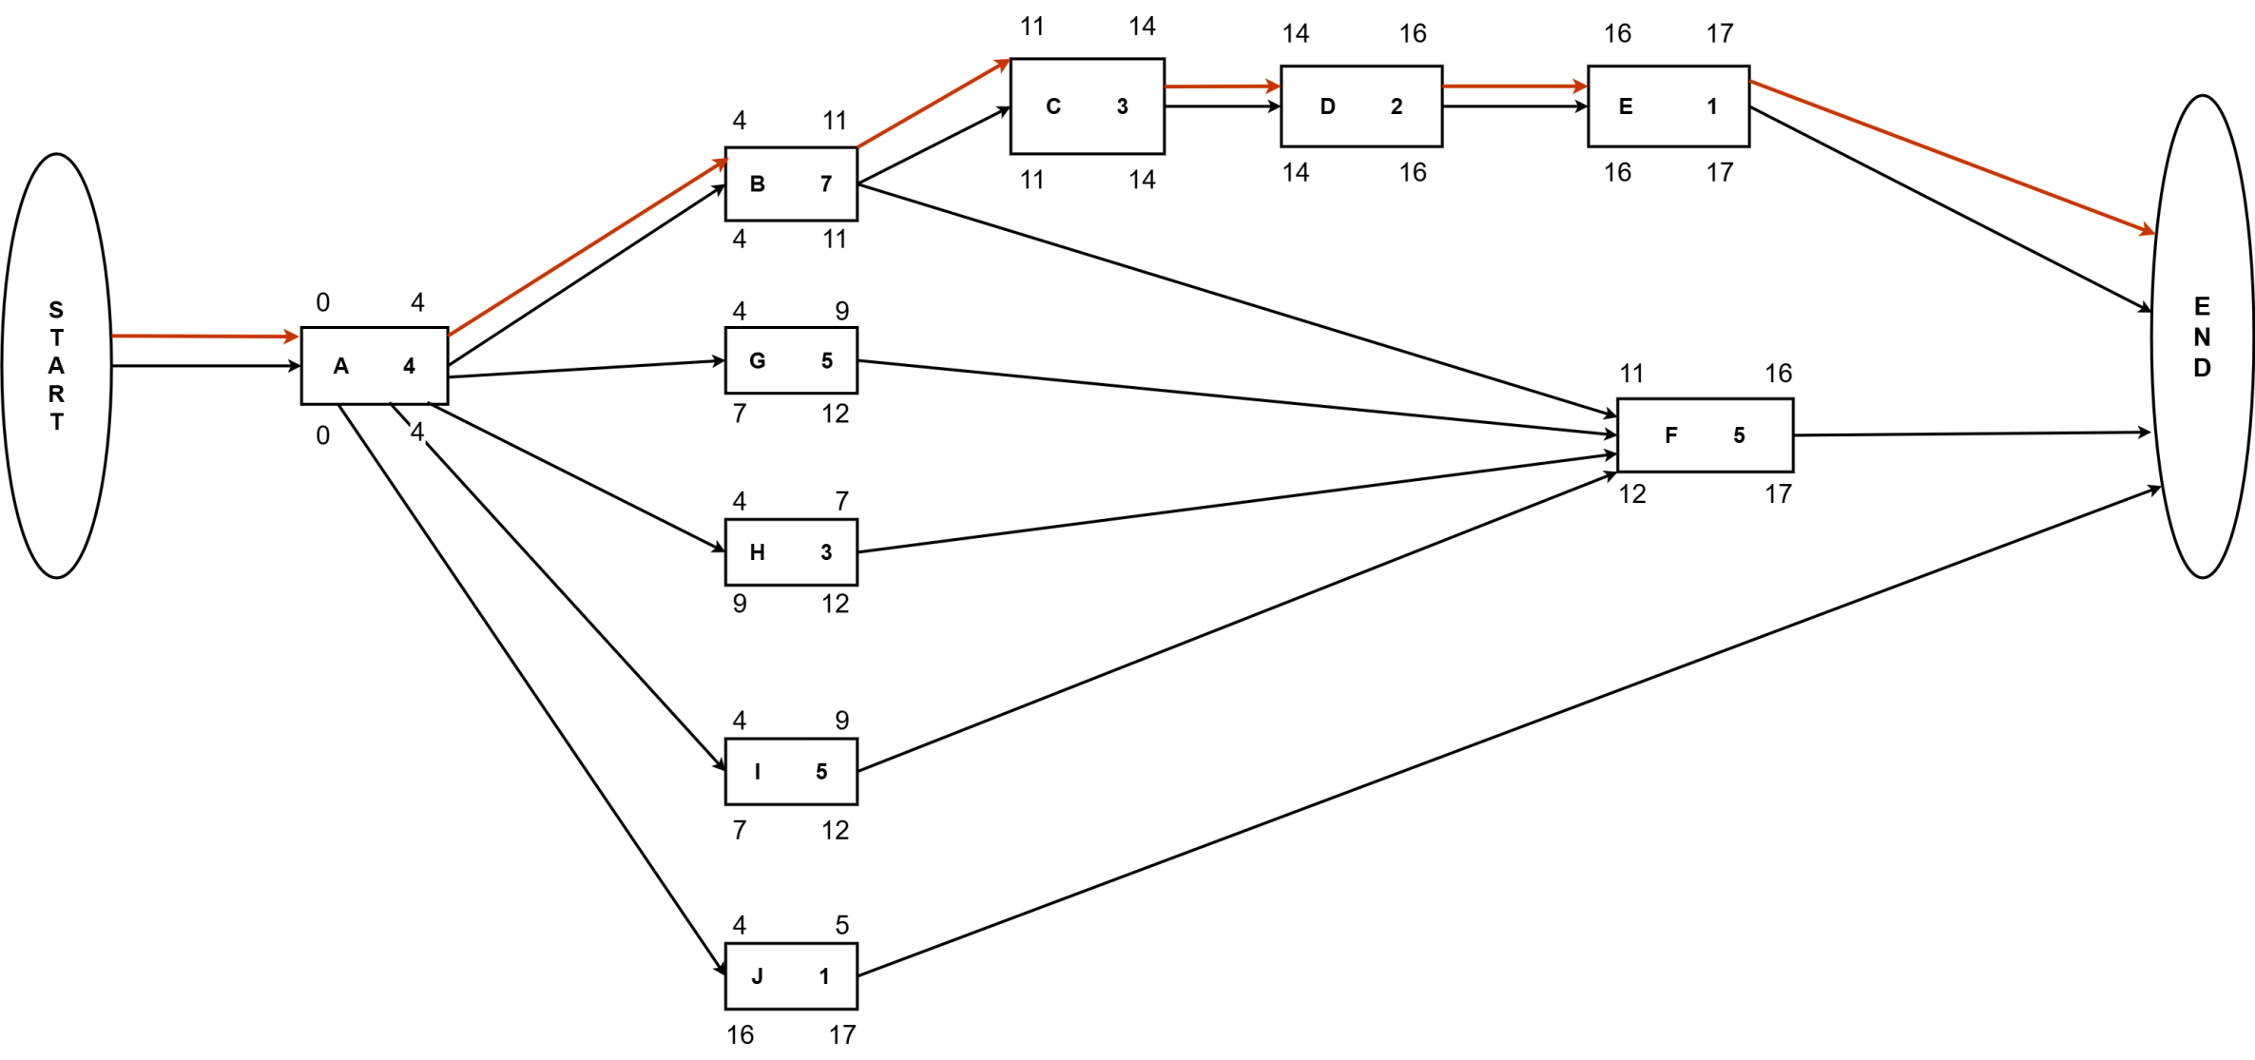
Network Diagram

Slide 11
Total Float & Free Float
Total Float
Critical Path :
A>B>C>D>E
No. | Subtraction | Result
A | 0 – 0 | 0
B | 4 – 4 | 0
C | 11 – 11 | 0
D | 14 – 14 | 0
E | 16 – 16 | 0
F | 12 -11 | 1
G | 7 – 4 | 3
H | 9 – 4 | 5
I | 7 – 4 | 3
J | 16 -4 | 12
Free Float
No. | Subtraction | Result
A | 4 – 4 | 0
B | 11 – 11 | 0
C | 14 – 14 | 0
D | 16 – 16 | 0
G | 11 – 9 | 2
H | 11 – 7 | 4
I | 11 - 9 | 2

Slide 12
Importance Of Critical Path
Identifying the critical path ensures that the features such as
Order Payment,
Customer Dashboard and
Order Status
are catered for to reduce any chance of delay and poor use of resources. It facilitates smoother early testing to ensure timely completion and smooth integration of the core functions, thus improving the overall project efficiency and readiness for launch.

Slide 13
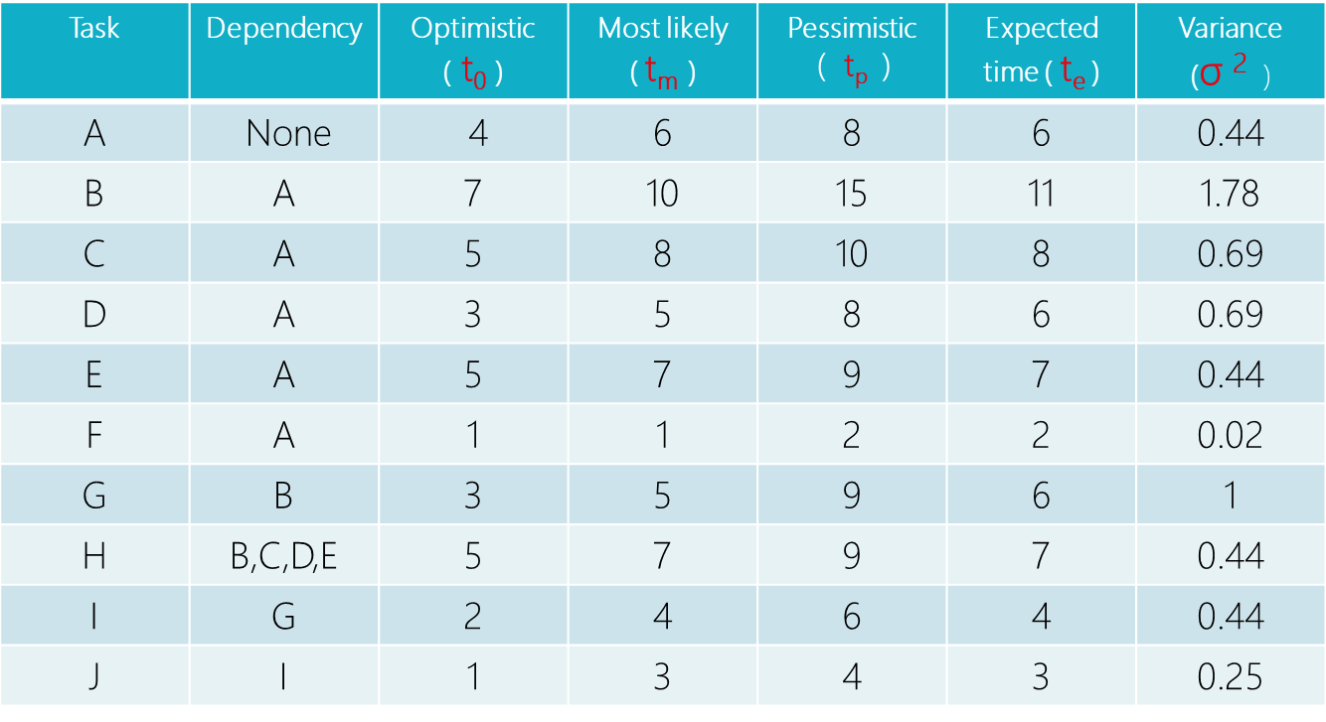
PERT Question Table

Slide 14
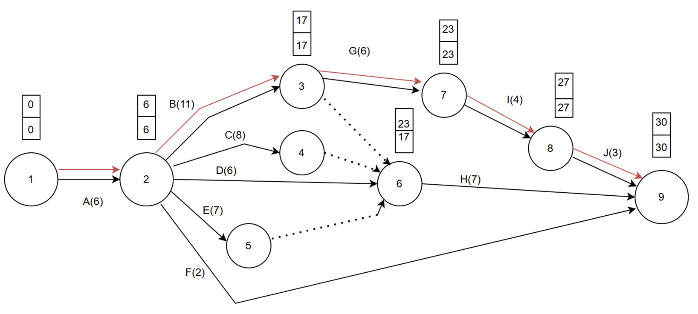
Network Diagram

Slide 15
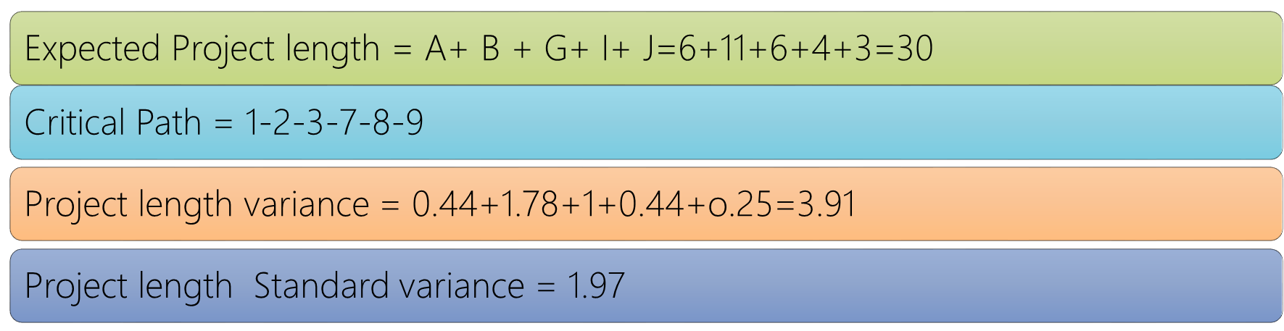

Slide 16
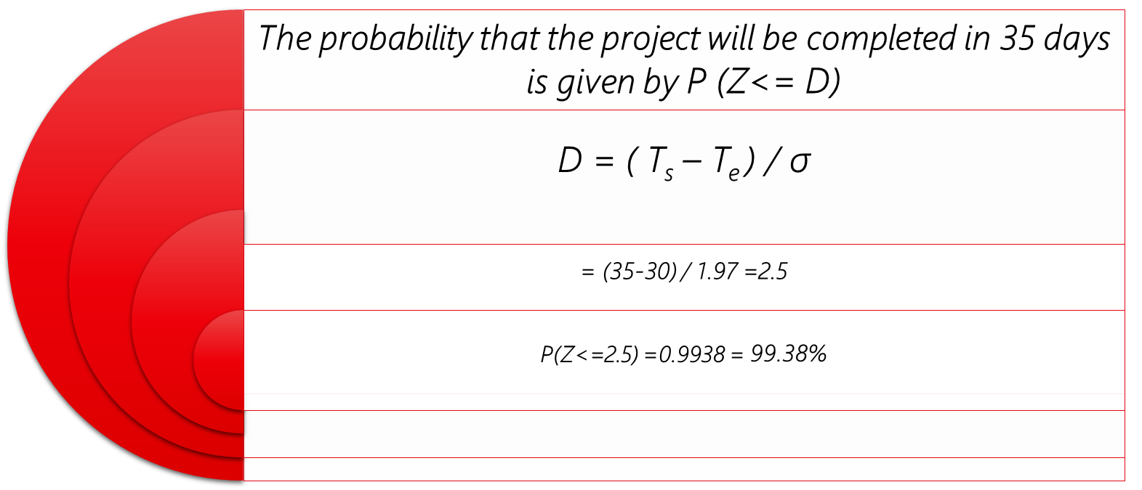

Slide 17
Importance Of PERT for our Project
The Program Evaluation and Review Technique (PERT) is highly helps in
Planning
Organizing and
Coordinating tasks effectively
In an online food delivery system project, PERT is essential for identifying the key path, streamlining work scheduling, and managing time estimate uncertainties. It helps with risk minimization, resource allocation, progress monitoring, teamwork, and timely delivery. It also improves communication with stakeholders for a successful project launch

Slide 18
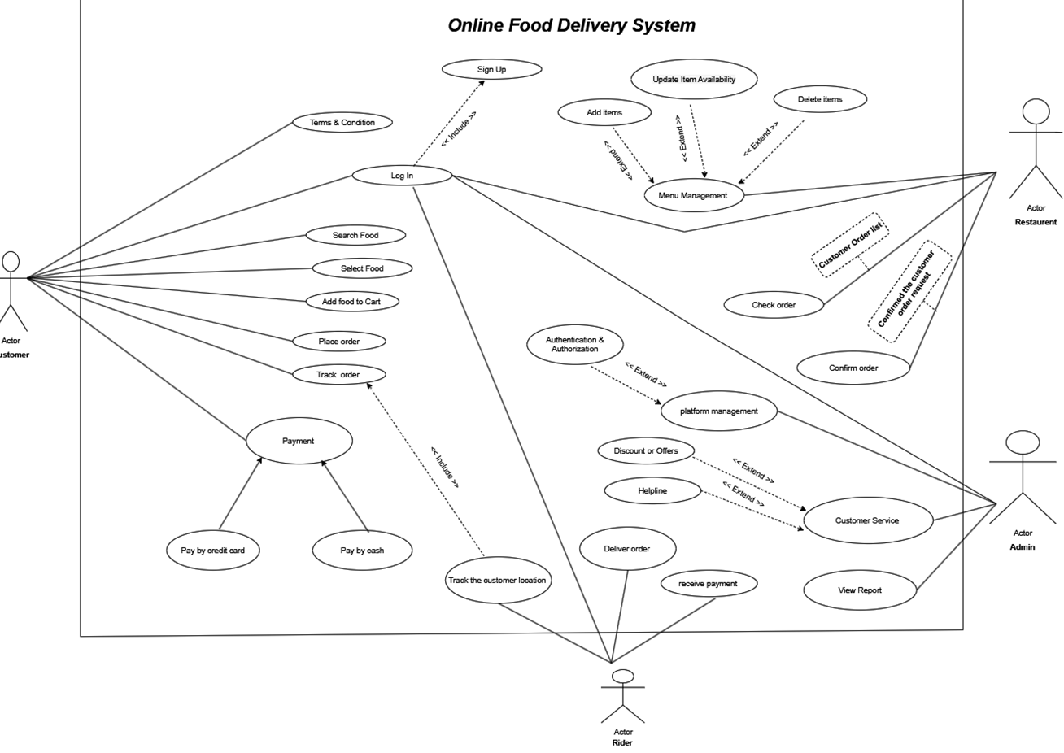
Use Case Diagram

Slide 19
Importance of the Use Case Diagram for Online Food Delivery Management System : Visual Clarity: Depicts core processes, including ordering, payment, and delivery. Stakeholder Communication: It helps developers, clients, and users understand the system. Role Identification: Lists the responsibilities of a customer, delivery agent, restaurant, and admins. Requirement Analysis: Simplifies the system requirements and their relationships. Efficient Design: Helps in the development of a well-organized and user-centered system.
Use Case Importance

Slide 20
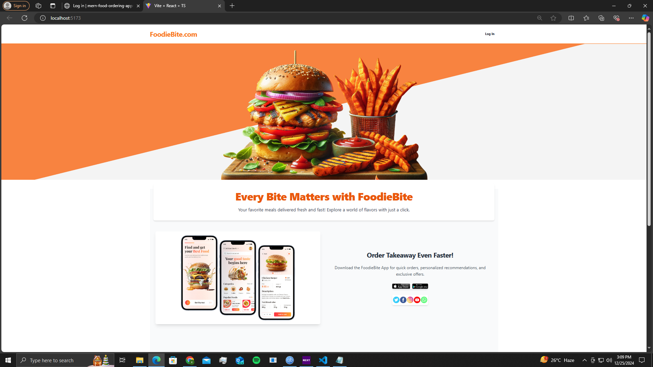
Progress of the project : Home Page(not completed !!) **Responsive

Slide 21
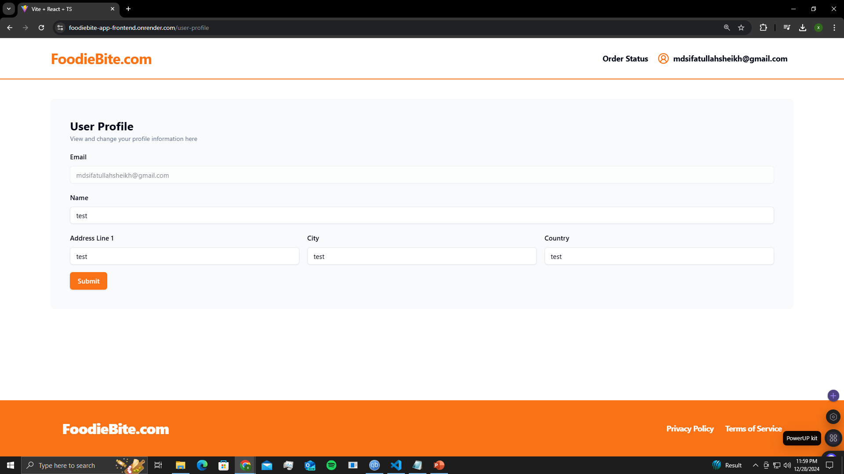
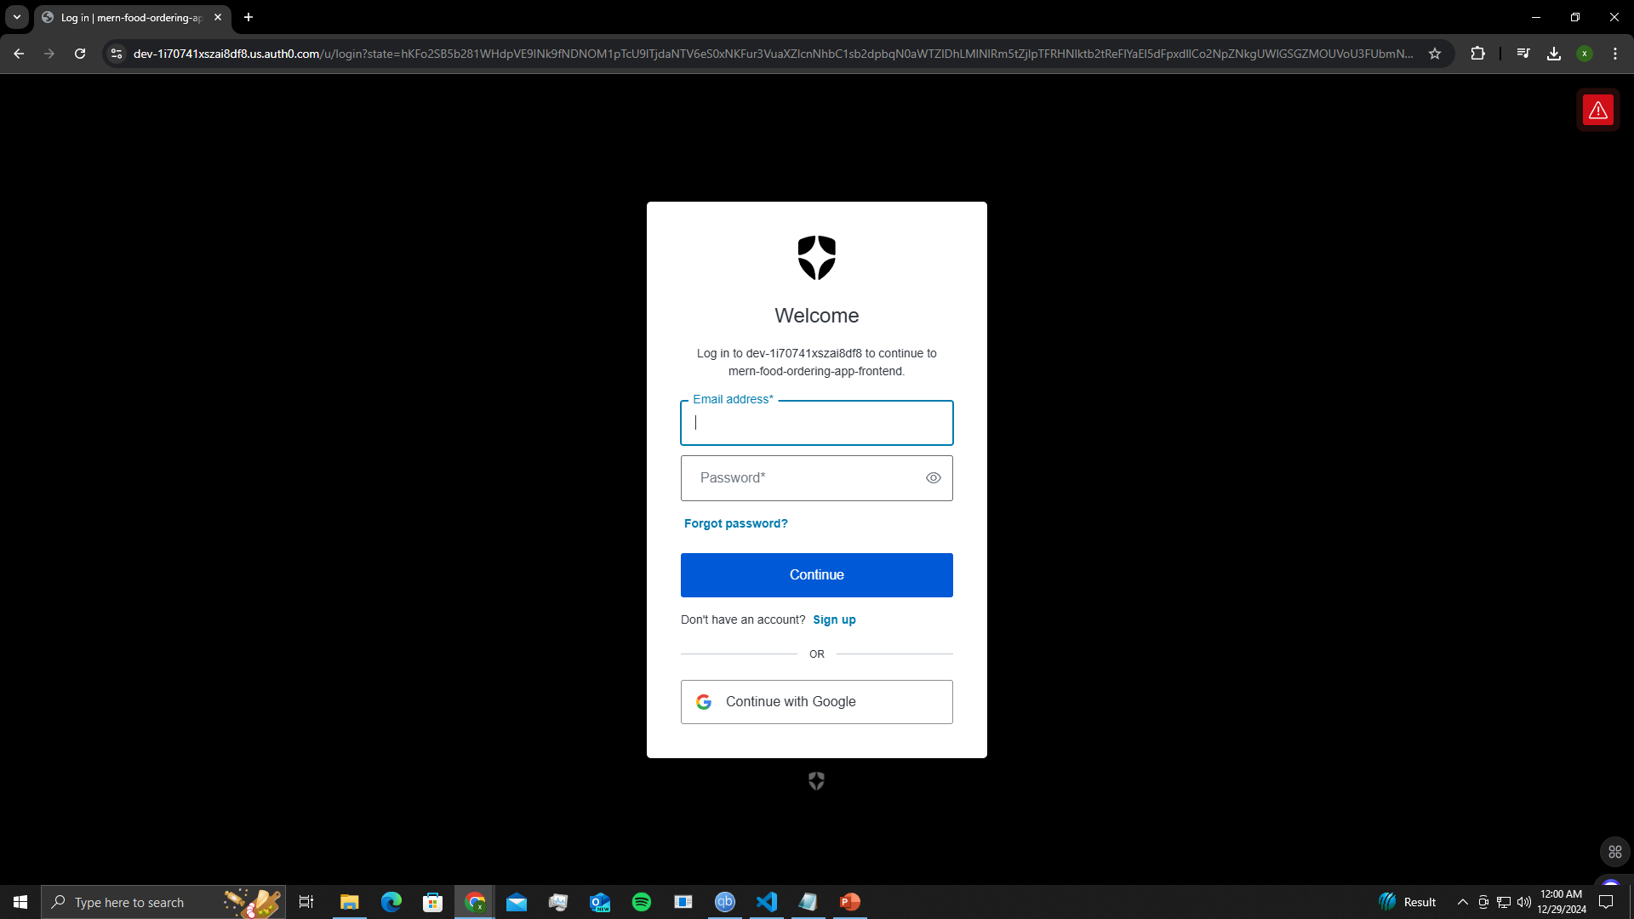
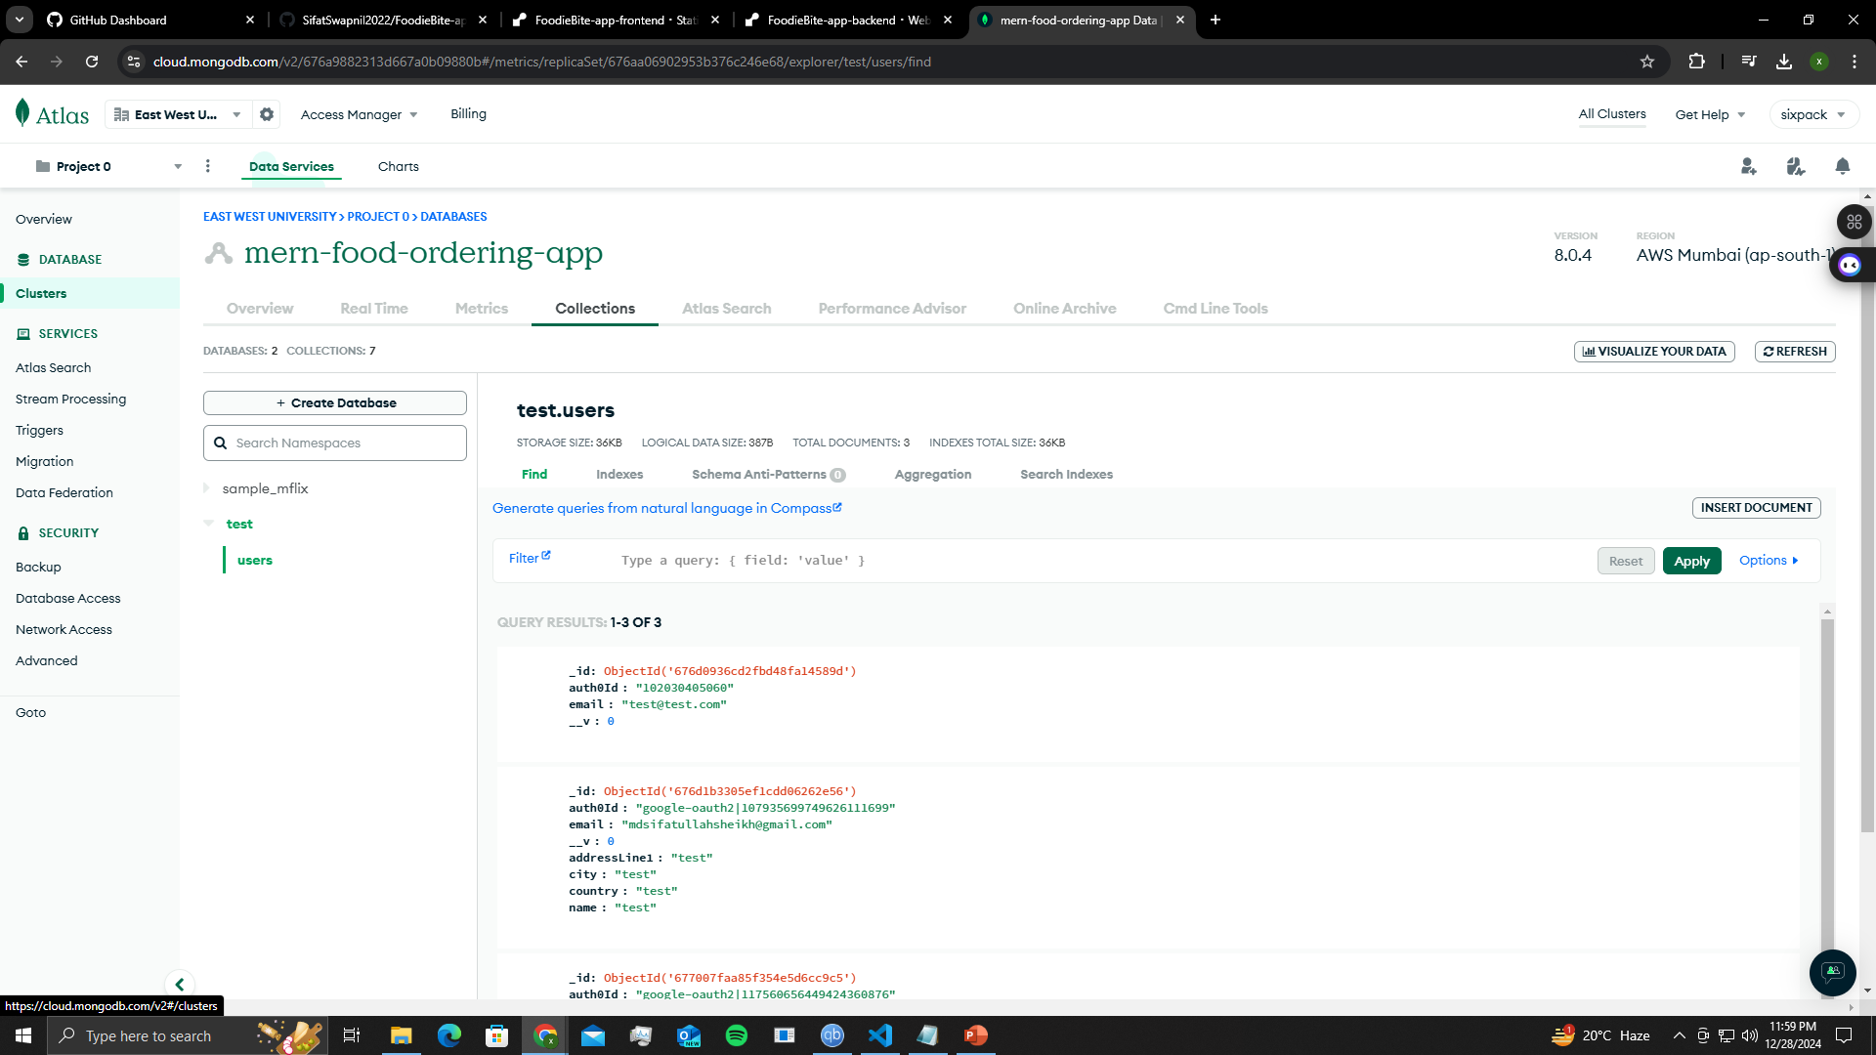
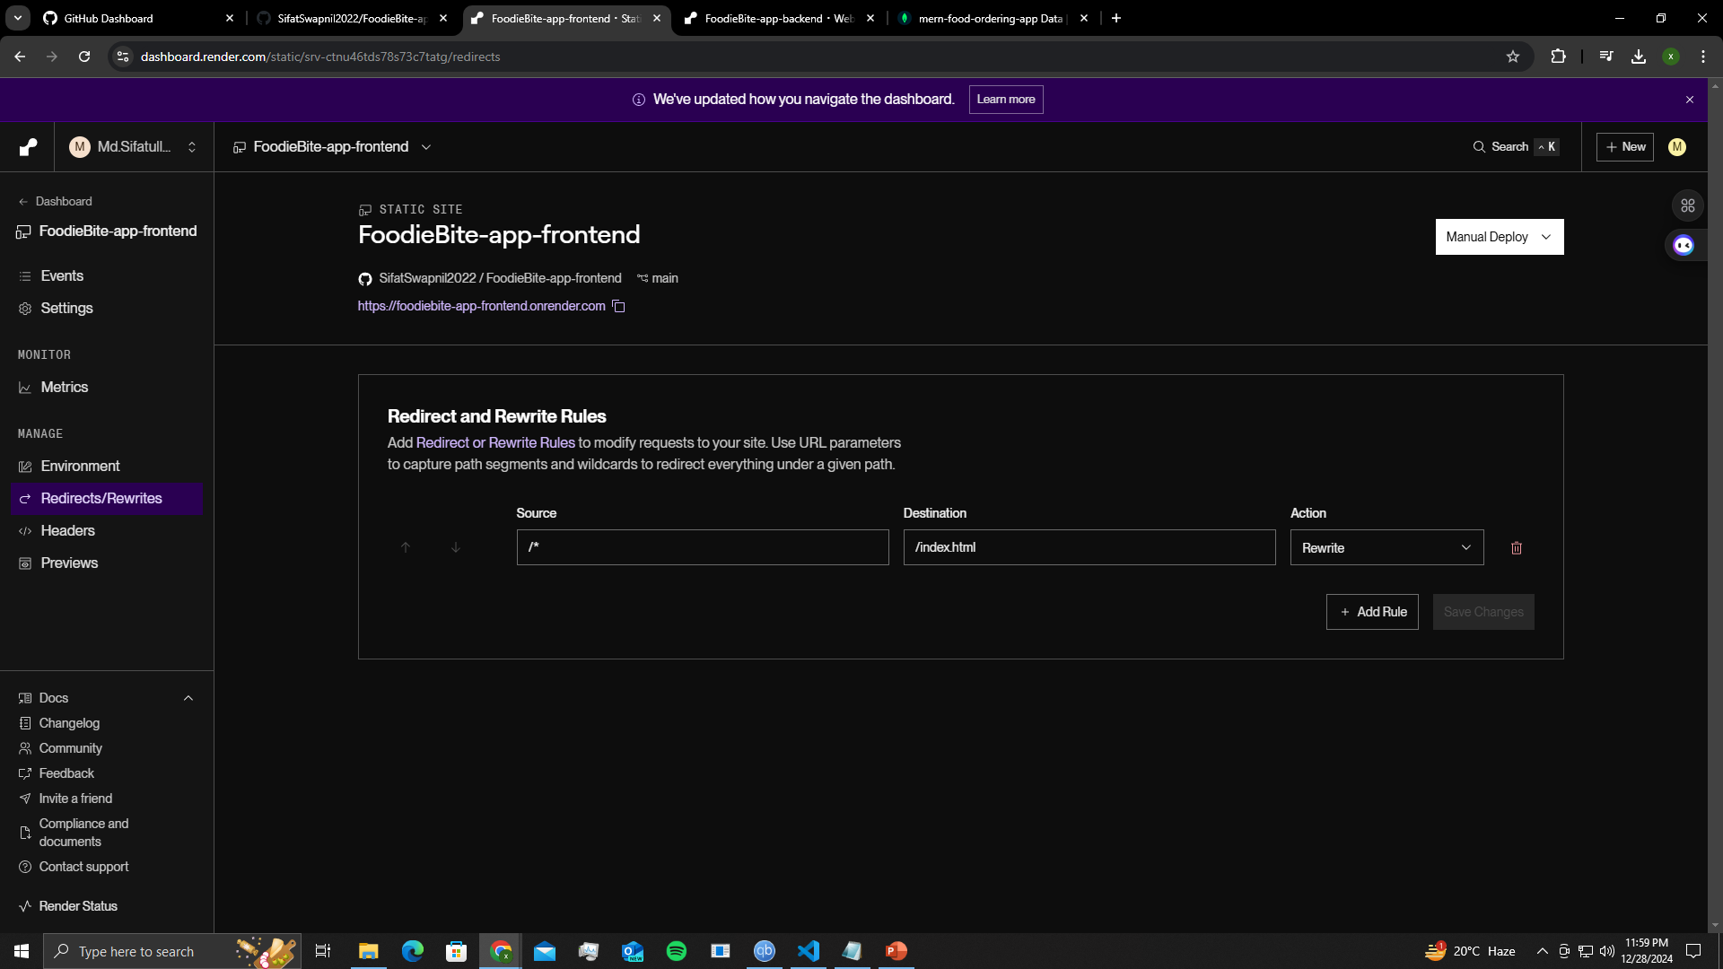
User Form
Sign in/sign up from Auth0
Database MongoDB
Deploying Frontend and Backend in Render

Slide 22
Thank You

