Slide 1
ONLINE FOOD DELIVERY SYSTEM LAB 03
GROUP - 01
Presented By
Arun Jyoti Mondal - 2020-3-60-064
Md Sifatullah Sheikh - 2022-1-60-029
Nuzath Tabassum Arthi - 2022-1-60-185
Urmi Kirtonia - 2022-1-60-184
Presented To
Dr. Shamim H. Ripon
Professor
East West University

Slide 2
PERT Question Table
Task | Dependency | Optimistic ( t₀ ) | Most likely ( t_{m} ) | Pessimistic ( t_{p} ) | Expected time ( t_{e} ) | Variance (σ ² )
A | None | 4 | 6 | 8 | 6 | 0.44
B | A | 7 | 10 | 15 | 11 | 1.78
C | A | 5 | 8 | 10 | 8 | 0.69
D | A | 3 | 5 | 8 | 6 | 0.69
E | A | 5 | 7 | 9 | 7 | 0.44
F | A | 1 | 1 | 2 | 2 | 0.02
G | B | 3 | 5 | 9 | 6 | 1
H | B,C,D,E | 5 | 7 | 9 | 7 | 0.44
I | G | 2 | 4 | 6 | 4 | 0.44
J | I | 1 | 3 | 4 | 3 | 0.25

Slide 3
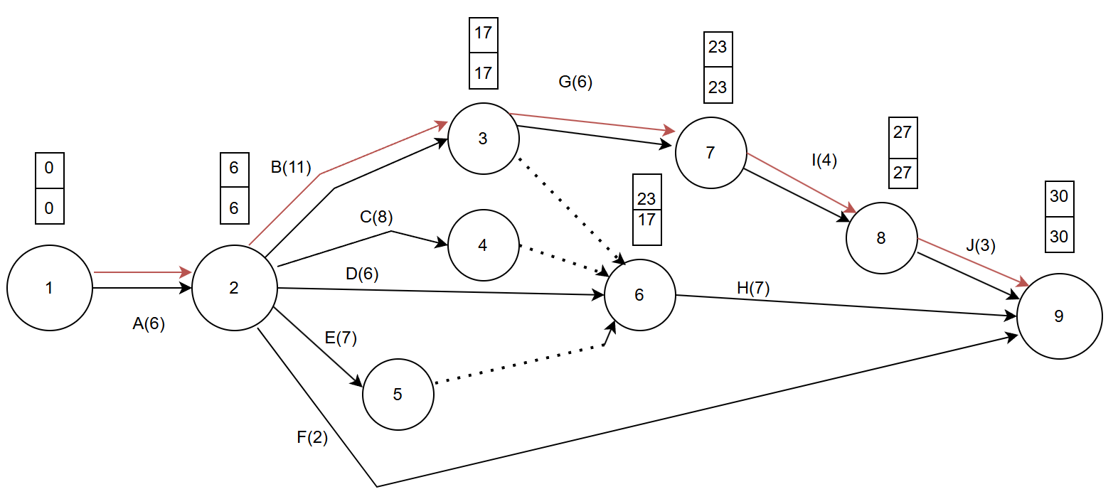
Network Diagram

Slide 4
Expected Project length = A+ B + G+ I+ J=6+11+6+4+3=30
Critical Path = 1-2-3-7-8-9
Project length variance = 0.44+1.78+1+0.44+o.25=3.91
Project length Standard variance = 1.97

Slide 5
The probability that the project will be completed in 35 days is given by P (Z<= D)
D = ( T_{s} – T_{e} ) / σ
^{= (35-30) / 1.97 =2.5}
^{P(Z<=2.5) =0.9938 = 99.38%}

Slide 6
Importance Of PERT for our Project
The Program Evaluation and Review Technique (PERT) is highly helps in
Planning
Organizing and
Coordinating tasks effectively.
In an online food delivery system project, PERT is essential for identifying the key path, streamlining work scheduling, and managing time estimate uncertainties. It helps with risk minimization, resource allocation, progress monitoring, teamwork, and timely delivery. It also improves communication with stakeholders for a successful project launch.

Slide 7
Thank You

