Slide 1
ONLINE FOOD DELIVERY SYSTEM LAB 02
GROUP 01
Presented By
Arun Jyoti Mondal - 2020-3-60-064
Md Sifatullah Sheikh - 2022-1-60-029
Nuzath Tabassum Arthi - 2022-1-60-185
Urmi Kirtania - 2022-1-60-184
Presented To
Dr. Shamim H. Ripon
Professor
East West University

Slide 2
CPM Question Table
No. | Task | Predecessor | Duration
A | Homepage | … | 4
B | Customer Dashboard | A | 7
C | Restaurant Dashboard | A | 5
D | Rider Dashboard | A | 3
E | Admin Dashboard | A | 5
F | Terms & Condition; Contact Us | A | 1
G | Restaurant Menu | B | 3
H | Order Status | B,C,D,E | 5
I | Shopping Cart | G | 2
J | Order Payment & Confirmation | I | 1

Slide 3
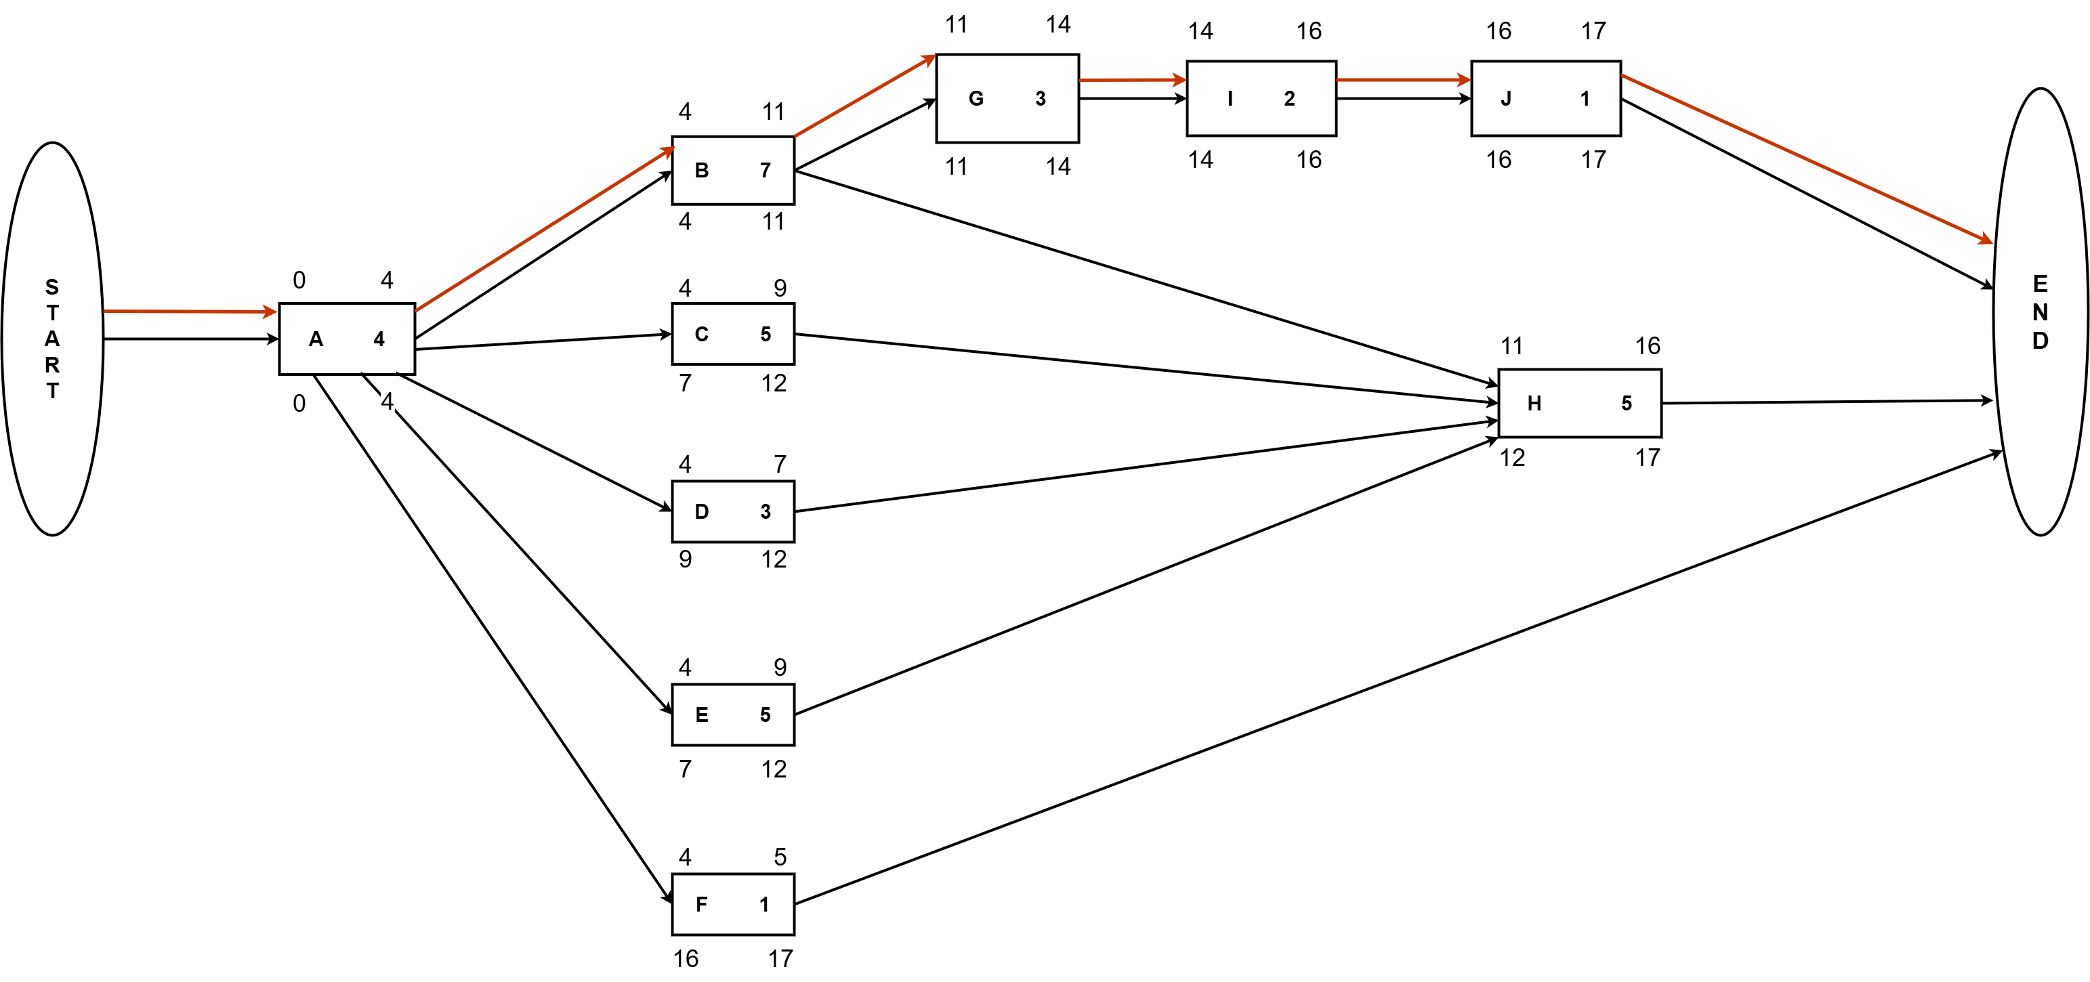
Network Diagram

Slide 4
Total Float & Free Float
Total Float
Critical Path :
A->B->G->I->J
No. | Subtraction | Result
A | 0 – 0 | 0
B | 4 – 4 | 0
C | 7 – 4 | 3
D | 9 – 4 | 5
E | 7 – 4 | 3
F | 16 -4 | 12
G | 11 – 11 | 0
H | 12 – 11 | 1
I | 14– 14 | 0
J | 16 -16 | 0
Free Float
No. | Subtraction | Result
A | 4 – 4 | 0
B | 11 – 11 | 0
C | 11 – 9 | 2
D | 11 – 7 | 4
E | 11 – 9 | 2
G | 14 – 14 | 0
I | 16 - 16 | 0

Slide 5
Importance Of Critical Path
Identifying the critical path ensures that the features such as
Order Payment,
Customer Dashboard and
Order Status
are catered for to reduce any chance of delay and poor use of resources. It facilitates smoother early testing to ensure timely completion and smooth integration of the core functions, thus improving the overall project efficiency and readiness for launch.

Slide 6
Thank You

