Slide 1
ONLINE FOOD DELIVERY SYSTEM Project
GROUP 01
Presented By
Arun Jyoti Mondal - 2020-3-60-064
Md Sifatullah Sheikh - 2022-1-60-029
Nuzath Tabassum Arthi - 2022-1-60-185
Urmi Kirtania - 2022-1-60-184
Presented To
Dr. Shamim H. Ripon
Professor
East West University

Slide 2
Abstract
An Online Food Delivery System Project Aims
Operational Efficiency
Customer Experience

Slide 3



Types of User
Customer
Restaurant Owner
Account Management
Profile Management
Search & Browse
Menu Management
Order Placement
Order Management
Payment integration
Inventory Management
Order Tracking
Promotion & Discounts
Feedback & Ratings
Sales & Analytics

Slide 4
CPM Question Table
No. | Task | Predecessor | Duration
A | Homepage | … | 6
B | Customer Dashboard | A | 7
C | Restaurant Dashboard | A | 5
D | Terms & Condition; Contact Us | A | 1
E | Restaurant Menu | B | 3
F | Order Status | B,C | 5
G | Shopping Cart | E | 2
H | Order Payment & Confirmation | G | 1

Slide 5
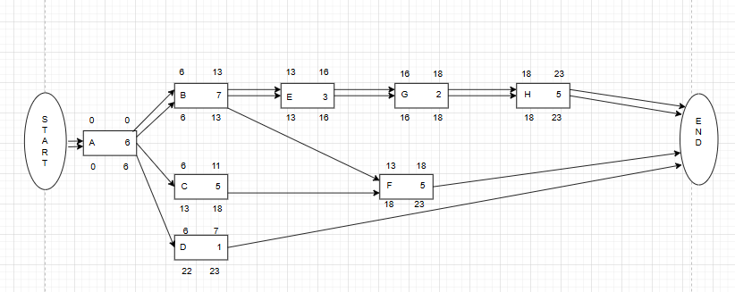
Network Diagram

Slide 6
Total Float & Free Float
Total Float
Critical Path :
A>B>E>G>H
No. | Subtraction | Result
A | 0 – 0 | 0
B | 6 – 6 | 0
C | 13 – 6 | 7
D | 22 – 6 | 16
E | 13 – 13 | 0
F | 18 -13 | 5
G | 16 – 16 | 0
H | 18 – 18 | 0
Free Float
No. | Subtraction | Result
A | 6 – 6 | 0
B | 13 – 13 | 0
C | 13 – 11 | 2
E | 16 – 16 | 0
G | 18 – 18 | 0

Slide 7
Importance Of Critical Path
Identifying the critical path ensures that the features such as
Order Payment,
Customer Dashboard and
Order Status
are catered for to reduce any chance of delay and poor use of resources. It facilitates smoother early testing to ensure timely completion and smooth integration of the core functions, thus improving the overall project efficiency and readiness for launch.

Slide 8
PERT Question Table
Task | Dependency | Optimistic | Most Likely | Pessimistic | Expected time | Variance
A | None | 6 | 8 | 10 | 8 | 0.11
B | A | 7 | 10 | 15 | 11 | 1.78
C | A | 5 | 8 | 10 | 8 | 0.69
D | A | 1 | 1 | 2 | 2 | 0.02
E | B | 3 | 5 | 9 | 6 | 1
F | B,C | 5 | 7 | 9 | 7 | 0.44
G | E | 2 | 4 | 6 | 4 | 0.44
H | G | 1 | 3 | 4 | 3 | 0.25

Slide 9
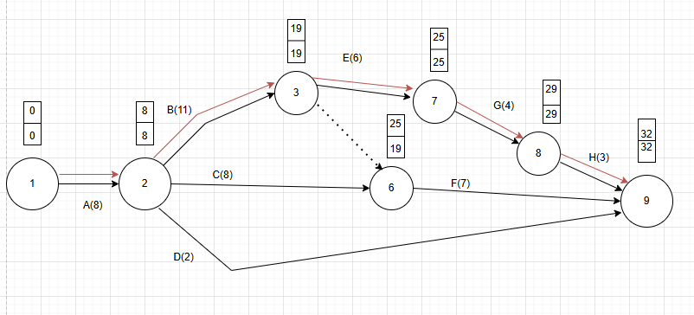
PERT Diagram

Slide 10
Expected Project length = A+ B + E+ G+ H=8+11+6+4+3=32
Critical Path = 1-2-3-7-8-9
Project length variance = 0.11+1.78+1+0.44+o.25=3.58
Project length Standard variance = 1.892

Slide 11
The probability that the project will be completed in 35 days is given by P (Z<= D)
D = ( T_{s} – T_{e} ) / σ
^{= (35-32) / 1.892=1.6}
^{P(Z<=1.6) =0.4452= 44.52%}

Slide 12
Importance Of PERT for our Project
The Program Evaluation and Review Technique (PERT) is highly helps in
Planning
Organizing and
Coordinating tasks effectively
In an online food delivery system project, PERT is essential for identifying the key path, streamlining work scheduling, and managing time estimate uncertainties. It helps with risk minimization, resource allocation, progress monitoring, teamwork, and timely delivery. It also improves communication with stakeholders for a successful project launch

Slide 13
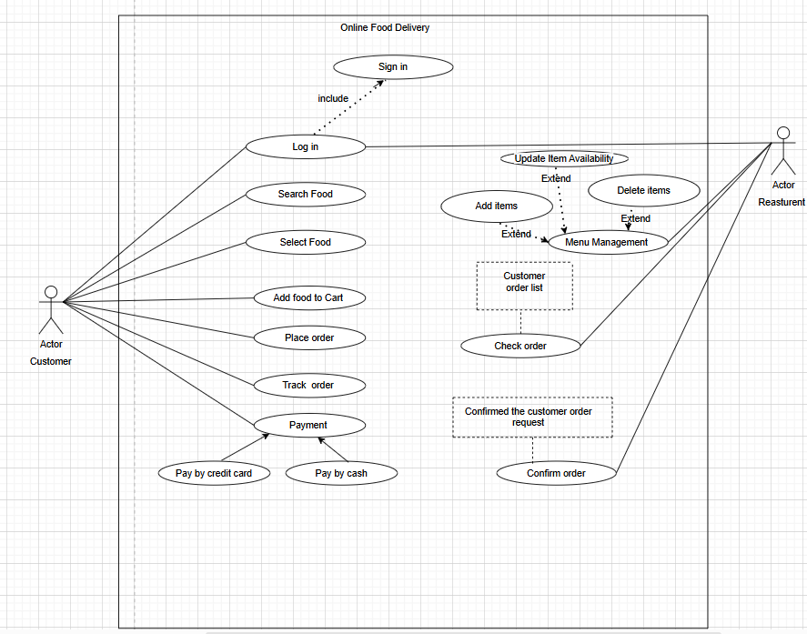
Use Case Diagram

Slide 14
Importance of the Use Case Diagram for Online Food Delivery Management System : Visual Clarity: Depicts core processes, including ordering, payment, and delivery. Stakeholder Communication: It helps developers, clients, and users understand the system. Role Identification: Lists the responsibilities of a customer, delivery agent, restaurant, and admins. Requirement Analysis: Simplifies the system requirements and their relationships. Efficient Design: Helps in the development of a well-organized and user-centered system.
Use Case Importance

Slide 15
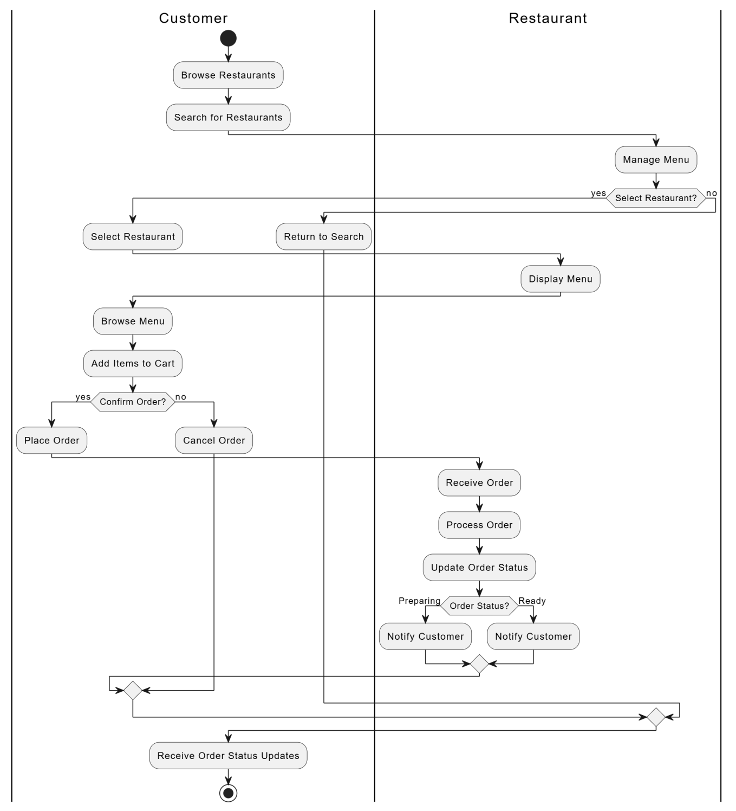
Activity Diagram

Slide 16
Importance Of Activity Diagram
1. Visual Workflow: Simplifies understanding of processes.
2. Defines Roles: Clarifies responsibilities of users.
3. Identifies Issues: Highlights inefficiencies and bottlenecks.
4. Improves Communication: Aligns team and stakeholders.
5. Guides Development: Acts as a blueprint for implementation.
6. Supports Scaling : Eases future enhancements.
7. Error Reduction: Identifies issues early to save costs.

Slide 17
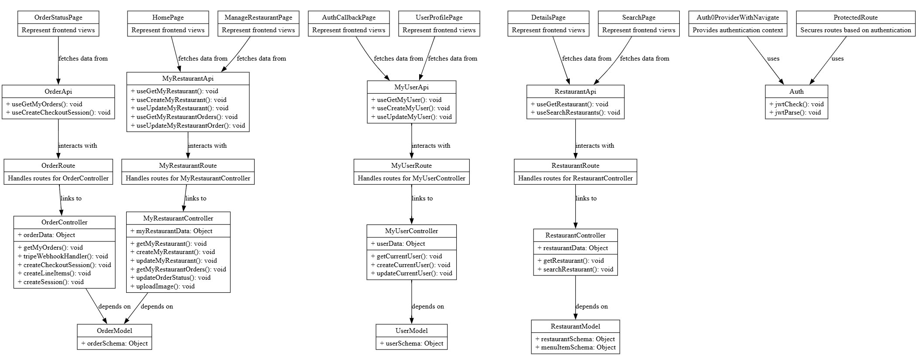
Class Diagram

Slide 18
Conclusion
The Online Food Delivery System enhances convenience, efficiency, and accessibility for users by streamlining the process of ordering and delivering food. This system benefits customers through an easy-to-use interface, restaurants by expanding their reach, and administrators by simplifying order management.

Slide 19
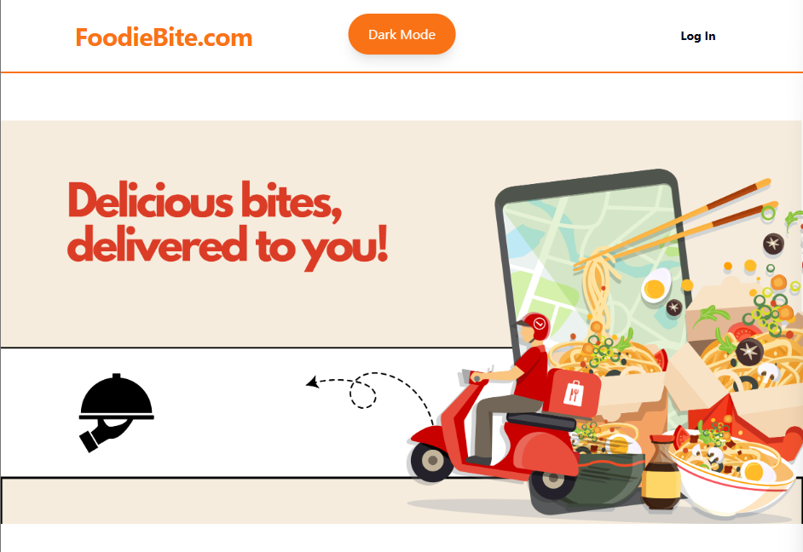

Slide 20
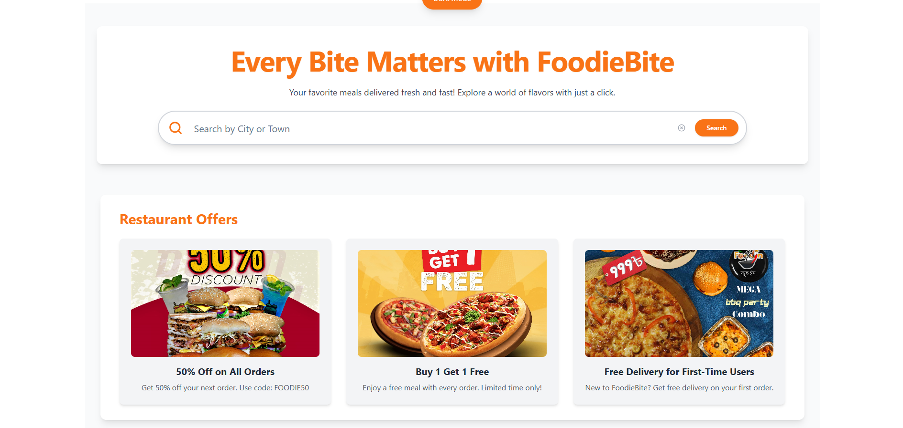

Slide 21
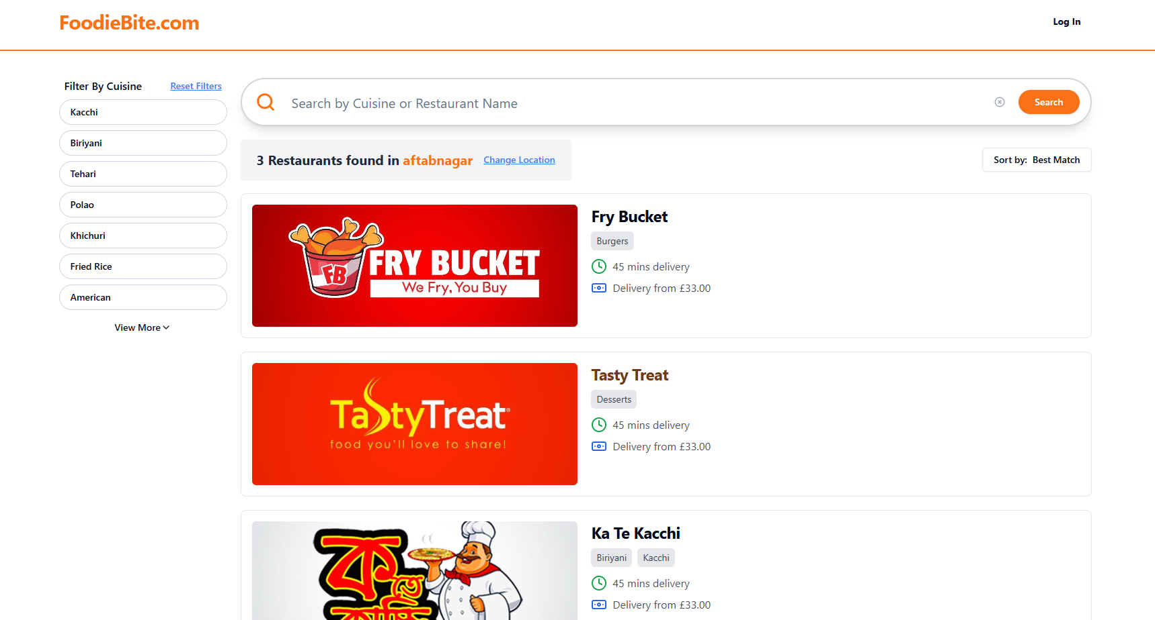

Slide 22
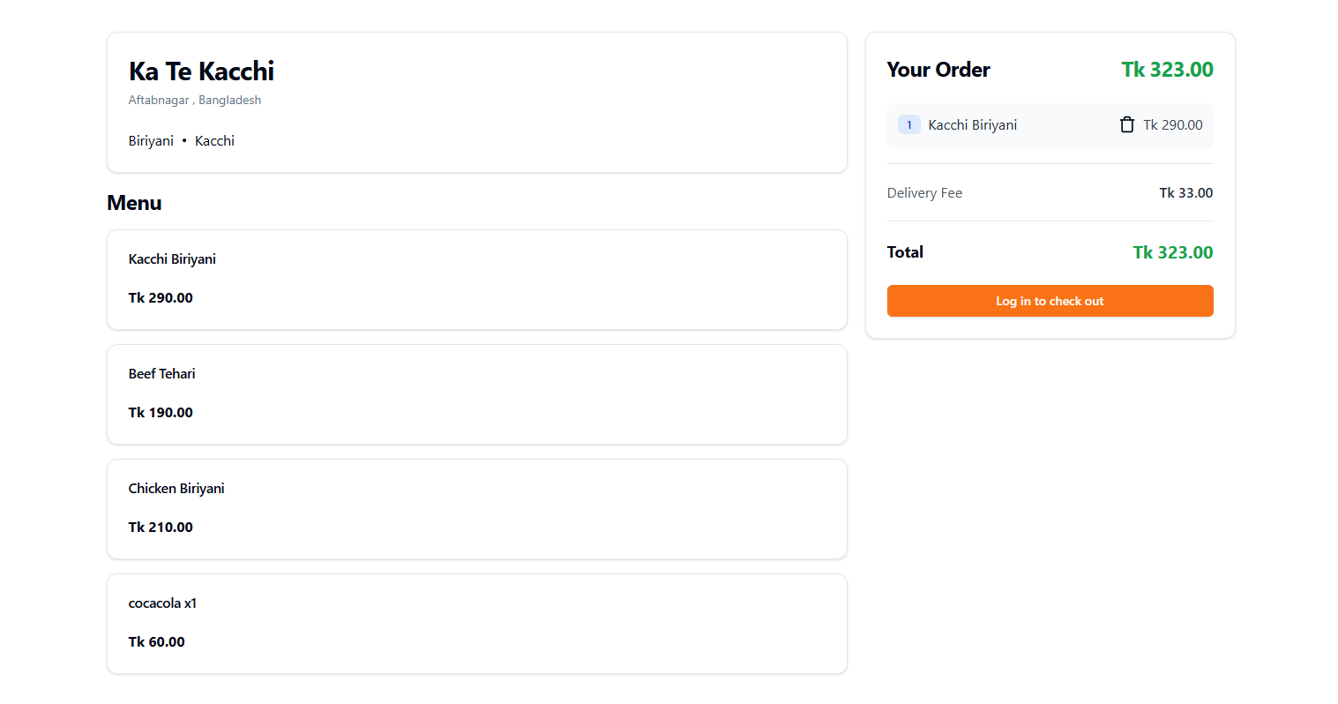

Slide 23
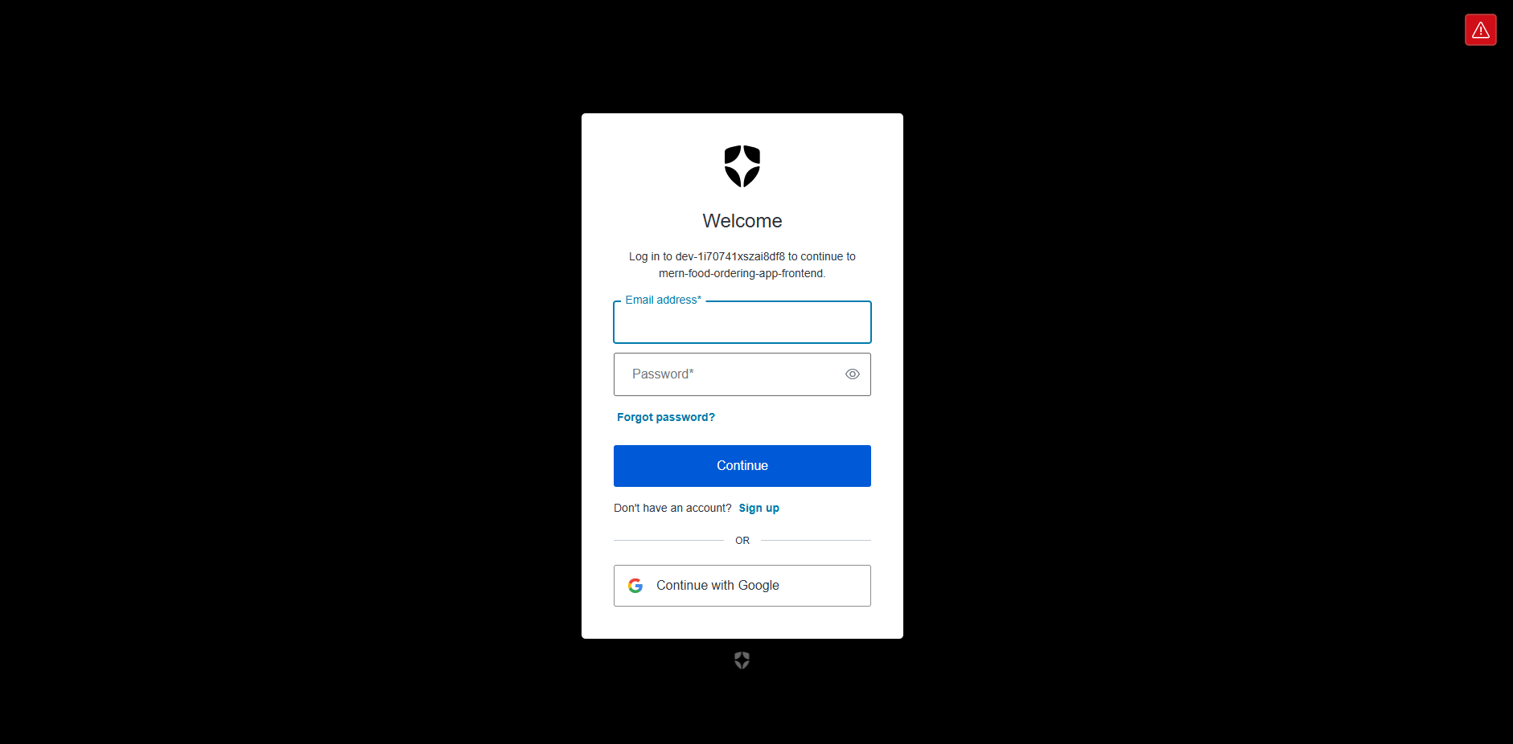

Slide 24
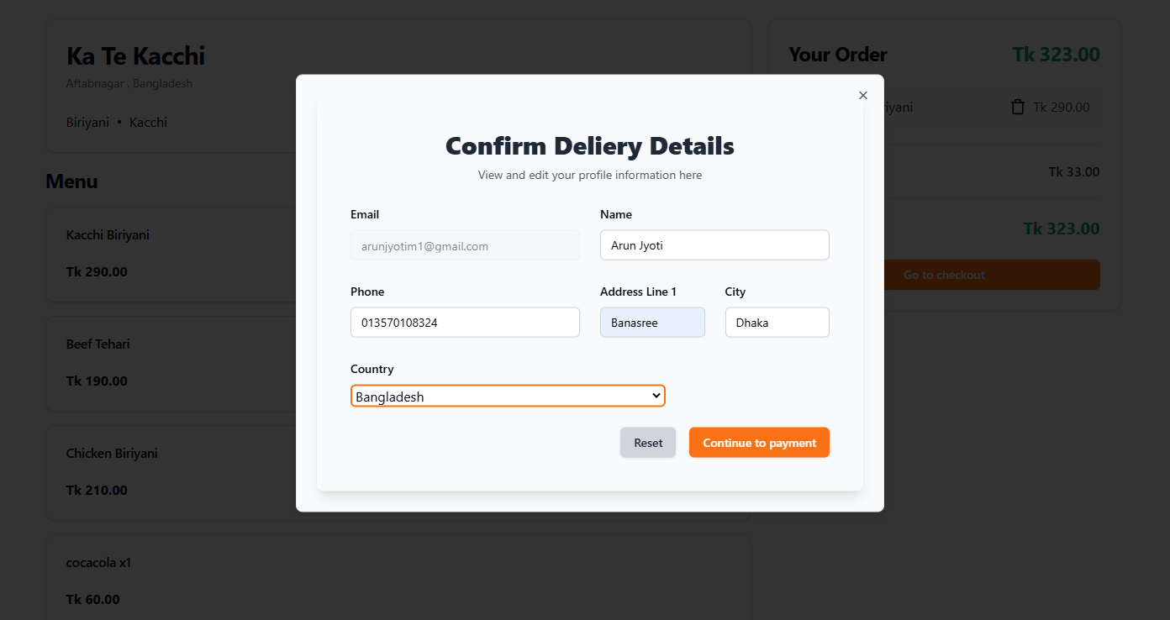

Slide 25
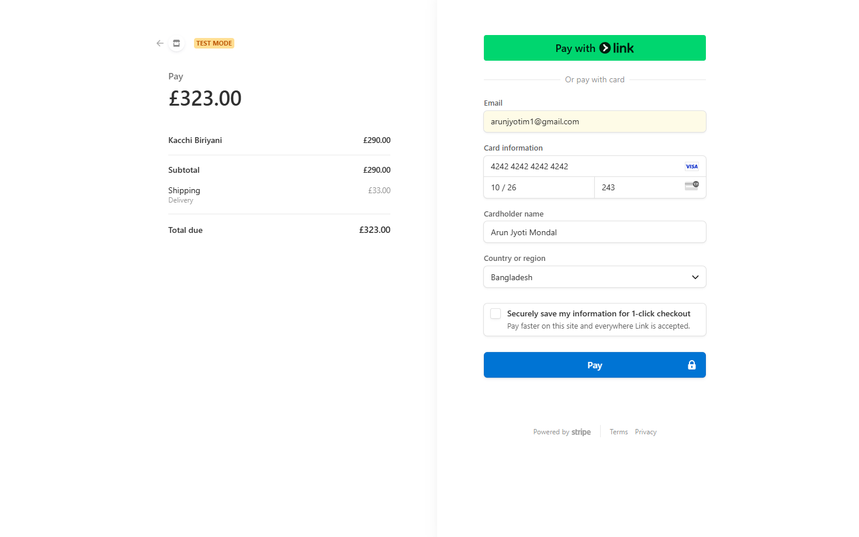

Slide 26
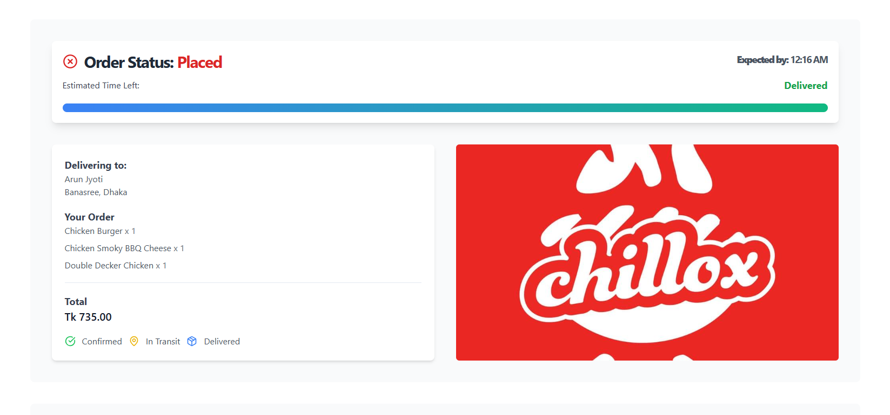

Slide 27
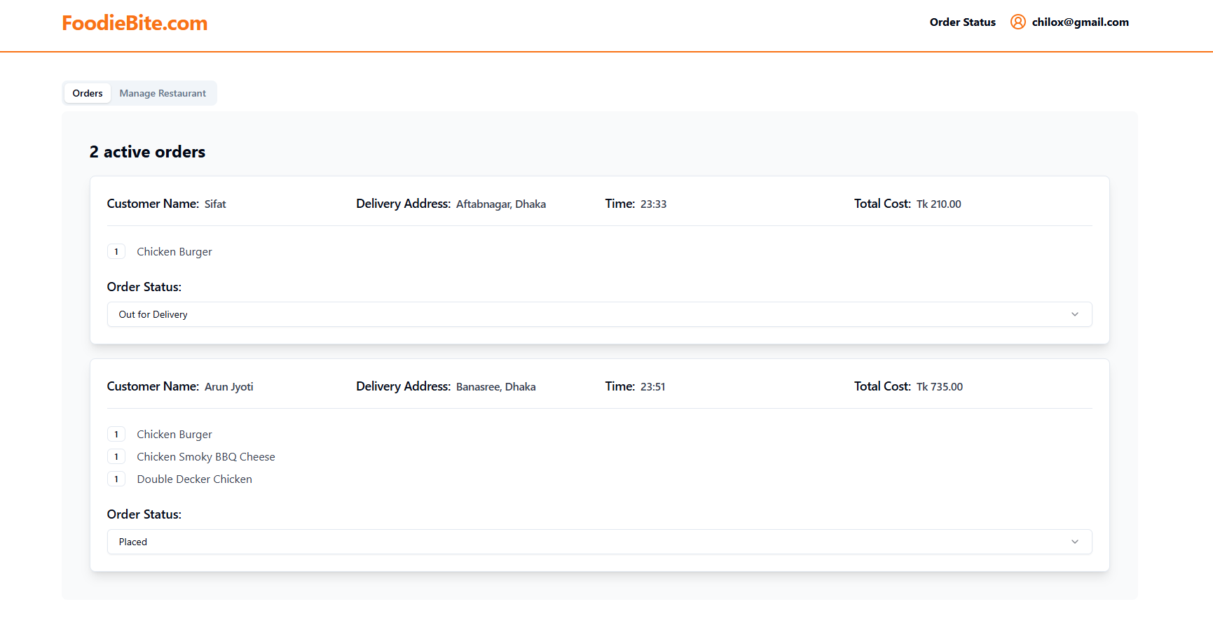

Slide 28
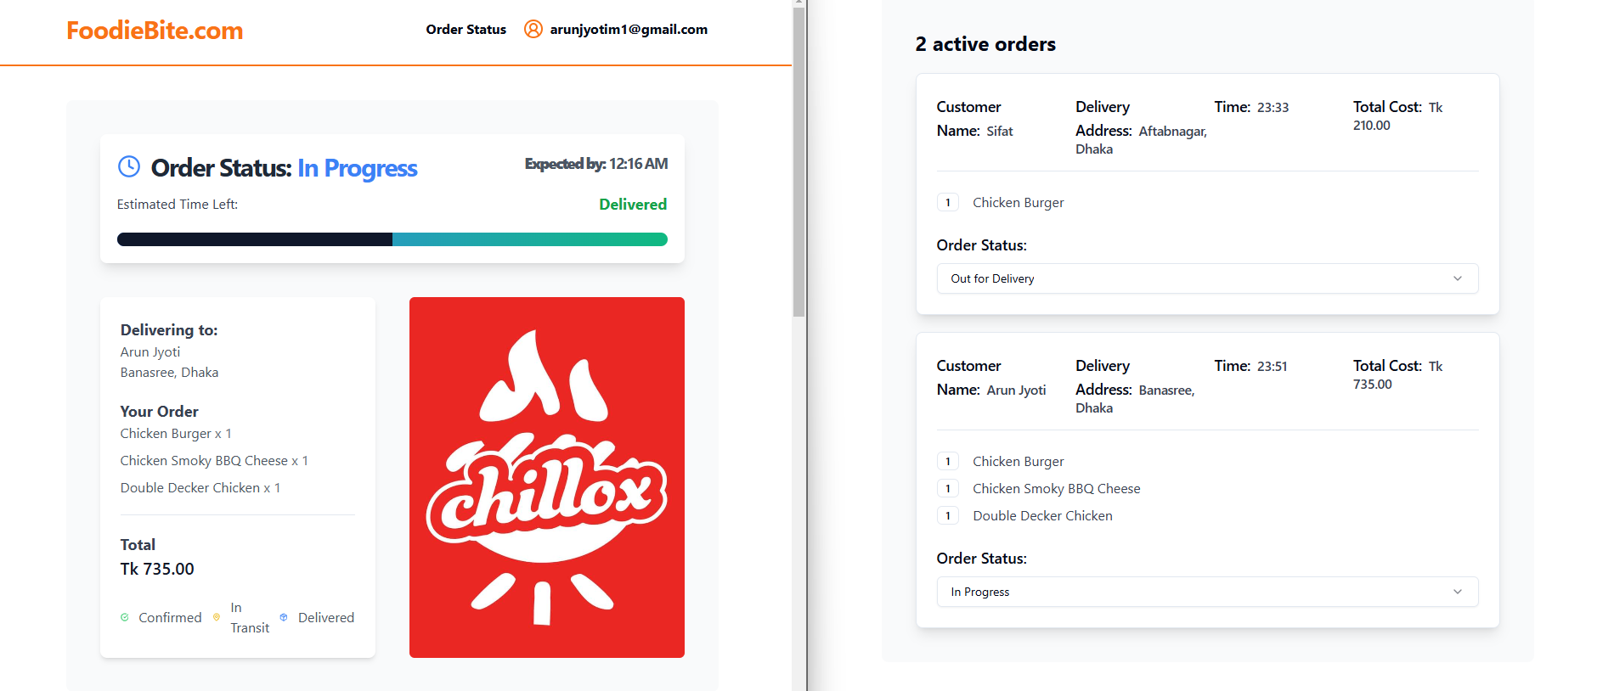

Slide 29
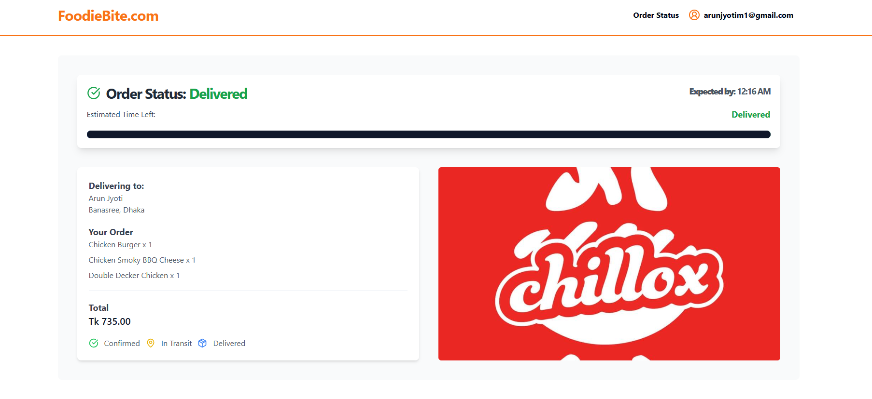

Slide 30
Thank You

