Slide 1



Faster hologram generation by using Max- Depth-Range-Length method
MD SIFATUL ISLAM
Masters student, OIP lab, Chungbuk National University
Email : sifatul@CBNU.ac.kr

Slide 2



Table of contents
Motivation
Conventional Multiple Wavefront Recoding Plane (M-WRP) method
Proposed Max-Length-Depth-Range (MLDR) method
Results and Summary
Future work

Slide 3

Motivation
Point cloud of real objects => depth ranges => discreet distance between WRP and object points
Long computational time
Non- uniformity in color

Slide 4
Conventional Multiple Wavefront recording plane (M-WRP) method
M-WRP calculates CGH in following steps:
Depth range is created with fixed number of depth layers
WRP in the center of each depth range
The light wave from 3D objects is recorded respective WRP [Equation. 1]
Light wave from WRPs to CGH is diffracted calculation based on fast Fourier transform (FFT)
Depth range 1
WRP 1
Depth range 2
WRP 2
Depth range 3
WRP 3
Equation. 1
θ
Depth range k
WRP k
Equation. 2
Diffraction
CGH
Notes:
1. Tomoyoshi Shimobaba, Nobuyuki Masuda, and Tomoyoshi Ito, "Simple and fast calculation algorithm for computer-generated hologram with wavefront recording plane," Opt. Lett. 34, 3133-3135 (2009)

Slide 5
Max-Depth-Range-Length (MDRL) method
Point cloud
Depth range 1
WRP 1
L
Make depth grid based on color
Depth range 2
WRP 2
L
Calculate L
Depth range 3
WRP 3
L
Place WRP in the center of depth ranges (created based on L) and record all object points information on respective WRP. Then, CGH is created based on Fresnel diffraction.
Equation. 3
Repeat for different active area dimension
θ
Depth range k-1
WRP k-1
L
Find L (L_{R}, L_{G},L_{B}) that created CGH in minimum time
Depth range k
WRP k
L
Diffraction
Repeat for all colors (R,G, B)
CGH
Generate full color CGH based on L_{R}, L_{G},L_{B}
Notes:
1. Tomoyoshi Shimobaba, Nobuyuki Masuda, and Tomoyoshi Ito, "Simple and fast calculation algorithm for computer-generated hologram with wavefront recording plane," Opt. Lett. 34, 3133-3135 (2009)

Slide 6
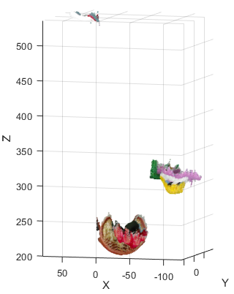
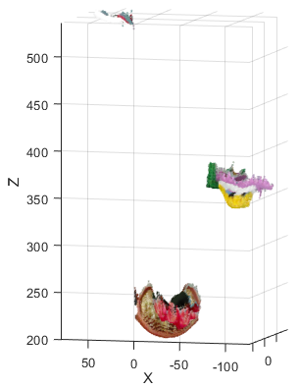
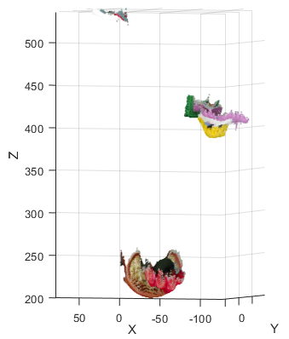
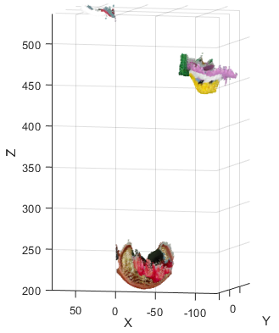
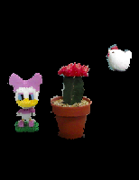
Change of no. of WRPs and object position effect calculation of CGH
a)
Notes:
1. Tomoyoshi Shimobaba, Nobuyuki Masuda, and Tomoyoshi Ito, "Simple and fast calculation algorithm for computer-generated hologram with wavefront recording plane," Opt. Lett. 34, 3133-3135 (2009)

Slide 7
Change of no. of WRPs and object position effect calculation of CGH
Notes:
1. Tomoyoshi Shimobaba, Nobuyuki Masuda, and Tomoyoshi Ito, "Simple and fast calculation algorithm for computer-generated hologram with wavefront recording plane," Opt. Lett. 34, 3133-3135 (2009)

Slide 8
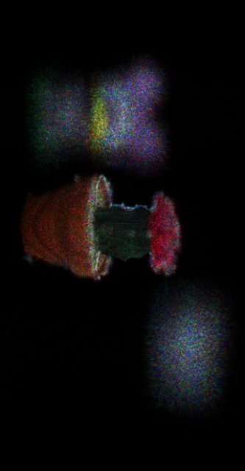
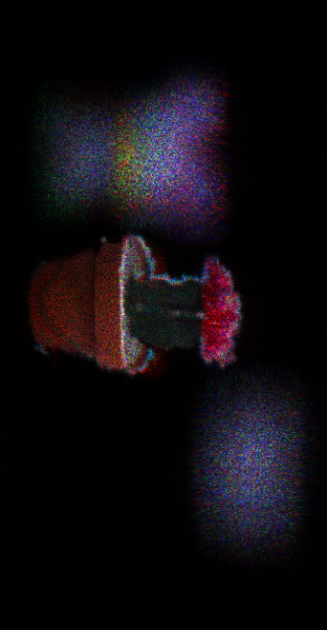
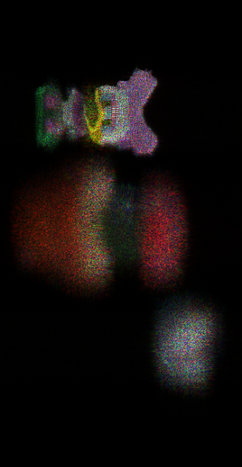
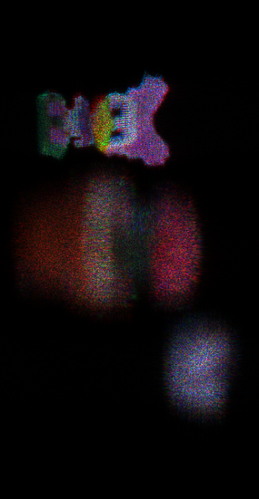
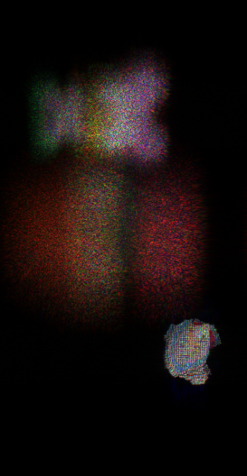
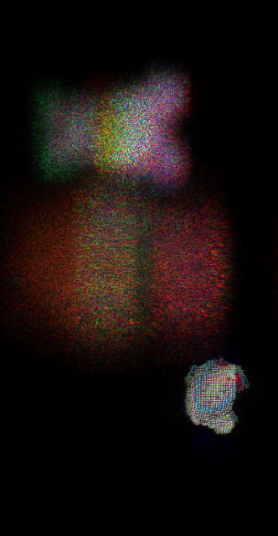
Result
Three objects |  | Calculation time(sec.)
Conventional M-Method | 2 WRPs ∕ color × 3 | 243.406
 | 4 WRPs ∕ color × 3 | 242.114
 | 8 WRPs ∕ color × 3 | 241.613
 | 16 WRPs ∕ color x 3 | 248.276
 | 32 WRPs ∕ color ×3 | 254.84
 | 64 WRPs ∕ color × 3 | 269.456
MLDR method | 5 WRPs (Red) 5 WRPS(Green) 3 WRPS (blue) | 164.586
a) Conventional M-WRP
b) MLDR method
Fig. 5 : Reconstructed image for ‘three object’ using a) conventional M-WRP b) MLDR method
Notes:
1. Tomoyoshi Shimobaba, Nobuyuki Masuda, and Tomoyoshi Ito, "Simple and fast calculation algorithm for computer-generated hologram with wavefront recording plane," Opt. Lett. 34, 3133-3135 (2009)

Slide 9
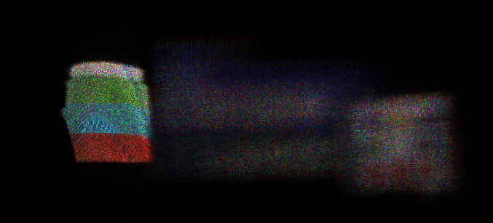
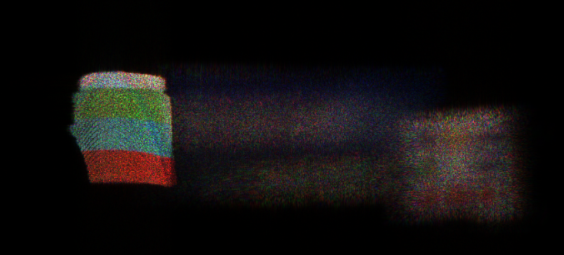
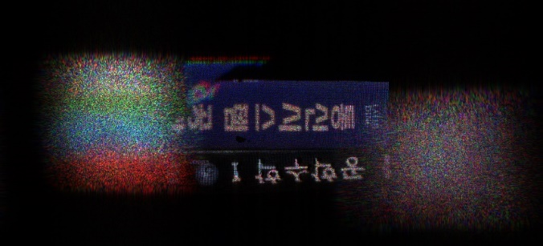
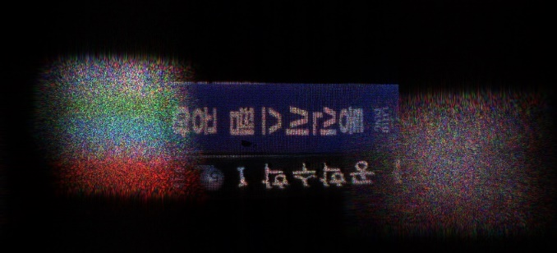
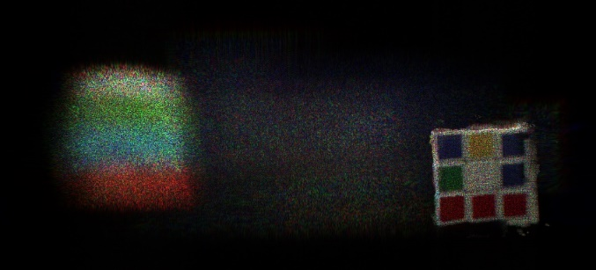
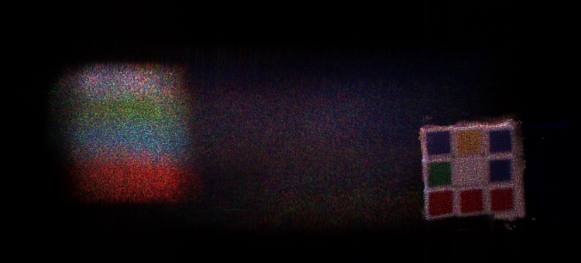
Result
Three items (1980 X1024) |  | Calculation time(sec.)
Conventional M-WRP Method | 2 WRPs ∕ color × 3 | 384.504
 | 4 WRPs ∕ color × 3 | 341.539
 | 8 WRPs ∕ color × 3 | 346.953
 | 16 WRPs ∕ color × 3 | 370.899
 | 32 WRPs ∕ color × 3 | 396.148
 | 48 WRPs ∕ color × 3 | 418.932
Proposed method | 2 WRPs (red) 2 WRPS(green) 4 WRPS (blue) | 298.737
a)
b)
Fig. 5 : Reconstructed image for ‘three object’ using a) conventional M-WRP b) MLDR method
Conventional MWRP
Proposed method
Fig 2 : Depth ranges in conventional M-WRP

Slide 10
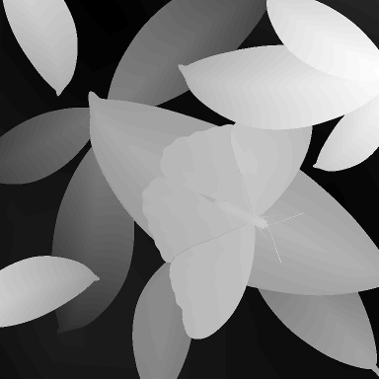
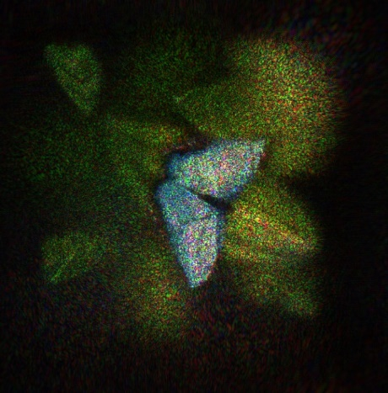
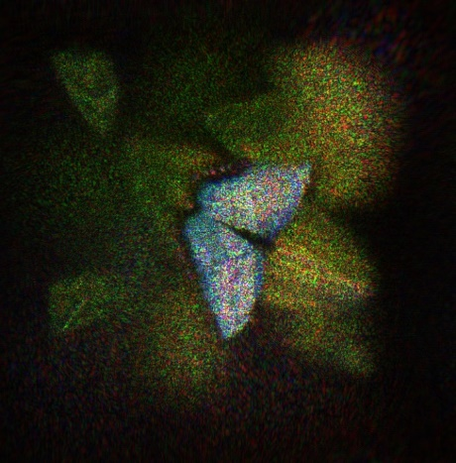

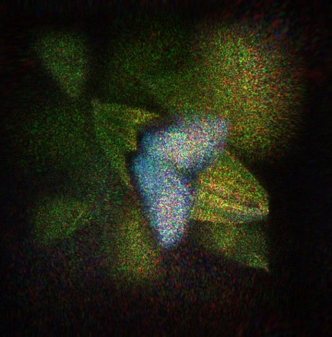
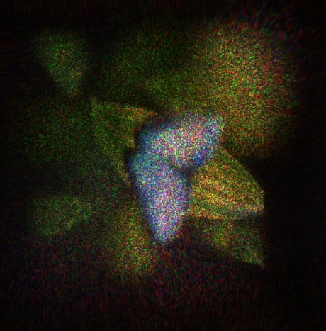
Result
Three items (1980 X1024) |  | Calculation time(sec.)
Conventional M-WRP Method | 2 WRPs ∕ color × 3 | 384.504
 | 4 WRPs ∕ color × 3 | 341.539
 | 8 WRPs ∕ color × 3 | 346.953
 | 16 WRPs ∕ color × 3 | 370.899
 | 32 WRPs ∕ color × 3 | 396.148
 | 48 WRPs ∕ color × 3 | 418.932
Proposed method | 2 WRPs (red) 2 WRPS(green) 4 WRPS (blue) | 298.737
a)
b)
c)
Fig. 5 : Reconstructed image for ‘three object’ using a) conventional M-WRP b) MLDR method
Conventional MWRP
Proposed method
Fig 2 : Depth ranges in conventional M-WRP

Slide 11
Results
Object | No. of object point | Resolution | No. of depth layer | Conventional M-WRP |  |  | Proposed DM-WRP
 |  |  |  | No. of WRP | Time(sec.) | PSNR(dB) | No. of WRP | Time(sec.) | PSNR(dB)
Three obj 1 | 84,549 | 190X1024 | 96 | 12 | 341.539 | 17.17 | 9 | 298.737 | 18.11
Three obj 2 | 35,263 | 190X1024 | 128 | 24 | 238.093 | 19.96 | 13 | 164.586 | 20.09
Papilion | 262,098 | 720X720 | 255 | 48 | 144.432 | 17.72 | 45 | 123.437 | 17.72
Table 1 : Calculation time and PSNR comparison between conventional M-WRP and DM-WRP

Slide 12
d
Depth
range 1
d
d
Depth
range 2
d
d
Depth
range 3
d
d
Depth
range 4
d
N(z₁) = 2
d
Depth
range 5
d
N(z₂) = 1
d
Depth
range 6
d
WRP 1
N(z₃) = 3
Depth
Range 1
d
Depth
range 7
d
Depth
range n
N(z₄) = 3
CGH
CGH
N(z₆) = 1
a)
b)
WRP 2
N(z₇) = 1
Depth
Range 2
N(z₆) = 1
N(z₇) = 2
WRP 1

Slide 13
Point cloud
Make depth grid based on color
Calculate L
Place WRP in the center of depth ranges (created based on L) and record all object points information on respective WRP. Then, CGH is created based on Fresnel diffraction.
Color < 3
Repeat for different active area dimension
Acquisition of real objects using depth camera
Find L (L_{R}, L_{G},L_{B}) that created CGH in minimum time
Repeat for all colors (R,G, B)
Active
area < k
Generate full color CGH based on L_{R}, L_{G},L_{B}

Slide 14
Point cloud
Make depth grid based on color
Point cloud
Make depth grid based on color
Calculate L
Calculate L
Place WRP in the center of depth ranges (created based on L) and record all object points information on respective WRP. Then, CGH is created based on Fresnel diffraction.
Place WRP in the center of depth ranges (created based on L) and record all object points information on respective WRP. Then, CGH is created based on Fresnel diffraction.
Repeat for different active area dimension
Repeat for different active area dimension
Find L_{R}, L_{G}, L_{B}
No
Repeat for all colors (R,G, B)
Find L that created CGH in minimum time (L_{R}, L_{G},L_{B})
Yes
Repeat for all colors (R,G, B)
Generate full color CGH based on L_{R}, L_{G},L_{B}
Generate full color CGH based on L_{R}, L_{G},L_{B}

Slide 15
Point cloud
Make depth grid based on color
Point cloud
Make depth grid based on color
Calculate L
Calculate L
Place WRP in the center of depth ranges (created based on L) and record all object points information on respective WRP. Then, CGH is created based on Fresnel diffraction.
Place WRP in the center of depth ranges (created based on L) and record all object points information on respective WRP. Then, CGH is created based on Fresnel diffraction.
Repeat for different active area dimension
Repeat for different active area dimension
Find L_{R}, L_{G}, L_{B}
No
Repeat for all colors (R,G, B)
Find L that created CGH in minimum time (L_{R}, L_{G},L_{B})
Yes
Repeat for all colors (R,G, B)
Generate full color CGH based on L_{R}, L_{G},L_{B}
Generate full color CGH based on L_{R}, L_{G},L_{B}

Slide 16
Point cloud
Make depth grid based on color
Calculate L
Place WRP in the center of depth ranges (created based on L) and record all object points information on respective WRP. Then, CGH is created based on Fresnel diffraction.
Repeat for different active area dimension C₁, C₂…..C_{i}
Find L_{R}, L_{G}, L_{B}
No
Repeat for all colors (R,G, B)
Yes
Generate full color CGH based on L_{R}, L_{G},L_{B}
a)
b)

Slide 17
a)
b)

