Slide 1

Beam-splitter
Object
Light from laser
Object beam
Reference beam
Mirror
Photographic plate

Slide 2

Beam-splitter
Virtual image
Light from laser
Reconstruction beam
Mirror
Photographic plate

Slide 3
Point cloud
R_{j}
Diffraction
WRP
Active Area
CGH

Slide 4
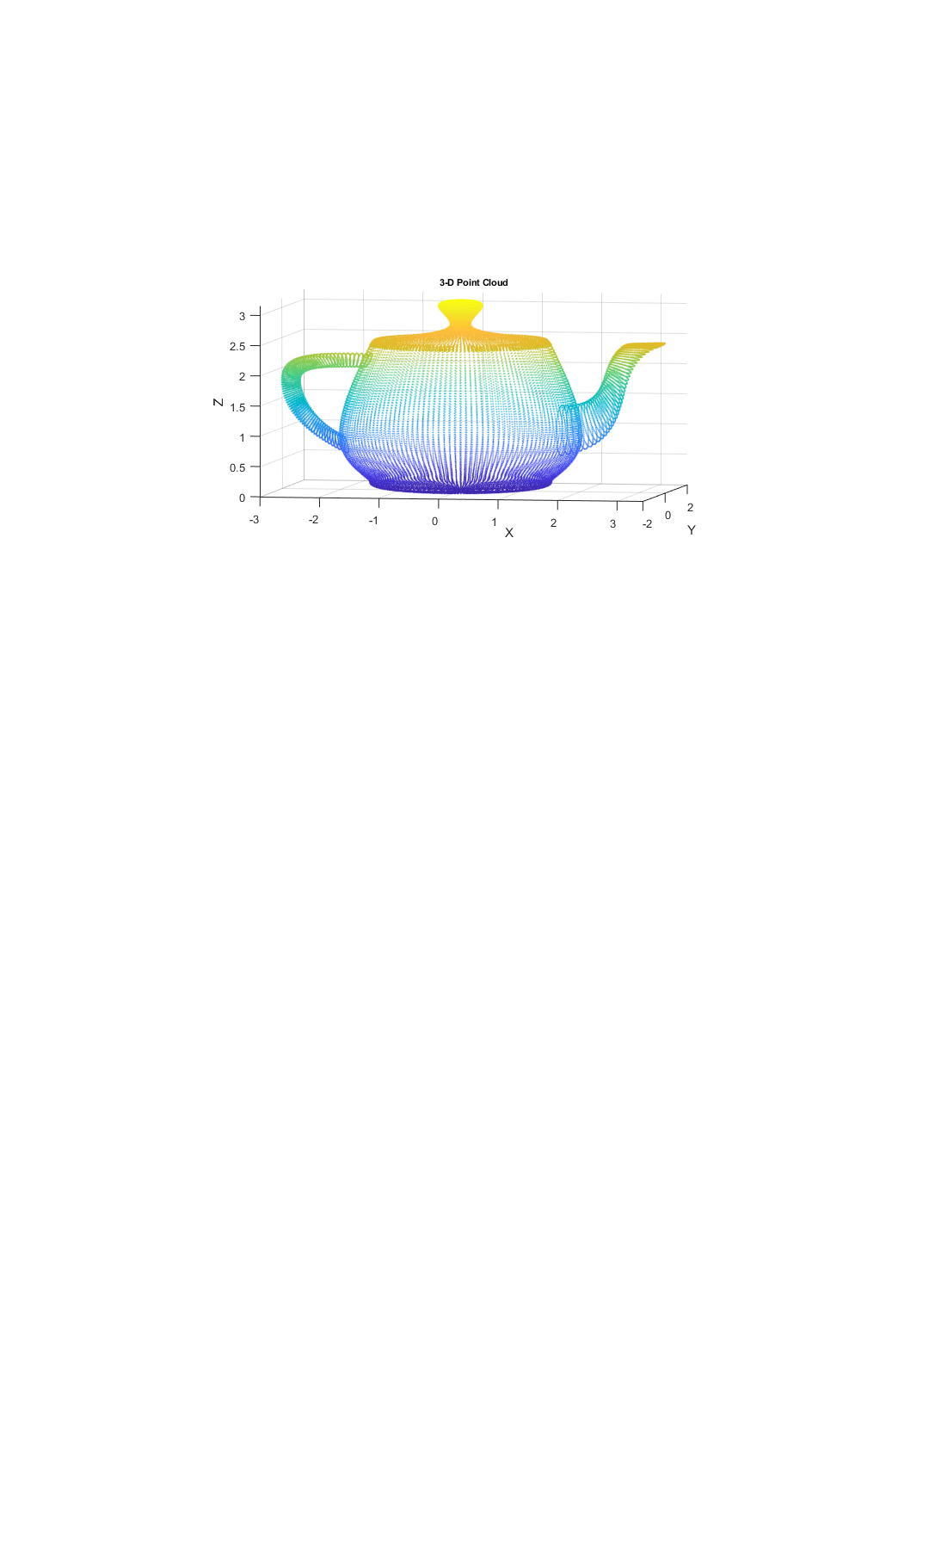
Point cloud
CGH

Slide 5

CGH

