Slide 1
The Header

Slide 2



Remal technology solutions offering end to end
solutions to the Market .
www.remal-projects.com

Slide 3


Slide 4
LOGO OF Egypt & Qatar

Slide 5
About Us
2019 Opening Element 29 Egypt
2020 Opening Of Element 29 Qatar

Slide 6
Contact Us
Egypt :
01117805212
26900130
Fax:26900330
E-mail: info.eg@remal-intl.com

Slide 7
Contact Us
Qatar:
E-mail: Info@remal-intl.com
30606902

Slide 8
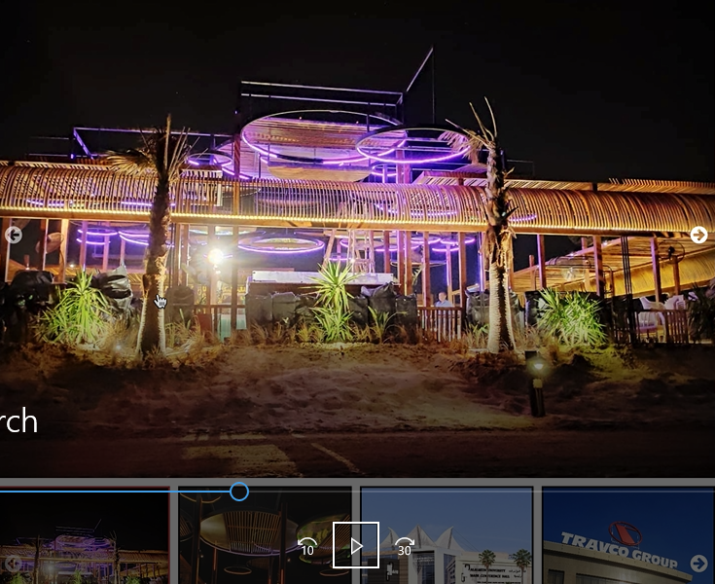
Projects :
Esm kol Project lma ba2of 3la sora
W nktb Gallery bdl Our Gallery

Slide 9
Lightning :
3ayzha mt2sma category kda zy l shops b3rd l products l 3ndy

Slide 10



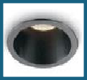


















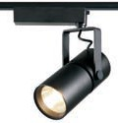




















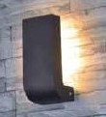







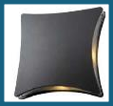


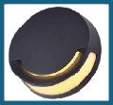
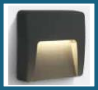













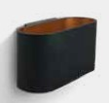










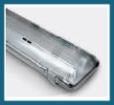
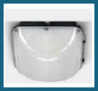
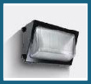














Lighting Products RANGE
Downlight (Recessed / surface mounted)
Spotlight (Track /
surface mounted)
Wall Mounted Luminaires (outdoor)
Wall Mounted Luminaires (INDOOR)
Exit Signs
Panel Lighting Industrial Lighting Step Lights

Slide 11








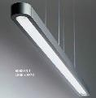
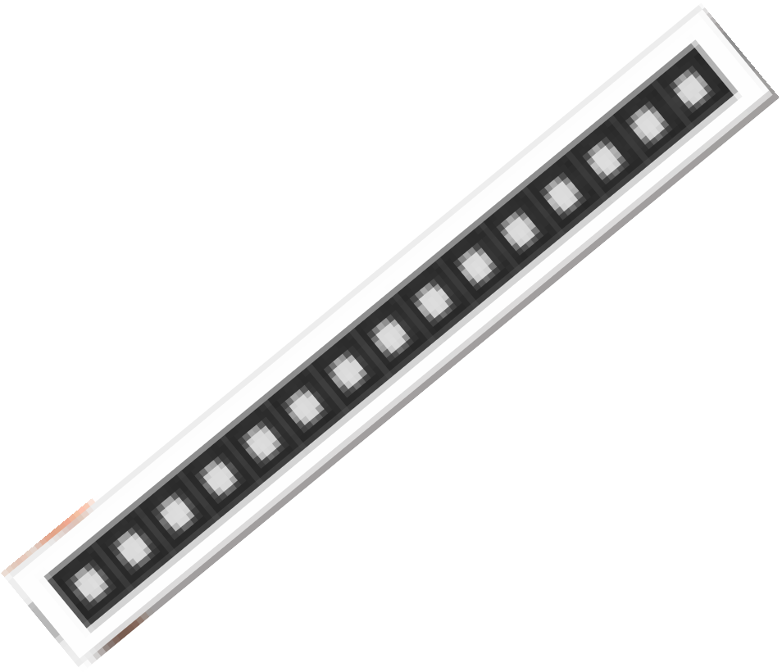
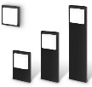
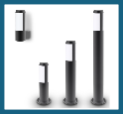
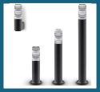



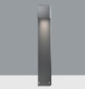






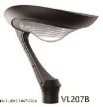


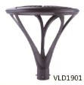

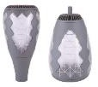

















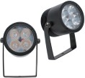











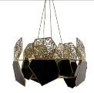







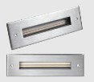


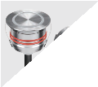






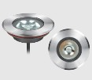

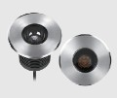

Lighting Products RANGE
Linear lighting
Bollards
Lighting Poles
Flood Lights
Chandeliers
Ground Recessed
Luminaires

