Slide 1

HOSPITALITY AND CLEANING SERVICES
Providing prompt professional service at reasonable price to meet all client requirements.

Slide 2

PO Box: 15575
Telephone No. 4458 3627
Fax No: 4471 2991
Email: remalfirstclass@remal-intl.com

Slide 3
CONTENTS:
CEO MESSAGE
MISSION, VISION AND COMPANY PHILOSOPY
ISO CERTIFICATES
OUR SERVICES
OUR CLIENTS
TESTIMONIALS
CONTENTS:
CEO MESSAGE
MISSION, VISION AND COMPANY PHILOSOPY
ISO CERTIFICATES
OUR SERVICES
OUR CLIENTS

Slide 4
A WORD FROM THE CEO
It is very challenging for our business to take it to a new professional level where client satisfaction is rare, and that what's make it worth the effort we are doing.
services.
While Doha has several different cleaning services, we are proud to be among the best and most wanted cleaning company.
We exist to attract and maintain customers. When we adhere to this maxim, everything else will fall into place.
And this is what make us different.

Slide 5


Slide 6
Mission
To be the most top company in Doha whose services exceeds the expectation of its clients.
Vision
To provide exceptional services and workmanship which is cost effective for individuals and companies. To strive to render our services in a reliable efficient and professional manner.
Company Philosophy
In accordance with standard requirements and the company’s commitment to quality standards are applied

Slide 7


ISO CERTIFICATES

Slide 8
ABOUT US

Slide 9
Our Company
Remal First Class (RFC) is a part of Remal International, established in 2011, having its footprint in in diversified businesses, with an extensive range of innovative products and services offering to all segments of the market.
RFC is a certified company: ISO 9001 22015 (Quality Management System) & GHK (Good Housekeeping).
RFC is a residential and commercial cleaning services providing different clients in Doha. Through generous human capital investments. Our clients ask for our service because of the high level of professionalism and trustworthiness that we offer, not replicated by any of our competition
RFC has developed a safety program to help protect workers from the hazards associated with its operations. A “safety culture” is implemented on RFC sites, with stringent measures being applied to minimize and prevent the occurrence of accidents.

Slide 10
Our Staff
Our competitive advantage will be based on our large investment in human capital. RFC begins with a rigorous program for new employees. At the outset, employees will be trained on how to clean. Granted everyone has some idea on how to clean, but we will show them a methodical way to producing a far cleaning home more efficiently. We will then be training employees to work effectively on teams. While there are some households that prefer individual instead of a team, a request that we are more happy to oblige , we generally works in teams as they are more efficient. Working efficiently on a team takes training and through this team training, we are able to make significant gains in efficiency.
This extensive training , both upfront, as well as continuously builds a trust relationship between company and the client. It is the bond of trust that will not only earn RFC the loyalty of that customer but also the referral more of their friends. Satisfied customers like to tell their friends about service providers that they are happy with, people like to spread the wealth with their friends.

Slide 11
Our amicable and hardworking staff have the skills to do the job asked of them and will do it to perfection. They have work ethics and properly vetted , At RFC, the management chooses only the very best candidates that apply to work for our company and before even being considered, each candidate must undergo an thorough criminal background check.
Why RFC? Simply because we offer our clients the best service by providing flexibility, quality, efficiency, punctuality and reliability, friendly and customer service.

Slide 12
Description of Business
Although there are lots of competition in the cleaning space (over 120 cleaning companies), there is good reason fro this competition, demand is high. Plenty of cleaner and janitorial services “standard’ operation. Cleaning service customers want quality, and not everyone in the cleaning service space offers it.
The cleaning niche is a subset of the larger cleaning business. Within the cleaning business, there are both residential as well as commercial cleaners. The commercial cleaners are typically a janitorial service that offers a wide range of services from general office cleaning, to carpet cleaning, to window cleaning , janitorial service are a one-stop service offering for commercial business. There are also residential cleaning services. The residential house cleaning market is serviced predominantly by independent companies. However, there are few large franchises, residential services are divided into a couple of different categories, cleaner or house cleaners, carpet cleaners, window cleaners and a variety of other services that are required on a less frequent basis. They are far more restricted in their range of offered services relative to the commercial janitorial services.

Slide 13
Our services includes but are not limited to the following:
Pre/ Post Party hosting and cleaning services
Entertain venue/hospitality services
Waitress services
Serving coffee/tea, refreshment and sweets
Dressing tables
Cleaning and dishwashing after the event
After party clean up and tidying of your residence
Apart from the regular cleaning activities , we also offer;
Pest Control Services
Car Cleaning

Slide 14






Frequency of Service
OJGHFHJFJHOFJHJG
D
One-Off
Daily
Weekly
Monthly
Yearly
Type of cleaning required
Regular
On-Call
Ironing
Spring Cleaning
Deep
Cleaning
Sofa
Cleaning
Moving
Cleaning
Pre/Post
Cleaning

Slide 15

Remal First Class (RFC) offers a complete range of cleaning solutions to meet the customer’s specific requirements. From general office cleaning to specialized home cleaning, pre/post cleaning and events services.

Slide 16
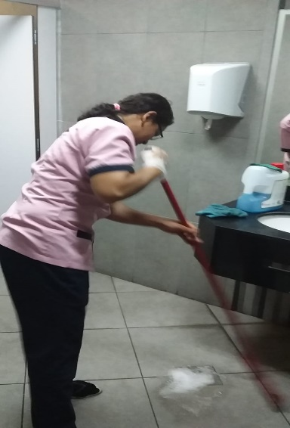
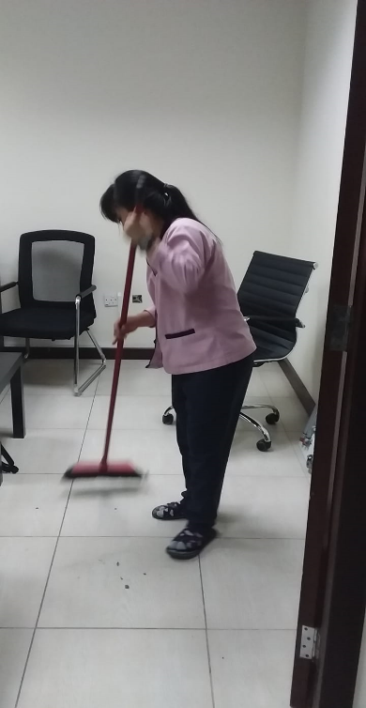
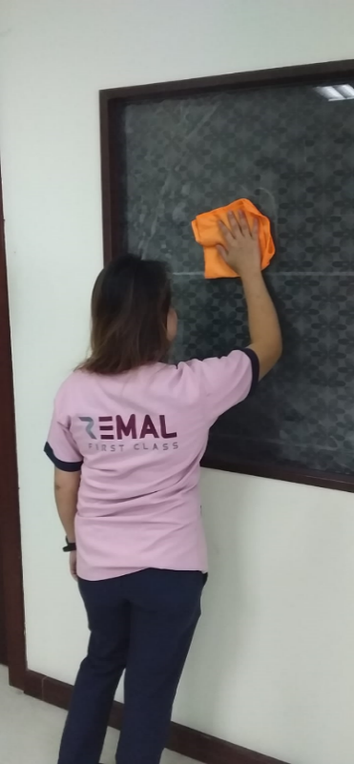
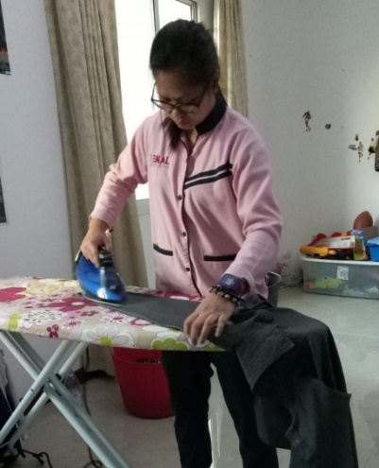

Slide 17
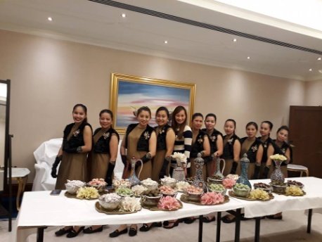
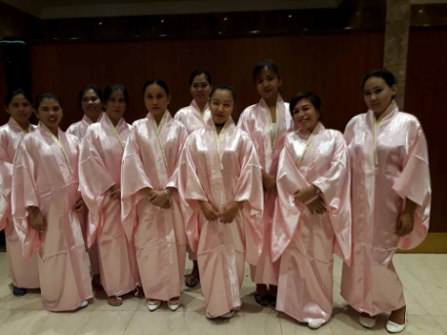
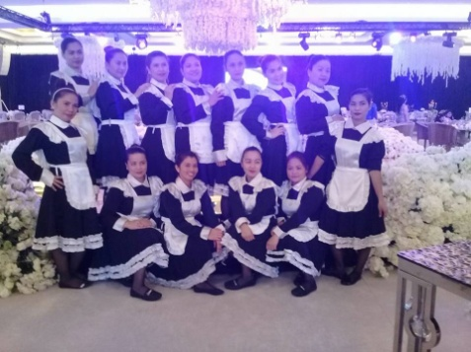
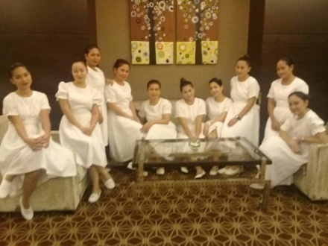
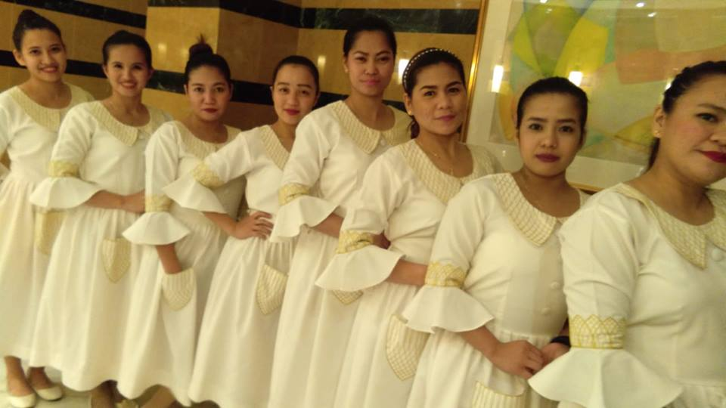
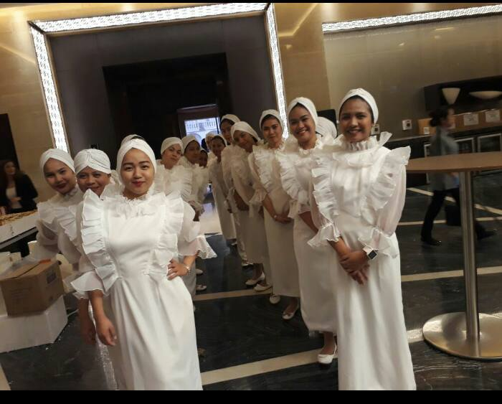
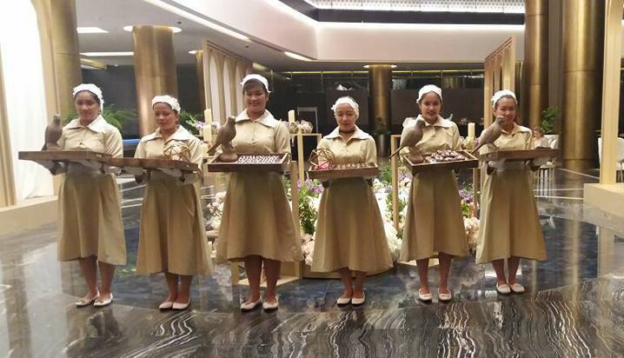
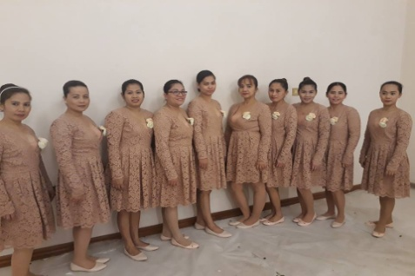
Event and Hospitality Services

Slide 18
For chemi
Product chemicals and tools
Our main supplier fo locally based and chemicals, tools and products, are locally based and get to deal with top rated hospitals in doha, such as Hamad Hospital, we guarantee the results and these products are eco friendly.
We emphasize our use of Eco friendly chemicals, so other companies also use environmentally sound chemicals so this is not a huge differentiation, but it is something that we are proud of, and will mentioned.
By acquiring the latest machineries, we reduce time and human energy and will be maintaining a abreast of technology and changing friends that may impact our business in the future.
Eco Friendly Product
Making of eco cleaning your home more eco friendly with range of eco cleaning products; kitchen, bath room, all purpose cleaners. Our products are toxic free. (Extra fee applied)

Slide 19


OUR CLIENTS

Slide 20
OUR CLIENTS
It would appear , if you open the yelow pages, that there is not need for another house cleaning service company. Make no mistake however, there is a need for a quality, honest service. RFC is offering a high quality, totally trustworthy service for its clients. Our service will ooze professionalism. We are perfectionist and this will be reflected by our service. Doha like most cities ., has a quite range of different residential house cleaning services. Although there are lots of competitors . We will not only target the upper / lower socio/ economic class but also business owners, compound and malls.
We are proud of our client feedback in regards of our services , the high reputation that has been gained by fulfilling obligations and going beyond the expectation of our clients.
Our service is more expensive. This is not a fact that we are trying to hide. We are settling up on expectation for the customer that they can indeed expect more with our service. This “angle” is based on the assumption that many people are not thrilled with their current cleaning services. Sure they clean adequately. This is how we will differentiate ourselves and ultimately with over new customer.

Slide 21
BENEFITS TO CLIENTS
Reduces time and cost of hiring
Address head count limitations
Reduces attrition at joining stage
Flexibility to focus on core business
Increase productivity
Manpower availability ensured at all times
Statutory obligation is longer clients responsibility
One point contact for all needs
OUR SUCCESS IS DUE TO
Delivery of High standard of professional service
Constant awareness
Corrective actions if any deviation
Maintenance of relations with clients
Dedication to cater to many more services and expand

Slide 22

FOR FURTHER DETAILS CONTACT US
SALES & MARKETING
Ellenrose De Lima
firstclass@remal-intl.com
Mob: 974 7787 7785
CLEANING SUPERVISOR
Jennifer Abella
firstclass@remal-intl.com
Mob: 974 7787 7783

Slide 23


