Slide 1

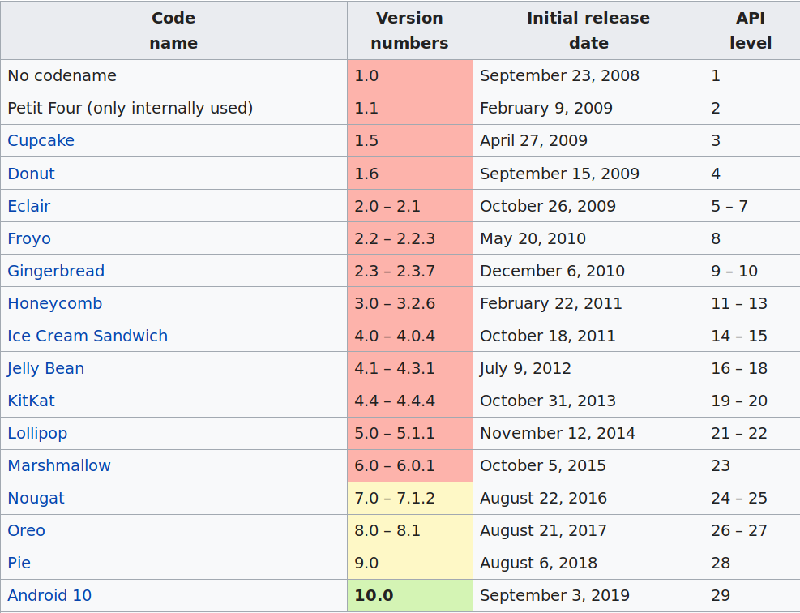
Android Development
1st beta: Nov 2007, 1st release: Sep 2008 - Google & Open Handset Alliance

Slide 2
Support Libraries
Backward Compatibility
Helper classes: user interface development
Debugging and utilities
Examples:
v7 Support Library
v13 Support Library
AndroidX S.Libray
“If you are designing only for the latest platform is a big no-no”
What are the Common Challenges Faced by Mobile Developers ? - Eminarti Sianturi

Slide 3
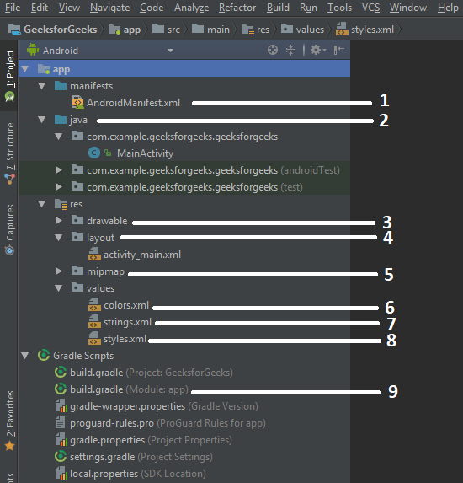
Application Structure
Manifest: Structure, meta-data, components
Java: java source code – controls UI
Drawable: resource type files
Layout: UI files (XML)
Mipmap: image asset files
Values: colors
Values: strings
Values: theme styles
Gradle: Build configurations
Source: https://www.geeksforgeeks.org/android-android-apps-file-structure/

Slide 4






Setup Dev Environment
Android Studio
IntelliJ - Official Android IDE
SDK (sdk-manager)
Emulator – Virtual Devices
  Built-in (Studio)
  Genymotion
  Bluestacks
Build System: Gradle
Java
  Embedded OpenJDK
  Java 7 (full)
  Java 8 (subset)
  Junit 4+
Kotlin 1.3.50

Slide 5
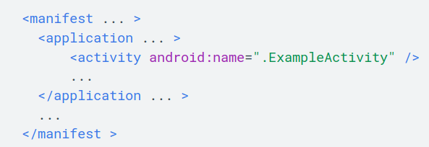
Activity.class
Entry point for interaction with the user
Provides the window in which app draws its UI
Generally, implements one screen in an app
MainActivity → starts Activities
Intent class provide the ability to launch activity
Define
permissions

Slide 6
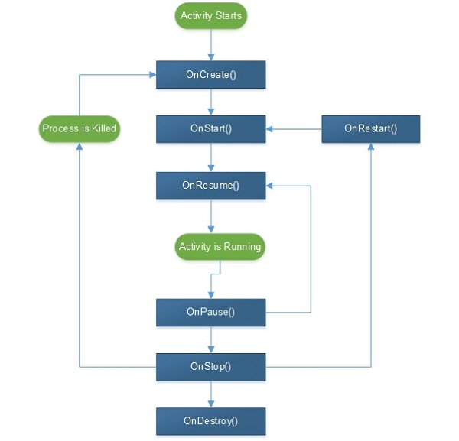
Activity Lifecycle

Slide 7
Fragment.class
represents behavior/portion of user interface
combine multiple fragments in a single activity
reuse in multiple activities
modular section of an activity (sub-activity)
its own lifecycle, its own input events
lifecycle directly affected by activity's lifecycle

Slide 8
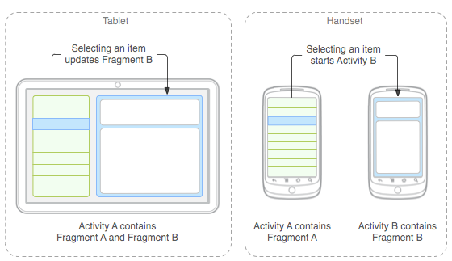
Fragment Use Case

Slide 9
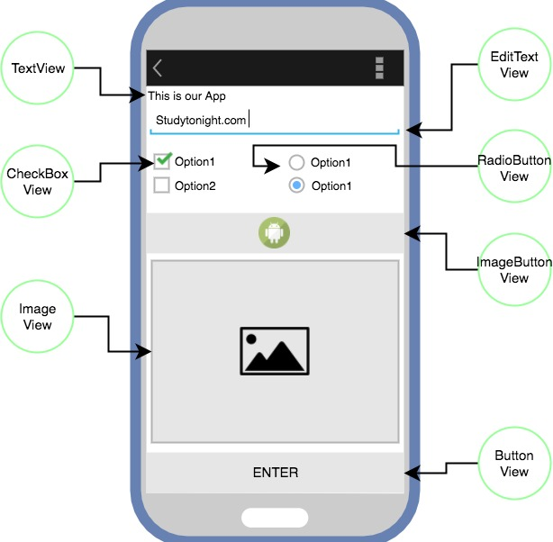
View.class
super class for all the GUI components
rectangle on screen that shows content
user can see and interact with
event listener is an interface with a callback method (onClick, onTextChanged etc)

Slide 10
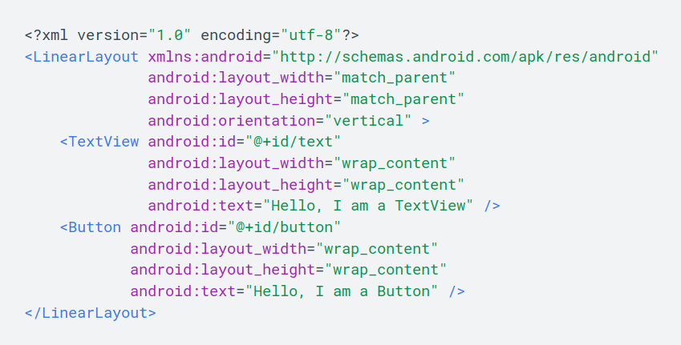
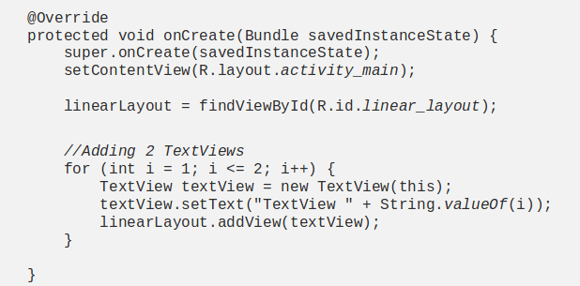
Building views in layout
Declare in XML
Instantiate at runtime

Slide 11
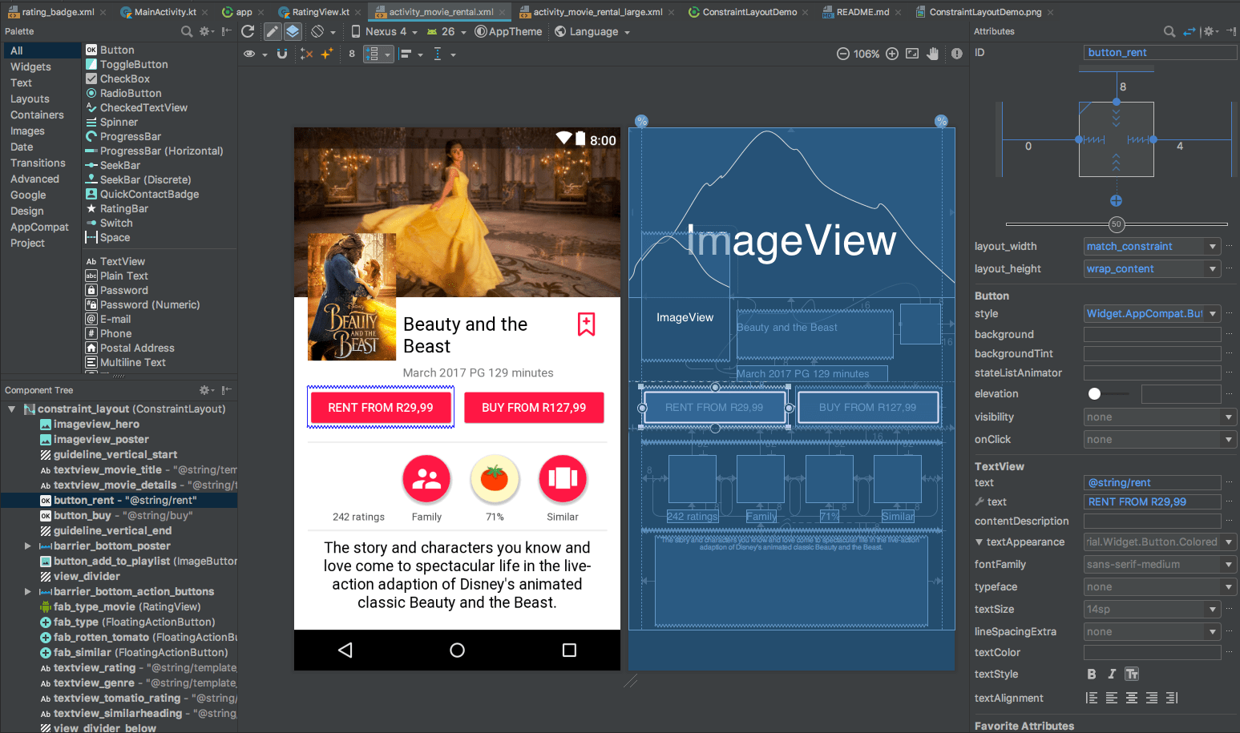
Layout Editor

Slide 12
Testing
Unit tests vs Instrumented test
  with/without device
  On a real device or emulator
Directories based on execution
  androidTest folder: integration, e2e
  test folder: unit tests (JVM)
Real Devices vs Emulator vs Simulator
  Speed vs low fidelity
Google recommends: 70 percent small, 20 percent medium, and 10 percent large.
Import AndroidX Test library

Slide 13
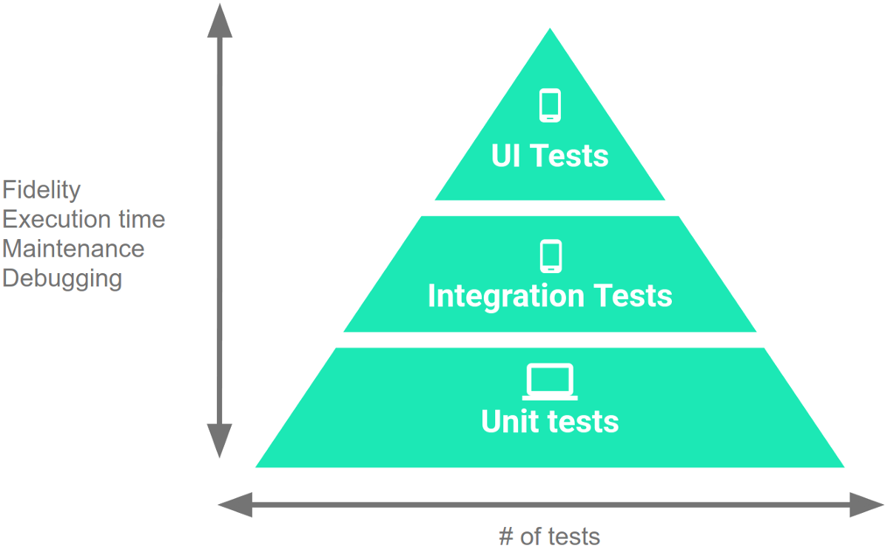
Extended Testing Capabilities
Mockito/Easymock: mocking dependencies
Dagger/Toothpick: dependency injection
Espresso/UI automator: instrumented tests on a real device or emulator
Robolectric: dummy implementation of the Android SDK using shadow classes
MockWebServer: mock
server

Slide 14
???
Deployment
Patterns / Best Practices

Slide 15
Books and guides...
Android Development Patterns: Best Practices for Professional Developers, Phil Dutson
Head First Android Development: A Brain-Friendly Guide, Dawn Griffiths & David Griffiths
The Busy Coder’s Guide to Android Development, Mark Murphy
Problems and Solutions for Android Developers, Ian F. Darwin
Android Programming for Beginners (Packt), John Horton
https://developer.android.com (+ “/courses”)
Practical Guide: https://medium.com/mindorks/learning-android-development-in-2019-a-practical-guide-ddc71e008696

Slide 16
..Thanks

