Slide 1

Introduction to Mobile App Development
Symianakis Sifis
Sofware Engineer @Pancreta Bank
https://www.linkedin.com/in/sifis-symianakis/

Slide 2
Mobile Development
Mobile Devices
  Smartphones
  Tablets
  Smartwatches
  Wearables

Slide 3
Challenges
Wide range of screen sizes
Device compatibility / Different OS
  Web, Hybrid or Native ?
Development on desktop while targeting on a different device
Different I/O types instead of traditional (mouse-keyboard)
  Touchsreen, Microphone, Sensors(GPS)
Emphasizing on context

Slide 4
Developer should consider
Constraints
Mobility
Connectivity – Offline
Low Resources (battery, processor, memory)
Hardware Specifications
Privacy
Security
(Apple strict guidelines https://developer.apple.com/app-store/resources/ )

Slide 5
Context awareness
“Ability of the system to gather information about environment at any given time and adapt behaviors accordingly.”
Variety of sensors
User personalization
Gestures
Constraints
UI / User distraction
Ubiquitous system integration

Slide 6
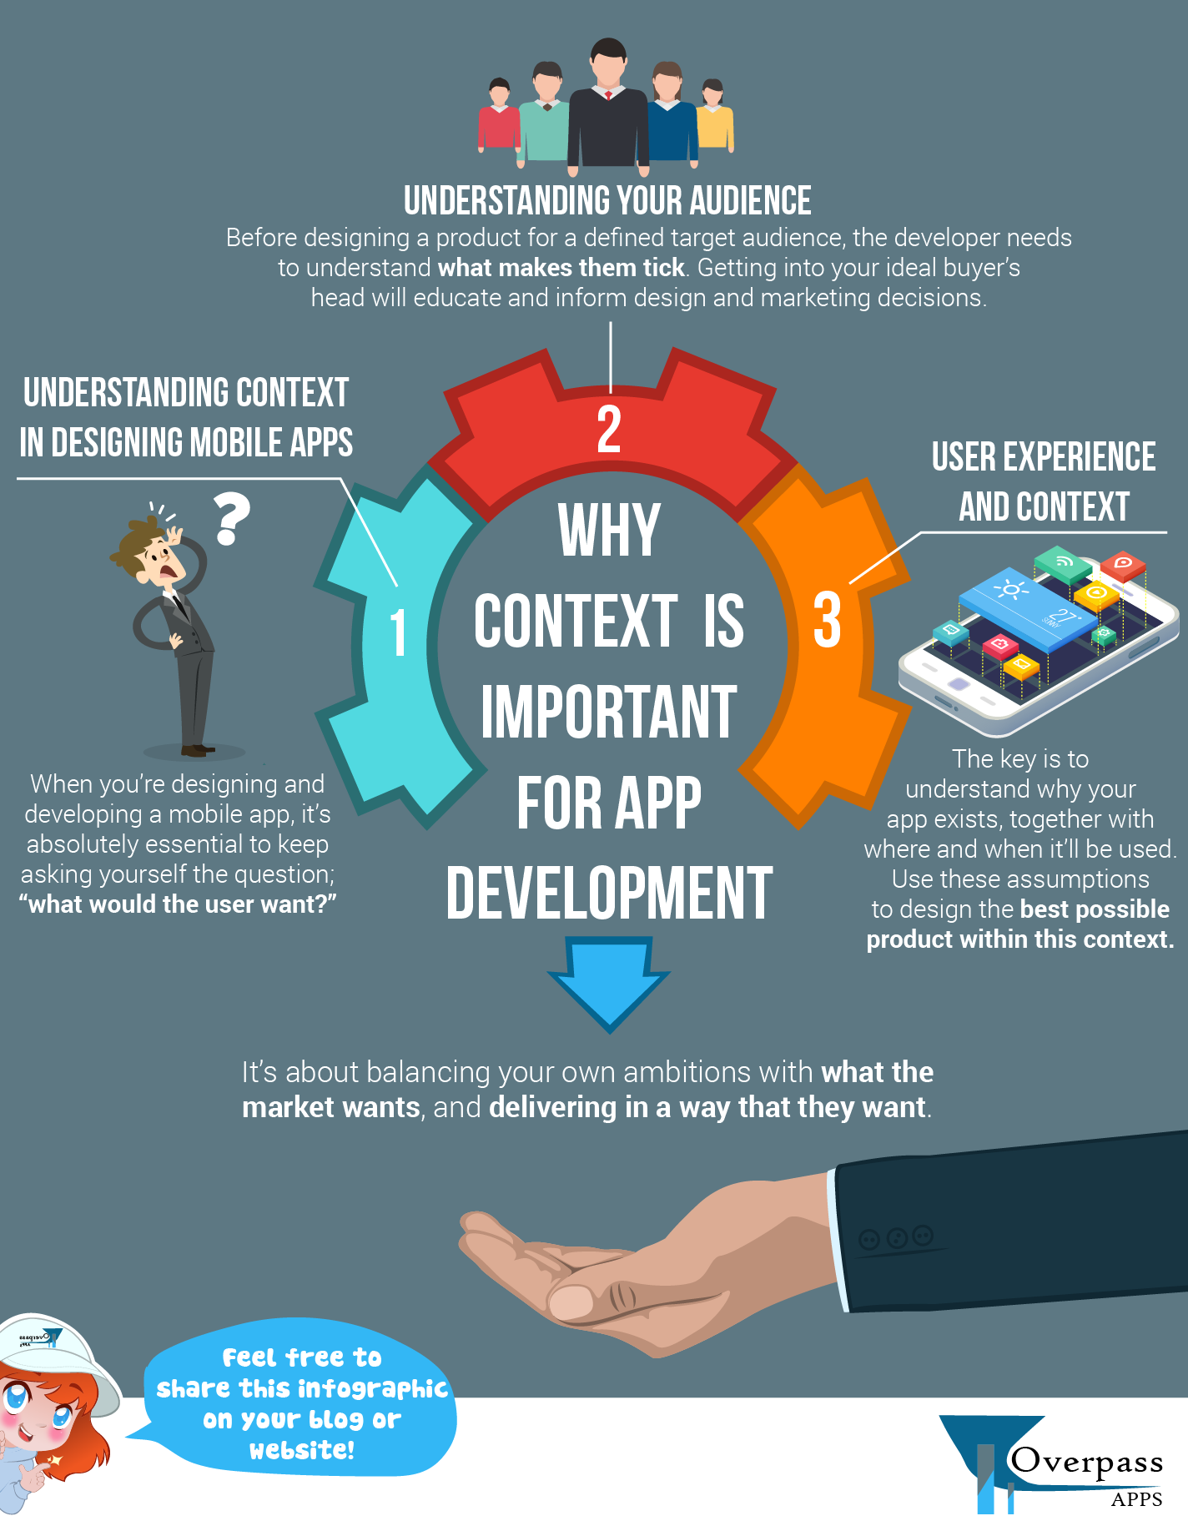
Is really context important
?
Source: https://www.overpass.co.uk/infographic-context-important-app-development/

Slide 7
UI/UX

Slide 8
Market (1/2)
Competition
  Building a robust does not mean it is successful.
  Measurement of success: No of users
Define your target group
  Win the attention of the users
  Value

Slide 9
Market (2/2)
Customer Reviews, experience & feedback
Funding
Promoting, branding and marketing
Numerous development framework and platforms to choose (share printer personal experience)
Quick prototype → Fail fast → Feedback loops

