Slide 1
Interview Projects
Developer

Slide 2
Practical test
Develop 2 applications
Spend no more than
6 hours on Project 1
4 hours on project 2
General skills tested:
Knowledge about C#, ASP.NET MVC, REST, Databases, SQL, JavaScript, CSS
Problem solving
Ability to keep things simple – don’t over engineer, make things overly complex.
Source Control
Documentation
Communication

Slide 3
Project 1
Product
ProductID
Name
Price
ReleaseDate
Goals
Store products in a database
Bulk load new products from Excel file using Console app
Provide own Excel Spreadsheet
Spreadsheet only contains Products, no comments.
Web Application
List Products
Add Product (1 at a time)
Edit Product
Add Comment (1 product can have many comments)
Comment
Comment
Email
DateOfComment

Slide 4
Project 1
Features:
Page 1
Sortable, Filterable Table
CRUD Products
Add/view multiple comments per product
Page 2
View stats showing how many products, and how many comments per product.
ASP.NET MVC
Browser
Pages / Views
Database
HTML
CSS
JavaScript
REST API
Features:
Bulk Upload products from Excel file.
Assume console app runs from Australia
Console Application
Excel File

Slide 5
Project 1
Aims
Find out how you write ASP.NET MVC applications
Test understanding of REST API
Test understanding of Console applications
Test understanding of Databases and queries (joins, aggregations, etc)
How do you structure Code and your projects
Usage of JavaScript, CSS, other libraries (e.g. Bootstrap)
How easy it is to get the application up and running on someone else’s PC
Clarity of your documentation / instructions

Slide 6
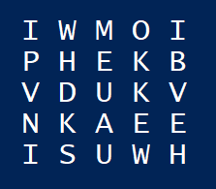
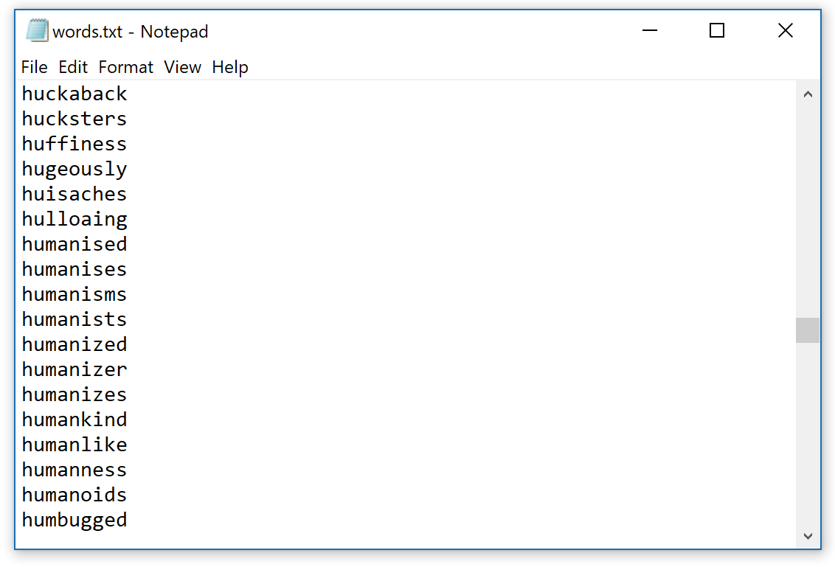
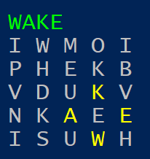
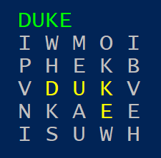
Project 2
Goal – search for Words
Console Application in C#
Generate a Random grid of letters: 5x5
Search the grid for valid English words
Use the provided “words.txt” file for a list
Don’t use the same letter twice (same position)
List the found words on the screen.
List of found words is fine
For bonus, show where the word was found

Slide 7
Project 2
Aims
Test understanding of Logic, reasoning
Test understanding of recursion
Test ability to optimize code
Test understanding of basic C# concepts
Data structures
Loops
Etc…

Slide 8
Submit your work
Option 1 – GitHub (preferred)
Use Git as your Source Control
Put your solution on GitHub as a public repository
Provide a Readme file that provides instructions on how to run / deploy the solution (This readme file should be part of the git repository)
Send the link to your github repository
Option 2 - Cloud Storage
Provide a Readme file that provides instructions on how to run / deploy the solution
Zip/pack your files
Upload to a cloud storage location (e.g. Google Drive, OneDrive, etc.)
Share the files

