Slide 1
MASTER'S THESIS RESEARCH
AITableGameMonitor
Research Plan & Thesis Framework
YOLO v11n + MobileNet + Rockchip Embedded
H.264 Compression Degradation · Card Classification · Casino Anomaly Detection
01
02
03
Compression
Analysis
Solution
Comparison
Application
Validation

Slide 2
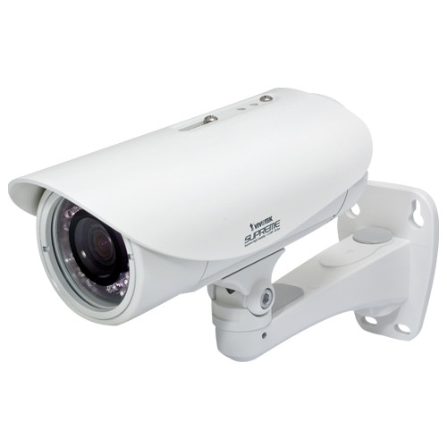
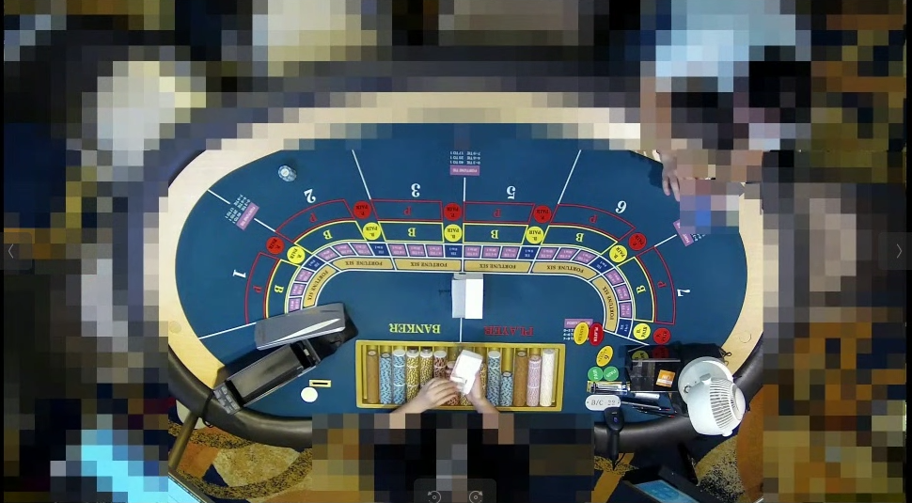
SYSTEM PIPELINE
End-to-End Architecture
Super resolution
Unblur
Custom algorithm
Yolov11n Detection
MobileNet classify
Baccarat Rule
H.264
Image compression
1080 x 720
Crop cards 53 classes
50~55 x 70~75
api1
Play win
Banker win
Draw
Player Foul
Banker Foul
Results
api2
Slide 2 / 9

Slide 3
Probable Dataset for Training
End-to-End Architecture
1. https://universe.roboflow.com/playcardsdetection/playing-cards-detection/browse?queryText=&pageSize=50&startingIndex=0&browseQuery=true
2. https://universe.roboflow.com/deez-qxupg/playing-cards-detection-5gms1
3. https://github.com/TeogopK/Playing-Cards-Object-Detection/tree/main
4. https://www.kaggle.com/datasets/andy8744/playing-cards-object-detection-dataset
5. https://www.kaggle.com/datasets/gpiosenka/cards-image-datasetclassification
Slide 2 / 9

Slide 4
53-CLASS CLASSIFICATION Dataset
53
52
+1
Card Faces
Card Back
4 suits × 13 ranks
(A 2 3 4 5 6 7 8 9 10 J Q K)
Face-down card detection
(critical first step)
Total Classes
A♠
2♠
3♠
4♠
5♠
6♠
7♠
8♠
9♠
10♠
J♠
Q♠
K♠
A♥
2♥
3♥
4♥
5♥
6♥
7♥
8♥
9♥
10♥
J♥
Q♥
K♥
A♣
2♣
3♣
4♣
5♣
6♣
7♣
8♣
9♣
10♣
J♣
Q♣
K♣
A♦
2♦
3♦
4♦
5♦
6♦
7♦
8♦
9♦
10♦
J♦
Q♦
K♦
52 standard card faces
Slide 3 / 9

Slide 5
PILLAR 1 — COMPRESSION DEGRADATION ANALYSIS
01
Baseline Test
03
Breaking Point
Clean card image → MobileNet → record per-class accuracy for all 53 classes
Identify at which quality level accuracy collapses sharply and which classes fail first
02
Compression Sweep
04
Camera Factors
Apply JPEG quality 100→5% → measure accuracy at each level → plot degradation curve
Add blur, noise, resolution reduction → generalize beyond just compression
Slide 4 / 9

Slide 6
PILLAR 2 — SOLUTION COMPARISON
Solution A
Solution B
Solution C
Super Resolution
Degraded Training
Mixed Training
Preprocessing approach
Domain adaptation
Hybrid approach
Degraded 50×70px card
Clean images collected
50% clean + 50% degraded
→ SR Model
→ Apply JPEG compression
→ Train MobileNet together
→ Restored 224×224px
→ Retrain MobileNet
→ Robust to both inputs
→ MobileNet classify
→ Deploy as-is
→ One model for all cases
⚠ Heavy compute — slow on Rockchip
⚠ May fail on clean images
⚠ May compromise peak accuracy
❓ Result unknown
❓ Result unknown
Slide 4 / 9

Slide 7
PILLAR 3 — APPLICATION & ANOMALY DETECTION
Baccarat Game Logic
Experiment Reporting Plan
4 Cards
Dealt
Classify
All 4
5th Card
Needed?
Classify
5th
6th Card
Needed?
Final
Score
Games simulated
30 – 100
Max 2-3 classifications per game round (not every frame)
Anomaly events introduced
~5 per run
Simulated Anomaly Scenarios
🃏
Wrong card count
🔄
Card substitution
Detection rate target
5 / 5 (100%)
3 cards dealt instead of 2 at Player position
9♠ swapped for 3♠ after initial detection
False positive rate
< 5%
🧮
Score mismatch
✋
Card concealment
Cards sum to 7 but dealer calls 8
Card disappears — count decreases unexpectedly
Why small dataset is acceptable:
· Proof of concept demonstration
· System architecture validation
· Failure case identification for future work
Slide 4 / 9

Slide 8
RESEARCH STEPS – Can Finish project in 1/1.5 months if after have data)
Phase 1
Phase 2
Phase 3
Phase 4
Data Preparation
Pillar 1
Experiments
Pillar 2
Solutions
Pillar 3
Application
· Collect 53-class dataset
from CCTV videos
· Compression sweep
JPEG 100→5%
· Test
· Simulate cheating
scenarios (30-100)
· Balance class distribution
with augmentation
· Per-class accuracy
curve generation
· Retrain MobileNet
on degraded data
· Measure detection
rate & false pos.
· Compute dataset mean/std
for normalization
· Breaking point
identification
· Mixed training
experiments
· Rockchip embedded
deployment test
Slide 4 / 9

Slide 9
Problems
1. Data I have is not enough. I have only 31 classes but still mission 22 classes. No data so cant apply augmentation.
2. Super-resulation might not be efficent for Rockchip
Slide 6 / 9

Slide 10
Research Paper Summary
Impact of Image Compression
on CNN Classification Performance
Steel Surface Defect Classification · NEU Dataset
Benbarrad et al. · J. Sensor & Actuator Networks 2021 · DOI: 10.3390/jsan10040073
Slide 6 / 9

Slide 11
DATASET, SETUP & EXPERIMENTAL DESIGN
1,800
6
7
3
Images
Classes
JPEG Levels
CNN Models
NEU steel defects
Cr·In·Pa·PS·RS·Sc
Quality 5 → 60
CNN3·VGG16·MobileNet
THREE EXPERIMENTS
EXP 01 · Same Quality
EXP 02 · Different Quality
EXP 03 · Augmentation
Train & test at same JPEG level
Train at one quality, test at others
Train on ALL 7 quality variants
All models stable across Q1–Q7. No accuracy loss.
Large drops at mismatched quality. MobileNet fell to 44% F1.
98–100% F1 on every quality. Near-perfect robustness.
STABLE
DROPS
PERFECT
Slide 6 / 9

Slide 12
KEY RESULTS
All models stayed at 82–100% regardless of compression level.
MobileNet trained on Q1 dropped to 44% F1 when tested on Q7.
Exp 3: Before vs After Compression Augmentation (F1 %)
CNN3 — Before
69%
CNN3 — After
99%
MobileNet — Before
44%
MobileNet — After
100%
VGG16 — Before
58%
VGG16 — After
100%
Slide 6 / 9

Slide 13
KEY FINDINGS & CONCLUSION
KEY FINDINGS & CONCLUSION
1
Same compression quality = stable accuracy
When train and test images share the same JPEG quality, all models maintain consistent F1 (82–100%). The CNN adapts its features to that compression domain.
2
Mismatched quality = accuracy collapse
Significant F1 drops when train/test quality differs — worst case MobileNet: 97% → 44%. Higher-accuracy models are MORE sensitive to mismatches.
3
Compression augmentation = 98–100% robustness
Training on all 7 quality variants makes models robust to any compression level at deployment — the recommended strategy for IoT / embedded vision systems.
Slide 6 / 9

Slide 14
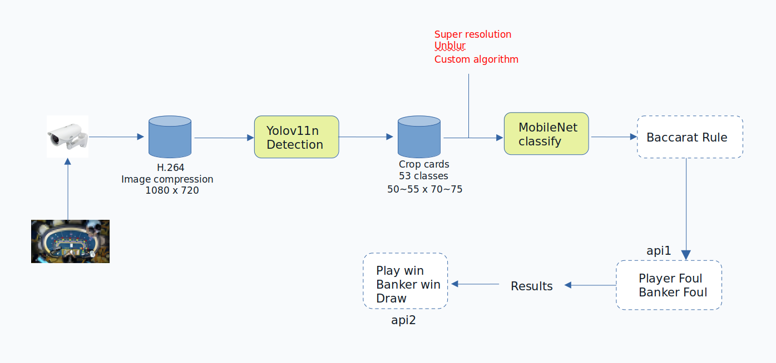
2nd paper
Slide 6 / 9

Slide 15




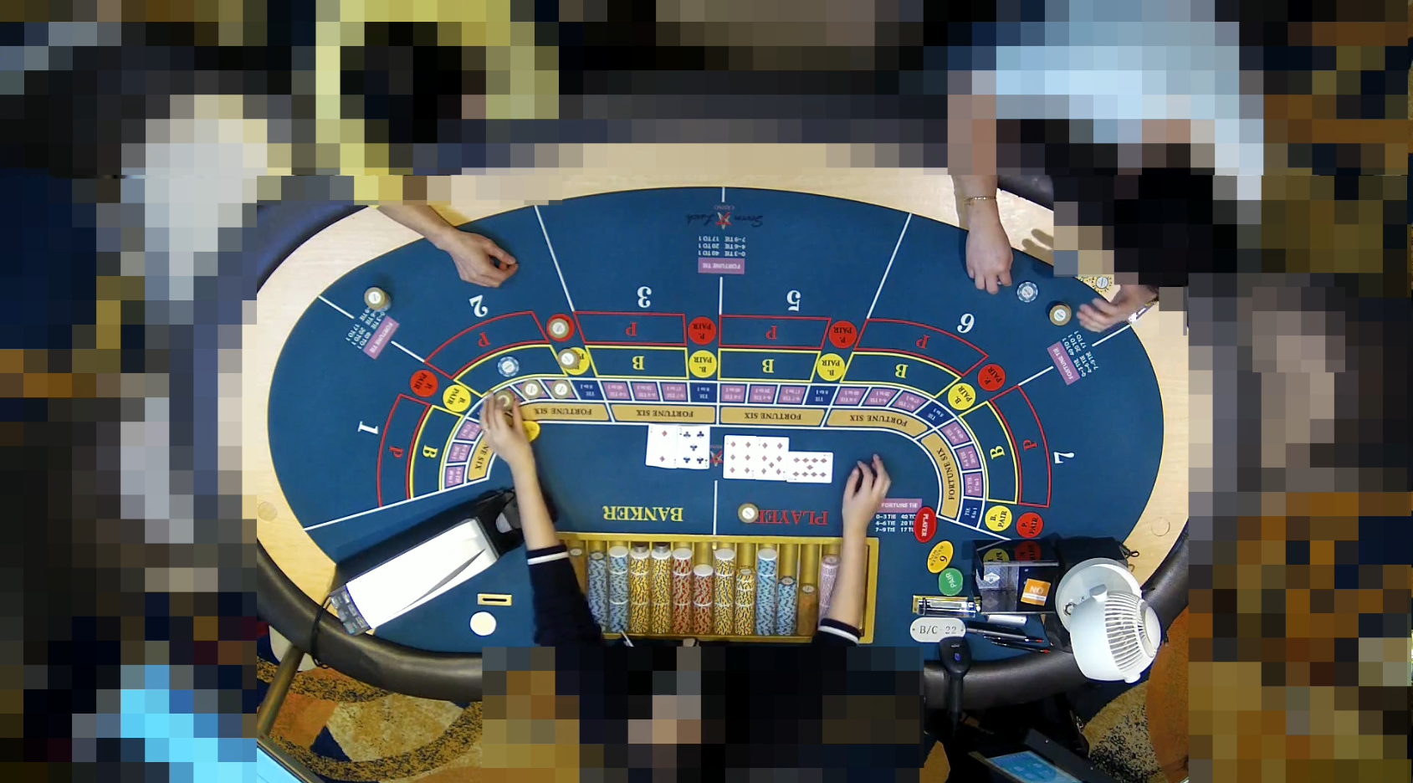
Data collection and labeling
11 classes
0 (K,Q,J)
1 (A)
10
2
3
4
5
6
7
8
9
gkl_mask1.avi Frame: 16,700
Class: 02 [x1, y1, x2, y2] =
[120, 80, 300, 260]
Img preprocessing
Image reconstruction
Unblur
Frame: 34,900
YOLO
Card: 90,000
gkl_mask2.avi Frame: 18,200

Slide 16
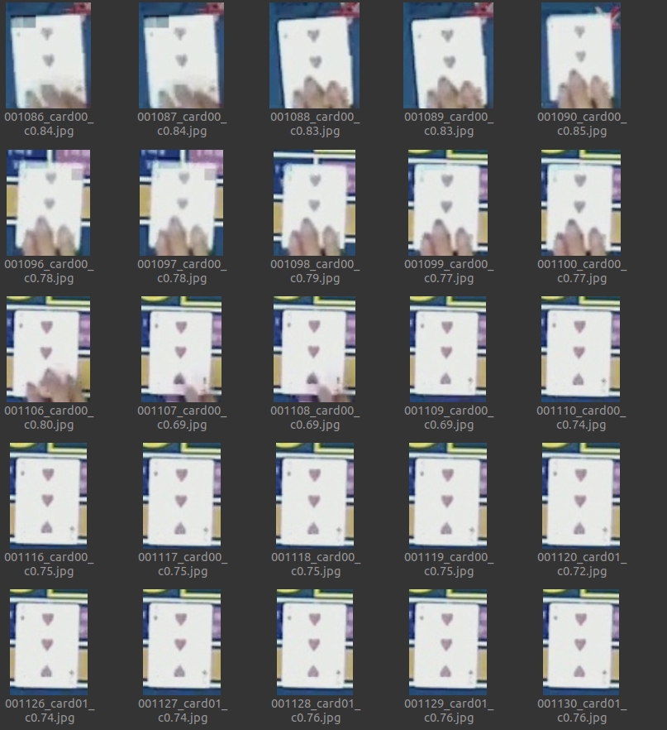


나쁜 이미지와 좋은 이미지를 분리하다

Slide 17
Code structure
main.py
tablelayout.py
TableTracker
model (sort)
detect
tracking
run
train_mobilenet.py
- model
- train
- Load
- Save
- Edit
layout:dict
layout_pixmap: narray
Id2label: dict
Label2id: dict
<Layout>.json
yolo11n_tablegame.pt
mobilenet_card.pt

Slide 18
last 10 epoch training accuracy
Epoch 91/100 | train_loss=0.0034 train_acc=0.9996 | val_loss=0.0119 val_acc=0.9989
Epoch 92/100 | train_loss=0.0045 train_acc=0.9993 | val_loss=0.0086 val_acc=0.9989
Epoch 93/100 | train_loss=0.0035 train_acc=0.9995 | val_loss=0.0092 val_acc=0.9989
Epoch 94/100 | train_loss=0.0032 train_acc=0.9995 | val_loss=0.0091 val_acc=0.9989
Epoch 95/100 | train_loss=0.0034 train_acc=0.9996 | val_loss=0.0092 val_acc=0.9989
Epoch 96/100 | train_loss=0.0035 train_acc=0.9995 | val_loss=0.0081 val_acc=0.9989
Epoch 97/100 | train_loss=0.0034 train_acc=0.9996 | val_loss=0.0085 val_acc=0.9989
Epoch 98/100 | train_loss=0.0035 train_acc=0.9996 | val_loss=0.0087 val_acc=0.9989
Epoch 99/100 | train_loss=0.0033 train_acc=0.9996 | val_loss=0.0069 val_acc=0.9989
Epoch 100/100 | train_loss=0.0037 train_acc=0.9994 | val_loss=0.0105 val_acc=0.9989
Training finished. Best val acc: 0.9988505747126437

Slide 19
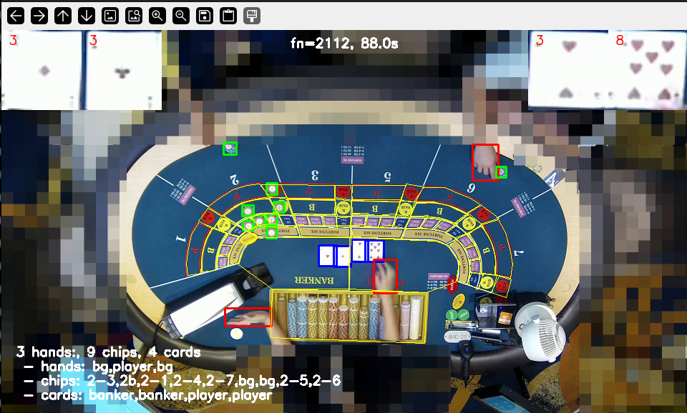
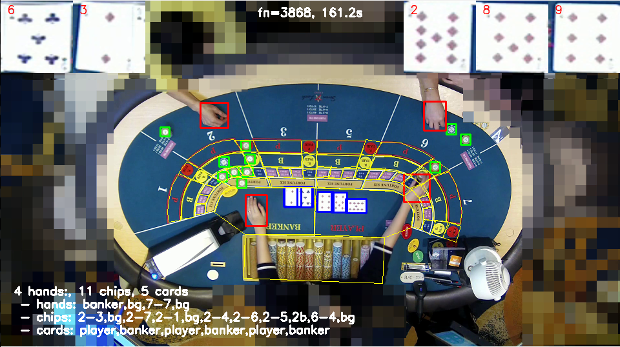
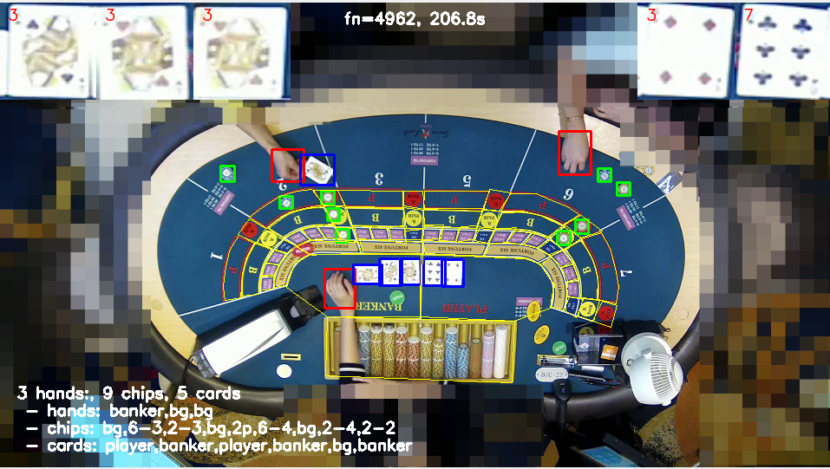
Before

Slide 20
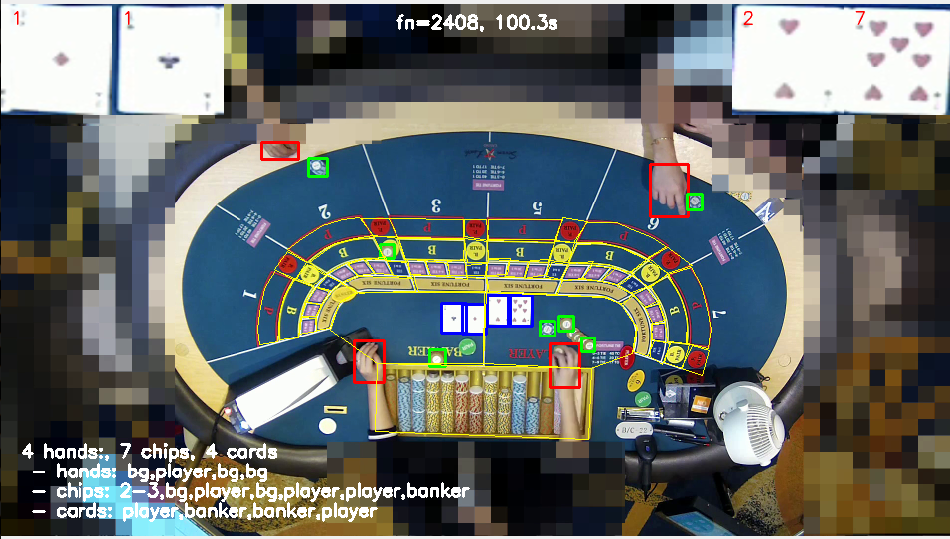
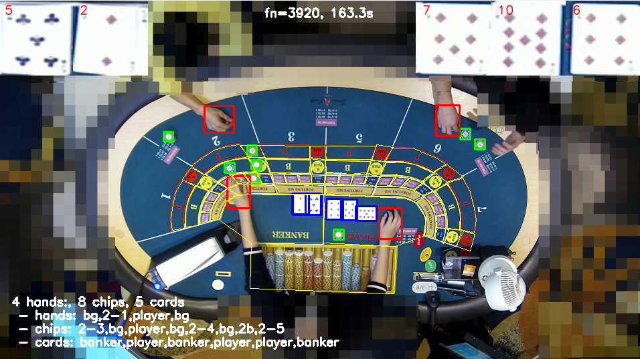
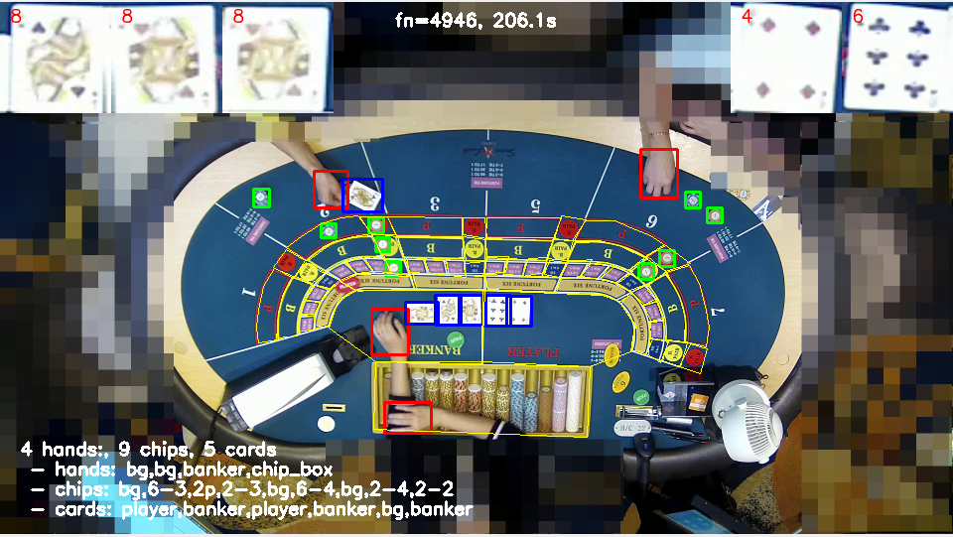
After

Slide 21
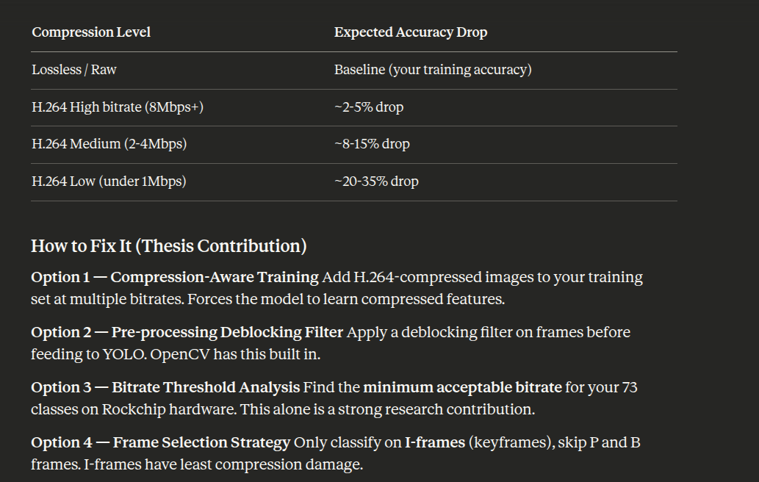
After

