Slide 1
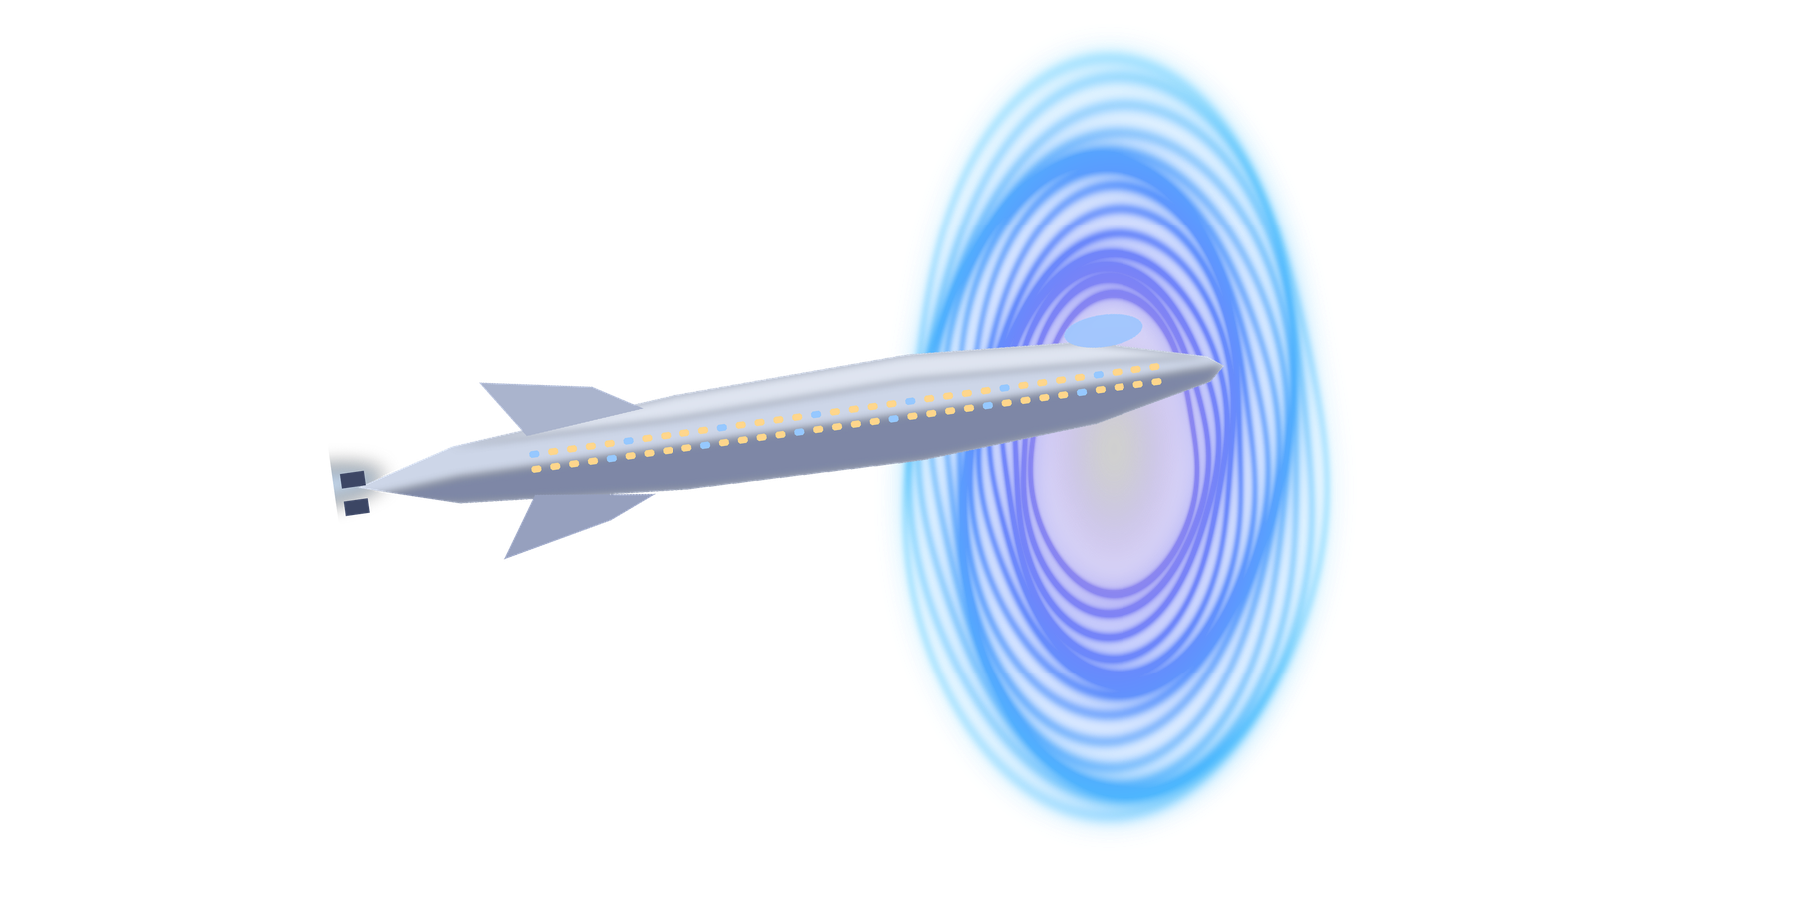

MACHINE LEARNING / COURSE PROJECT
SPACESHIP
TITANIC
Predicting passenger transport outcomes with supervised classification
TEAM
PUBLIC SCORE
Eugine · Adedamola
0.79611
Kaggle competition | Checkpoint presentation | 13 November 2026
Notes:
Open with the task: Spaceship Titanic is a Kaggle binary-classification competition. Our checkpoint public score is 0.79611.

Slide 2


Can we predict who was transported?
01 / TASK FRAMING
A binary classification task using passenger and travel attributes.
PREDICTION TARGET
COMPETITION METRIC
VALIDATION DESIGN
TRUE / FALSE
ACCURACY
80 / 20
Transported: whether a passenger was transported to another dimension.
Share of test predictions that match the true labels.
Stratified holdout split; random_state = 42 for all reported comparisons.
WHY ACCURACY?
DECISION RULE
It is the competition's specified metric, and the training target is nearly balanced.
Compare candidates on one validation split, then test the chosen model on Kaggle's public leaderboard.
SOURCE: KAGGLE SPACESHIP TITANIC COMPETITION — TASK AND EVALUATION METRIC
Notes:
Explain the target, why accuracy is the metric, and our decision rule: one shared validation split for model comparison, then Kaggle's public leaderboard as a separate check.

Slide 3


A balanced target, mixed feature types
02 / DATA AND EXPLORATION
Training data: 8,693 labeled passengers. Test data: 4,277 unlabeled passengers.
8,693
4,277
14
13
TRAINING ROWS
TEST ROWS
TRAIN COLUMNS
TEST COLUMNS
Labeled examples
Prediction cases
Including target
No target column
TARGET DISTRIBUTION
EDA COMPLETED
Target balance and missingness
Age and five spending distributions
Home planet, destination, CryoSleep, VIP
Selected links with Transported
False 49.64% (4,315)
True 50.36% (4,378)
Spending is zero-inflated and right-skewed; high values were not automatically treated as errors.
SOURCE: KAGGLE COMPETITION DATA; PROJECT DATA DICTIONARY AND COMMITTED EDA FIGURES
Notes:
8,693 training rows, 4,277 test rows. The target is almost perfectly balanced, so accuracy is a fair metric. Spending variables are zero-inflated and skewed.

Slide 4


Modest missingness, handled in-pipeline
03 / DATA QUALITY
No target missingness; predictors are missing roughly 1.9–2.5% per field.
2.50%
2.48%
0
MAX TRAIN MISSINGNESS
MAX TEST MISSINGNESS
TARGET MISSINGNESS
CryoSleep: 217 values
FoodCourt: 106 values
No missing labels
PREPROCESSING
QUALITY CHECKS & DECISIONS
Numeric fields
Median imputation + missingness indicators
Categorical fields
Most-frequent imputation + one-hot encoding
No duplicate rows or passenger IDs; no malformed IDs/cabins, negative ages or spending.
IQR extremes kept: flags are not proof of errors. Zero spending is plausible.
SOURCE: PROJECT DATA DICTIONARY; PREPROCESSING DESCRIBED IN ANALYSIS NOTEBOOK
Notes:
Missingness is small and spread across fields, so imputation happens inside the pipeline. We deliberately kept IQR outliers and zero spending, since neither is proof of an error.

Slide 5

Engineered features lifted the result
04 / FEATURE ENGINEERING
A controlled ablation: core predictors vs. core + a combined engineered block.
HOLDOUT ACCURACY
+1.84 pp
ABSOLUTE IMPROVEMENT
Combined feature block
ENGINEERED EXAMPLES
Cabin deck / number / side
Group size and sequence
Age band, surname frequency
Total / log spend indicators
Axis starts at 0.70. One stratified holdout split.
Caution: the block is tested jointly, not feature by feature. Group/surname counts use unlabeled train+test metadata.
SOURCE: REPORTS/FEATURE_ABLATION.CSV; FEATURE-ABLATION NOTEBOOK AND SCRIPT
Notes:
Core predictors score 0.7872; adding the engineered block gives 0.8056, a +1.84 percentage point gain. Be upfront: this is a joint test on a single split.

Slide 6
Random Forest led the comparison
05 / MODEL EVALUATION
All scores use the same stratified 80/20 split (seed 42).
TUNING
−0.17 pp
Tuning did not beat the untuned Random Forest.
Working candidate: Random Forest (0.8045). Local validation scores, not leaderboard scores.
SOURCE: REPORTS/MODEL_COMPARISON.CSV; HYPERPARAMETER SEARCH DOCUMENTED IN NOTEBOOK
Notes:
Random Forest is our working candidate at 0.8045. The tuned version was slightly lower at 0.8028. The majority baseline of 0.5037 shows the models are learning real signal.

Slide 7

A valid submission was uploaded
06 / KAGGLE SUBMISSION
The Kaggle result is a separate evaluation from our local validation split.
0.79611
4,277
PASSED
PUBLIC LEADERBOARD SCORE
PREDICTIONS
FILE CHECKS
Kaggle Spaceship Titanic
One row per test passenger
Columns OK; no missing values
SUBMISSION LOG
File: submission.csv
12-Nov-2026 · “Initial Random Forest baseline”
Status: Submitted
0.8045
Local holdout
0.79611
Kaggle public
SOURCE: REPORTS/KAGGLE_SUBMISSION_LOG.CSV; SUBMISSION.CSV STRUCTURE VERIFIED IN ZIP
Notes:
Keep the two numbers distinct: 0.8045 is our local holdout accuracy, 0.79611 is Kaggle's public leaderboard score from the 12 November submission.

Slide 8
Promising, but robustness still matters
07 / LIMITATIONS AND NEXT STEPS
Next: test whether the gains hold beyond one random split.
VALIDATION ROBUSTNESS
FEATURE ATTRIBUTION
One headline holdout split; group-aware validation remains outstanding.
The combined ablation does not isolate individual feature contributions.
TRANSDUCTIVE FEATURES
REPRODUCIBILITY
Group/surname counts use train+test metadata; assess with grouped validation.
Reconcile notebook and script; pin the environment and rerun from a clean runtime.
Code audit: the notebook counts the first name token, while the ablation and script count the last token as surname. Standardise before claiming reproducibility.
Group-aware validation
Feature-level ablation
Error analysis
Clean rerun
Update report + slides
SOURCE: INTERMEDIATE STATUS REPORT; DATA DICTIONARY; NOTEBOOK/SCRIPT REVIEW
Notes:
Four honest limitations, then the plan: group-aware validation, feature-level ablation, error analysis, clean rerun, and updated report and slides.

Slide 9
A documented, transparent workflow
08 / TEAM, INTEGRITY AND SOURCES
Roles as recorded in the repository README.
EUGINE
ADEDAMOLA
Coordination, data audit, EDA and feature-engineering integration, documentation and presentation coordination.
Independent EDA review, extra feature and model experiments, validation and tuning, error analysis, reproducibility review.
ACADEMIC INTEGRITY & SOURCES
Dataset, task, metric: Kaggle Spaceship Titanic (kaggle.com/competitions/spaceship-titanic)
Methods: scikit-learn user guide (scikit-learn.org/stable/user_guide.html)
TEAM CONTRIBUTIONS: README.MD | SOURCES: KAGGLE; SCIKIT-LEARN OFFICIAL USER GUIDE
Notes:
State the roles, then the sources. Check with both teammates that no other external resource was consulted before presenting the integrity statement.

Slide 10
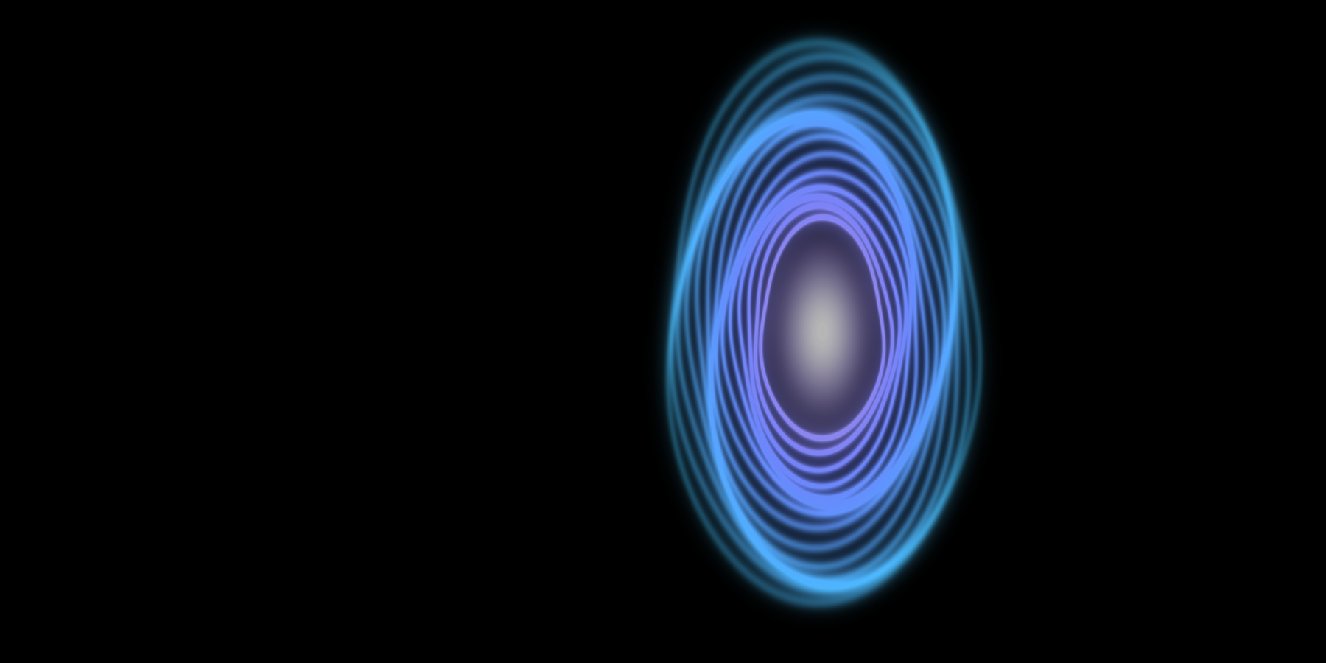
THANK YOU
QUESTIONS
& DISCUSSION
Eugine · Adedamola
Spaceship Titanic | Kaggle public score 0.79611
Notes:
Invite questions. Be ready for: why accuracy, why Random Forest over the tuned model, what the transductive features mean, and the difference between 0.8045 and 0.79611.

