Slide 1
NYC Restaurant Inspections
& "Best Restaurant" Recognition
Shawn Ganz

Slide 2
02
RESEARCH QUESTION
Do NYT-recognized NYC restaurants have better health inspection outcomes than non-NYT restaurants?

Slide 3


Motivation
03
Personal Background
The Practical Question
NYC resident and former waiter
Firsthand experience with restaurant industry
Personal curiosity about food safety
Does "good restaurant" mean "cleaner restaurant"?
Is critical acclaim linked to food safety?
Worth ordering from a C-rated spot vs. an A?

Slide 4



Data Sources
04
NYC DOHMH
NYT Top 100
Yelp (Dropped)
Restaurant inspection results from NYC OpenData — grades, violations, severity scores
New York Times list of the best NYC restaurants (2025) — top 10 ordinal, rest alphabetical
Originally planned, but NYC was not included in the Yelp Open Dataset

Slide 5



Data Cleaning + Matching
05
1
2
3
Clean Names
Match Records
Resolve Duplicates
Lowercased and trimmed restaurant names in both datasets
Joined NYT restaurants to DOHMH records by cleaned name
Manually mapped duplicate names/locations to correct CAMIS IDs

Slide 6
Analysis Dataset
06
NYT Top 10
NYT 11-100
Non-NYT Sample
Top-ranked restaurants (ordinal)
Remaining NYT restaurants (alphabetical)
10,000 random non-NYT restaurants
KEY METRICS
Grade
Total Violations
Critical Violations
Severity Score
A / B / C letter grade
Count per latest inspection
Critical-flagged violations
Critical=2, Not Critical=1, N/A=0

Slide 7
Descriptive Results
07
NON-NYT RESTAURANTS
NYT RESTAURANTS
89.8%
82.9%
A Grade
A Grade
Metric | Non-NYT | NYT
Mean Total Violations | 2.68 | 2.74
Mean Critical Violations | 1.26 | 1.52
Mean Severity Score | 3.90 | 4.23

Slide 8
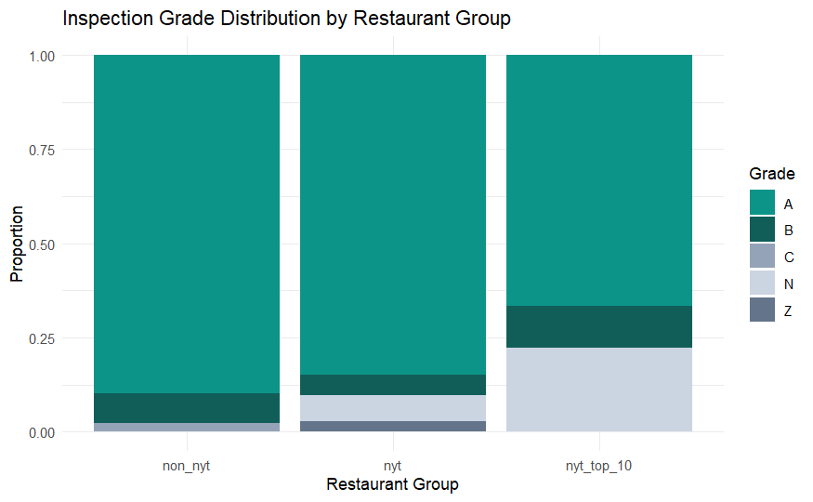

Slide 9
Statistical Tests
08
Chi-Square Test
Wilcoxon Test
A-Grade Proportions
Total Violations
Not Significant
Not Significant
p = 0.06
W = 393,565 | p = 0.300
Wilcoxon Test
Wilcoxon Test
Critical Violations
Severity Scores
Significant
Significant
W = 357,093 | p = 0.009
W = 368,117 | p = 0.046
Significance level: α = 0.05
Notes:
Wilcoxon
- It takes all restaurants in the test.
It ranks their values, like critical_violations.
It keeps track of which group each restaurant belongs to: NYT or non-NYT.
It adds the ranks for one group.
It compares that rank total against what rank totals would look like if group labels were basically random.
The p-value is the chance of getting a rank imbalance that extreme, assuming no real difference between groups.
- z = (observed - expected) / standard error

Slide 10
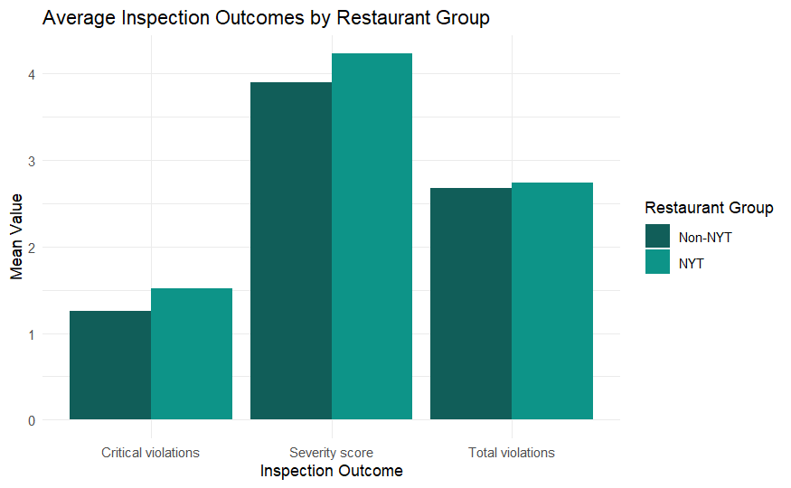

Slide 11


Conclusion
09
NYT restaurants did not show better inspection outcomes than non-NYT restaurants
Critical violations and severity scores were significantly higher among NYT restaurants
"Acclaimed" does not necessarily mean "cleaner" — food quality recognition and food safety are separate dimensions

Slide 12
Questions?
Thank you for listening

