Slide 1

Genetic Algorithms
for Portfolio Strategy Optimization
SCS 3547: Intelligent Agents
Presenter:
Sigao Li
Instructors:
Simon, Larry
April 2nd, 2024

Slide 2
Introduction to the Project
Background:
In the dynamic and complex world of financial markets, predicting stock movements remains a challenging task. Traditional time series methods often fail to capture dependencies and patterns in the data. Advanced models such as Transformer require a lot of time to train the model and optimize the hyperparameters.
Objectives:
This study aims to use the Transformer model for price prediction and use genetic algorithms for hyperparameter optimization to quickly identify the "optimal" model. The result is an effective and computationally efficient forecasting framework that empowers investment portfolios.

Slide 3
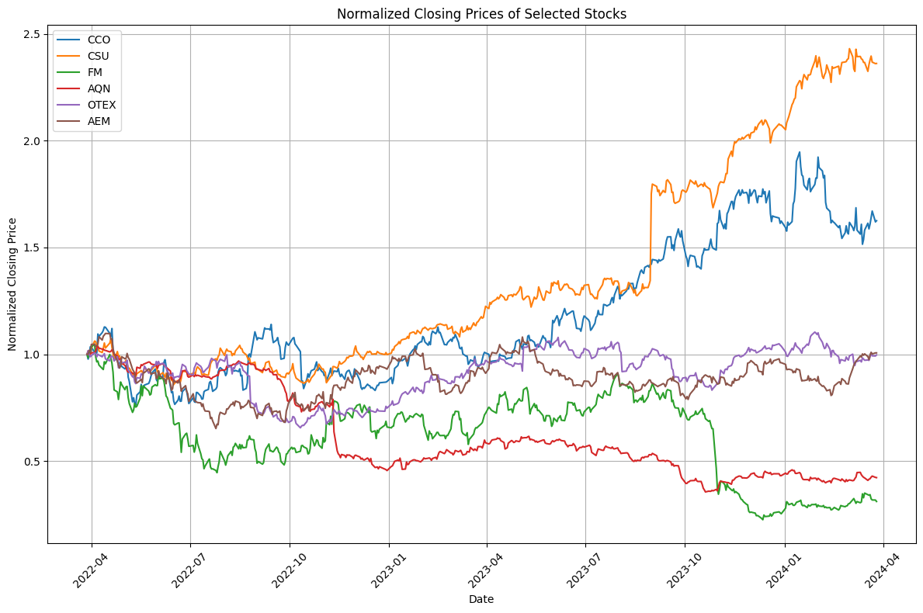
Data Overview
Data Source 1. The stock data set is obtained from IBKR API and collects daily data for 2 years.
(highest price, lowest price, opening price, closing price, average, trading volume and number of transactions)
2. The risk-free interest rate refers to the Canadian Overnight Repo Rate Average provided by the Bank of Canada.
Data Processing 1. Technical Indicators:
EMA, RSI, BB, VWAP, ATRP, MFI, VPT, TMI
2. Use Z-Score normalization and choose 20 as the Sequence Length (approximately the number of trading days in a month).
3. Split the dataset:
Train: #386 Days=80%; Test: #97 Days=20%
Note: Stock trends over the past two years among the S&P/TSX 60 (60 large companies listed on the Toronto Stock Exchange) - the 6 stocks with the biggest gainers/fallers, and smallest spreads.

Slide 4
Model Architecture and Training
Transformer
PositionalEncoding
TimeSeriesTransformer
Genetic Algorithm
Uniform Crossover (Pop: 25)
Mutation (CXPB: 0.7, MUTPB; 0.3, NGEN; 30)
Selection (Roulette Wheel)
Early Stopping (5 Epochs)
Fitness Evaluation(Directional Accuracy & Theil's U(Uncertainty coefficient))
Parallelizing Computations
Hyperparameters Optimization
Number of Layers (2 / 4 / 8)
Number of Heads (2 / 4 / 8)
Learning Rate (0.01 / 0.05 / 0.1)
Dropout Rate (30% / 40% / 50%)
Batch Size (16 / 32 / 64)
Number of Epochs (30 / 40 / 50)

Slide 5
Results
Symbol | Runtime(s) | Type | Fitness Score | num_layers | num_heads | lr | dropout | batch_size | epochs
FM | 835.54 | Best | 0.52532 | 2 | 2 | 10 | 30 | 16 | 30
 |  | Worst | 0.51236 | 4 | 2 | 10 | 50 | 16 | 40
OTEX | 1442.89 | Best | 0.64384 | 2 | 2 | 5 | 40 | 32 | 30
 |  | Worst | 0.48580 | 2 | 2 | 10 | 50 | 64 | 40
AQN | 1366.72 | Best | 0.47117 | 4 | 2 | 10 | 50 | 32 | 50
 |  | Worst | 0.43289 | 4 | 4 | 10 | 50 | 16 | 50
CCO | 710.18 | Best | 0.62857 | 2 | 4 | 10 | 50 | 64 | 30
 |  | Worst | 0.52188 | 4 | 4 | 5 | 50 | 32 | 30
CSU | 2471.12 | Best | 0.37553 | 2 | 4 | 10 | 50 | 16 | 40
 |  | Worst | 0.35789 | 4 | 8 | 5 | 50 | 32 | 40
AEM | 1207.21 | Best | 0.60442 | 2 | 2 | 1 | 40 | 64 | 30
 |  | Worst | 0.40577 | 4 | 4 | 5 | 30 | 64 | 40

Slide 6
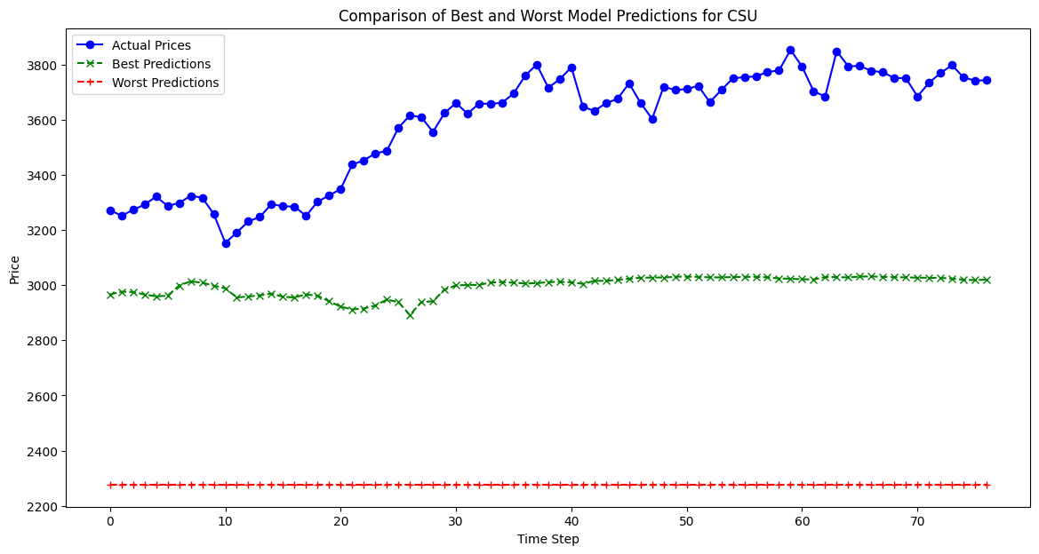
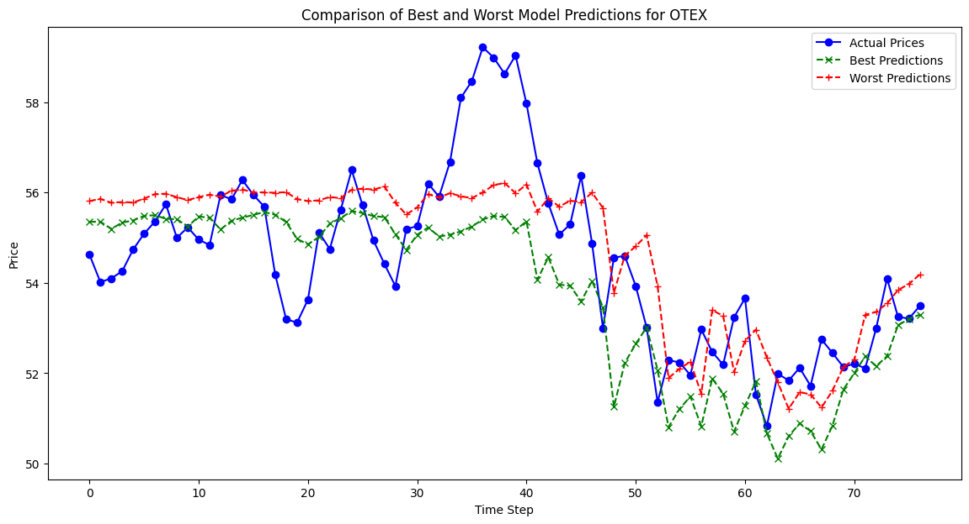
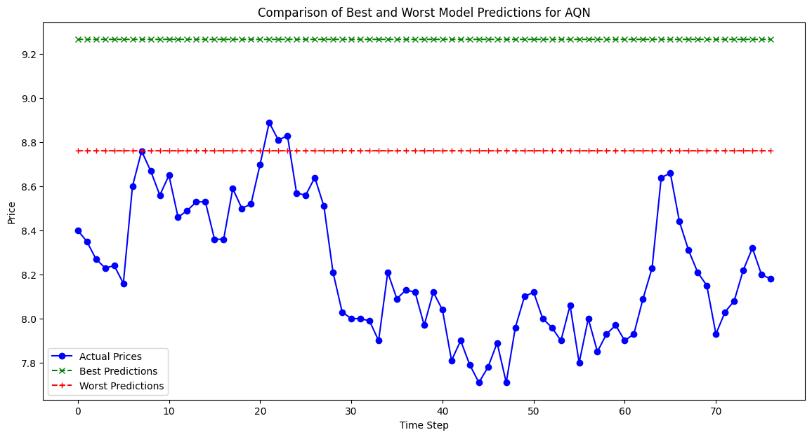
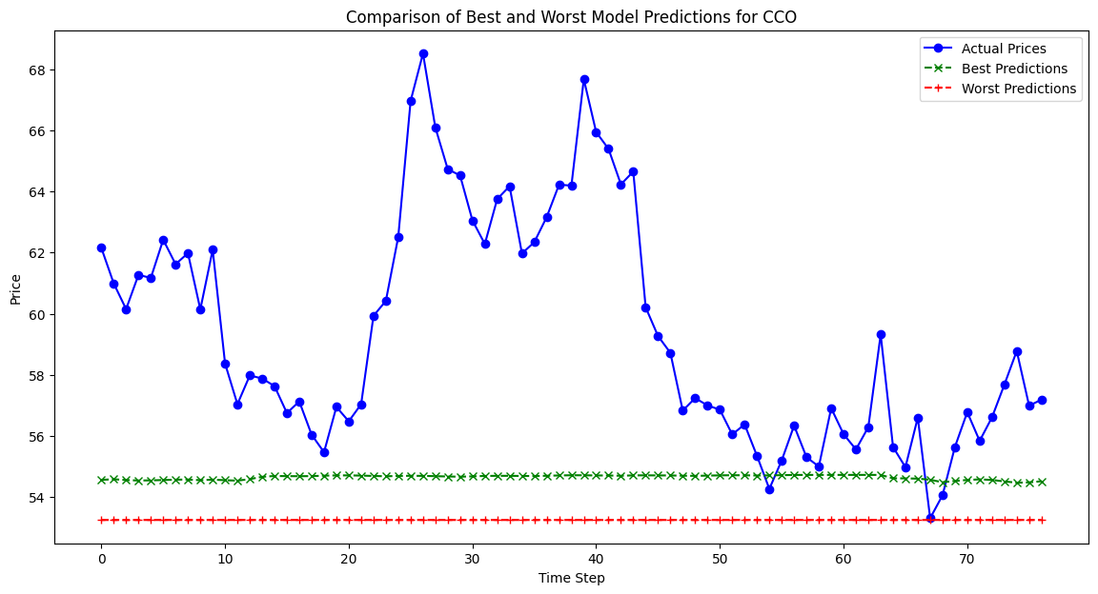
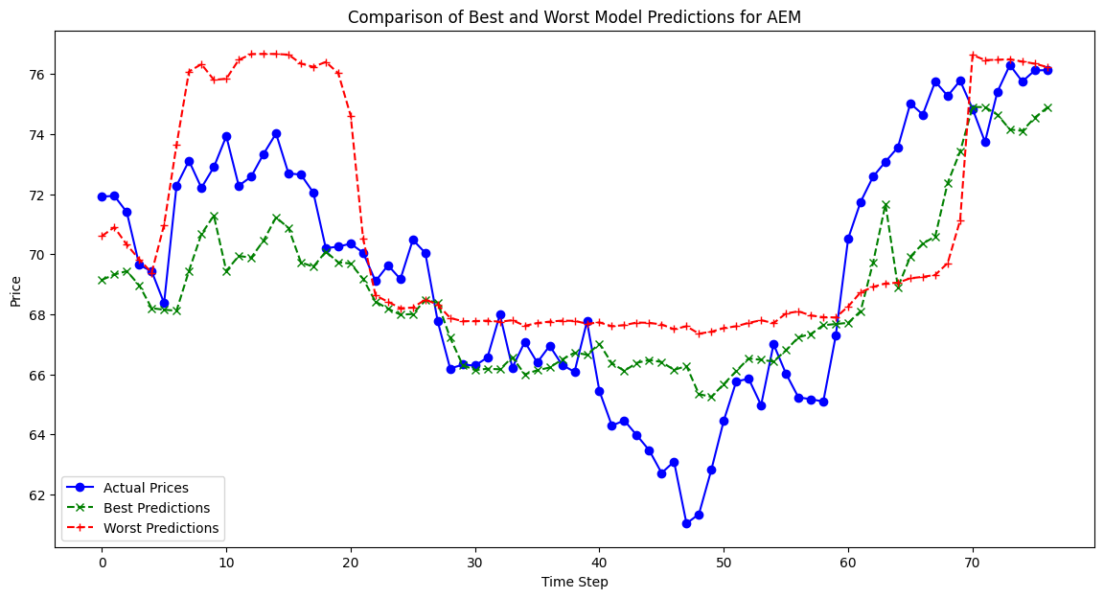
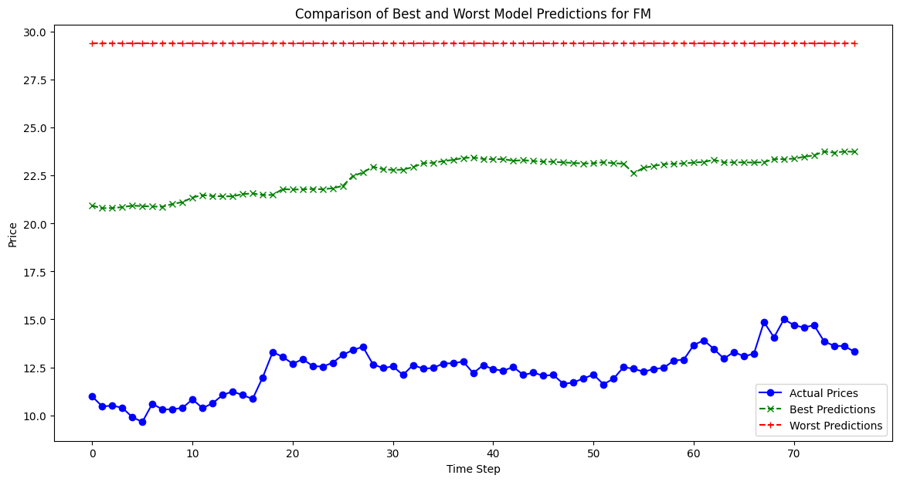
Performance Evaluation
Biggest Gainers
Smallest Spreads
Biggest fallers

Slide 7
Conclusions and Future Work
Conclusions
Future Work:
01
Adaptive Sequence:
If the model can be trained on multiple sequence lengths, it will enable it to learn both short-term and long-term trends, allowing it to make more informed predictions.
This study successfully demonstrates the potential of combining Transformer models with genetic algorithms. By utilizing the advantages of the Transformer model to analyze time series data and the search efficiency of the genetic algorithm, the computational overhead is significantly reduced while improving prediction accuracy.
02
Enhanced Population Diversity:
A larger population size can introduce more genetic diversity and provide a wider search space for the algorithm.
03
Optimization Complexity:
Implementing more efficient hyperparameter optimization techniques (e.g. using continuous values) may lead to better convergence to an optimal solution.

Slide 8
THANKS FOR WATCHING
SCS 3547: Intelligent Agents
Presenter:
Sigao Li
Instructors:
Simon, Larry
April 2nd, 2024

