Slide 1

Genetic Algorithms
for Portfolio Strategy Optimization
SCS 3547: Intelligent Agents
Presenter:
Sigao Li
Instructors:
Simon, Larry
April 2nd, 2024

Slide 2
Introduction to the Project
Background:
In the dynamic and complex world of financial markets, predicting stock prices with high accuracy remains a challenging task due to the volatile nature of market data and the myriad of factors influencing stock movements. Traditional time series forecasting methods often fall short in capturing the intricate temporal dependencies and patterns within stock market data.
Objectives:
This study aims to exploit the advanced sequential data processing capabilities of Transformer models to enhance the accuracy and efficiency of stock price predictions. By integrating genetic algorithms for hyperparameter optimization, facilitating the rapid identification of superior model configurations. Ultimately, the project endeavours to establish a more effective and computationally efficient framework for financial market forecasting.

Slide 3
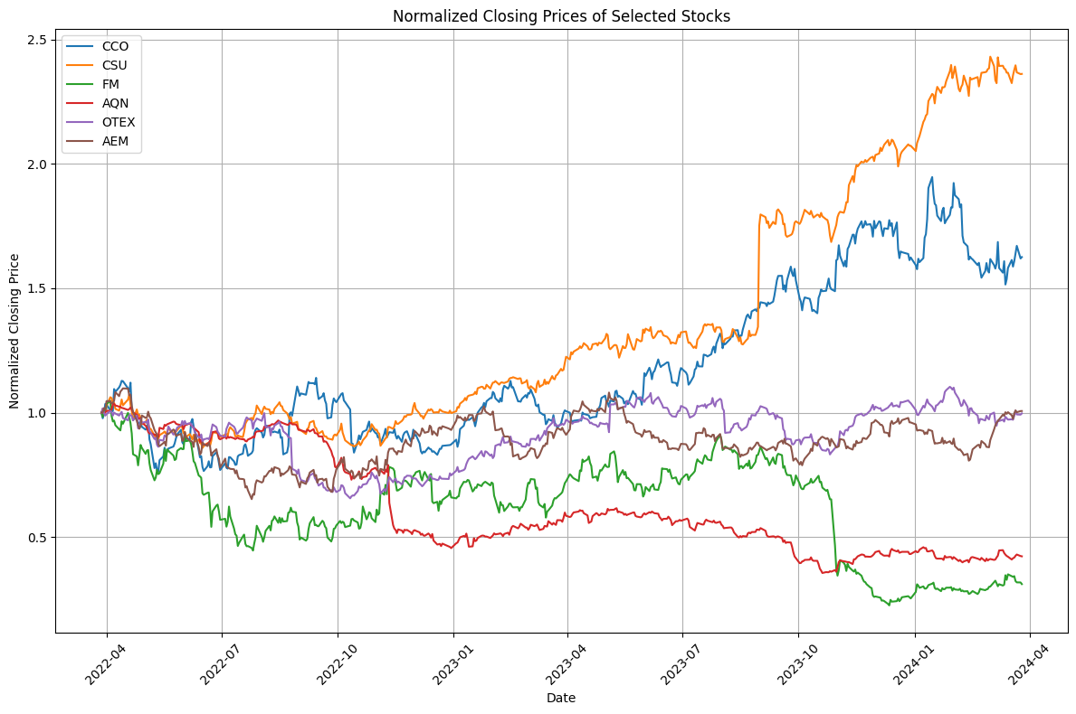
Data Overview and Preprocessing
Data Source 1. The stock data set is obtained from IBKR API and collects daily data for 2 years.
(highest price, lowest price, opening price, closing price, average, trading volume and number of transactions)
2. The risk-free interest rate refers to the Canadian Overnight Repo Rate Average provided by the Bank of Canada.
Data Preprocessing 1. Technical Indicators:
EMA, RSI, BB, VWAP, ATRP, MFI, VPT, TMI
2. Use Z-Score normalization and choose 20 as the Sequence Length (approximately the number of trading days in a month).
3. Split the dataset:
Train: #386 Days=80%; Test: #97 Days=20%
Note: Stock trends over the past two years among the S&P/TSX 60 (60 large companies listed on the Toronto Stock Exchange) - the 6 stocks with the biggest gainers/fallers, and smallest spreads.

Slide 4
Model Architecture and Training
Transformer
PositionalEncoding
TimeSeriesTransformer
Genetic Algorithm
Selection (Roulette Wheel)
Uniform Crossover (Pop: 25)
Mutation (CXPB: 0.7, MUTPB; 0.3, NGEN; 30)
Fitness Evaluation (Directional Accuracy & Theil's U Statistic)
Early Stopping (5 Epochs)
Parallelizing Computations
Hyperparameters Optimization
Number of Layers (2 / 4 / 8)
Number of Heads (2 / 4 / 8)
Learning Rate (0.01 / 0.05 / 0.1)
Dropout Rate (30% / 40% / 50%)
Batch Size (16 / 32 / 64)
Number of Epochs (30 / 40 / 50)

Slide 5
Results and Performance Evaluation
Symbol | Runtime(s) | Type | Fitness Score | num_layers | num_heads | lr | dropout | batch_size | epochs
FM | 835.54 | Best | 0.52532 | 2 | 2 | 10 | 30 | 16 | 30
 |  | Worst | 0.51236 | 4 | 2 | 10 | 50 | 16 | 40
OTEX | 1442.89 | Best | 0.64384 | 2 | 2 | 5 | 40 | 32 | 30
 |  | Worst | 0.48580 | 2 | 2 | 10 | 50 | 64 | 40
AQN | 1366.72 | Best | 0.47117 | 4 | 2 | 10 | 50 | 32 | 50
 |  | Worst | 0.43289 | 4 | 4 | 10 | 50 | 16 | 50
CCO | 710.18 | Best | 0.62857 | 2 | 4 | 10 | 50 | 64 | 30
 |  | Worst | 0.52188 | 4 | 4 | 5 | 50 | 32 | 30
CSU | 2471.12 | Best | 0.37553 | 2 | 4 | 10 | 50 | 16 | 40
 |  | Worst | 0.35789 | 4 | 8 | 5 | 50 | 32 | 40
AEM | 1207.21 | Best | 0.60442 | 2 | 2 | 1 | 40 | 64 | 30
 |  | Worst | 0.40577 | 4 | 4 | 5 | 30 | 64 | 40

Slide 6
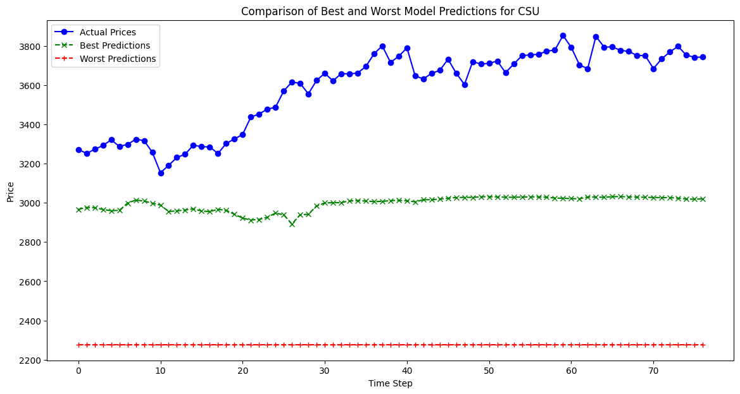
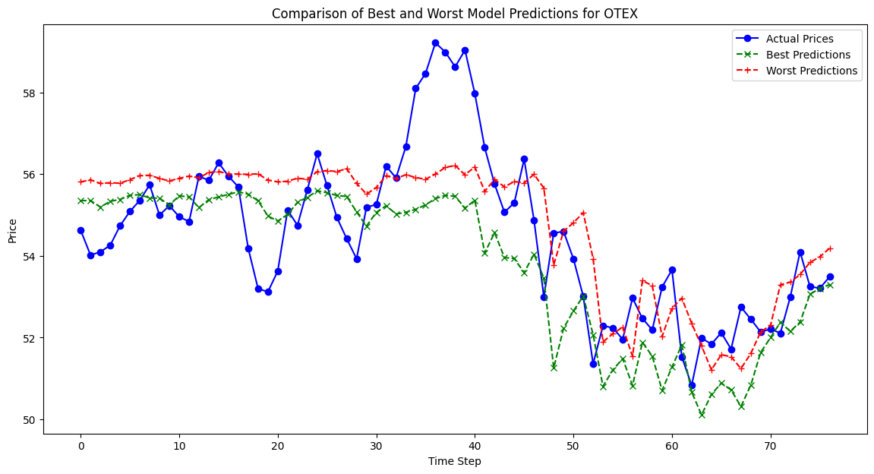
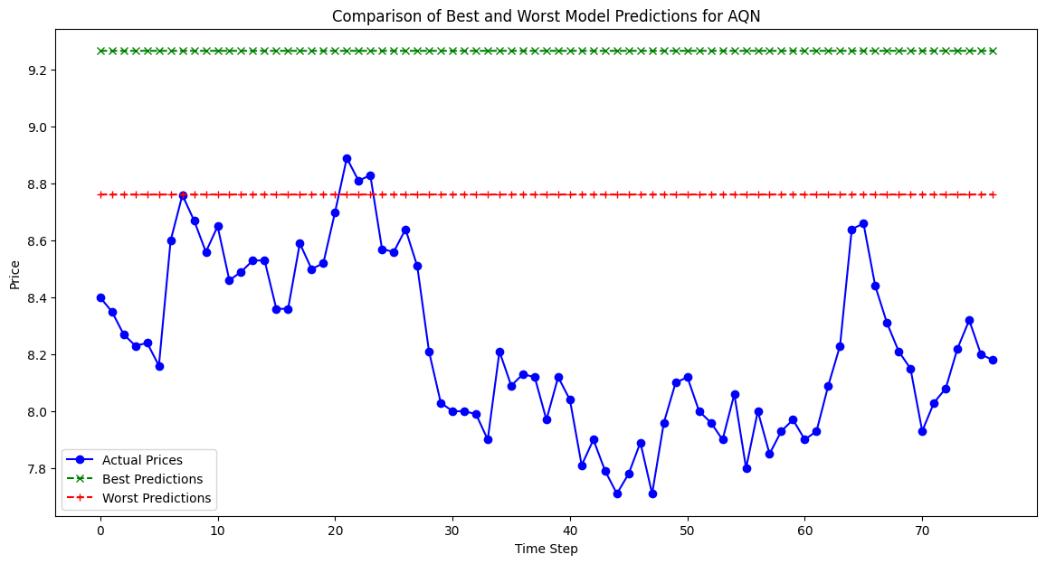
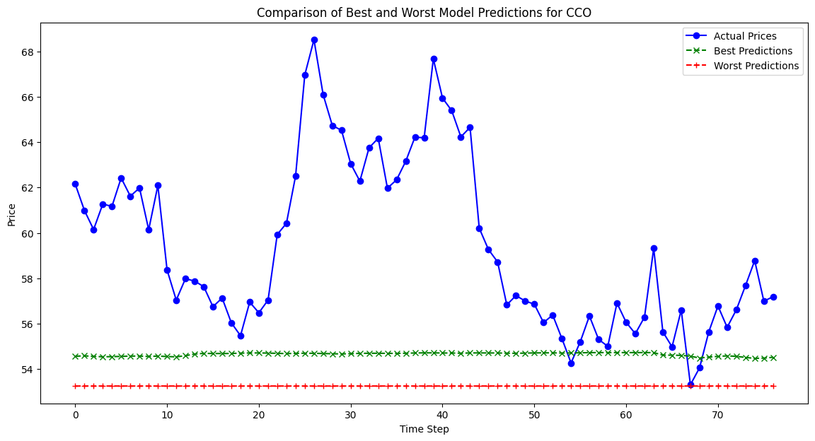
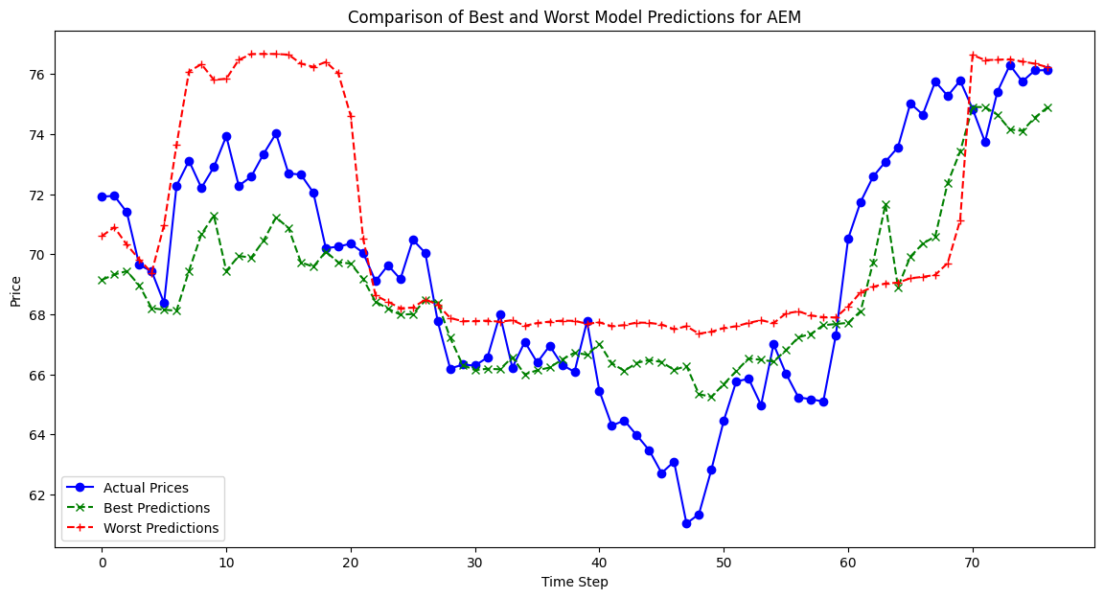
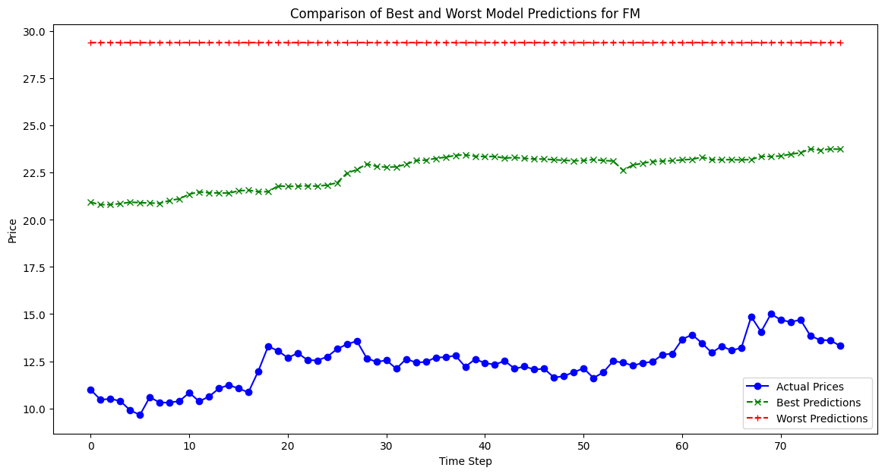
Results and Performance Evaluation
Biggest Gainers
Smallest Spreads
Biggest fallers

Slide 7
Conclusions and Future Work
Conclusions
Future Work:
01
Adaptive Sequence:
If the model is trained on multiple sequence lengths, allowing it to learn from short- and long-term trends to make more informed predictions.
This study successfully demonstrates the potential of combining Transformer models with genetic algorithm-based hyperparameter optimization to predict stock prices effectively and efficiently. By leveraging the sophisticated sequence processing capabilities of Transformer models and the strategic search efficiency of genetic algorithms, we have identified optimal model configurations that significantly improve forecast accuracy while reducing computational overhead.
02
Enhanced Population Diversity:
Larger population sizes can introduce more genetic diversity, providing a wider search space for the algorithm.
03
Optimization Complexity:
Implementing more efficient hyperparameter optimization techniques, such as using continuous values, may lead to better convergence to the optimal solution.

Slide 8
THANKS FOR WATCHING
SCS 3547: Intelligent Agents
Presenter:
Sigao Li
Instructors:
Simon, Larry
April 2nd, 2024

