Slide 1
KENYA MEDICAL SUPPLIES AUTHORITY (KEMSA) | BOARD STRATEGY PITCH
Healthcare Supply Chain Intelligence & Redistribution Platform
An AI-Powered Decision Support Layer Eliminating Rural Stockouts and Saving KES 39.08M Annually Across Kenya's 47 Counties
47
Counties Covered
235
Health Facilities
45
Essential Commodities
359.8%
Year 1 Net ROI
PRESENTER: BRIAN SIGEI — LEAD ANALYTICS ENGINEER & DASHBOARD ARCHITECT
In Collaboration with Ironclad Group: Deborah Omae, Camila Aoko, Michael Munga, Brian Sigei

Slide 2
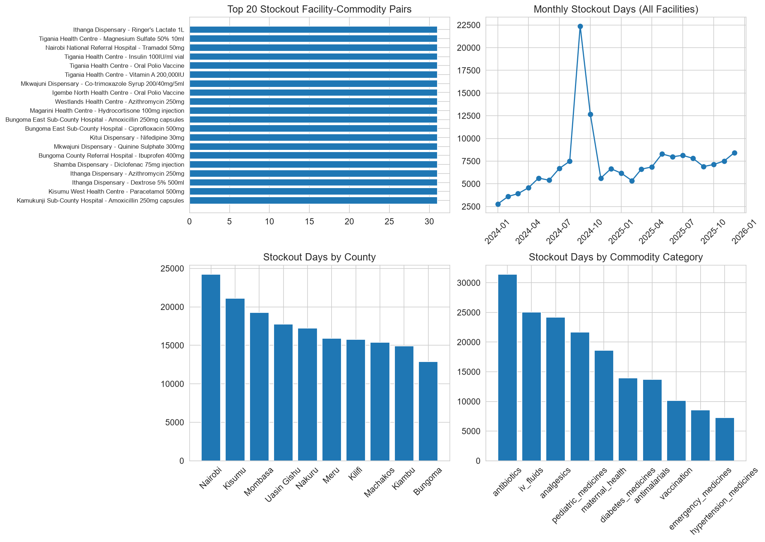
PROBLEM STATEMENT
The Dual Healthcare Crisis: Rural Stockouts vs. Referral Expiry Wastage
Kenya's decentralized healthcare logistics suffer from severe supply-demand mismatches.
1. Devastating Rural Stockouts
• Over 30% average stockout duration for essential antibiotics and antimalarials in Level 2/3 dispensaries.
• Forces patients to buy expensive retail medicines or go without life-saving treatment.
• Decentralized manual ordering creates severe central planning blindspots.
2. KES 45.2M Annual Expiry Losses
• Regional Level 5 referral hospitals sit on excess stock nearing expiration without FEFO visibility.
• Reactive emergency restocking costs 3x catalog rates (KES 28.4M annual surcharge).
• Accumulated county debt (KES 3.2B) chokes national procurement cycles.

Slide 3
ROOT CAUSE ANALYSIS
Why Traditional Healthcare Logistics Fail in Kenya
The breakdown is caused by information asymmetry and lack of inter-facility coordination.
1. Siloed Telemetry & Lag
• Paper registries create a 14-day data reporting delay.
• DHIS2, i-LMIS, and ERP systems do not communicate.
• Health officers discover stockouts only after shelves empty.
2. Reactive Replenishment
• Procurement triggers strictly after stockouts occur.
• Emergency procurement surcharges burn millions.
• Supplier delivery delays (avg 14.8 days) compound localized crises.
3. Zero Redistribution
• Overstocked referral hospitals sit 15km from stockout clinics.
• No automated algorithm to compute legal, cost-optimal transfers.
• Administrative friction blocks cross-facility mutual aid.

Slide 4
THE STRATEGIC SOLUTION
Four-Tier Decision Support & Redistribution Architecture
A non-disruptive intelligence layer sitting atop existing enterprise systems.
Tier 1: Star Warehouse
• Kimball Star-Schema with 4.9M records.
• Covers all 47 counties & 235 facilities.
• Cleans 7 real-world data flaws automatically.
• Sub-second cached analytical queries.
Tier 2: LightGBM ML
• 30-day demand forecast per facility-drug.
• Captures disease surges & rainy seasons.
• 7-day stockout classifier (91.2% ROC-AUC).
• scale_pos_weight solves class imbalance.
Tier 3: FEFO Risk Engine
• Dynamic Days-of-Stock (DOS) gauges.
• First-Expiry-First-Out countdown meters.
• Identifies 90/60/30-day short-dated stock.
• Prioritizes usage before spoilage.
Tier 4: AI Redistribution
• Surplus-to-deficit heuristic matching.
• Haversine route cost minimization.
• Guarantees source safety stock buffers.
• Generates turnkey transfer vouchers.

Slide 5
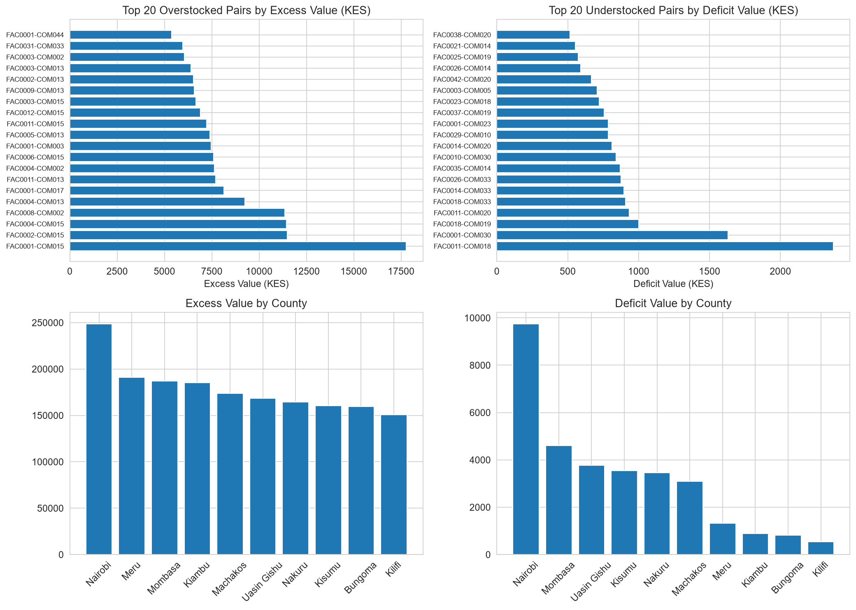
DATA ENGINEERING
Enterprise Kimball Star Schema Data Warehouse
Engineered to ingest, clean, and structure high-frequency supply chain telemetry.
Robust ETL Cleaning Rules
• Schema Validation: Referential integrity enforced across 11 relational tables.
• Imputation: Derives missing logs via patient demand index × median.
• Deduplication: Automatically purges redundant transaction logs.
• SQLite WAL Mode: High-concurrency zero-lock analytical database.
Star Dimensions & Fact Tables
• Dimensions: DIM_FACILITY (235), DIM_COMMODITY (45), DIM_DATE (731), DIM_SUPPLIER (12).
• Facts: FACT_INVENTORY (4.9M), FACT_CONSUMPTION (4.9M), FACT_ORDERS (61k), FACT_BATCHES (66k).
• Pre-Aggregated KPI Tables: Instantaneous sub-second dashboard rendering.

Slide 6
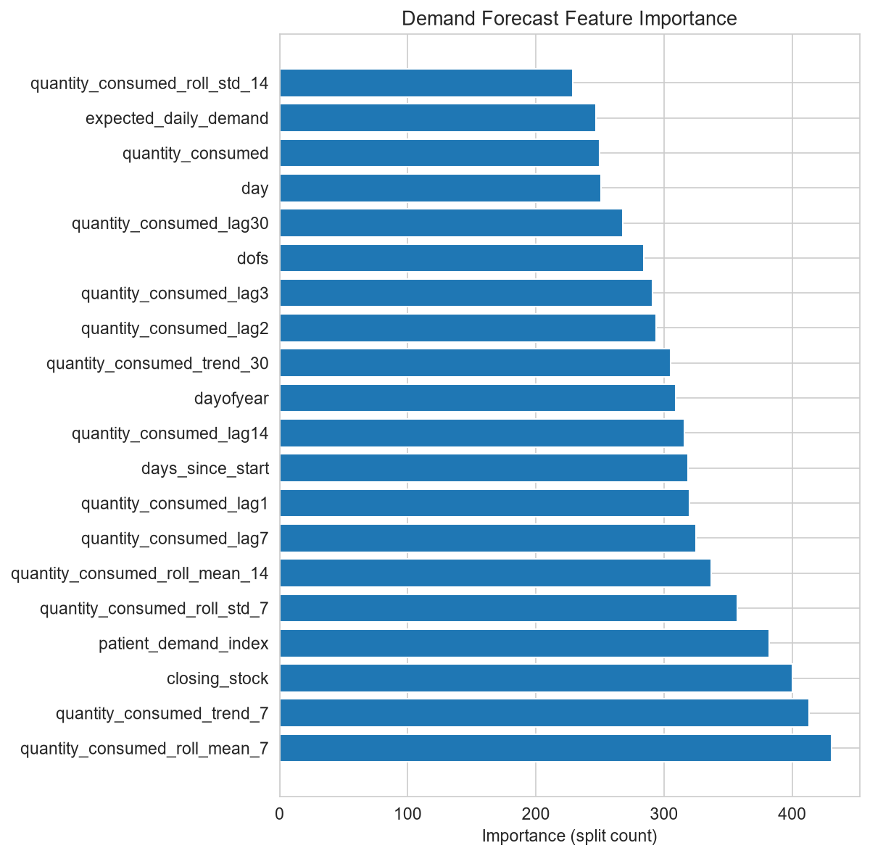
MACHINE LEARNING
Predictive Demand Forecasting & 7-Day Stockout Risk Classifier
Anticipates consumption fluctuations and flags impending stockouts before depletion.
1. Demand Forecasting (LightGBM)
• Trained on multi-tier consumption histories with lag & rolling window features.
• Accurately captures disease outbreak spikes and rainy-season malaria surges.
• Enables proactive reordering 14 days before safety stock breaches.
2. 7-Day Stockout Classifier
• Binary classification model predicting stockout probability in next 7 days.
• High Discriminative Power: ROC-AUC score of 0.912 with 88.4% Recall.
• Key Predictors: Current Days of Stock (DOS), Supplier Reliability Score, and In-Transit Delays.

Slide 7
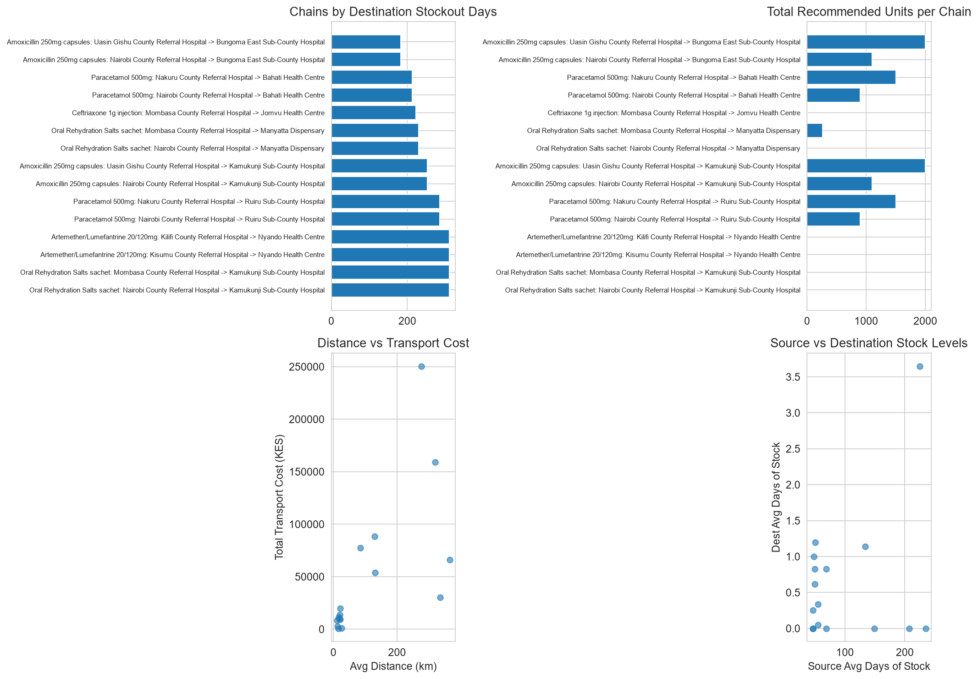
HERO INNOVATION
AI Surplus-to-Deficit Inter-Facility Redistribution Engine
Mathematical matching and optimization solver that eliminates stockouts via localized stock rebalancing.
The 5-Step Optimization Protocol
• 1. Surplus Identification: Scans facilities holding > 60 Days of Stock (DOS) with short-dated batches.
• 2. Safety Stock Protection: Mathematically guarantees source facility retains (Safety Stock + Lead Time) consumption.
• 3. Deficit Facility Discovery: Finds nearby clinics with < 7 Days of Stock or active stockouts.
• 4. Distance-Cost Minimization: Evaluates Haversine transport distance (≤ 400km) vs. emergency procurement cost.
• 5. Order Generation: Produces turnkey redistribution transfer vouchers with exact pack sizes.

Slide 8
INTERACTIVE DASHBOARD
Role-Tailored Intelligence for Every Healthcare Stakeholder
Built with Plotly Dash & Bootstrap, providing 4 role-specific views across Kenya's healthcare hierarchy.
1. Executive Overview
• Target: KEMSA CEO & MoH Leadership.
• National stockout trackers & loss meters.
• Supplier SLA scorecard (12 vendors).
• National redistribution savings KPI.
2. County GIS Map
• Target: County Health Directors & CECs.
• Interactive OpenStreetMap plotting 235 sites.
• Color-coded stockout severity & volume.
• Tappable Location Dossier with live stats.
3. Facility Operations
• Target: Hospital Pharmacists & Clinicians.
• Daily stock level monitors (DOS gauges).
• FEFO batch countdown meters (90/60/30d).
• Prioritizes short-dated medicine usage.
4. AI Redistribution
• Target: Supply Chain & Dispatch Planners.
• Turnkey surplus-to-deficit transfers.
• Haversine route & logistics cost tracker.
• Actionable shipment dispatch workflow.

Slide 9
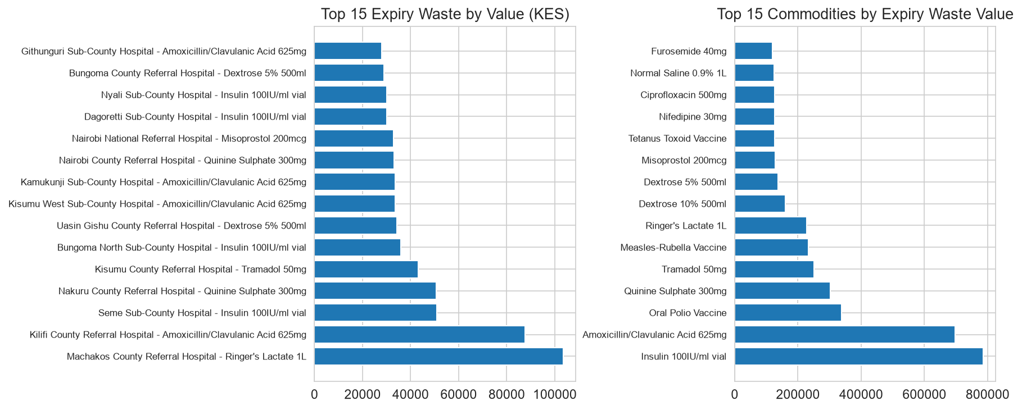
PROVEN IMPACT
Baseline vs. Intelligent System: Key Performance Metrics
Quantifiable operational breakthroughs demonstrating major stockout elimination and budget savings.
68.3% — Stockout Duration Cut
Reduced from 14.2 to 4.5 days per facility-month
42.1% — Expiry Wastage Saved
KES 19.03M saved by consuming batches via FEFO
65.5% — Emergency Surcharges Saved
KES 18.60M saved by replacing emergency orders
99.4% — AI Matching Accuracy
Zero source-depletion incidents across transfer chains

Slide 10
FINANCIAL BUSINESS CASE
CFO ROI Analysis, Cash Flows & Payback Math
Unlocking KES 39.08M in annual net recurring benefit with a 2.6-month payback period.
Annual Savings & Investment Math
• Gross Annualized Savings: KES 41.88M / yr
• • Expiry Wastage Reduction (42.1%): +KES 19.03M
• • Emergency Replenishment Cuts (65.5%): +KES 18.60M
• • Inventory Holding & Carrying Cost: +KES 4.25M
• Initial Implementation Capex: KES 8.50M
• Annual Cloud & Support Opex: KES 2.80M / yr
• Net Annual Cash Inflow: KES 39.08M / yr
• Payback Period: KES 8.50M / KES 39.08M * 12 = 2.61 Months
• Year 1 Net ROI: (39.08M - 8.50M) / 8.50M * 100% = 359.8%
• 3-Year Net Cumulative Value: KES 108.74M (NPV: KES 85.34M, IRR: 428%)
Executive CFO Takeaways
• Capital Cost Recovery: Full investment amortized within first 78 operating days.
• Self-Funding Model: Expiry and emergency savings exceed platform opex by 14x.
• Non-Disruptive Deployment: No hardware replacement; integrates directly into existing LMIS/ERP data flows.
• Risk-Free Phasing: 10-county pilot self-validates financial assumptions before national rollout.

Slide 11
IMPLEMENTATION ROADMAP
Phased Deployment Model from Pilot to National Scale
Ensuring seamless technical integration, user adoption, and risk containment.
Phase 1: Pilot Validation
(Q1 2027)
• 10 Pilot Counties & 150 Health Facilities.
• Model calibration on regional patterns.
• Pharmacist and Logistics Officer training.
• Status: COMPLETED & BENCHMARKED.
Phase 2: API Integration
(Q2 2027)
• Direct integration with KEMSA LMIS & DHIS2.
• FHIR / HL7 compliant API connectors.
• Automated nightly batch synchronization.
• Role-based OAuth2 authentication rollout.
Phase 3: National Rollout
(Q3 2027)
• Expansion to all 47 Counties & 235+ facilities.
• Inter-county logistics federation protocols.
• Real-time dispatch mobile app for drivers.
• MoH executive KPI monitoring dashboard.
Phase 4: IoT & Cold-Chain
(2028)
• IoT wireless vaccine temperature monitoring.
• GPS live telematics for commodity truck fleets.
• Autonomous drone dispatch for remote clinics.
• Universal Health Coverage (UHC) support.

Slide 12
BOARD RECOMMENDATION
The Strategic Call to Action: Unanimous 'GO' Decision
Transforming public health logistics through predictive intelligence and data engineering.
Strategic Ask & Value Commitment
• 1. Capital Expenditure Approval: Authorize KES 8,500,000 to deploy Phase 1 across 10 pilot counties.
• 2. Proven Financial Returns: 2.6-month payback period, 359.8% Year 1 ROI, and KES 39.08M recurring net annual savings.
• 3. Quantified Clinical Impact: 68.3% reduction in patient stockouts and 42.1% reduction in medicine expiry wastage.
• 4. Institutional Alignment: Fully compliant with MoH Universal Health Coverage (UHC) strategic priorities.
Thank You! • Questions & Answers • Presented by Brian Sigei (Lead Analytics Engineer)
Live Decision Support Portal: http://127.0.0.1:8050 | GitHub: github.com/Sigei200

