Slide 1
CS209/210: MINI PROJECT
Lalit Chandra Routhu 2101ai17
Siddhant Senapati 2101ai38

Slide 2
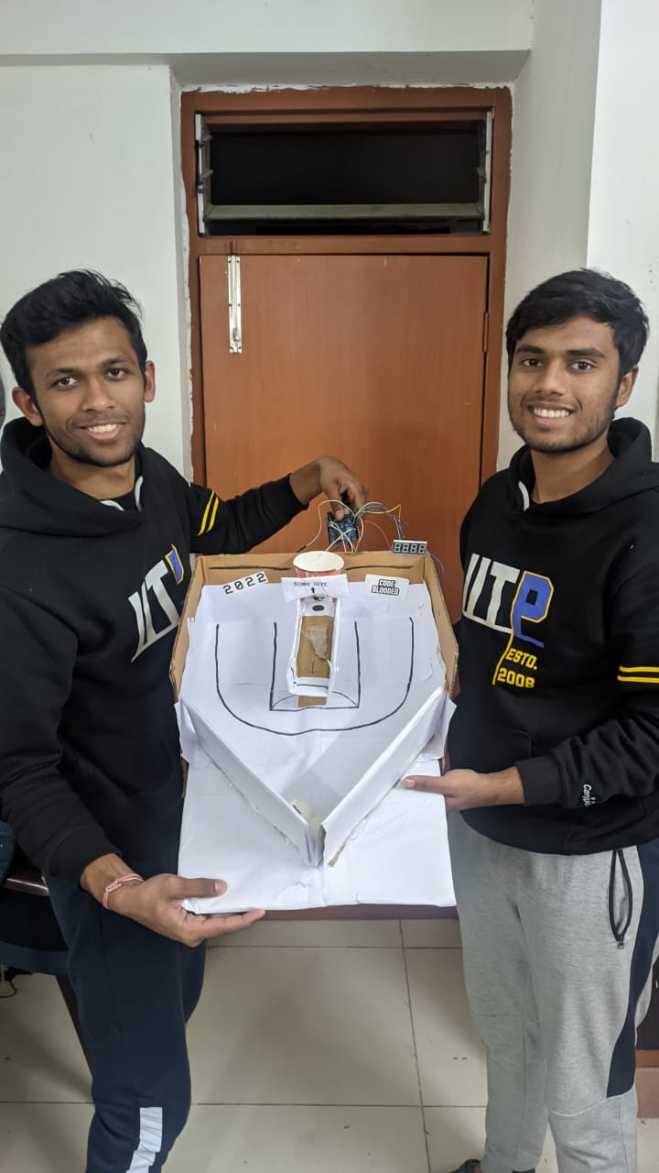
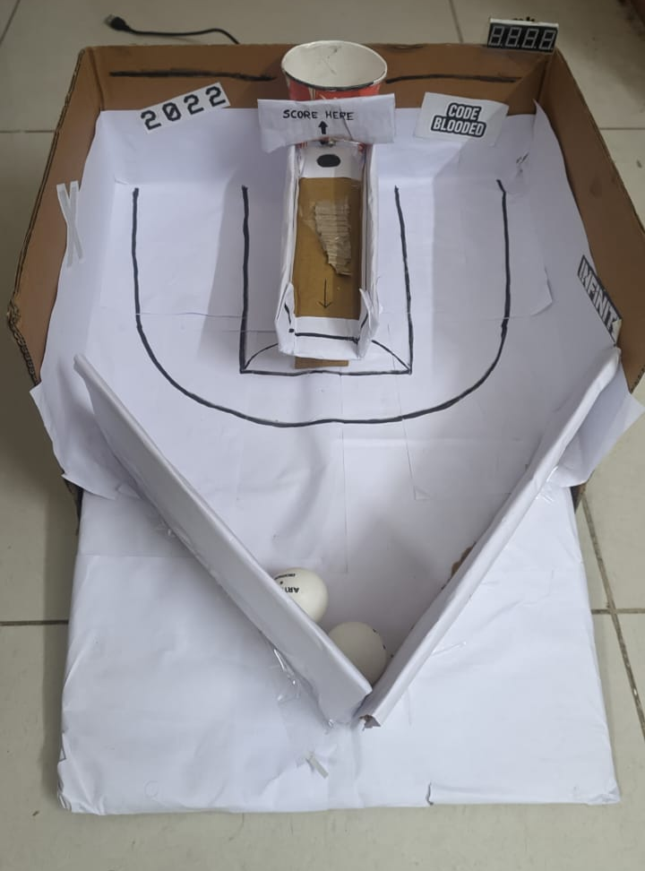
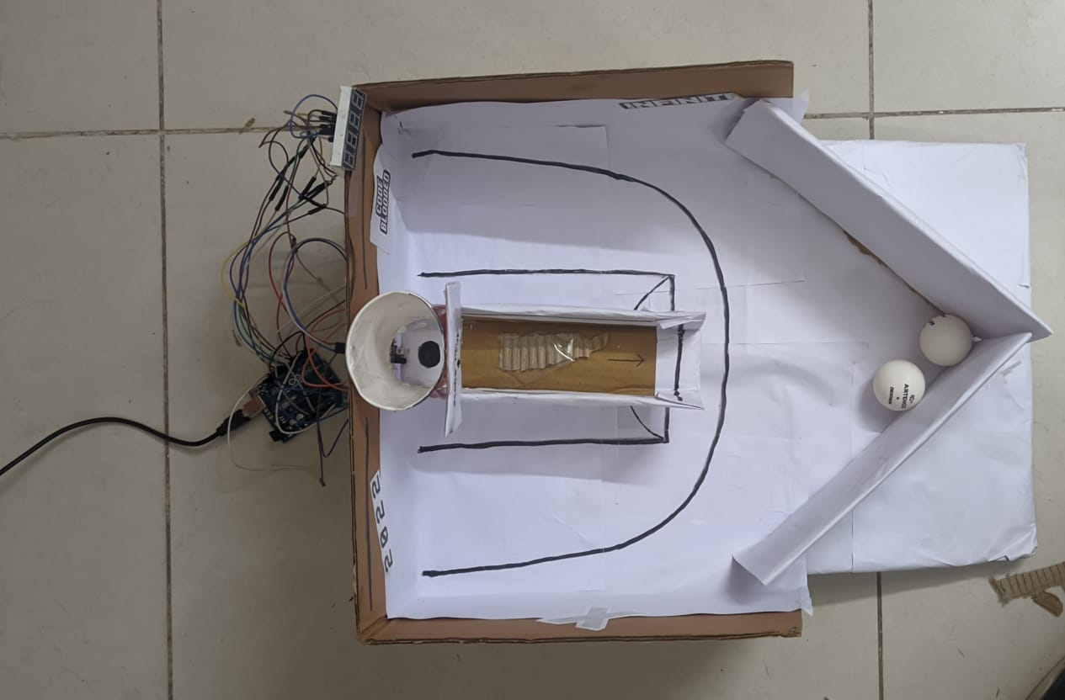

Slide 3
SUMMARY OF ARDUINO PROJECT
An arcade game made using Arduino Uno. The game is controlled through an app made using MIT AppInventor.
There are three game modes:
30 second game
60 second game
90 second game
Aim of the Game: Score as many baskets as possible

Slide 4
SUMMARY OF ARDUINO PROJECT(contd.)
The score is displayed through a 4-digit Seven Segment Display.
An IR Sensor is connected to the basket, so whenever you throw a ball, the score increases by 1 if it is a basket.
During our tests, we on average experienced a 90-95% accuracy in basket detections.
We ensured this by placing the IR in an optimal location, and ensuring that the ball does not go through the basket in such a way that the IR does not detect it.

Slide 5
COMPONENTS USED
Arduino Uno
IR Sensor ()
Bluetooth Module (HC-05)
Android Phone
Buzzer ()
4-Digit Seven Segment Display (5641AS)
Wires, Breadboard etc.
Software: MIT AppInventor and Arduino IDE

Slide 6
FLOW OF ARDUINO CODE
Check via Bluetooth (using check_start() function) if Start or Reset has been pressed on phone, or if game has ended
If start, game begins
If reset, reset all values
If the game has ended (phone has sent “game ended signal”), then stop increasing score.
start part of the above if condition checks if the IR Sensor has detected something. If it has, then increase the score by one and sound buzzer.
reset part resets the score count.
check_start() function receives value from phone via HC-05. It sends the received value to the main loop() function.

Slide 7
ARDUINO CODE

Slide 8
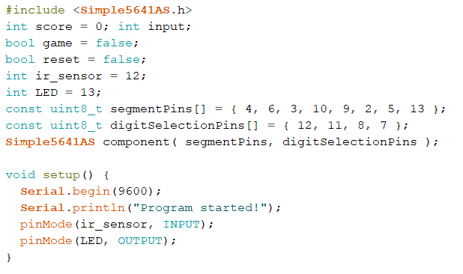
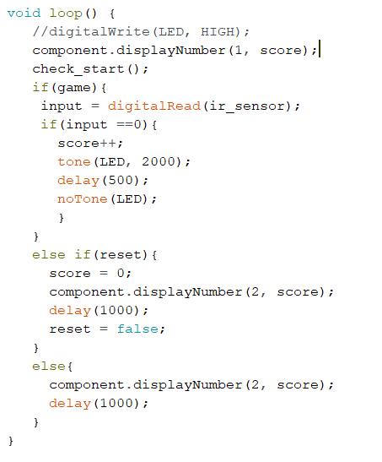
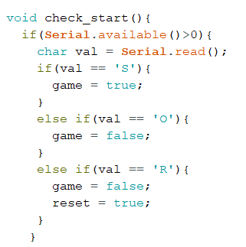

Slide 9
CODE FOR THE ANDROID APP

Slide 10
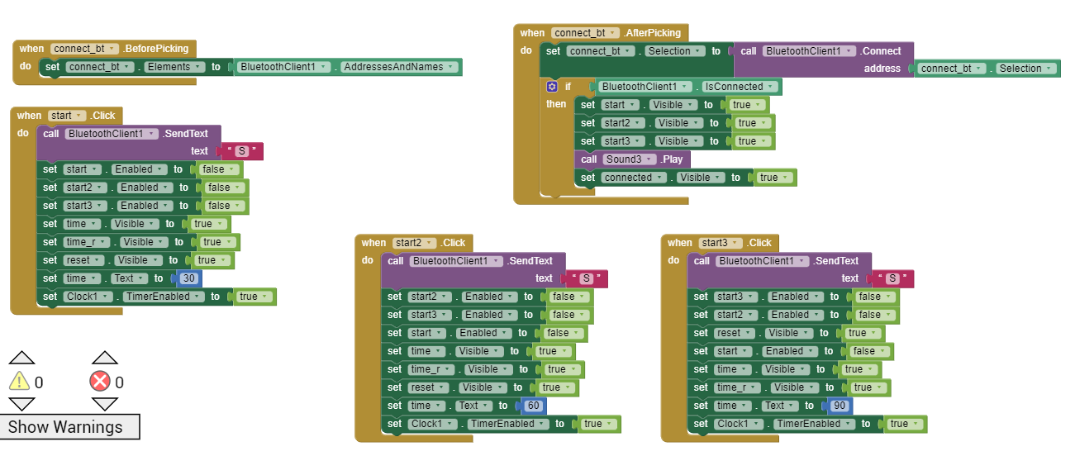

Slide 11
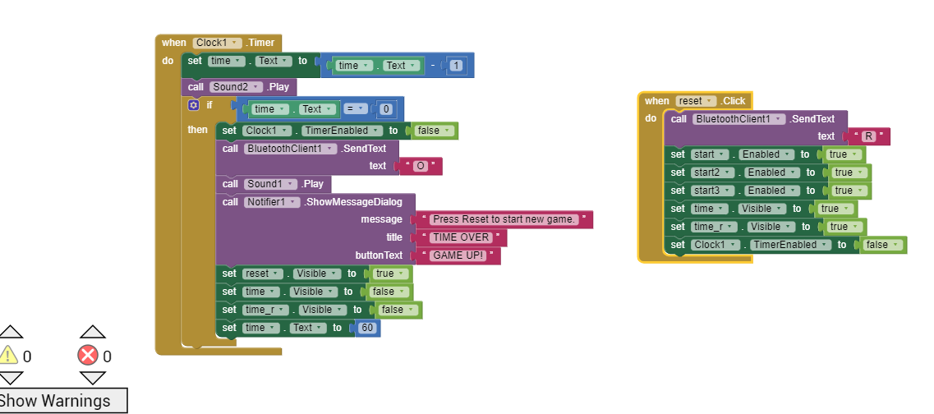

Slide 12
THANK YOU!

