Slide 1


Slide 2
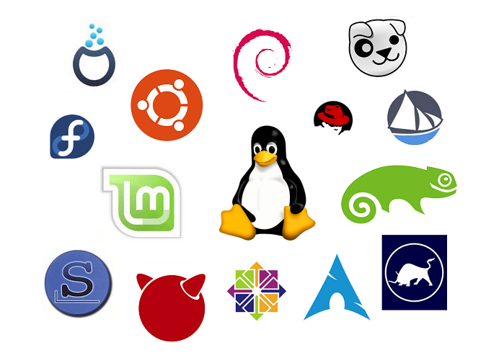
Debian
Ubuntu
Puppy
Fedora
LinuxMint
Open SuSE
ArchLinux
FreeBSD
Linux has many distributions

Slide 3
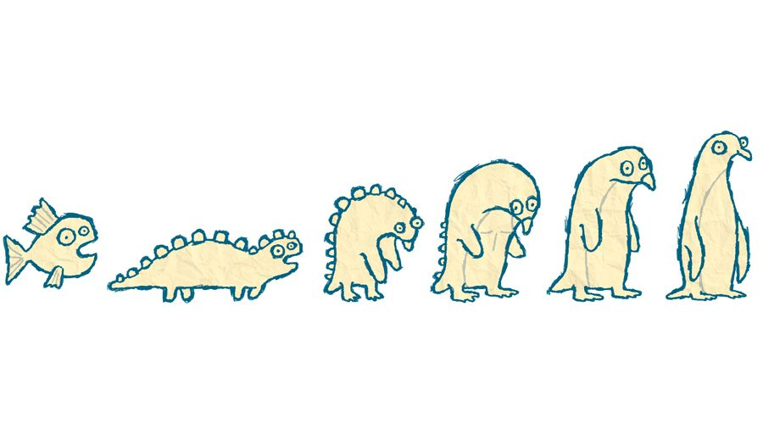
-
1969
-
1983
-
1991
Unix was at the very beginning,
and twenty-two years later Linux was created.

Slide 4
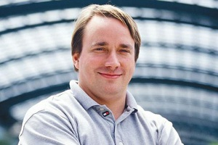
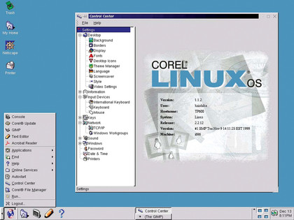
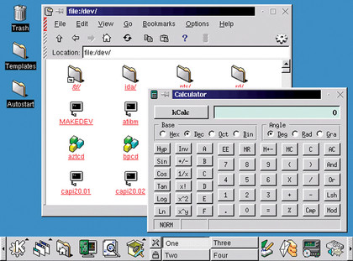
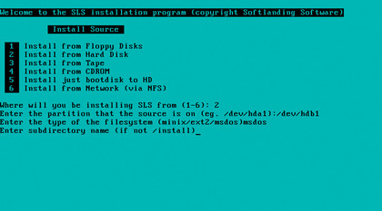
In 1991, Linus Torvalds, a Finnish student,
was extremely keen on writing an
Unix-compatible operating system kernel for his personal computer.
The prototype for the future kernel was the Minix operating system:
a Unix-compatible operating system for personal computers.

Slide 5
With Linux you can:
Compile your own kernel.
This allows you to use only those drivers and functions that you specifically need
The Linux operating system doesn’t have the layout of the hard drive volumes as it is done in Windows; instead,
different types of directories are used
Update and install Ubuntu Linux apps without an internet connection.

Slide 6
Any Linux user should have basic commands in the terminal for ease of operation.
Here is one example of its use:

