Slide 1

Image Compression using SVD
SUMANTH NR (MA20BTECH11016)
TAPISHI (MA20BTECH11017)
DEEPAK (MA20BTECH11019)

Slide 2

Need for Image Compression
In a variety of applications, we frequently need to send and store photographs.
The lower the image size, the lower the cost of transmission and storage.
As a result, we frequently need to use data compression techniques to reduce the amount of storage space taken up by the image.
Applying Singular Value Decomposition (SVD) to the image matrix is one such methods.

Slide 3

SVD for image compression
The digital image is delivered to SVD in this technique. The supplied digital image is refactored into three matrices by SVD.
Singular values are used to restructure the image, and the image is represented with a smaller set of values at the end of the process, resulting in a reduction in the amount of storage space required by the image.
The goal here is to compress the image while keeping the crucial characteristics that describe the original image.

Slide 4
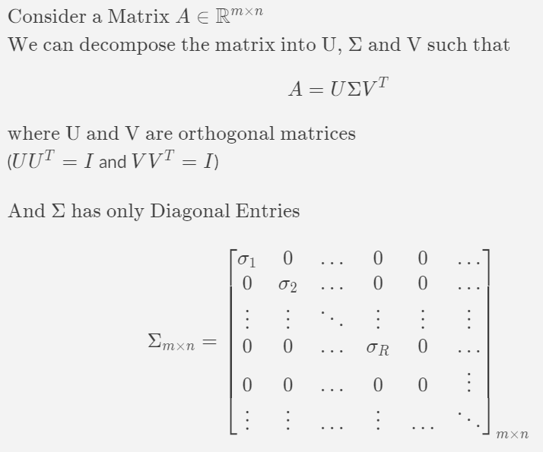
Singular Value Decomposition (SVD)

Slide 5
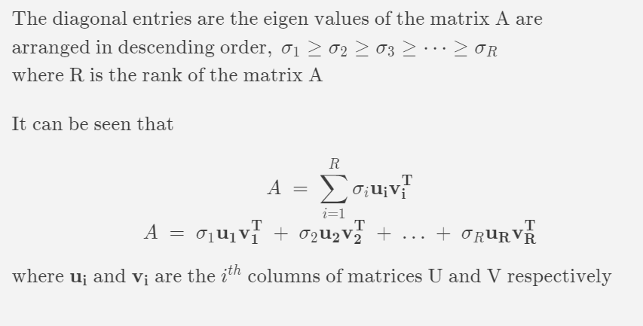
Singular Value Decomposition (SVD)

Slide 6
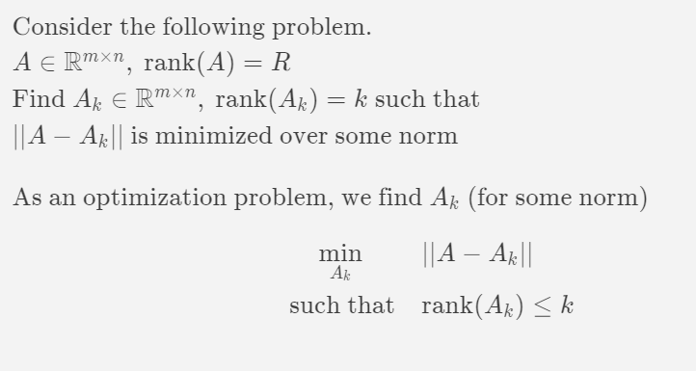
Low Rank Approximation

Slide 7
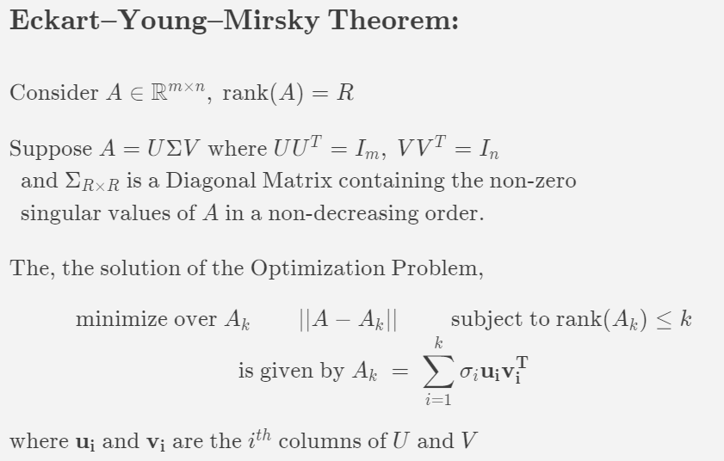
SVD as a low rank Approximation

Slide 8
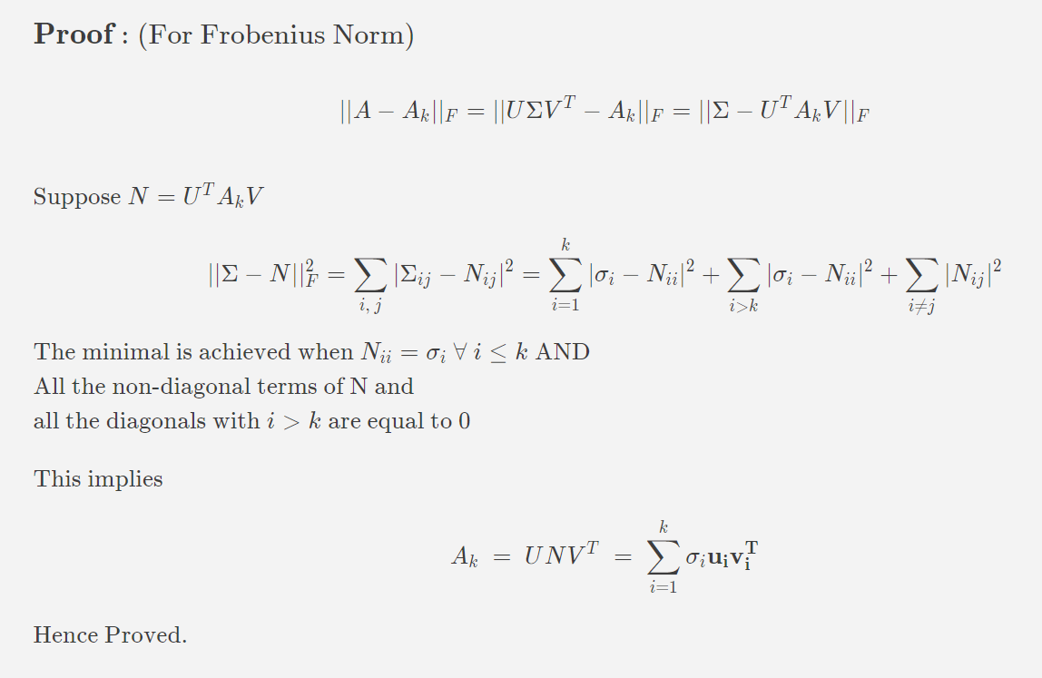
Proof For Frobenius Norm

Slide 9
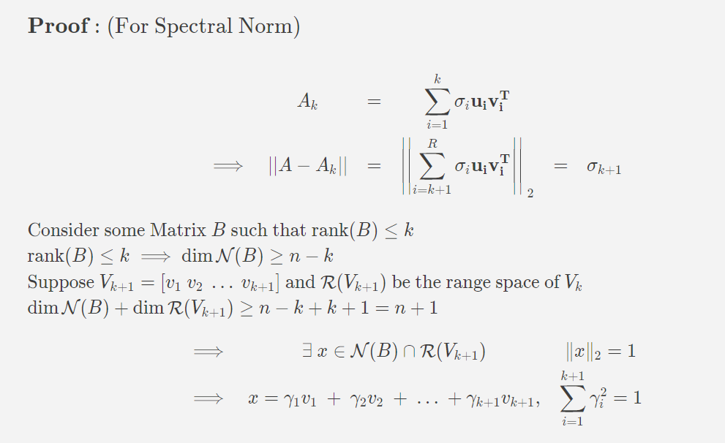
Proof for Spectral Norm

Slide 10
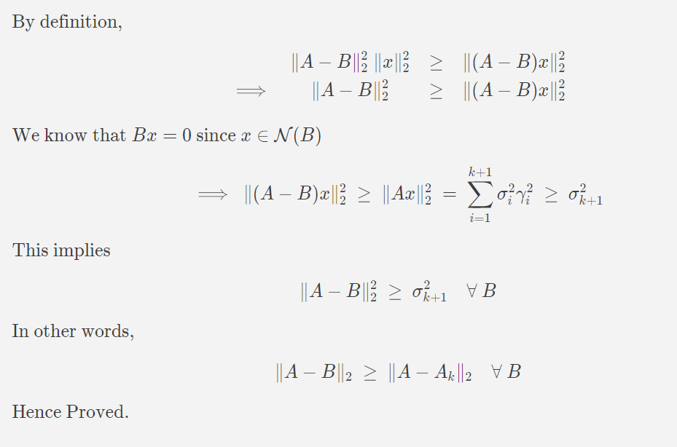
Proof for Spectral Norm

Slide 11
REFERENCES
Image compression using singular value decomposition
https://ieeexplore.ieee.org/stamp/stamp.jsp?tp=&arnumber=4426357
Applications of the SVD http://www.columbia.edu/itc/applied/e3101/SVD_applications.pdf

