Slide 1
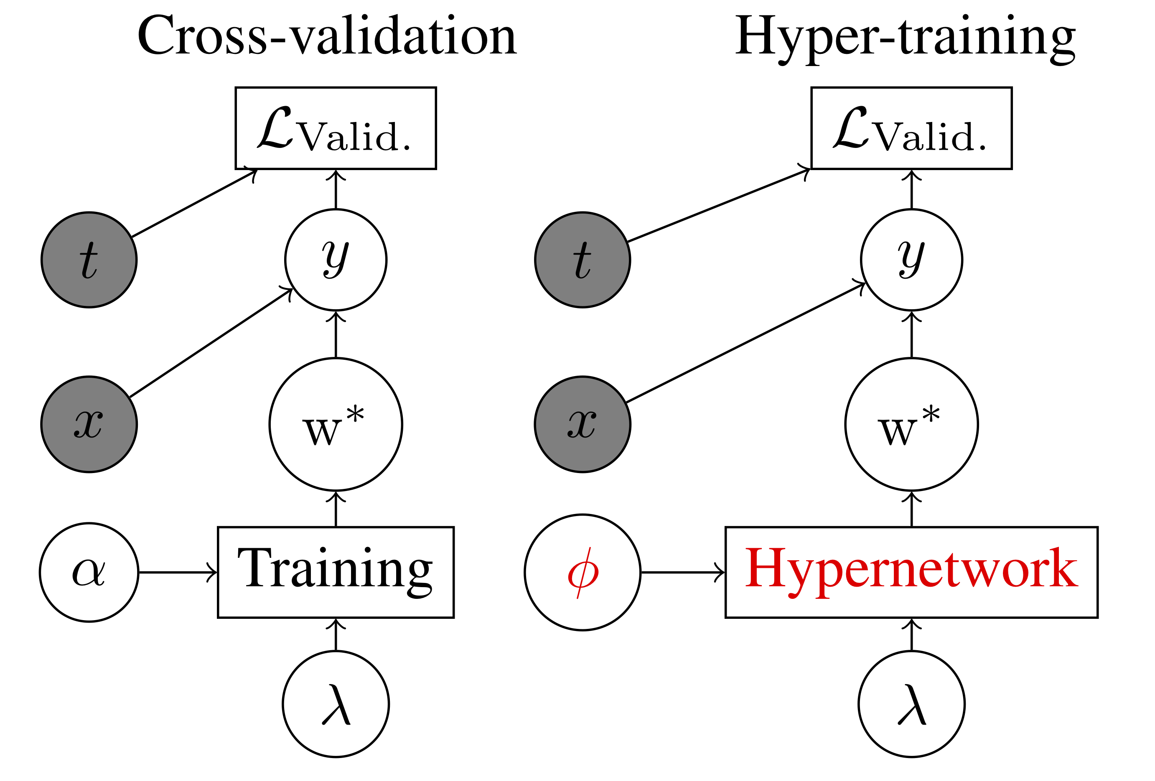
Stochastic Hyperparameter Optimization through Hypernetworks
Jonathan Lorraine
& David Duvenaud

Slide 2


Cross-valid as Bi-level Opt
Cross-validation nests optimization of network weights inside of optimization of hyperparameters.
Bi-level optimization is like a game with a leader and a follower player. Each has their own objective.
The followers best-responding strategy depends on the leaders strategy.

Slide 3
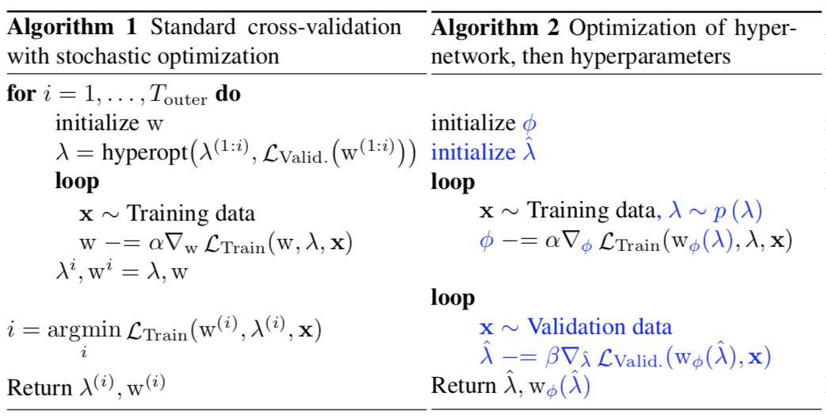

Global Optimization
Lets learn the best-response
function!
New gradient terms:

Slide 4
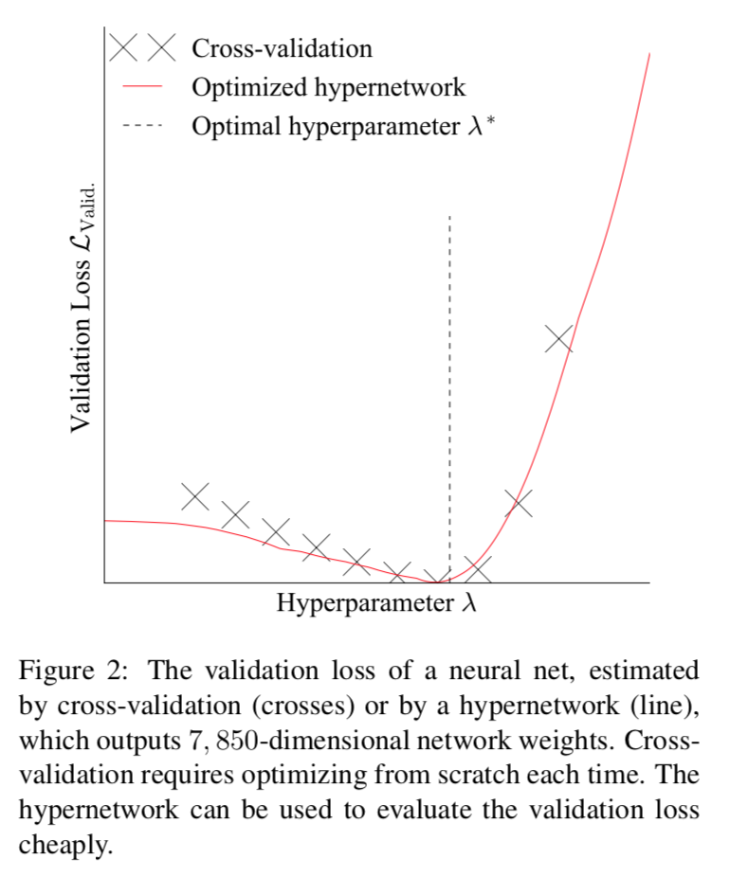

Slide 5
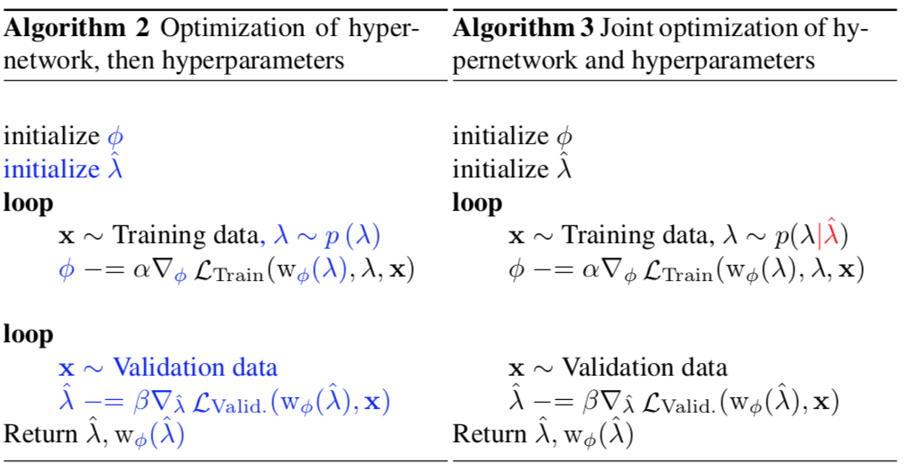
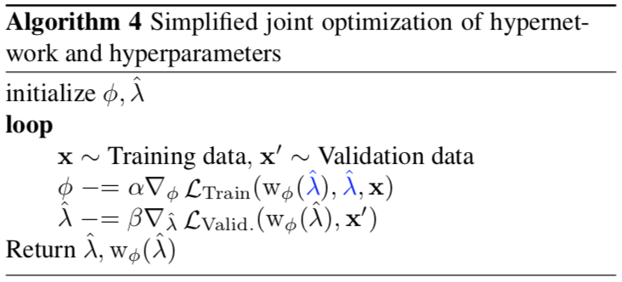
Local Optimization
Limited capacity hypernetwork in practice.
Learn the best-response in some small neighborhood about our current hyperparameter.

Slide 6
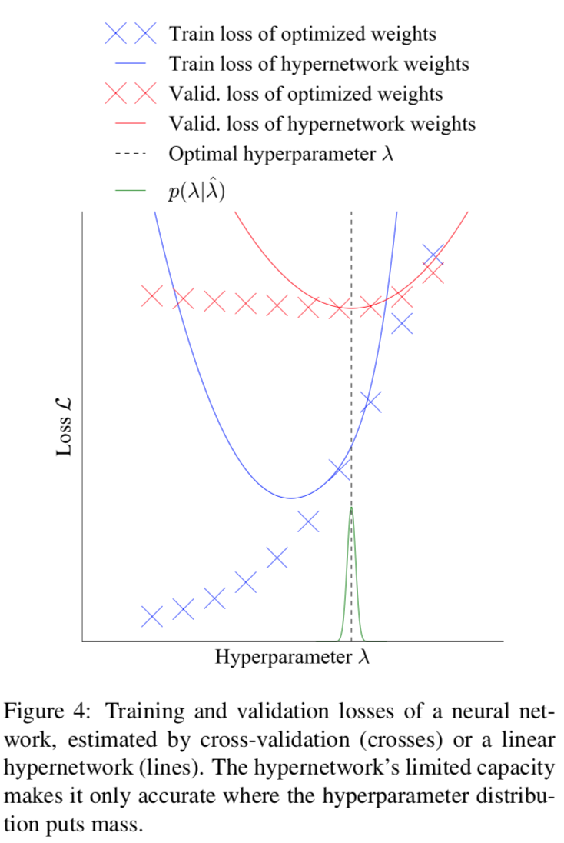

Slide 7
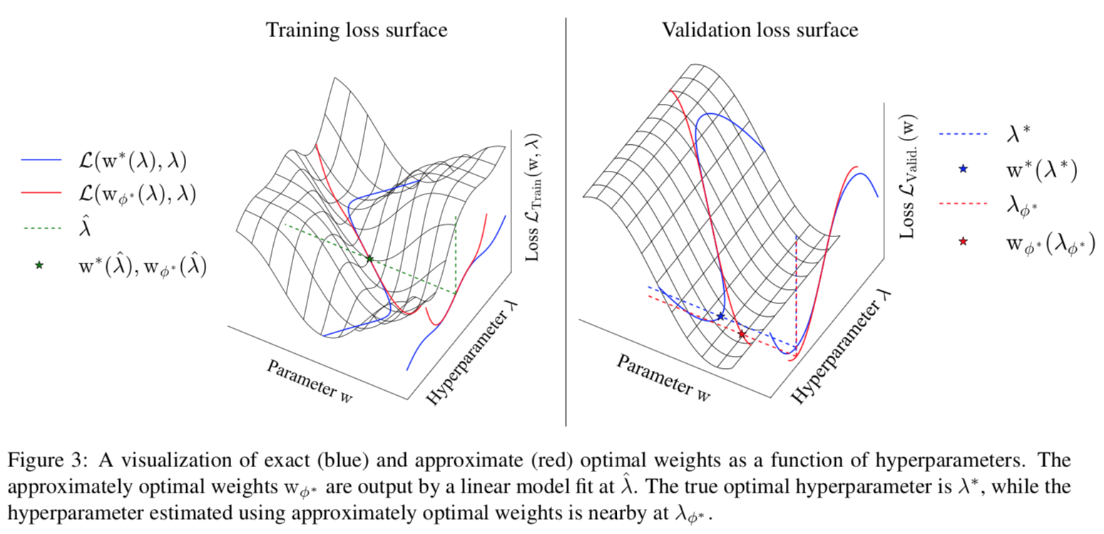
Visualization

Slide 8
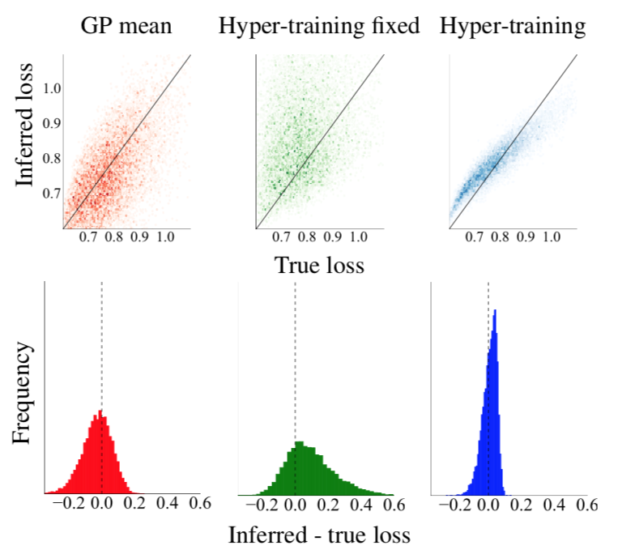
Other Experiments

Slide 9
Limitations
No inner optimization parameters can be tuned.
Hard to tune discrete hyperparameters with gradients.
No uncertainty based exploration.
Hard to choose the distribution of hyperparameters to train against.

Slide 10
Future Directions
Learning how the weights vary w.r.t. hyperparameters can be expensive - consider a net with 10,000,000 weights and 10 hyperparameters. Instead learn how the policy/predictions vary w.r.t hyperparameters.
This uses special structure found in prediction problems, not found in general bi-level optimizations.

