Slide 1
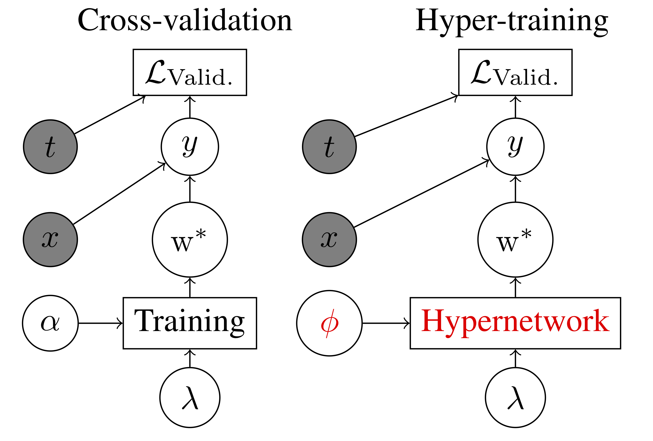
Stochastic Hyperparameter Optimization through Hypernetworks
Jonathan Lorraine
& David Duvenaud
University of Toronto
Notes:
We want our models to do well on unseen data. We replicate this process with cross-validation where we train on one subset and evaluate on another. Typically there are parameters which affect the generalization gap called hyperparameters. These are difficult to optimize because we must see how they affect the optimal weights through training.
High-level idea: Many problems involve training a model to learn a mapping on some labelled data set, and then applying that model on an unseen data set. Our real goal is performance on the unseen data set, but we are restricted to using the seen data set to learn.
Cross-validation helps us assess the generalization gap between trained data and new data by replicating the procedure of training on a subset and assessing performance on a data subset not seen during training.
There are often a number of variables – called hyperparameters – that we can modify to decrease the divergence between validation and training performance, likely at the cost of decreases training performance.
Hyperparameters are difficult to tune, because we must model how they affect the optimal set of weights for our model. We propose to model this relationship with a neural network.

Slide 2


Cross-validation as Bilevel Optimization
Cross-validation nests optimization of network weights inside of optimization of hyperparameters.
Bi-level optimization is a game with a leading player and a following player. Each has their own objective.
The followers best-responding strategy depends on the leaders strategy.
Notes:
Bilevel optimization is a fairly general class of problems, that are often difficult to solve. I like to think of them as a game between a leader and a follower. For example, a GAN where L_v = L_t = V.
The argmin_w(…) is a function of the hyperparameters, denoted the best-response function in the context of game-theory. If we can differentiate through L_v and the best-response, then we could do gradient descent on the hyperparameters.
Best-response functions are common for solutions in game theory. Here bi-level optimizations correspond to stackelberg competitions, but best-response functions are usefull in basically any game. Some examples include cooperative/non-cooperative games, symmetric/asymmetric games (ex. soccer vs ), zero-sum/non-zero-sum games (chess or war), simultaneous/sequential games, perfect information/imperfect information, discrete/continuous games, many-player games, or meta-games like mechanism design. Partially observed stochastic games are one of the most general.

Slide 3
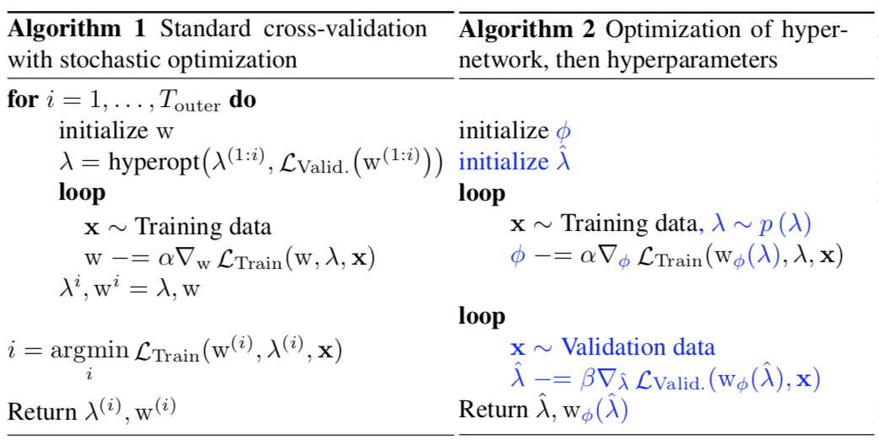

Global Optimization
Lets learn the best-response
function and amortize
optimization!
New gradient terms:
Notes:
Lets learn the best-response function! We will save effort by amortizing the optimization, which means trying to share work between the different optimizations. It would be best if we could simultaneously solve all points we are interested in, maximally sharing effort between searches.
We do this by sampling hyperparameters and training a neural network to output optimal weights.

Slide 4
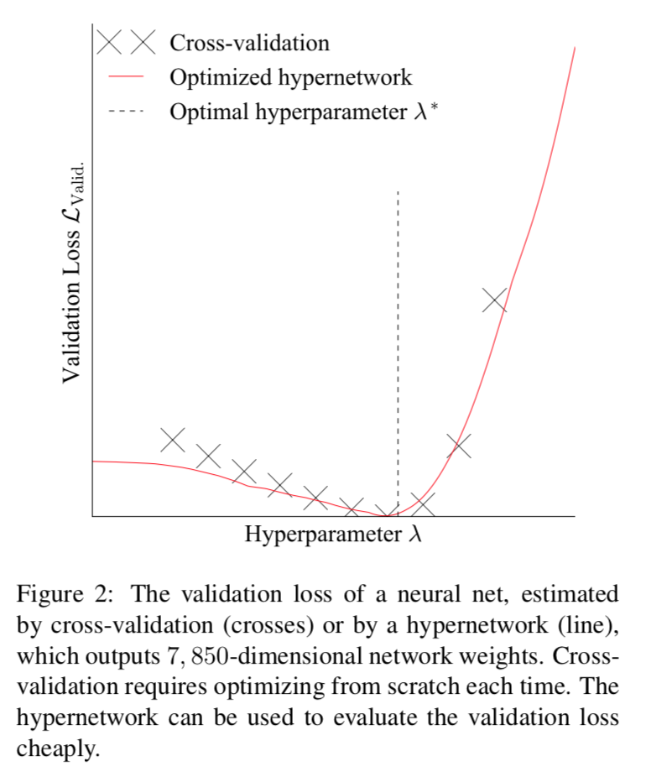

Slide 5
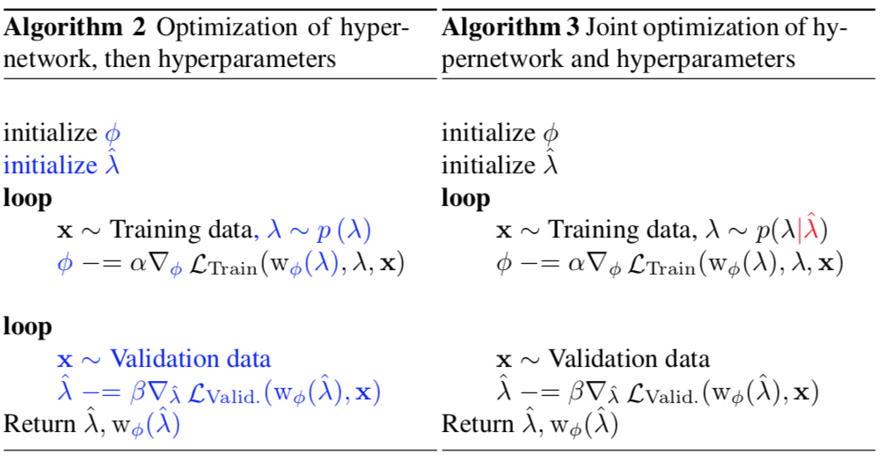
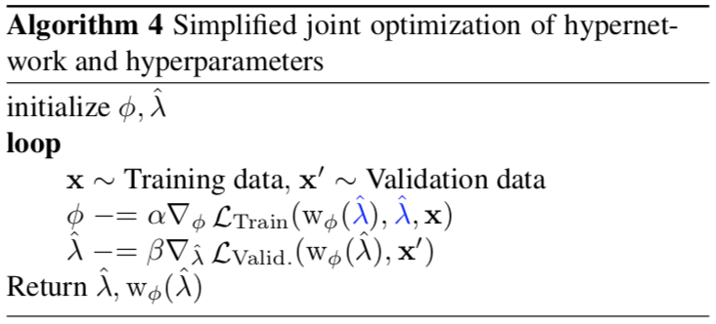
Local Optimization
Limited capacity hypernetwork in practice.
Learn the best-response in some small neighborhood about our current hyperparameter.
Notes:
It can be difficult to learn the best-response everywhere. Imagine we have a limited capacity network.
Also, it can be incredibly wasteful. We only have to learn it in in some neighborhood along our gradient descent path to a local optima.
Lets introduce a “current hyperparameters selection” and conditional training distribution. The current hyperparameter represents where we are in our search, and the conditional training distribution is some small neighborhood around our current hyperparameter. Maybe a very tight Gaussian.
Thus, we hope to learn a local approximation to the best-response, take a small step, then re-update the local approximation. <JUMP TO NEXT PAGE THEN JUMP BACK>
The conditional training distribution is hard to choose, especially in high dimensions. In practice, it was sufficient to just use the updates as noise, but this has no guarantees.

Slide 6
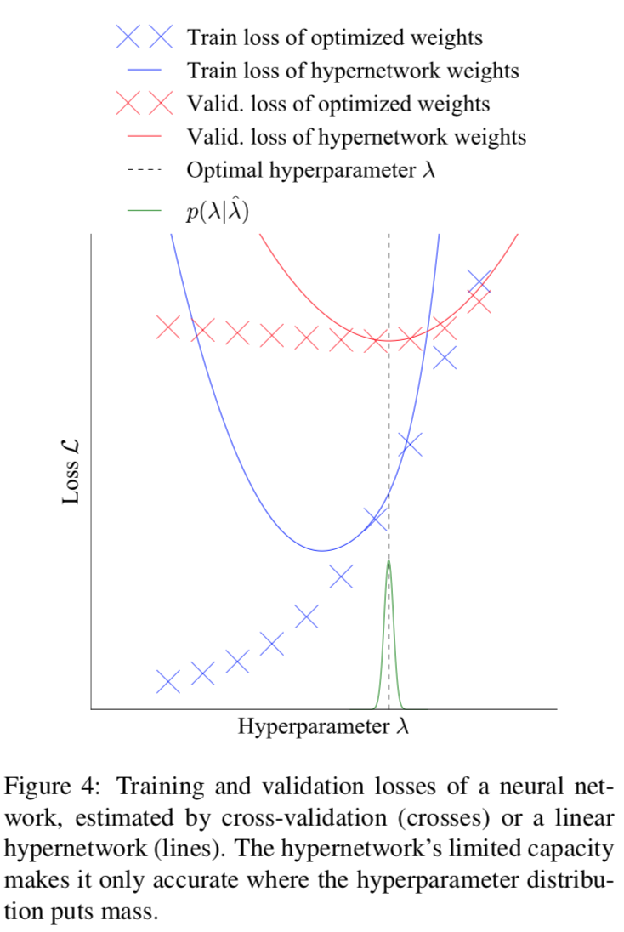
Global:
Local:

Slide 7
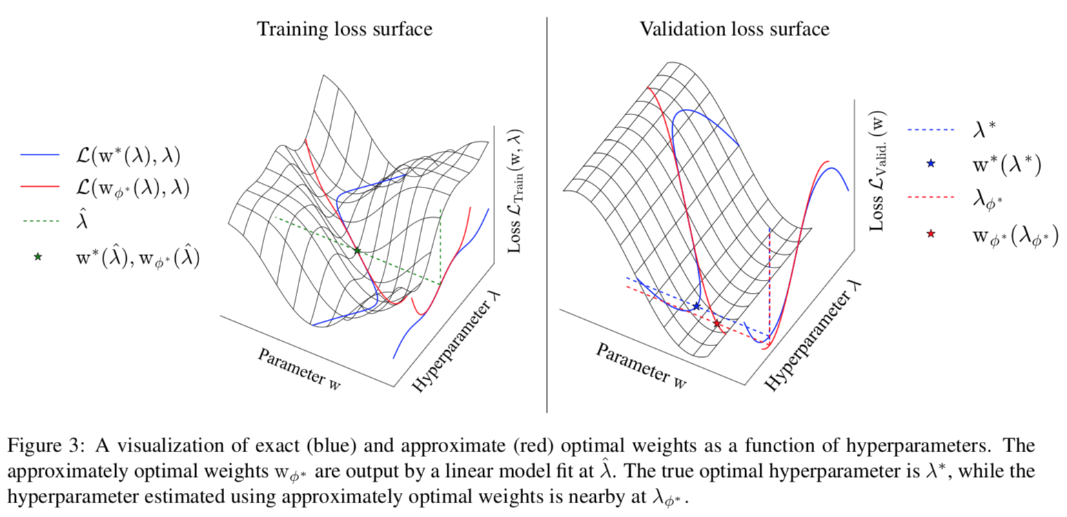
Visualization

Slide 8
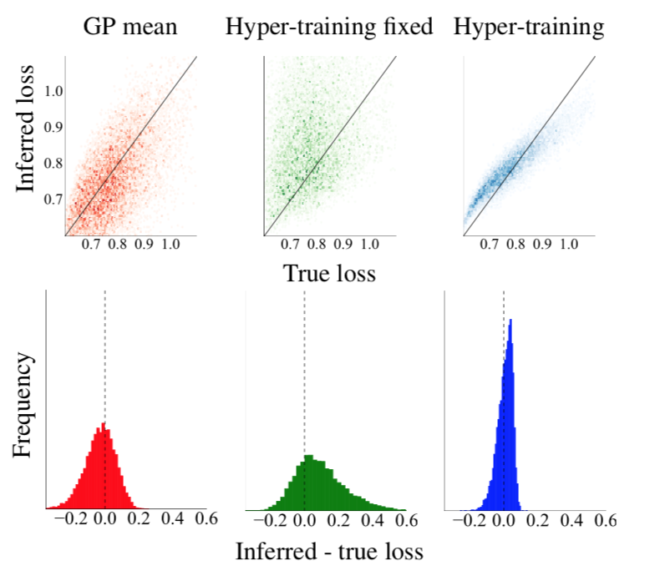
Other Experiments
Idea: Hyper-training is effective because it partially optimizes across many hyperparameters.

Slide 9
Limitations
No inner optimization parameters can be tuned.
Hard to tune discrete hyperparameters with gradients.
No uncertainty based exploration.
Hard to choose the distribution of hyperparameters to train against.
Potentially more expensive training iterations.

Slide 10


Future Directions
Learning how the weights vary w.r.t. hyperparameters can be expensive - consider a net with 10,000,000 weights and 10 hyperparameters. Instead learn how the policy/predictions vary w.r.t hyperparameters.
Try optimizing other hyperparameters
Notes:
Note that this uses special structure found in prediction functions, and that the weights are just some arbitrary parametrization anyways.

Slide 11
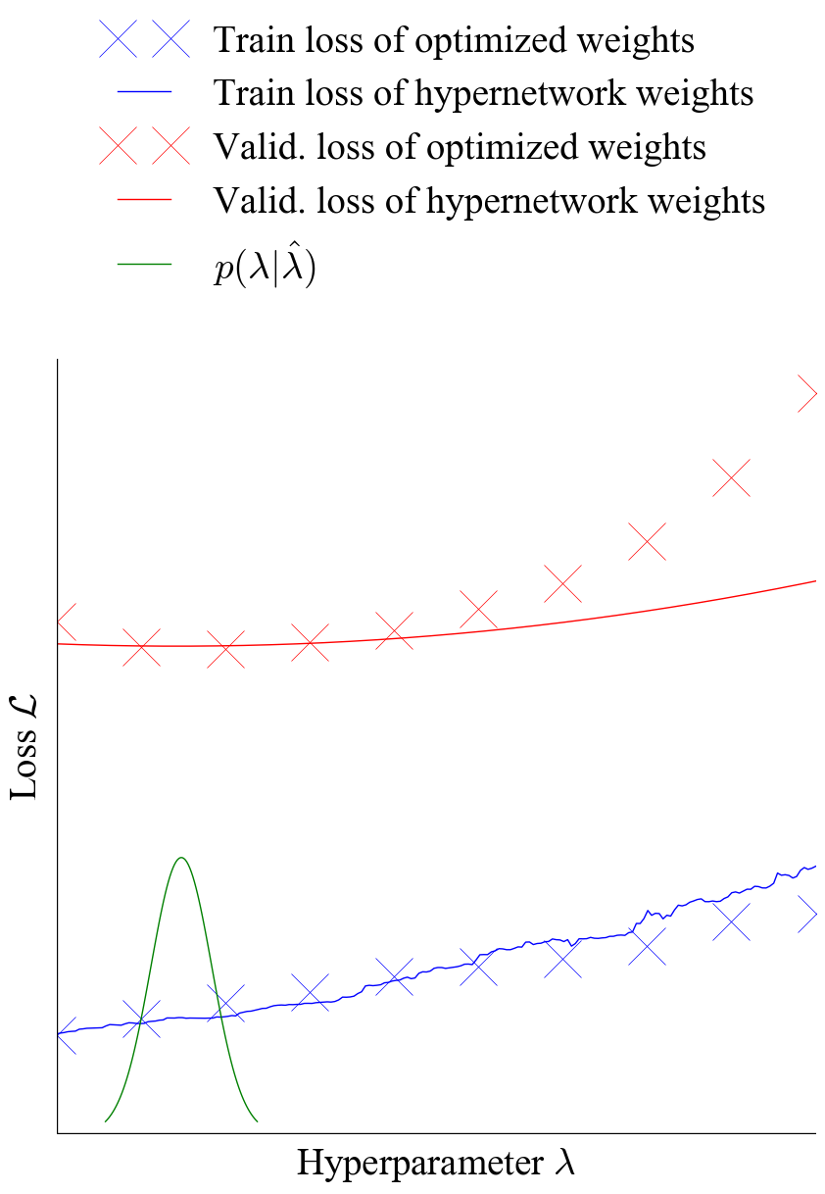
Optimizing weight dropout on
MNIST.

Slide 12
Related Work
Brock, Andrew, Lim, Theodore, Ritchie, JM, and Weston, Nick. Smash: One-shot model architecture search through hypernetworks. arXiv:1708.05344, 2017.

