Slide 1
CIS 554 OOP Board Game
Xin Liu

Slide 2
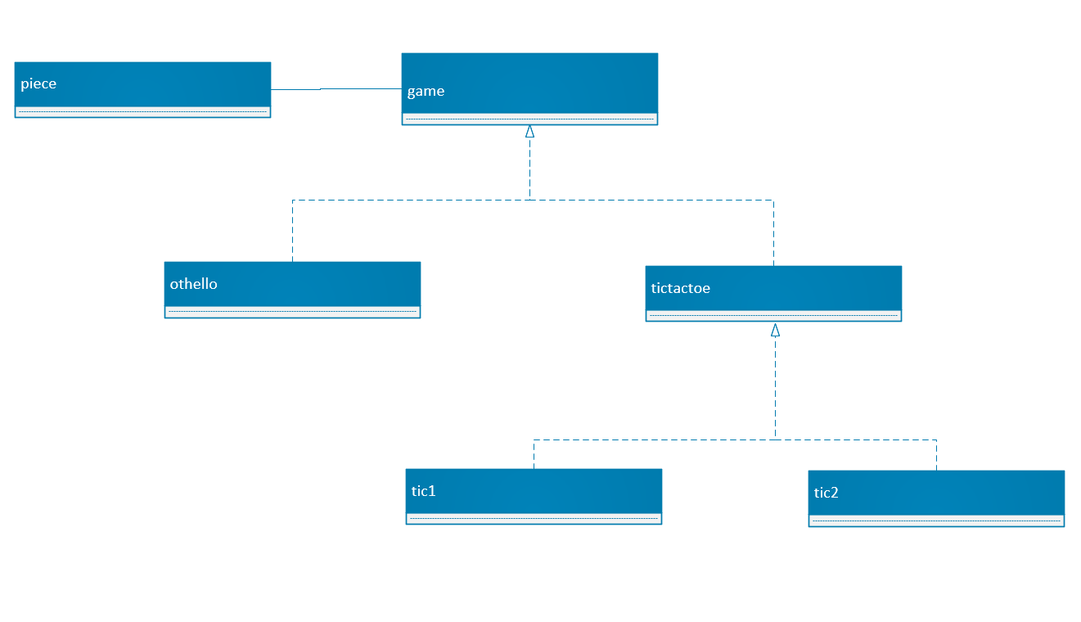
class diagram

Slide 3
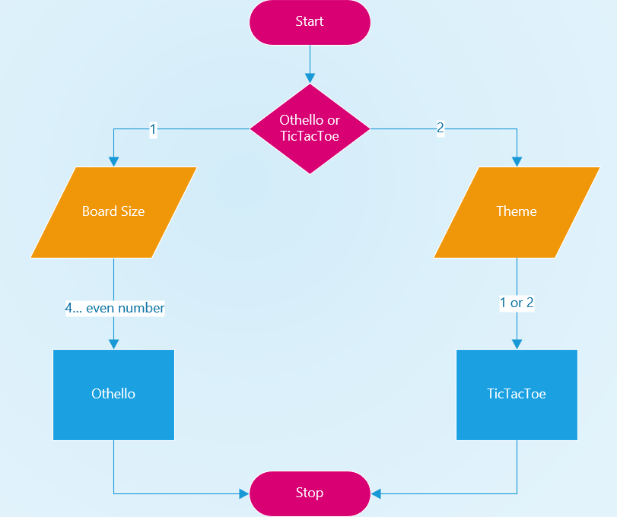
Flow Chart

Slide 4
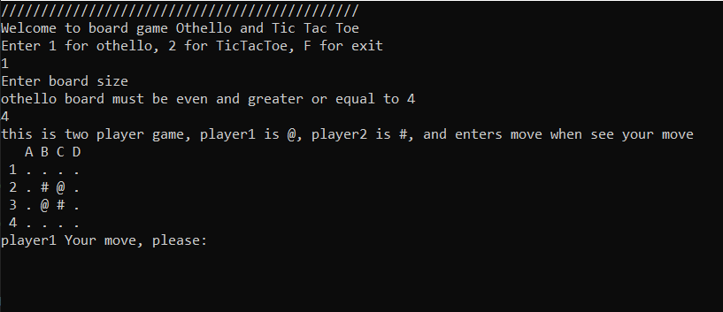
Demo

Slide 5
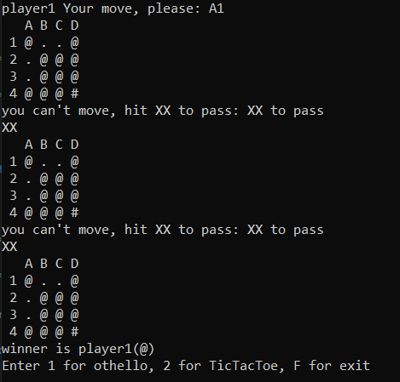
Demo

Slide 6
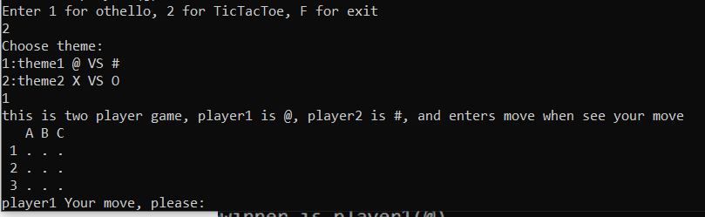
Demo

Slide 7
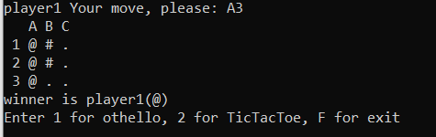
Demo

Slide 8
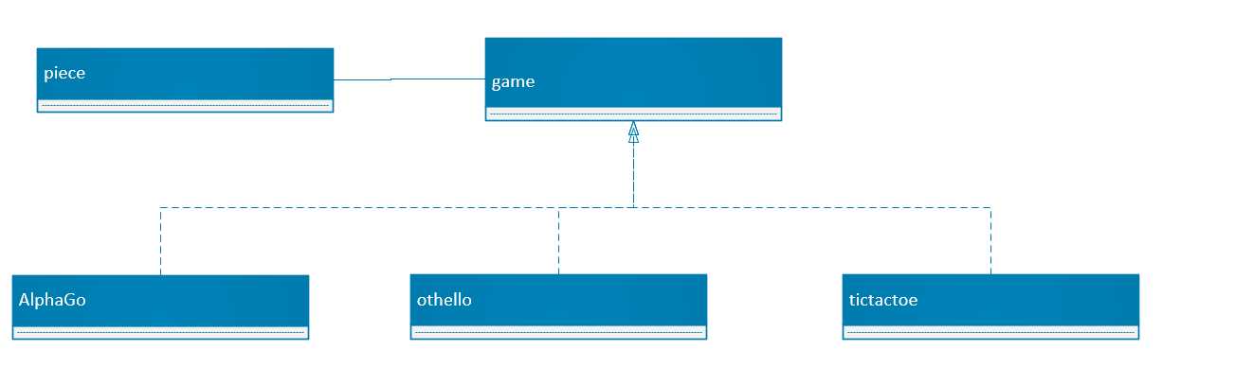
Suggestion for other child class

Slide 9
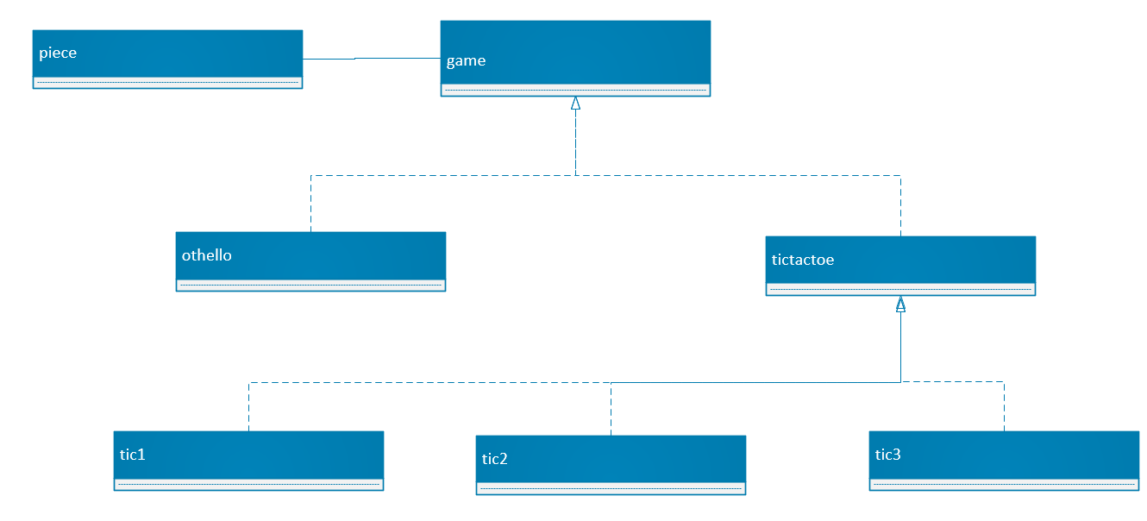
Suggestion for other child class

