Slide 1
Matlab Implementation of
Horn and Schunk Algorithm
Pi-Feng Chiu
Ying Qiao
10/18/2012

Slide 2
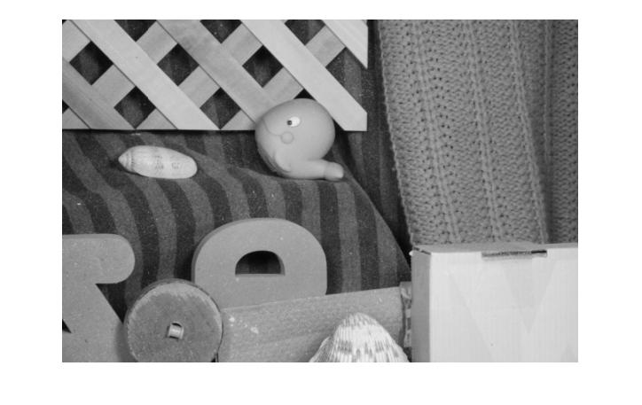
2nd frame

Slide 3
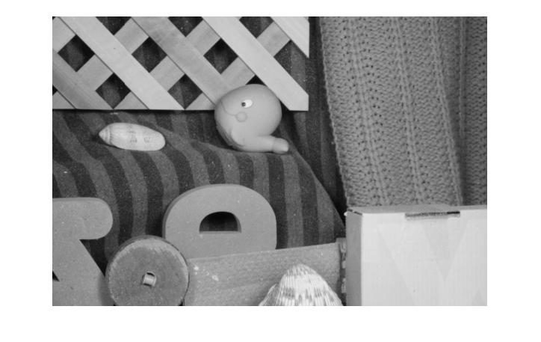
1st frame

Slide 4
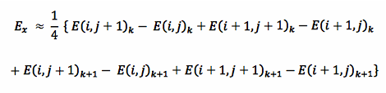
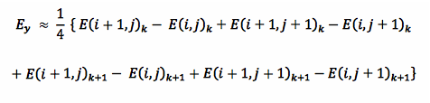
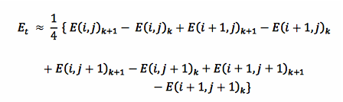
Gradient calculation

Slide 5
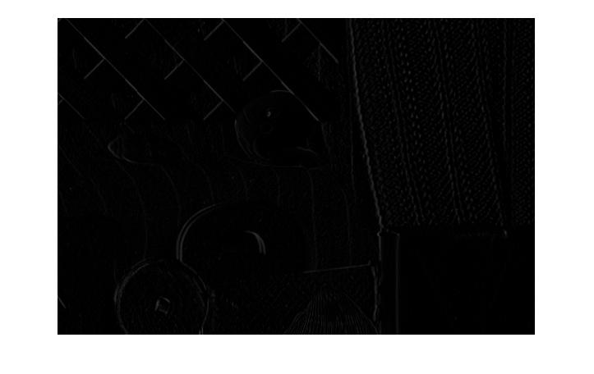
Ex

Slide 6
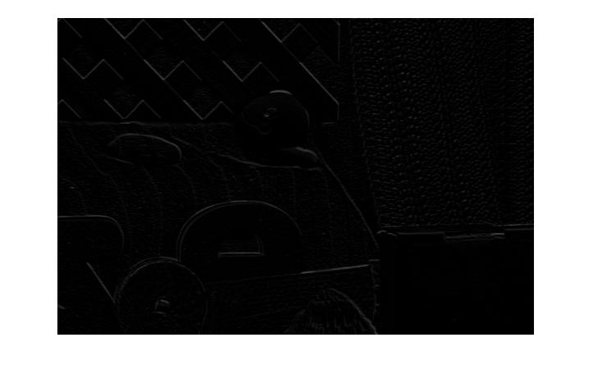
Ey

Slide 7
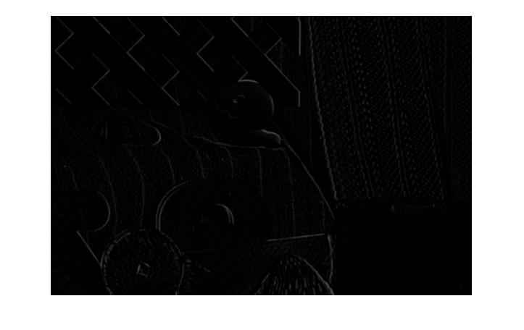
Et

Slide 8
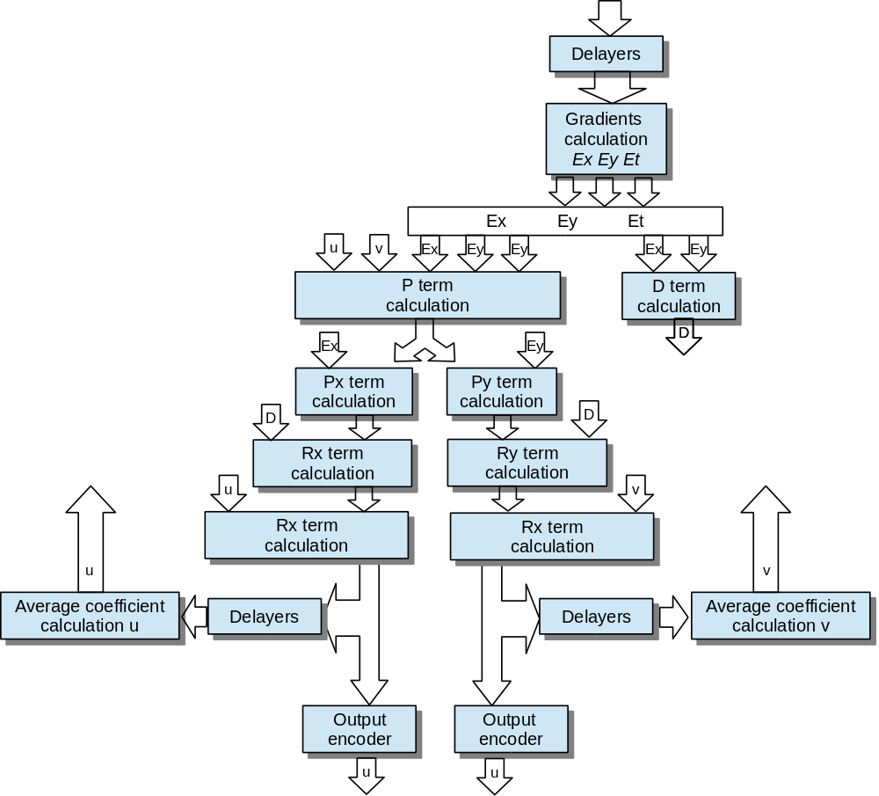

Slide 9
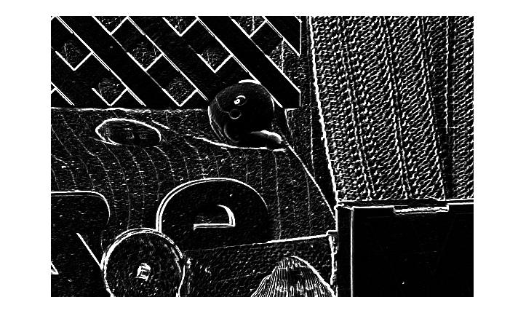
D term
$D=α^{2}+{E_{x}}^{2}+{E_{y}}^{2}$

Slide 10

P term
$P≡\left(E_{x}\bar{u}+E_{y}\bar{v}+E_{t}\right)$

Slide 12
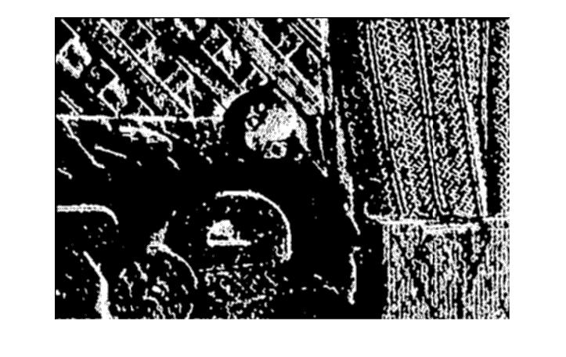
Average u
${\bar{u}}_{i,j}=\frac{1}{6}\left(u_{i−1,j}+u_{i,j+1}+u_{i+1,j}+u_{i,j−1}\right)+\frac{1}{12}\left(u_{i−1,j−1}+u_{i−1,j+1}+u_{i+1,j+1}+u_{i+1,j−1}\right)$

Slide 13
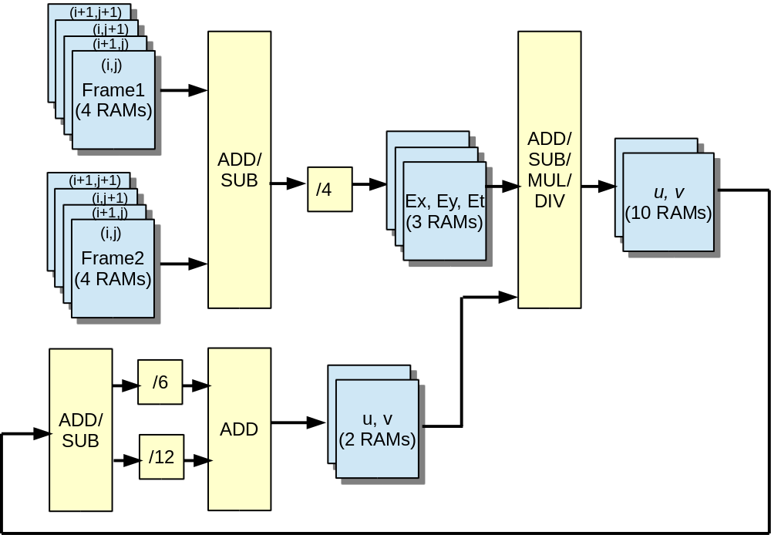
Iteration=8
Initial u,v=ones

Slide 14
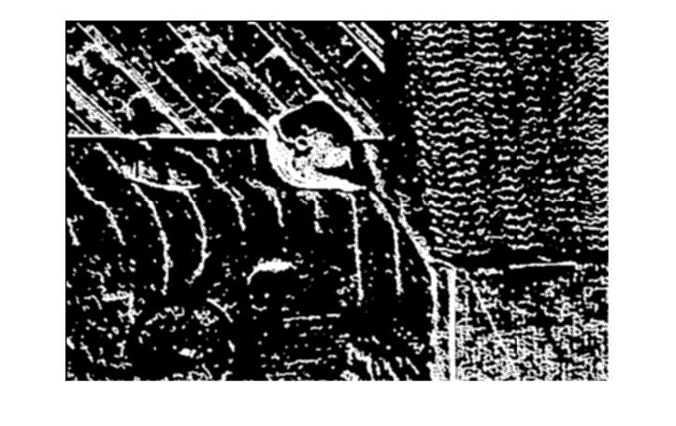
Average v
${\bar{v}}_{i,j}=\frac{1}{12}\left(v_{i−1,j}+v_{i,j+1}+v_{i+1,j}+v_{i,j−1}\right)+\frac{1}{12}\left(v_{i−1,j−1}+v_{i−1,j+1}+v_{i+1,j+1}+v_{i+1,j−1}\right)$

Slide 15
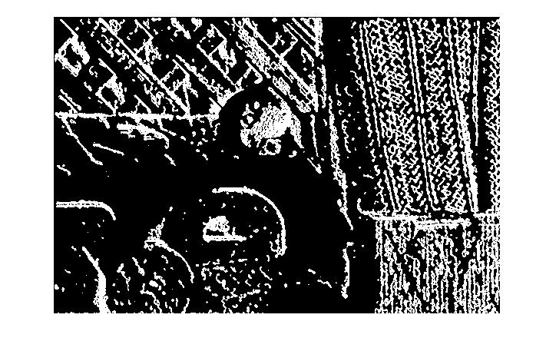
u
$u=\bar{u}−R_{x}=\bar{u}−\frac{P_{x}}{D},whereP_{x}=E_{x}P,D=α^{2}+{E_{x}}^{2}+{E_{y}}^{2}$

Slide 16
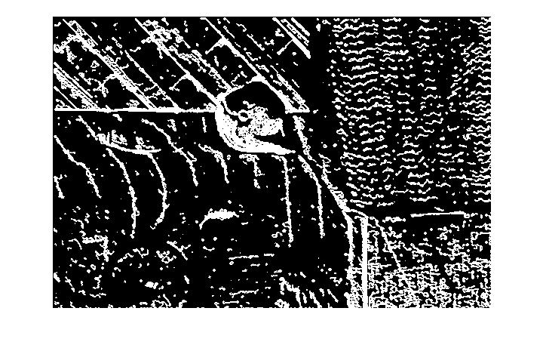
v
$v=\bar{v}−R_{y}=\bar{v}−\frac{P_{y}}{D},whereP_{y}=E_{y}P,P≡\left(E_{x}\bar{u}+E_{y}\bar{v}+E_{t}\right)$

Slide 17
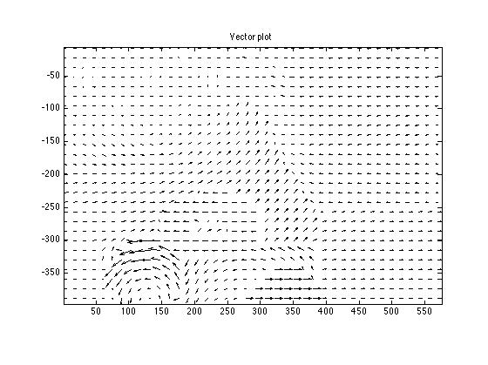
Result from sample code

Slide 18
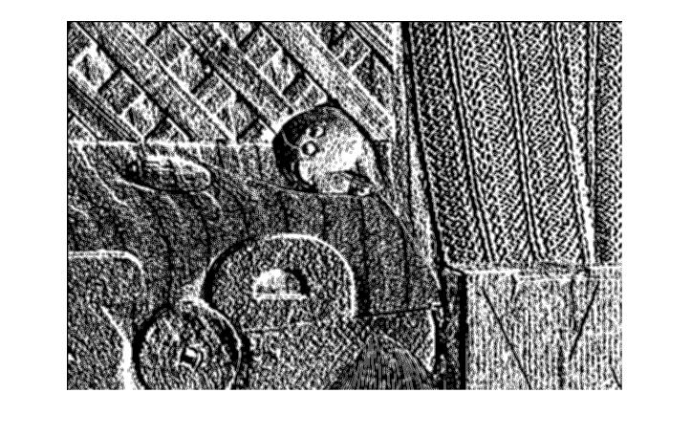
Average u @iteration=2

Slide 19
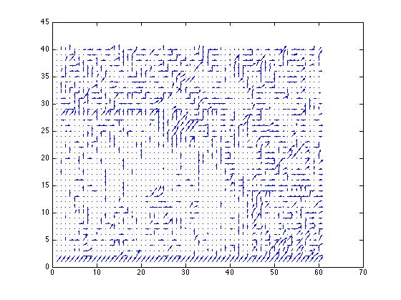
Result

