Slide 1

ASIC Imlementation of
Horn & Schunck Optical Flow Algorithm
Progress Report 1
Pi-Feng Chiu
Ying Qiao
Notes:
Hi everyone, I'm Pi-Feng and this is Ying. Our project topic is about the implementation of HS optical flow algorithm.
Same as the other team focusing on LK algorithm, our objective is to determine apparent velocities of brightness patterns in an image.

Slide 2
Outline
H&S Optical Flow Algorithm
Flow chart
Matlab implementation
Hardware Block Diagram
Design Space Exploration
Next step
Notes:
First, We'll go through our targeted algorithm in more detail
And then show some progress in matlab codes based on this algorithm.
After that, we'll move on to the hardware implementation plan and the design space exploration.

Slide 3
H&S Optical Flow Algorithm
1) Assumes smoothness in the flow over the whole image
$E\left(x,y,t\right)$
$\frac{dE}{dt}=0$
$\frac{∂E}{∂x}\frac{dx}{dt}+\frac{∂E}{∂y}\frac{dy}{dt}+\frac{∂E}{∂t}=0$
$E_{x}u+E_{y}v+E_{t}=0$
Notes:
One main idea of horn and schunk algorithm is that it assumes that the apparent velocity of the brightness pattern varies smoothly almost everywhere in the image.
So now, we define the image brightness at point (x,y) at time t as E(x,y,t)
And due to the assumption, the brightness of a particular point in the pattern is constant, dE dt would equal to zero.
Then using chain rule to expand the equation, we can get an equation of partial derivative of brightness in x,y,t direction, and also u and v vector.

Slide 4
H&S Optical Flow Algorithm
2) Neighboring points on the objects have similar velocities
$∇^{2}u=\frac{∂^{2}u}{∂^{2}x}+\frac{∂^{2}u}{∂^{2}y}$
$∇^{2}v=\frac{∂^{2}v}{∂^{2}x}+\frac{∂^{2}v}{∂^{2}y}$
Approximation of the Laplacians of u and v
$∇^{2}u≈κ\left({\bar{u}}_{i,j,k}−u_{i,j,k}\right)$
$∇^{2}v≈κ\left({\bar{v}}_{i,j,k}−v_{i,j,k}\right)$
Notes:
Another assumption is that neighboring points on the objects have similar velocities that limits the difference between the flow velocity at a point and the average velocity over a samll neighborhood containing the point
we can equivalently express the velocity difference using Laplacians of the x and y components of the flow
And we can approximate the laplacians of u and v in the form of the average flow velocity and the velocity at the point

Slide 5
H&S Optical Flow Algorithm
3) Minimize the sum of the errors in the equation for the rate of change of image brightness
$ε_{b}=E_{x}u+E_{y}v+E_{t}$
$ε_{c}^{2}={\left(\bar{u}−u\right)}^{2}+{\left(\bar{v}−v\right)}^{2}$
$ε^{2}=a^{2}ε_{c}^{2}+ε_{b}^{2}$
Set two derivatives equal to zero
leads to two equations in u and v
$\left(a^{2}+E_{x}^{2}+E_{y}^{2}\right)\left(u−\bar{u}\right)=−E_{x}\left[E_{x}\bar{u}+E_{y}\bar{v}+E_{t}\right]$
$\left(a^{2}+E_{x}^{2}+E_{y}^{2}\right)\left(v−\bar{v}\right)=−E_{x}\left[E_{x}\bar{u}+E_{y}\bar{v}+E_{t}\right]$
Notes:
The problem then is to minimize the sum of the errors in the equation for the rate of change of image brightness.
To minimize the error term, take differentiation of the total error term by u and v. and set these two derivatives equal to zero.
Finally, we can get the equations to solve u and v

Slide 6
Estimation of partial derivatives and local averages of u, v
E_{x} ≈ { E_{i,j+1,k} – E_{i,j,k} + E_{i+1,j+1,k} – E_{i+1,j,k}+ E_{i,j+1,k+1} – E_{i,j,k+1} + E_{i+1,j+1,k+1} – E_{i+1,j,k+1} }/4
E_{y} ≈ { E_{i+1,j,k} – E_{i,j,k} + E_{i+1,j+1,k} – E_{i,j+1,k}+ E_{i+1,j,k+1} – E_{i,j,k+1} + E_{i+1,j+1,k+1} – E_{i,j+1,k+1} }/4
E_{t} ≈ { E_{i,j,k+1} – E_{i,j,k} + E_{i+1,j,k+1} – E_{i+1,j,k}+ E_{i,j+1,k+1} – E_{i,j+1,k} + E_{i+1,j+1,k+1} – E_{i+1,j+1,k} }/4
u_{i,j,k}={u_{i-1,j,k} + u_{i,j+1,k} + u_{i+1,j,k} + u_{i,j-1,k} }/6
+{u_{i-1,j-1,k} + u_{i-1,j+1,k} + u_{i+1,j+1,k} + u_{i+1,j-1,k} }/12
v_{i,j,k}={v_{i-1,j,k} + v_{i,j+1,k} + v_{i+1,j,k} + v_{i,j-1,k} }/6
+{v_{i-1,j-1,k} + v_{i-1,j+1,k} + v_{i+1,j+1,k} + v_{i+1,j-1,k} }/12
Notes:
Here's how we estimate the partial derivatives
To implement the partail derivatives in hardware we can simply calculate the difference between adjacent pixels in x,y,t direction and take average.
And there are also equations for the average vectors u and v
All the equations would bring us a to the flow chart

Slide 7
Flow chart
Initialize u,v = zeros
u,v
E(x,y,t)
Averages of u,v
Frame k
Frame k+1
u,v
Partial derivatives
(x,y,t)
Iteration = n
P term
calculation
D term
calculation
–
X
$u=\bar{u}−E_{x}\frac{\left[E_{x}\bar{u}+E_{y}\bar{v}+E_{t}\right]}{\left(a^{2}+E_{x}^{2}+E_{y}^{2}\right)}$
P term
D term
Notes:
This is the equation of u vector in terms of average vectors u and v and the brightness gradient in three directions.
We can derive v vector in the same way.
First, Input two frames in adjacent time interval, calculate the partial derivatives in x,y and t direction, take those values for D term here.
This loop should be iterated to achieve minimum error

Slide 8
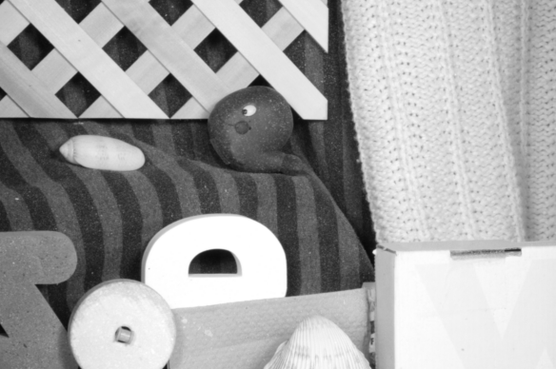
Matlab Implementation
Notes:
And then we pull all the equation to matlab and see how it works
To verify the function, we use two frames with one pixel displacement.

Slide 9
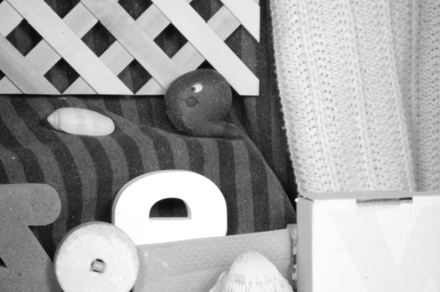
Matlab Implementation

Slide 10
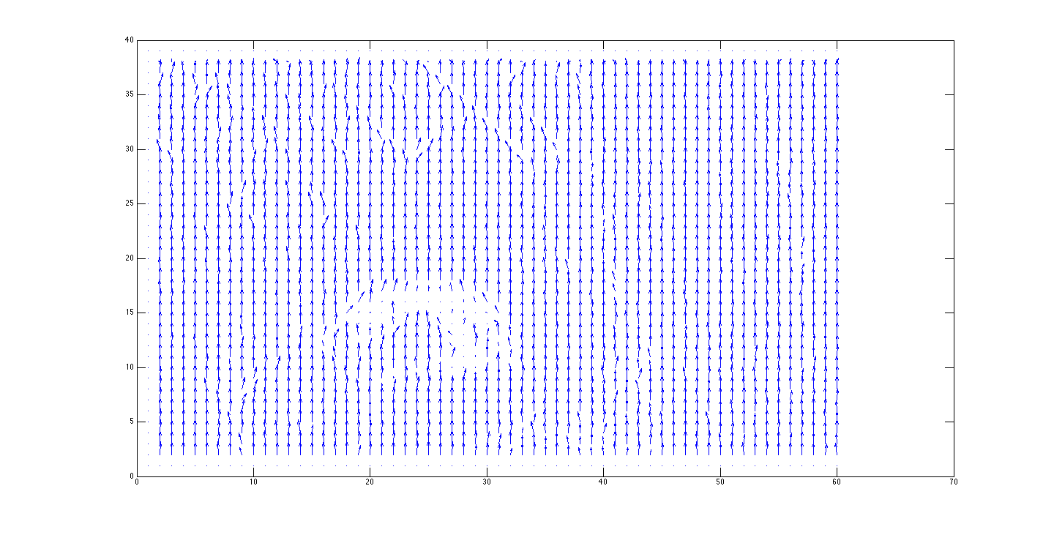
n=10

Slide 11
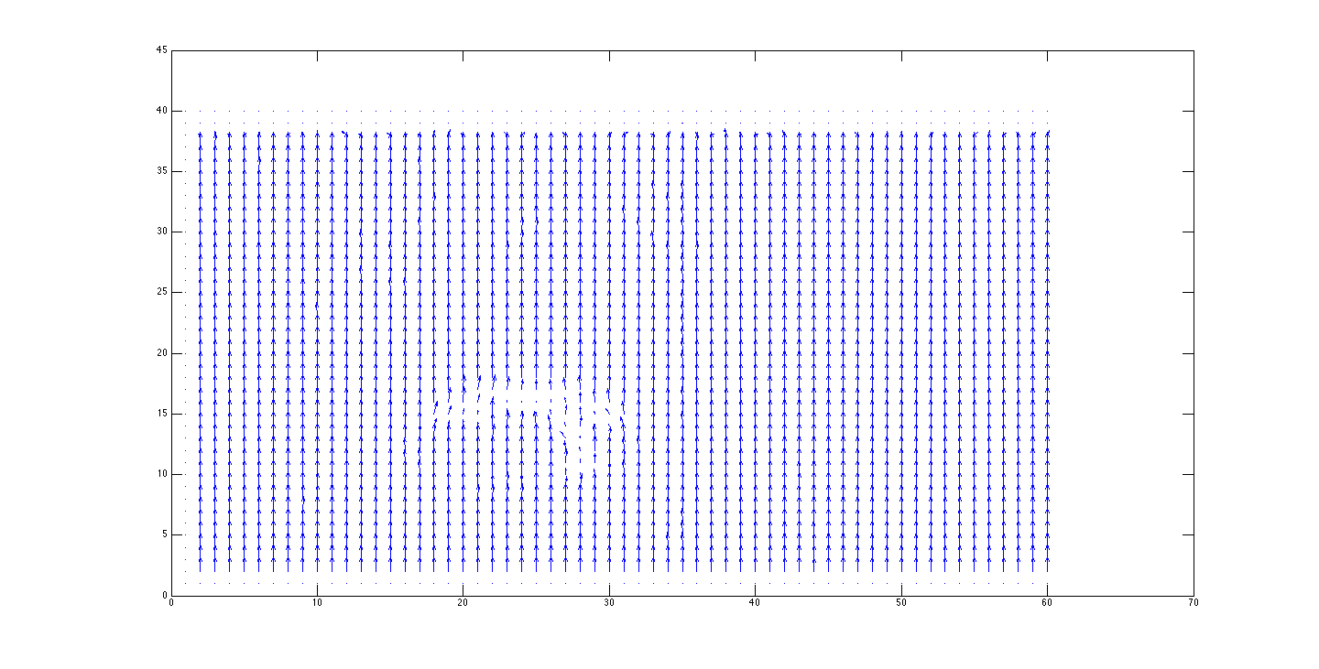
n=50

Slide 12
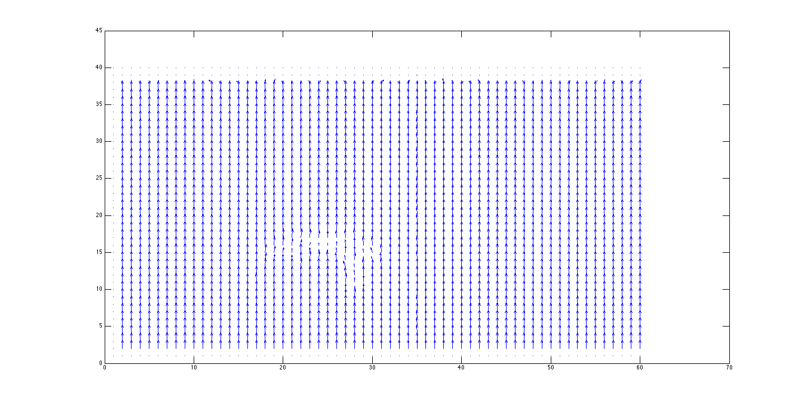
n=100

Slide 13
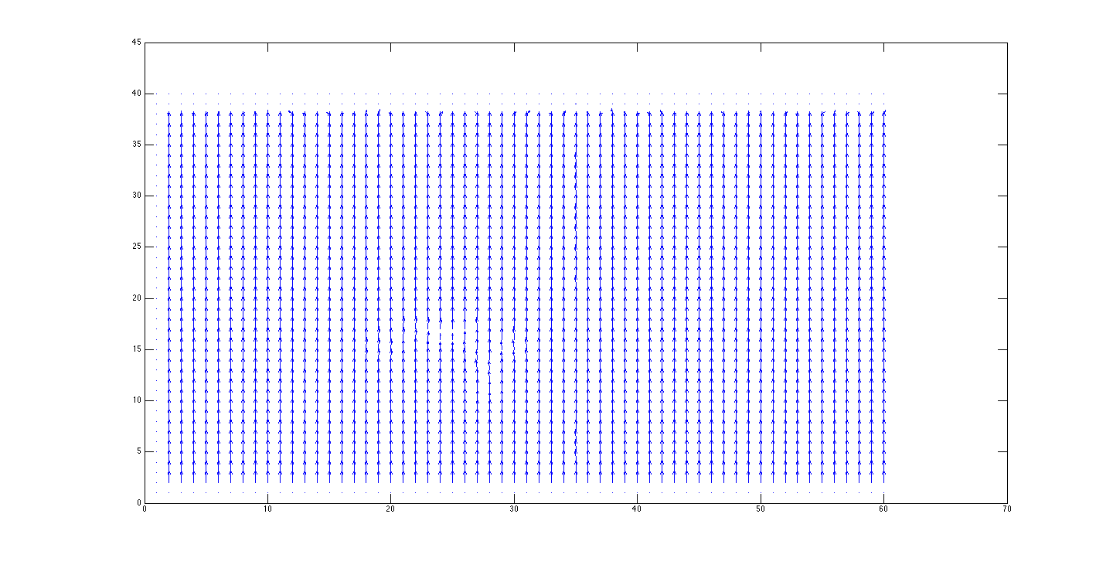
n=200

Slide 14
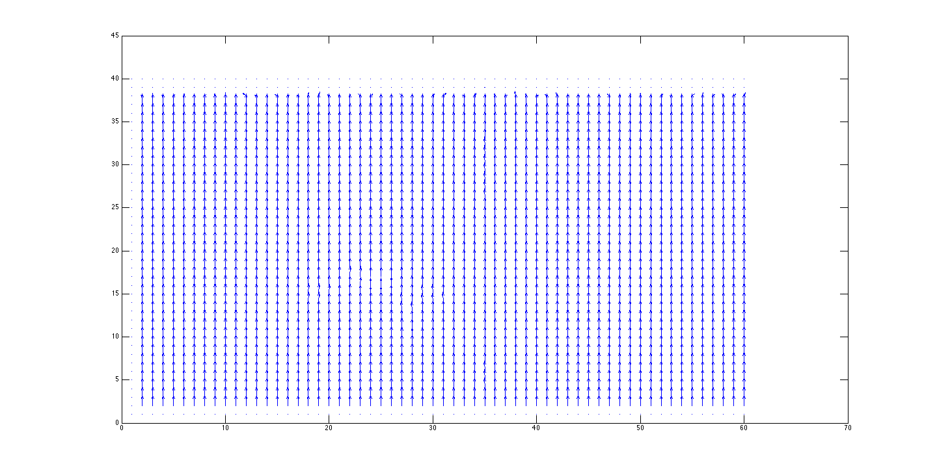
n=300
Matlab runtime = 45 sec

Slide 16


Slide 17
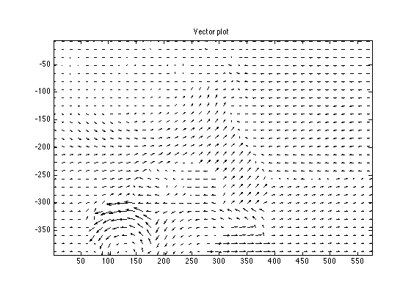

Slide 18
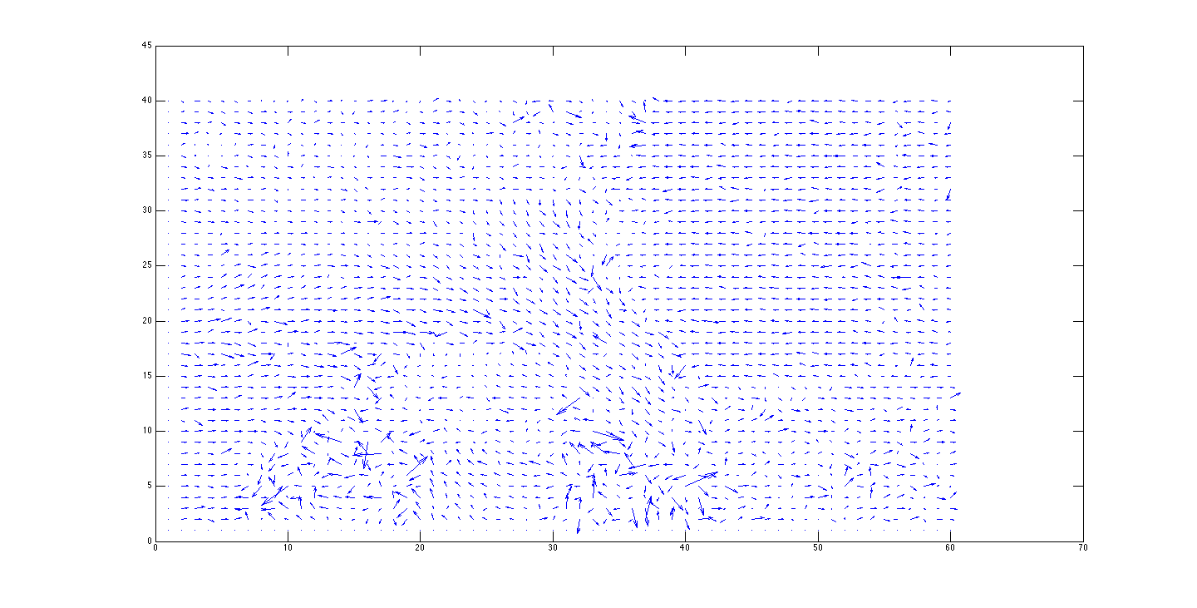

Slide 19
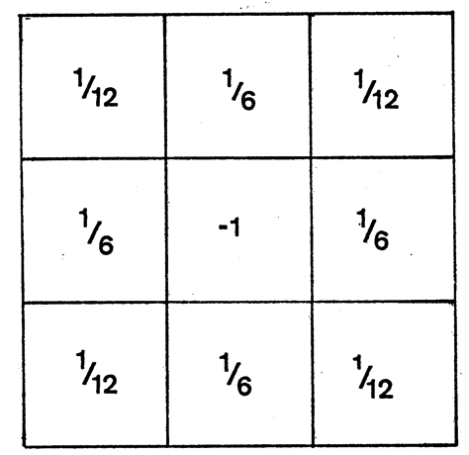
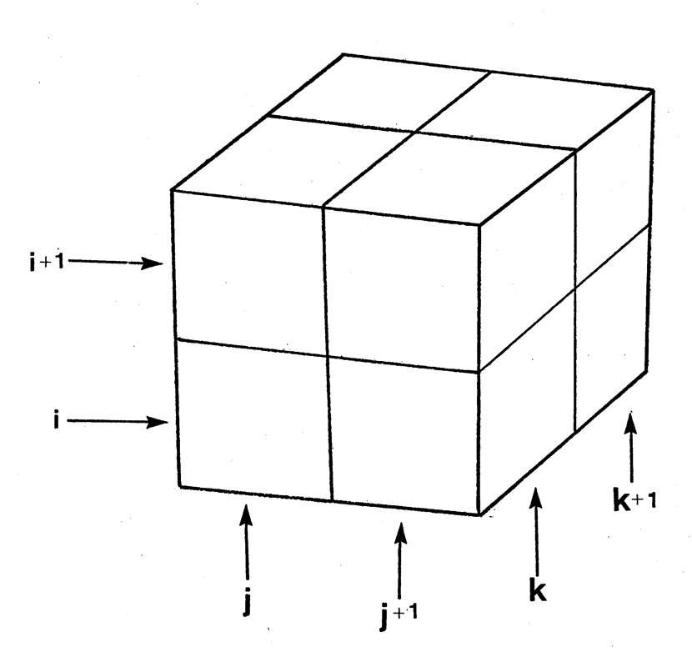
Hardware Block Diagram
Control
Unit
frame1
Window Buffer
frame2
Weighted
Average
Median Filter
n
u
v
u
Vector Buffer
v
Vector
Calc
Partial Derivative
Ex, Ey, Et
Notes:
Parametize the frame size

Slide 20
Design Space Exploration
Parameterize the variables
Fixed Pipeline Stage
Explore Parallelism with Area/Voltage Tradeoffs

Slide 21
Design Space Exploration
Please think about where
we can implement parallelism
to improve performance
Control
Unit
frame1
Window Buffer
frame2
Weighted
Average
Median Filter
n
u
v
u
Vector Buffer
v
Vector
Calc
Partial Derivative
Ex, Ey, Et
Notes:
Parametize the frame size

Slide 22
Next...
Block calculation
Fixed point
Iteration number
C++ Contract
Chisel

