Slide 1
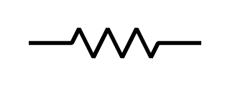













–
+
$$I_{G}$$
$$R_{G}$$
$$V_{1}$$
$$I_{G_{1}}$$
$$C_{G}$$
$$I_{leak}$$
$$C_{G}$$
$$I_{G_{2}}$$
$$I_{ch}$$
$$V_{D}$$
$$R$$
$$I_{D}$$
+
$$V_{bias}$$
–

Slide 2
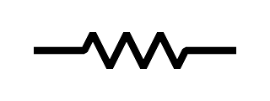
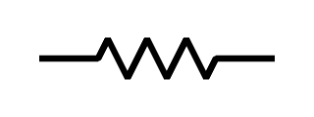
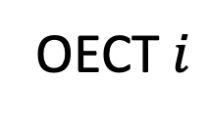
























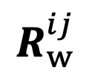



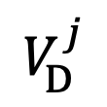
b)
–
+
$$I_{G}$$
$$R_{G}$$
$$V_{1}$$
$$I_{G_{1}}$$
$$C_{G}$$
$$I_{leak}$$
$$C_{G}$$
$$I_{G_{2}}$$
$$I_{ch}$$
$$V_{D}$$
$$R$$
$$I_{D}$$
+
$$V_{bias}$$
–
c)
–
$$V_{bias}$$
+
$$V_{G}$$
$$V_{D}$$
–
$$V_{bias}$$
–
+
$$V_{D}^{i}$$
+
$$V_{bias}$$
$$V_{G}$$
OECT $j$
$$V_{D}$$
$$R$$
$$V_{D}^{i}$$
–
$$V_{bias}$$
–
$$R_{w}^{ij}$$
+
+
$$V_{bias}$$
$$V_{G}^{j}$$
OECT $i$
$$V_{G}$$
$$V_{D}^{j}$$
$$V_{D}$$

