Slide 1

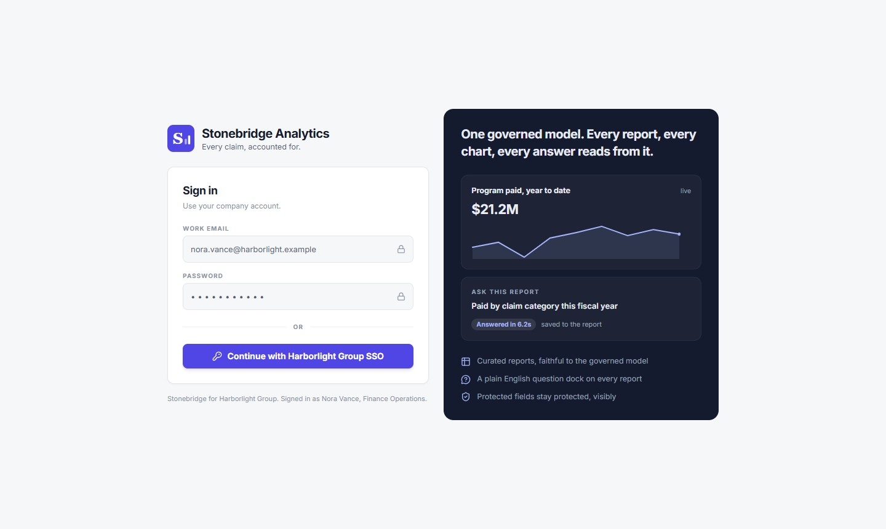
Stonebridge
ANALYTICS · EVERY CLAIM, ACCOUNTED FOR
Stonebridge Analytics
Governed Claims Reporting · A Solved Use Case
A corporate claims program’s reporting, rebuilt on one governed semantic layer with a conversational layer on top. An analyst signs in, reads the program at a glance, asks a report a question in plain English and watches it become a saved, governed chart.
The front door: company SSO into the workspace
A solved use case, presented under a fictional brand with fictional data.
SQL Server warehouse · Cube semantic layer · Python FastAPI · LLM orchestration · Web client

Slide 2
The use case
Stonebridge
A corporate claims program ran its reporting on aging BI tooling: dozens of reports, numbers that disagreed between systems, and weeks of work for every new view. The fix was structural: one governed semantic layer over the warehouse, every report rebuilt on it, and a conversational layer so analysts ask instead of waiting on a queue.
46
6.2s
4
reports, one model
question to chart
ways a question ends
finance, operations and partner reporting rebuilt on a governed semantic layer
median time from plain English to a governed chart saved on the report
answered, compared, rewritten, or refused by the access check
This showcase plays the whole journey on scripted data, so the use case can be walked end to end in any browser.

Slide 3





How it is solved
Stonebridge
1. Warehouse
2. Semantic layer
3. Python API
4. Ask in English
5. Saved answers
every figure lives in one SQL warehouse
Cube models measures, dimensions and tenancy
FastAPI applies roles, scope and guardrails
the LLM builds a query from the governed catalog
charts pin back onto the report for the team
Reports and the question dock read the same definitions, so a number matches everywhere it appears. The showcase plays stages 4 and 5 live on every report screen.

Slide 4
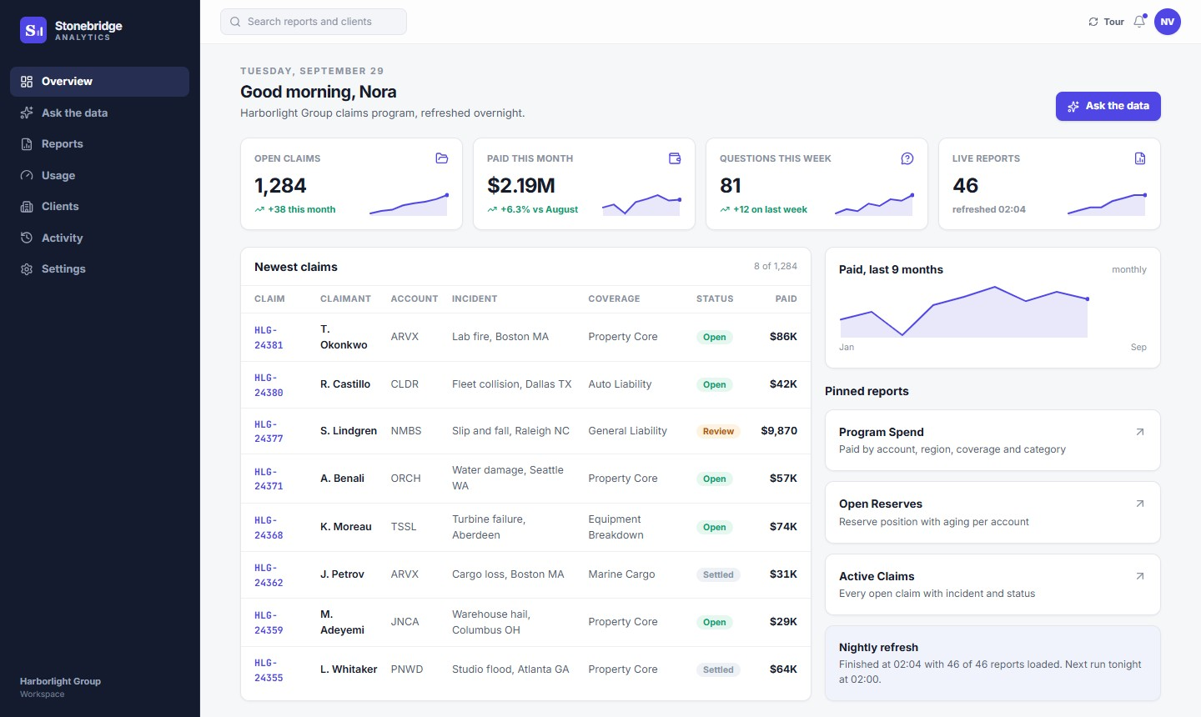
The workspace
Stonebridge
One governed model
the tiles, the file table and every report trace to warehouse SQL through the semantic layer, refreshed nightly.
Trend at a glance
program tiles carry their own history, so a number arrives with its direction, not just its size.
A quiet start
a welcome dialog offers a short guided tour once per session; the tour rings live regions of the page.
The overview: program tiles, the newest files and pinned reports.

Slide 5
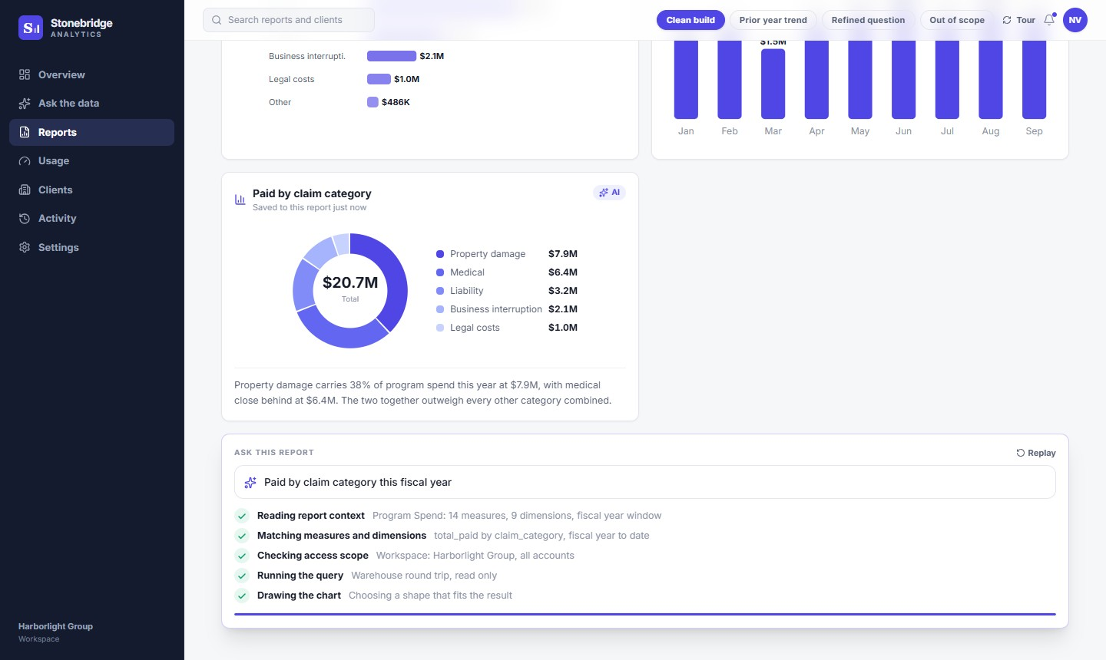
The report and the dock
Stonebridge
Built in views
summary tiles, curated charts and a line by line table, all scoped by the same slicers.
The pipeline, visible
the dock shows each production stage as it runs: context, matching, the access check, the query, the chart.
First class answers
a saved answer becomes a report chart like any other: same slicers, same refresh, visible to the whole team.
Program Spend after a run: the question, the checked steps and the saved chart.

Slide 6
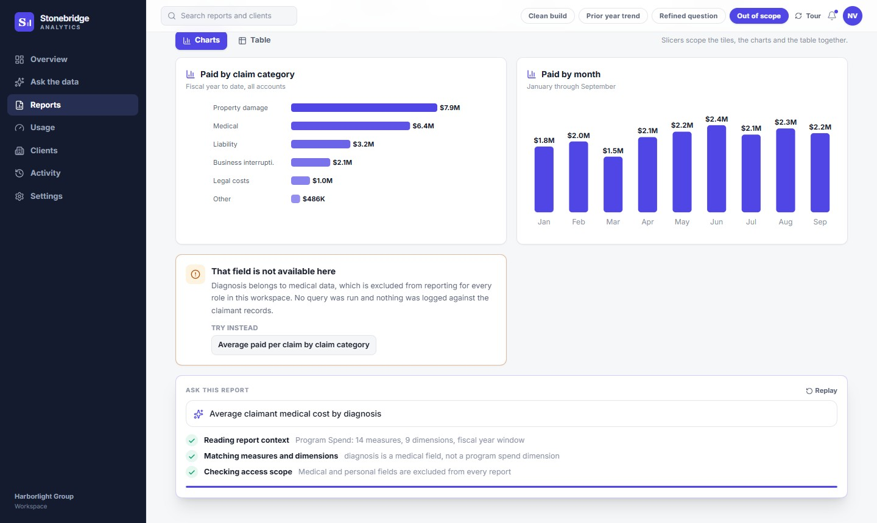
The guardrail
Stonebridge
Guarded in the model
medical and personal fields are marked private in the semantic layer itself, not in UI code.
Refused before the query
the access check stops the run before anything reaches the warehouse, and says why.
Refused on the record
the activity log keeps the refusal and the reason, never the blocked data.
A question about medical data stops at the access check, with the reason and a better ask.

Slide 7
Four questions, four endings
Stonebridge
Question | What happens | Ends as | Why it matters
Paid by claim category this fiscal year | a clean first pass build | A saved donut | the happy path reads effortless
Monthly paid against last year | two windows, one query | A two line trend | prior year comparisons are one sentence
Which regions cost the most | 48 members would not read; rewritten to the top 8 | Ranked bars | the assistant narrows vague asks and says so
Average medical cost by diagnosis | the access check stops the run | A refusal with a better ask | protected fields stay protected, visibly
Each question is one typed script: the text, the pipeline steps with durations, and the chart or refusal it ends in. The header pills switch them and every screen accepts the question in its URL.
Example: /reports/program-spend?s=guarded opens the report straight into the refusal run.

Slide 8
How it is built
Stonebridge
Semantic layer
First class answers
AI with guardrails
Cube models every measure, dimension and join over the warehouse. Reports and the question dock read the same definitions, so one number means one thing everywhere.
A saved answer becomes a governed report chart like any built in one: same slicers, same nightly refresh, same model, visible to everyone with access.
The language model may only assemble queries from the governed catalog. Scope is enforced before execution, refusals are logged, and nothing invents a number.
The same pipeline the showcase plays on every run: context, matching, access check, query, chart.

Slide 9

Built with
Stonebridge
The product stack
This showcase
A SQL Server warehouse under a Cube semantic layer, a Python FastAPI service for identity, scope and report specs, LLM orchestration for the question pipeline, and a web client.
A static Next.js build of the product on scripted data: the full journey, four question outcomes and every screen, clickable in any browser with no infrastructure or sign up.
The showcase exists so the solved use case can be demonstrated, not just described.

Slide 10
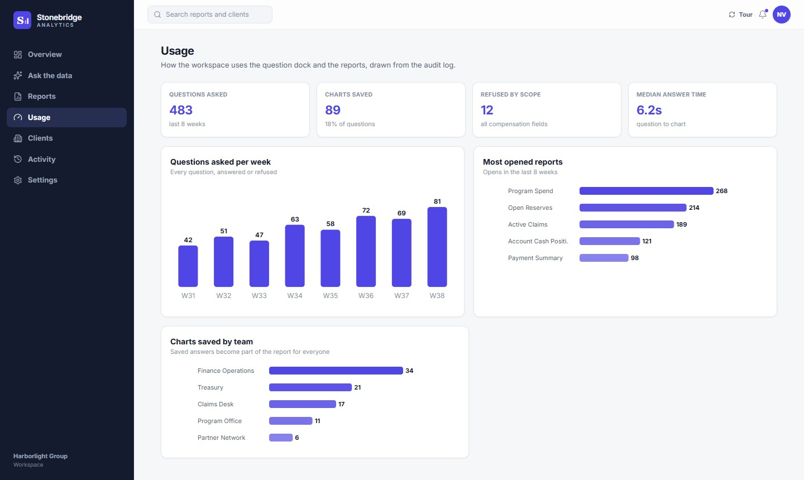

See it in action
Stonebridge
Live build
stonebridge-six.vercel.app
Open any screen directly; the pills in the header replay the same report with a different question.
Example: /reports/program-spend?s=refined shows a vague ask being rewritten before it runs.
The journey is the product’s own; the data is scripted for the showcase.
The usage view: questions, saves and the reports people actually open.
SQL Server · Cube · Python FastAPI · LLM orchestration · Next.js showcase

