Slide 1
Experiment Results
Visual Analysis of Cognitive Tasks

Slide 2
BART Task Results

Slide 3
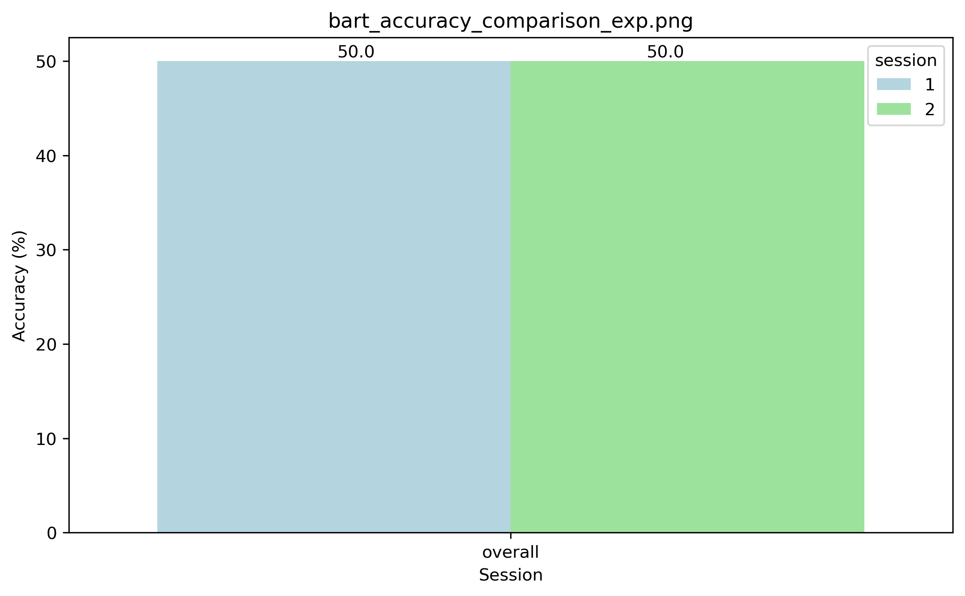
BART Task: Accuracy Comparison (Control)
bart_accuracy_comparison_control.png

Slide 4
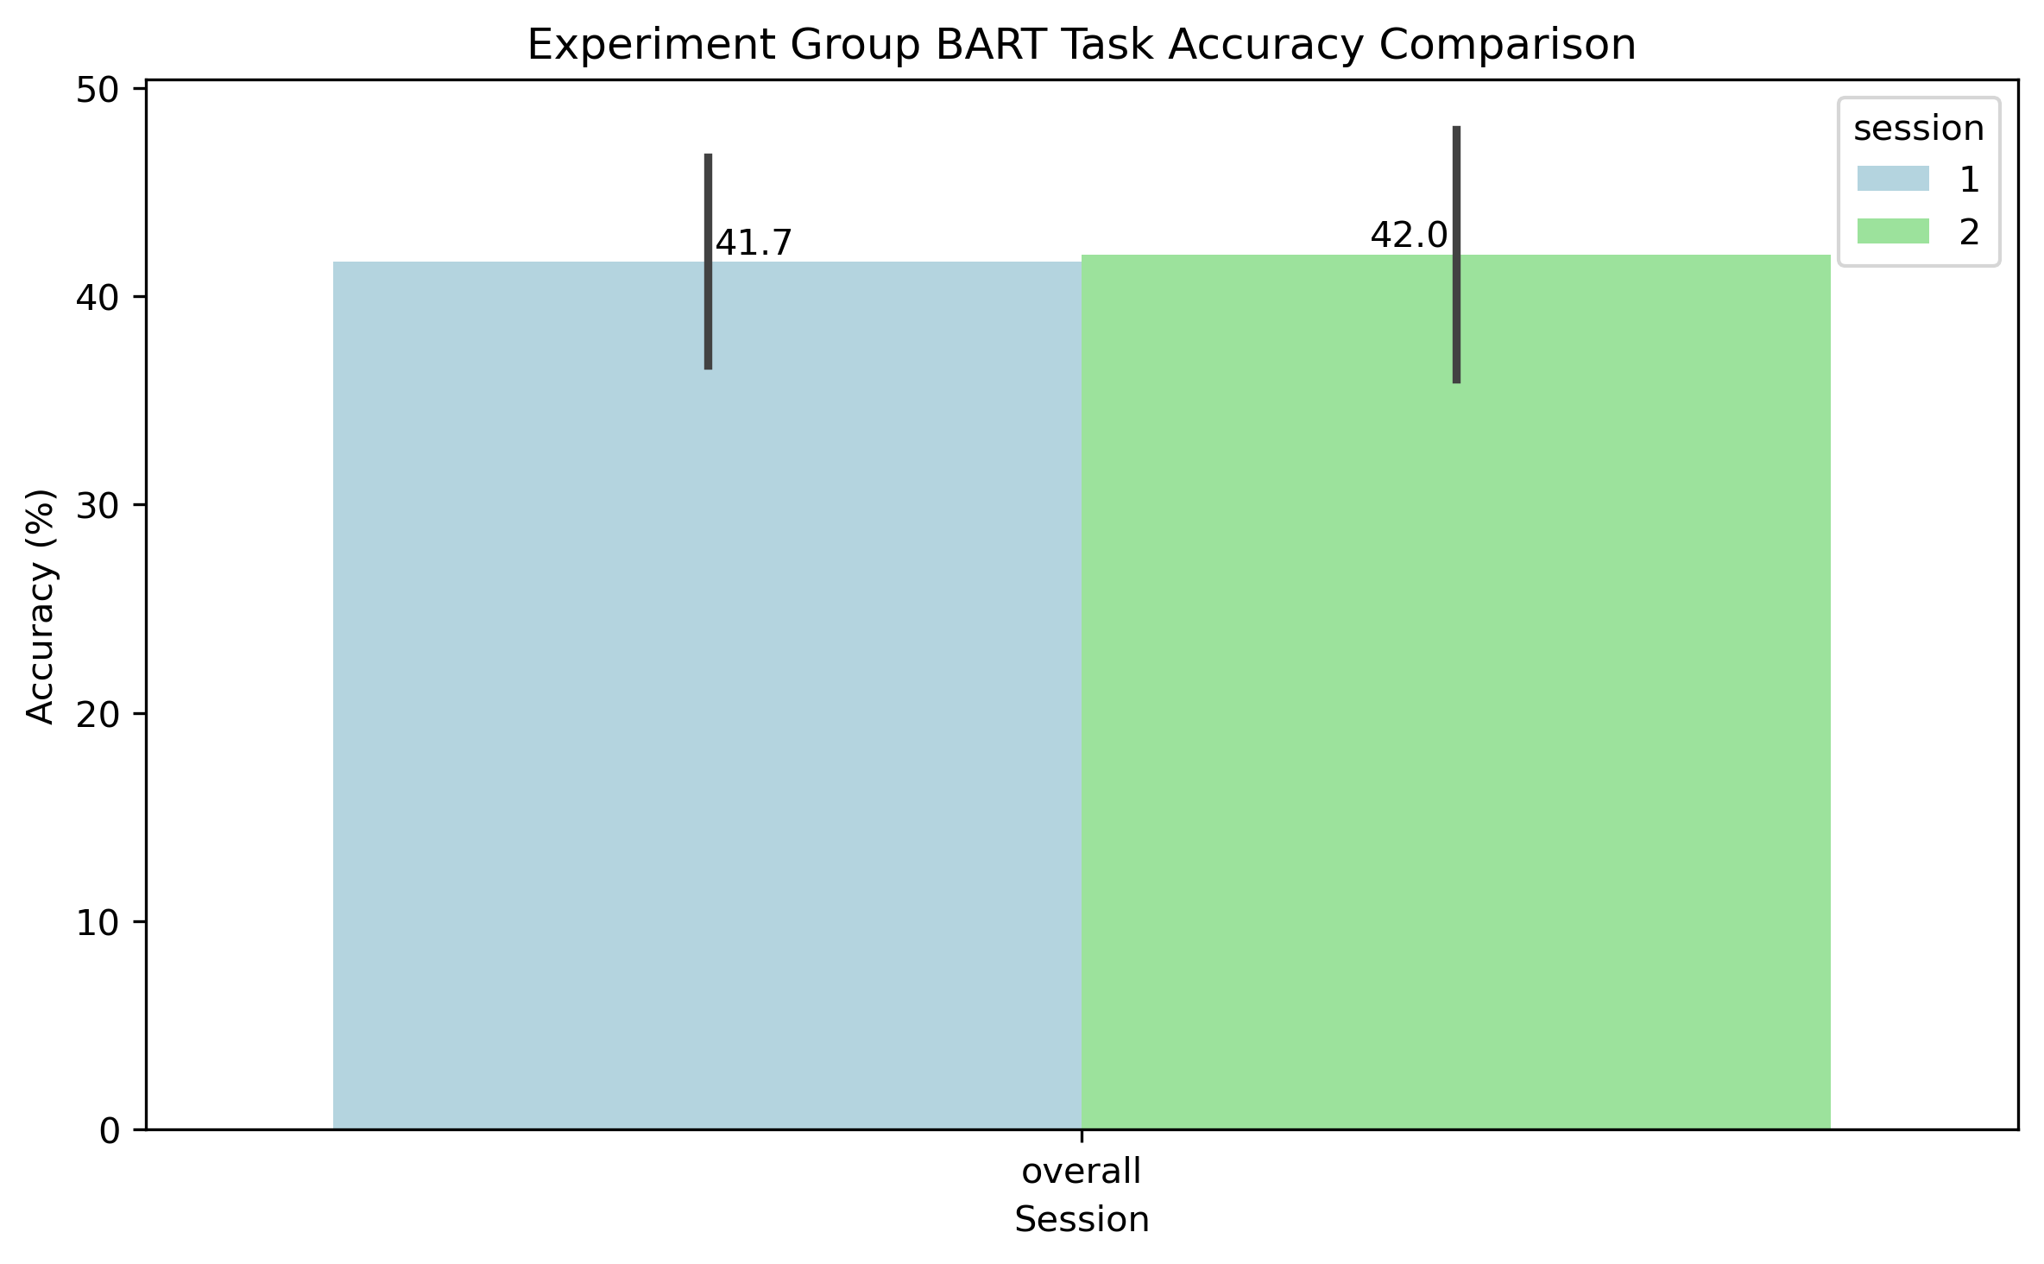
BART Task: Accuracy Comparison (Exp)
bart_accuracy_comparison_exp.png

Slide 5
BART Task: Rt Comparison (Control)
bart_accuracy_comparison_control.png

Slide 6
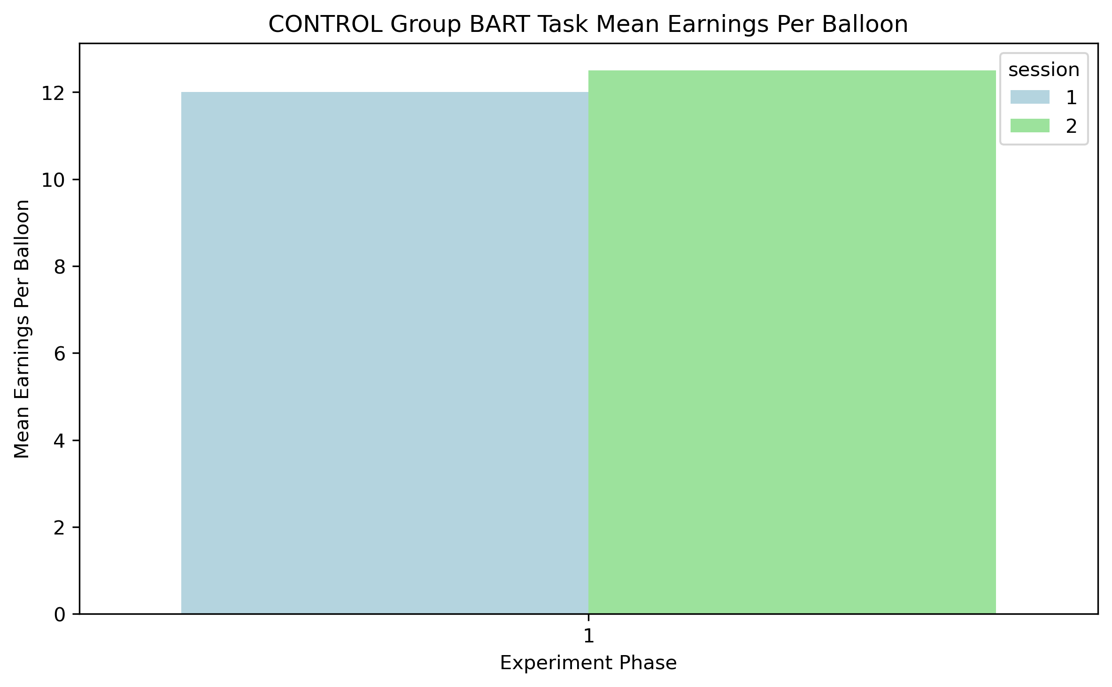
BART Task: Mean Per Balloon (Control)
bart_control_mean_per_balloon.png

Slide 7
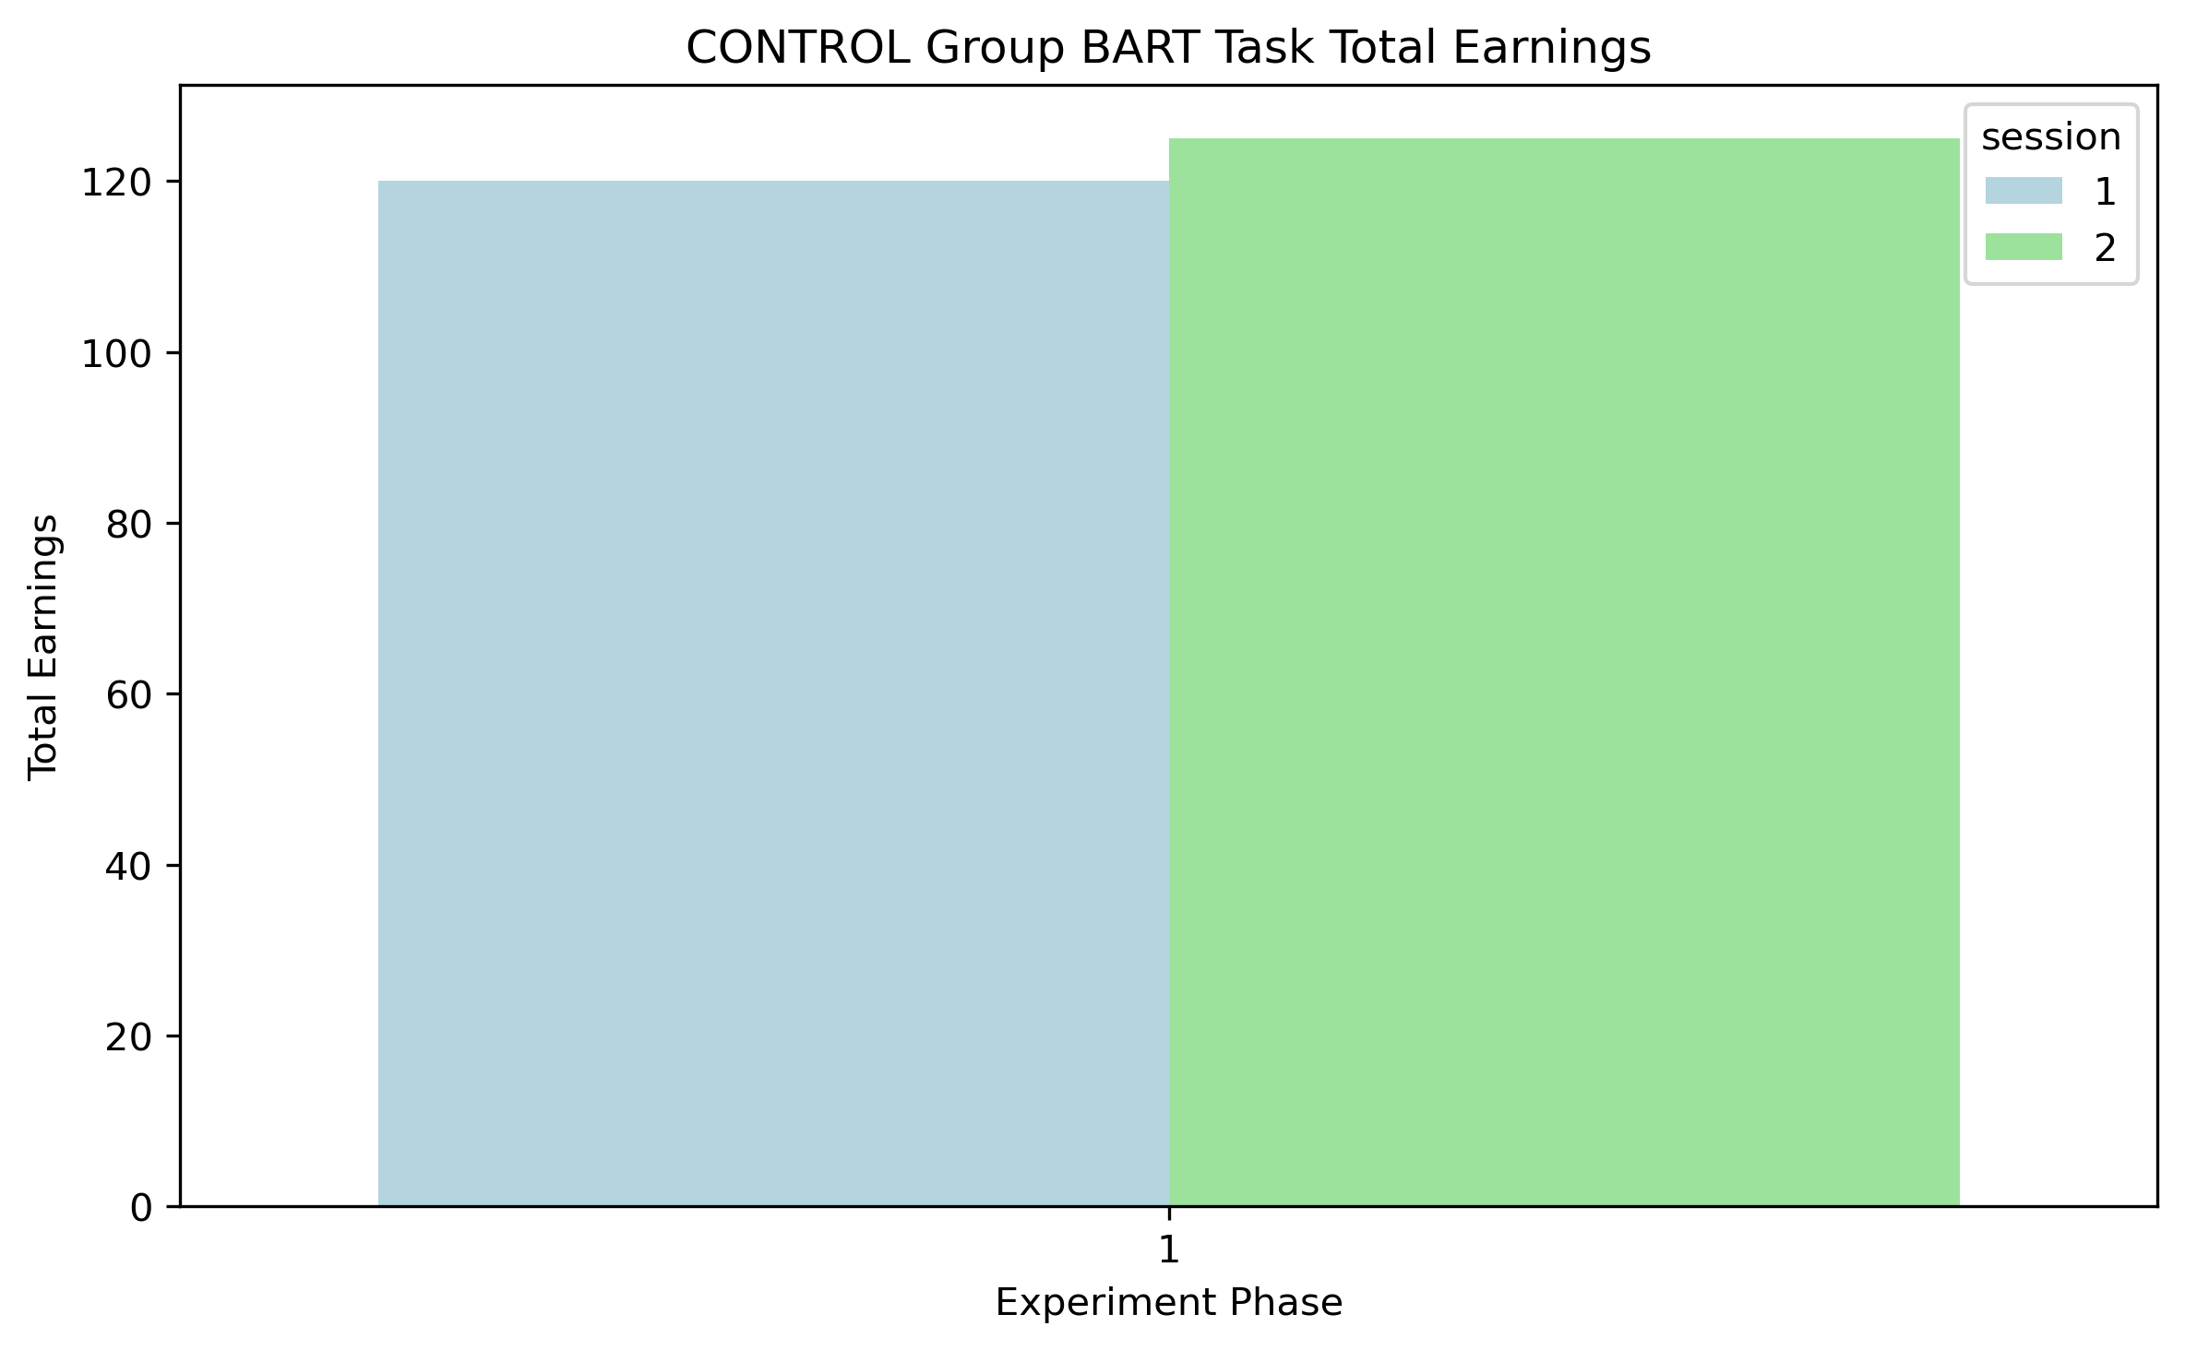
BART Task: Total Earnings (Control)
bart_control_total_earnings.png

Slide 8
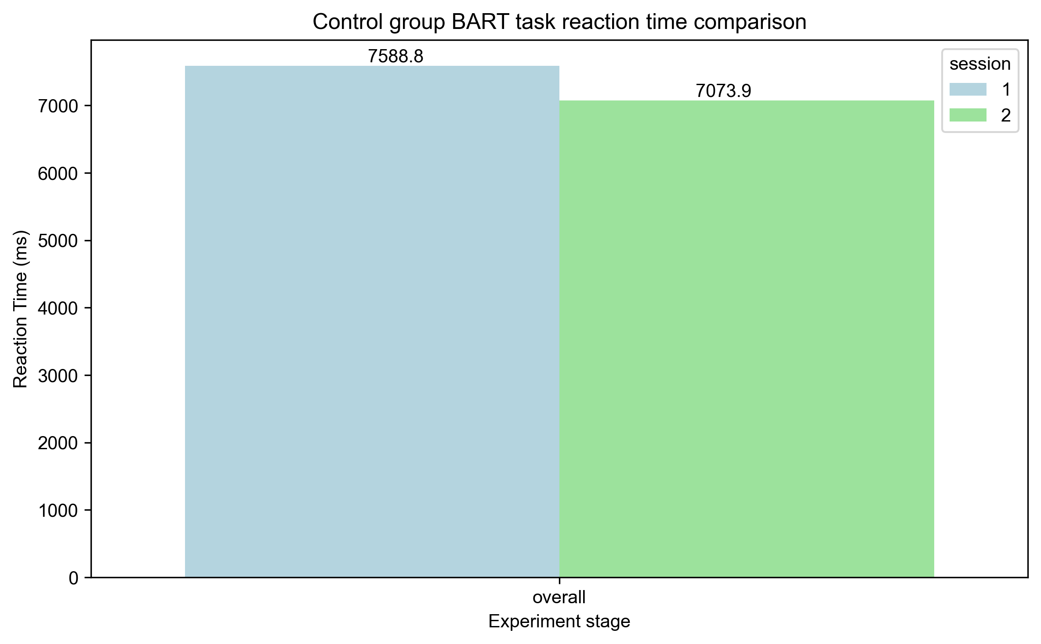
BART Task: Rt Comparison (Control)
bart_rt_comparison_control.png

Slide 9
BART Task: Rt Comparison (Exp)
bart_accuracy_comparison_exp.png

Slide 10
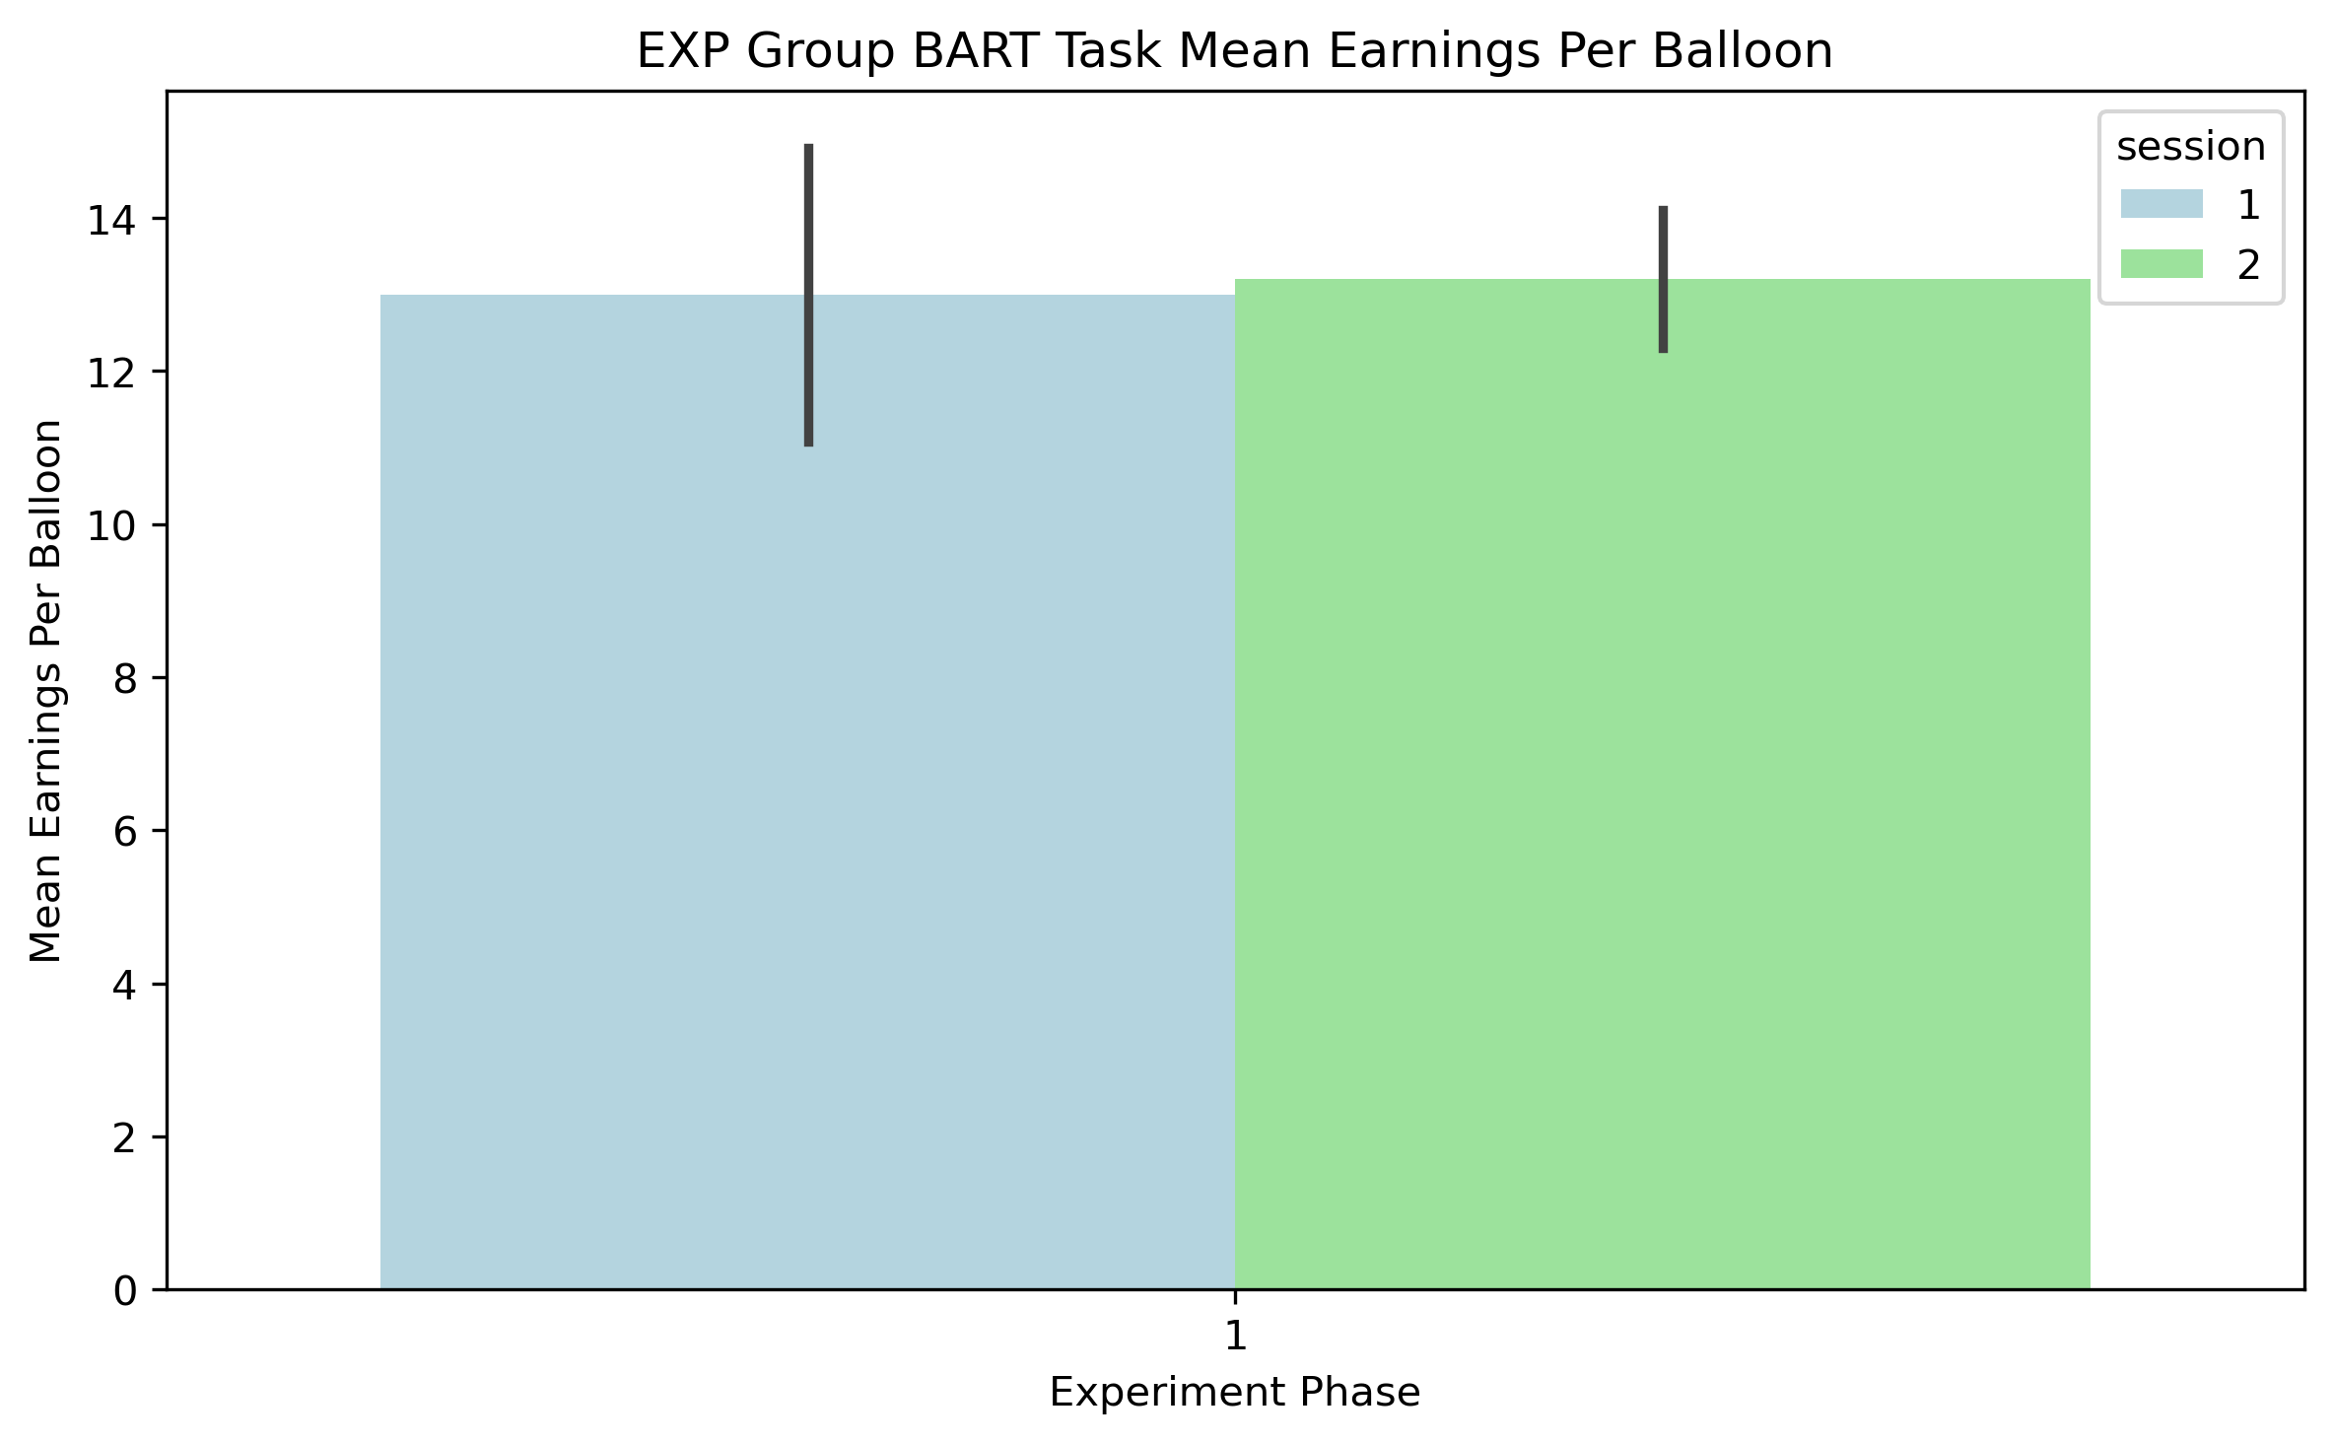
BART Task: Mean Per Balloon (Exp)
bart_exp_mean_per_balloon.png

Slide 11
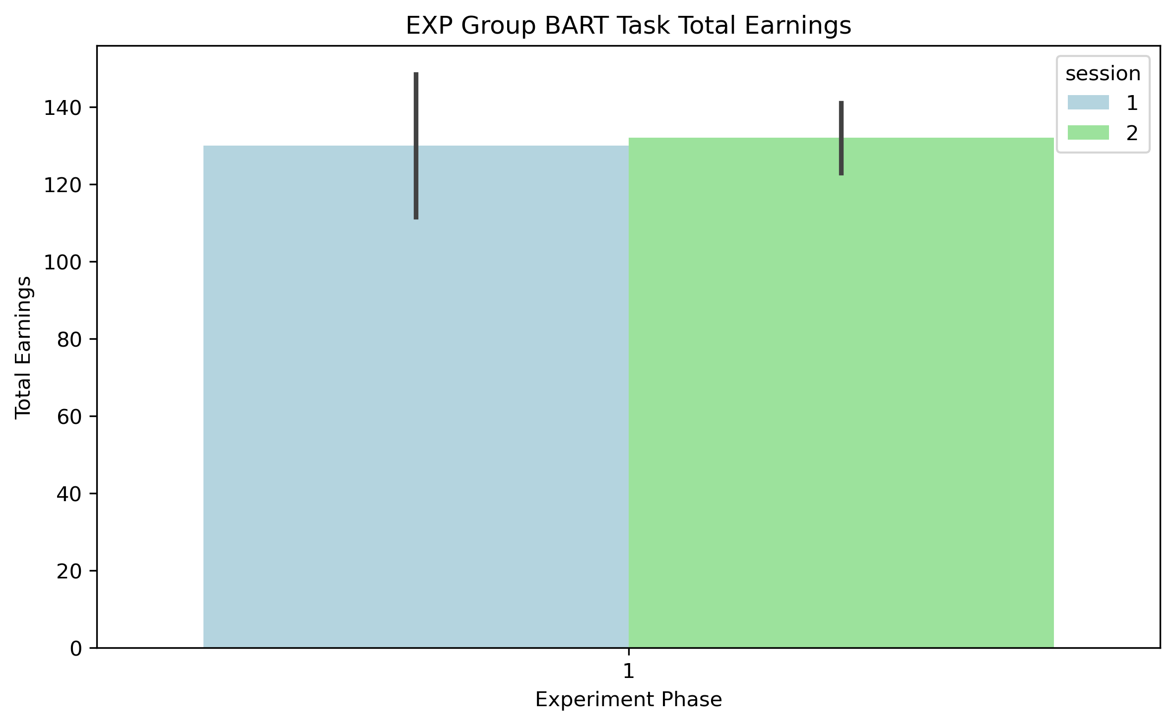
BART Task: Total Earnings (Exp)
bart_exp_total_earnings.png

Slide 12
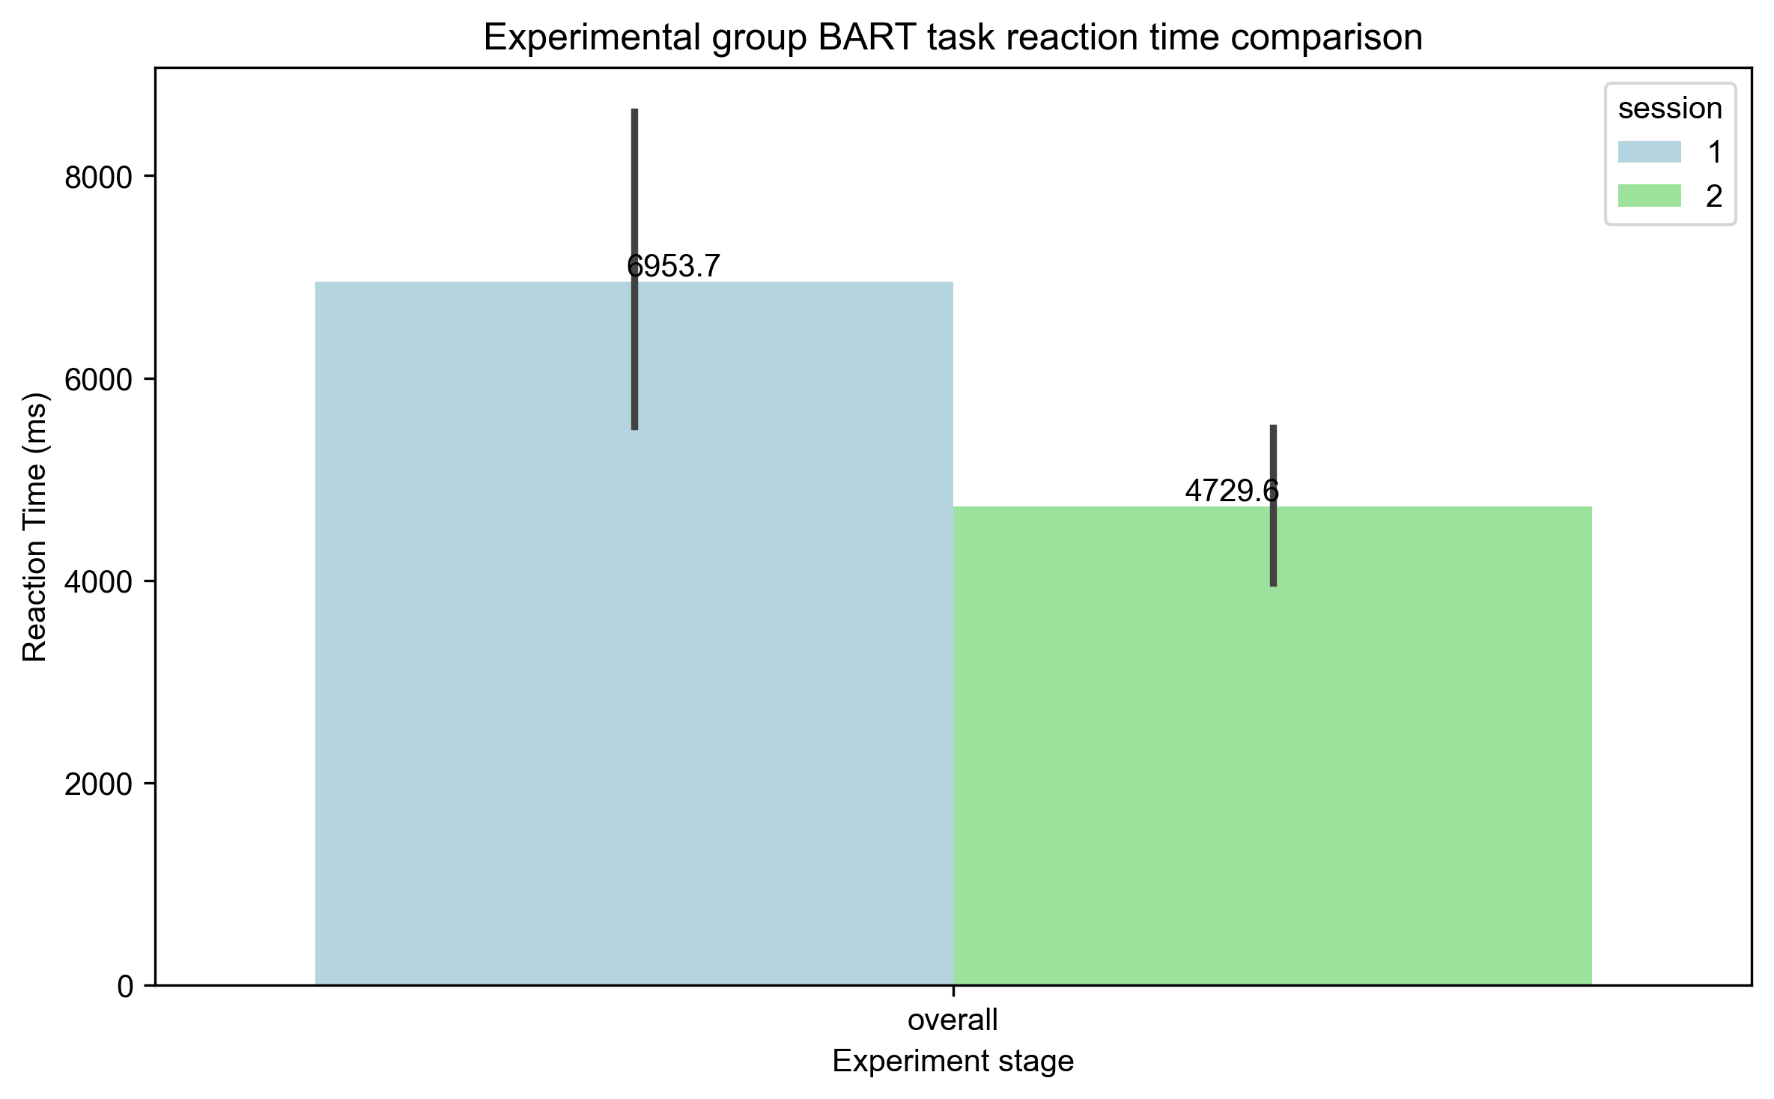
BART Task: Rt Comparison (Exp)
bart_rt_comparison_exp.png

Slide 13
BART Task: Mean Per Balloon (Control)
bart_control_mean_per_balloon.png

Slide 14
BART Task: Mean Per Balloon (Exp)
bart_exp_mean_per_balloon.png

Slide 15
BART Task: Total Earnings (Control)
bart_control_total_earnings.png

Slide 16
BART Task: Total Earnings (Exp)
bart_exp_total_earnings.png

Slide 17
STROOP Task Results

Slide 18
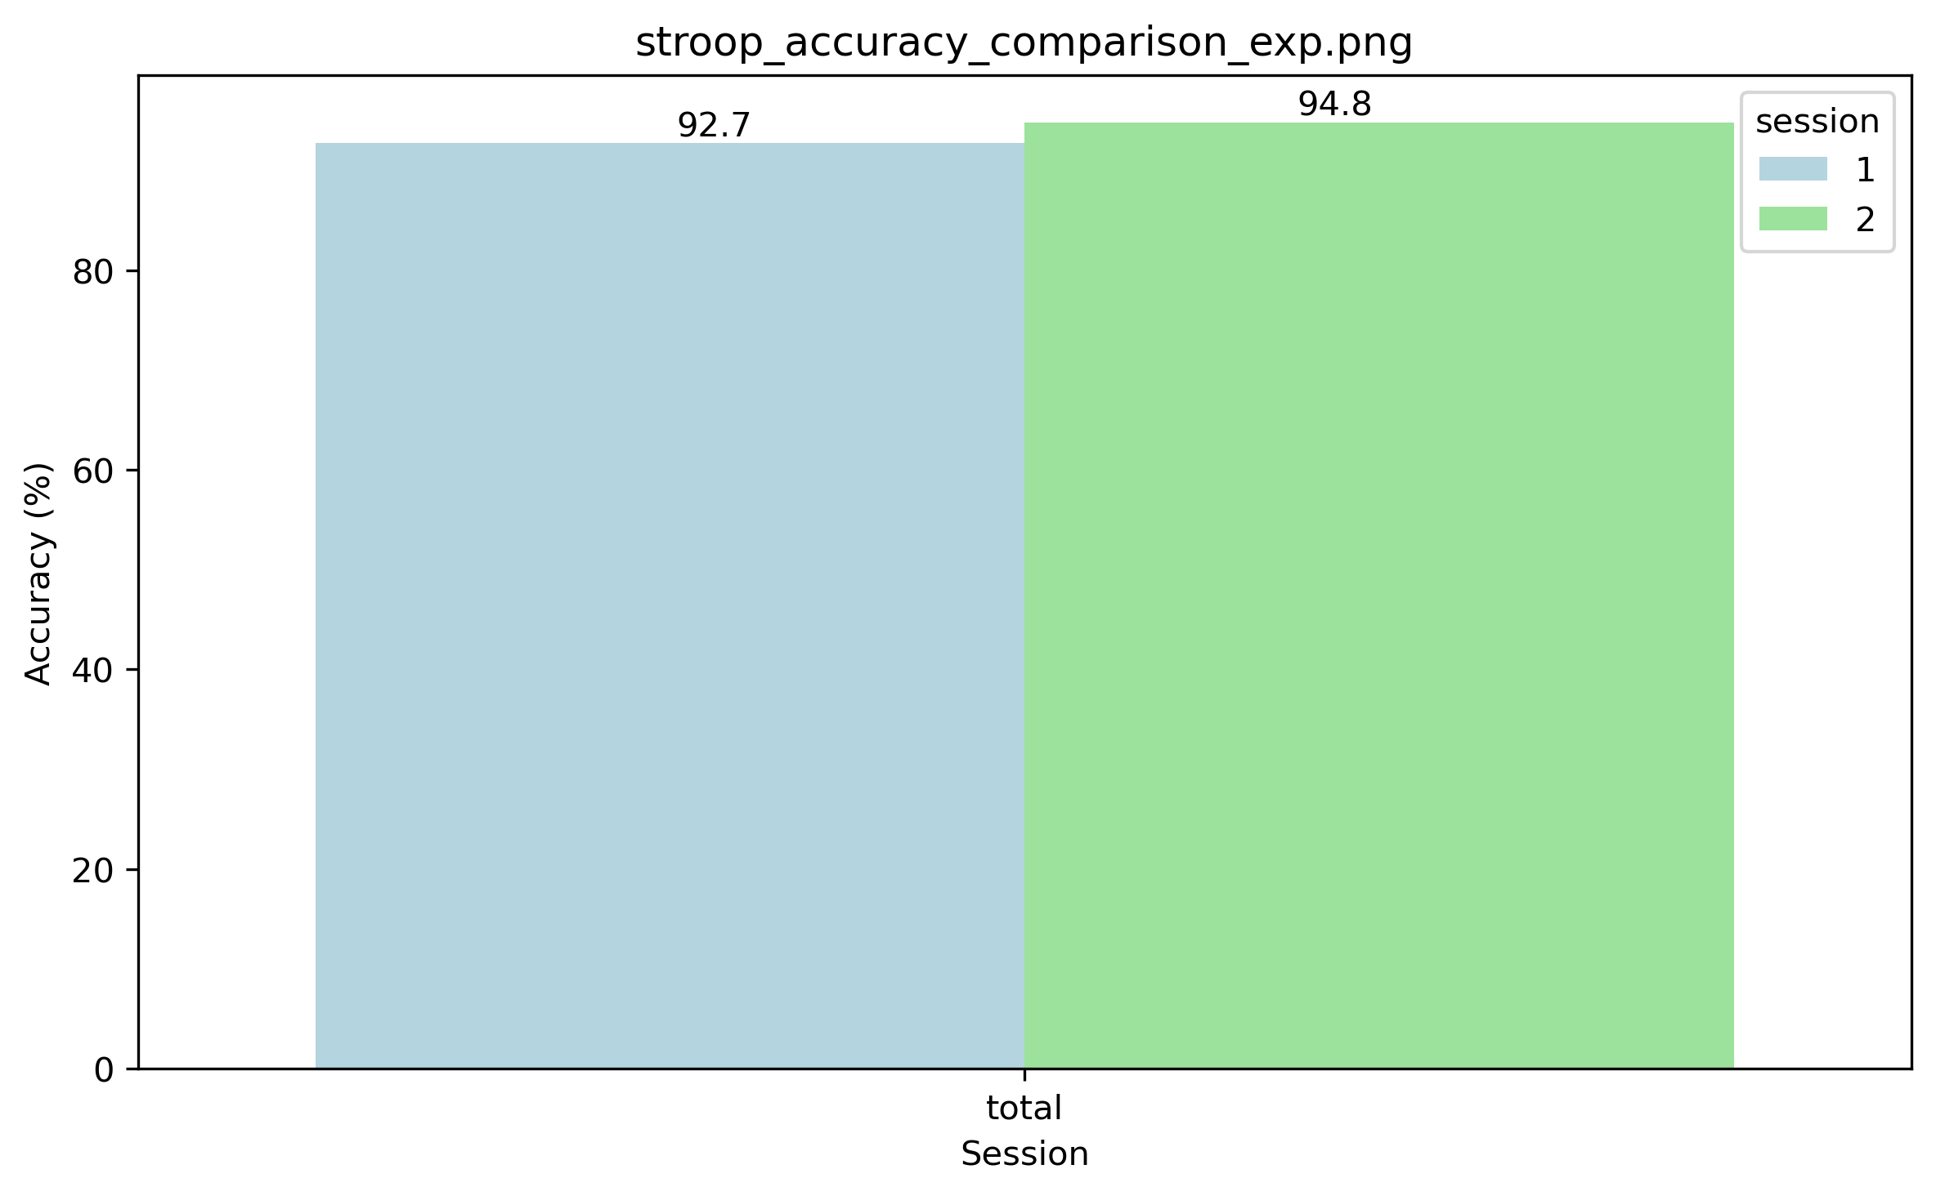
STROOP Task: Accuracy Comparison (Control)
stroop_accuracy_comparison_control.png

Slide 19
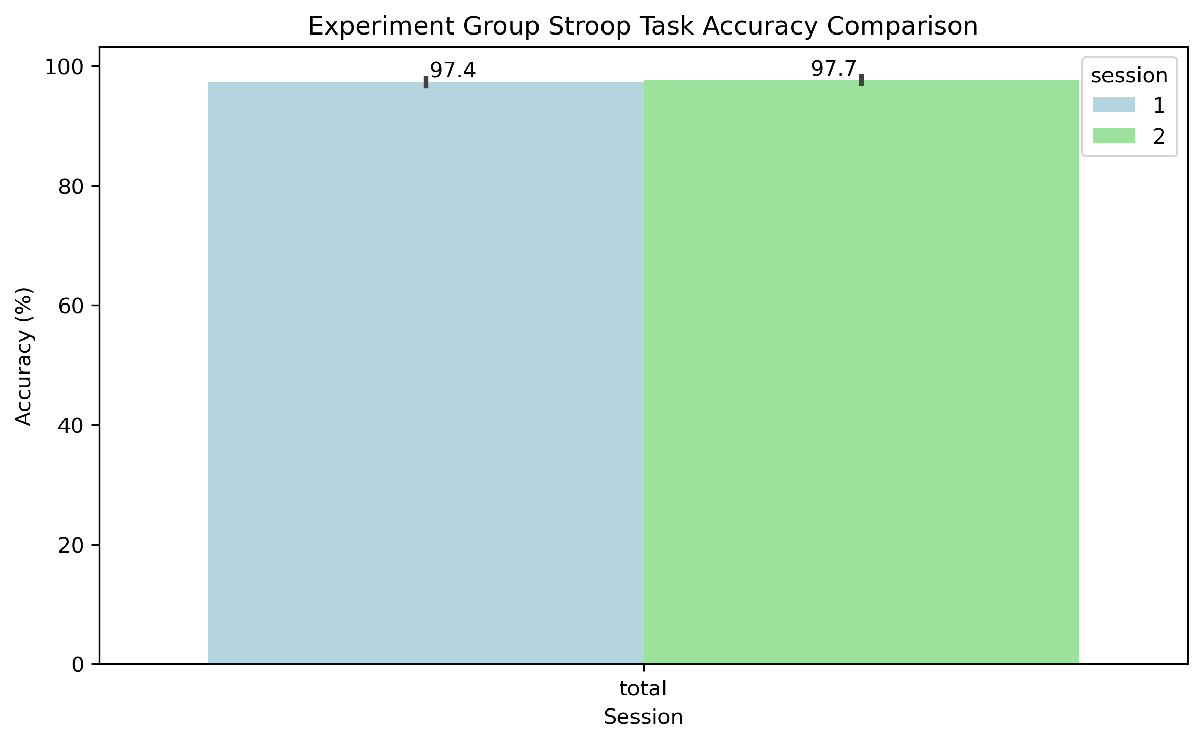
STROOP Task: Accuracy Comparison (Exp)
stroop_accuracy_comparison_exp.png

Slide 20
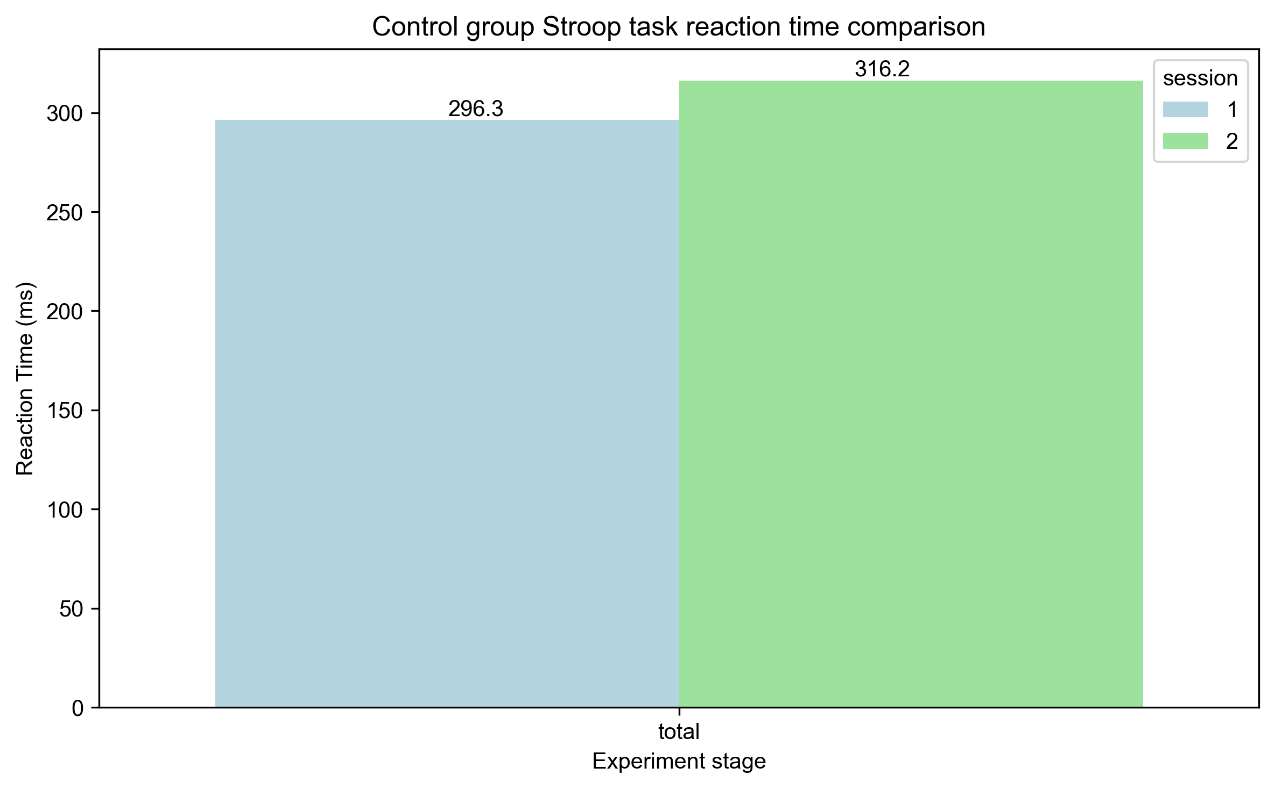
STROOP Task: Rt Comparison (Control)
stroop_rt_comparison_control.png

Slide 21
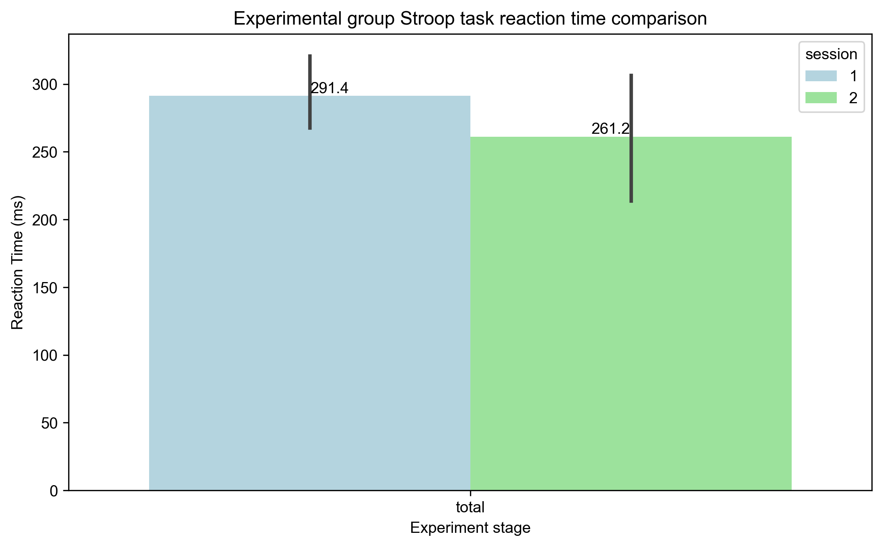
STROOP Task: Rt Comparison (Exp)
stroop_rt_comparison_exp.png

Slide 22
NBACK Task Results

Slide 23
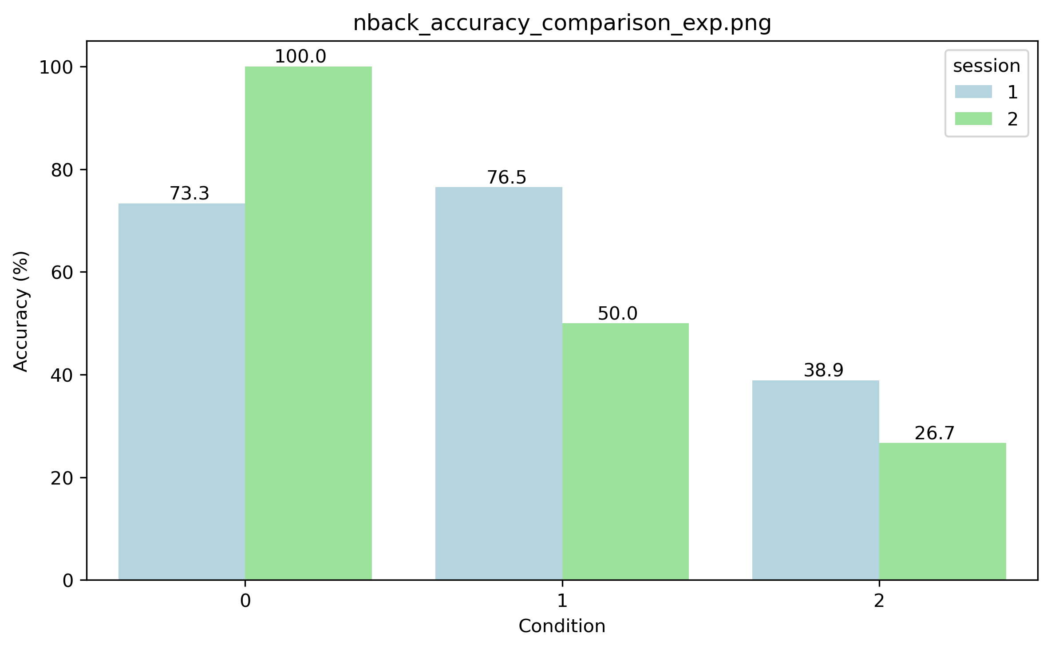
NBACK Task: Accuracy Comparison (Control)
nback_accuracy_comparison_control.png

Slide 24
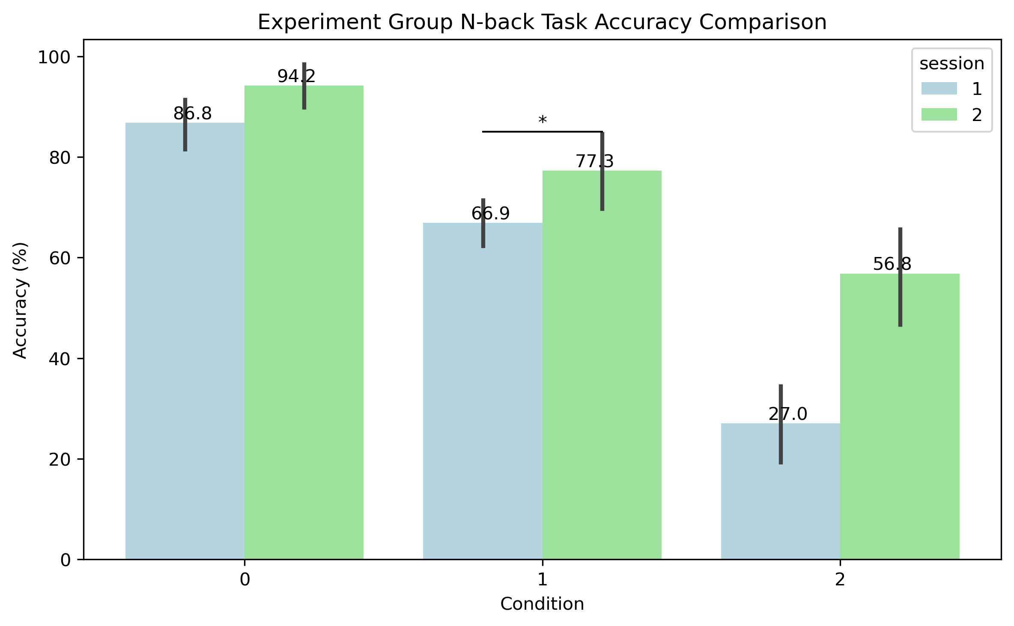
NBACK Task: Accuracy Comparison (Exp)
nback_accuracy_comparison_exp.png

Slide 25
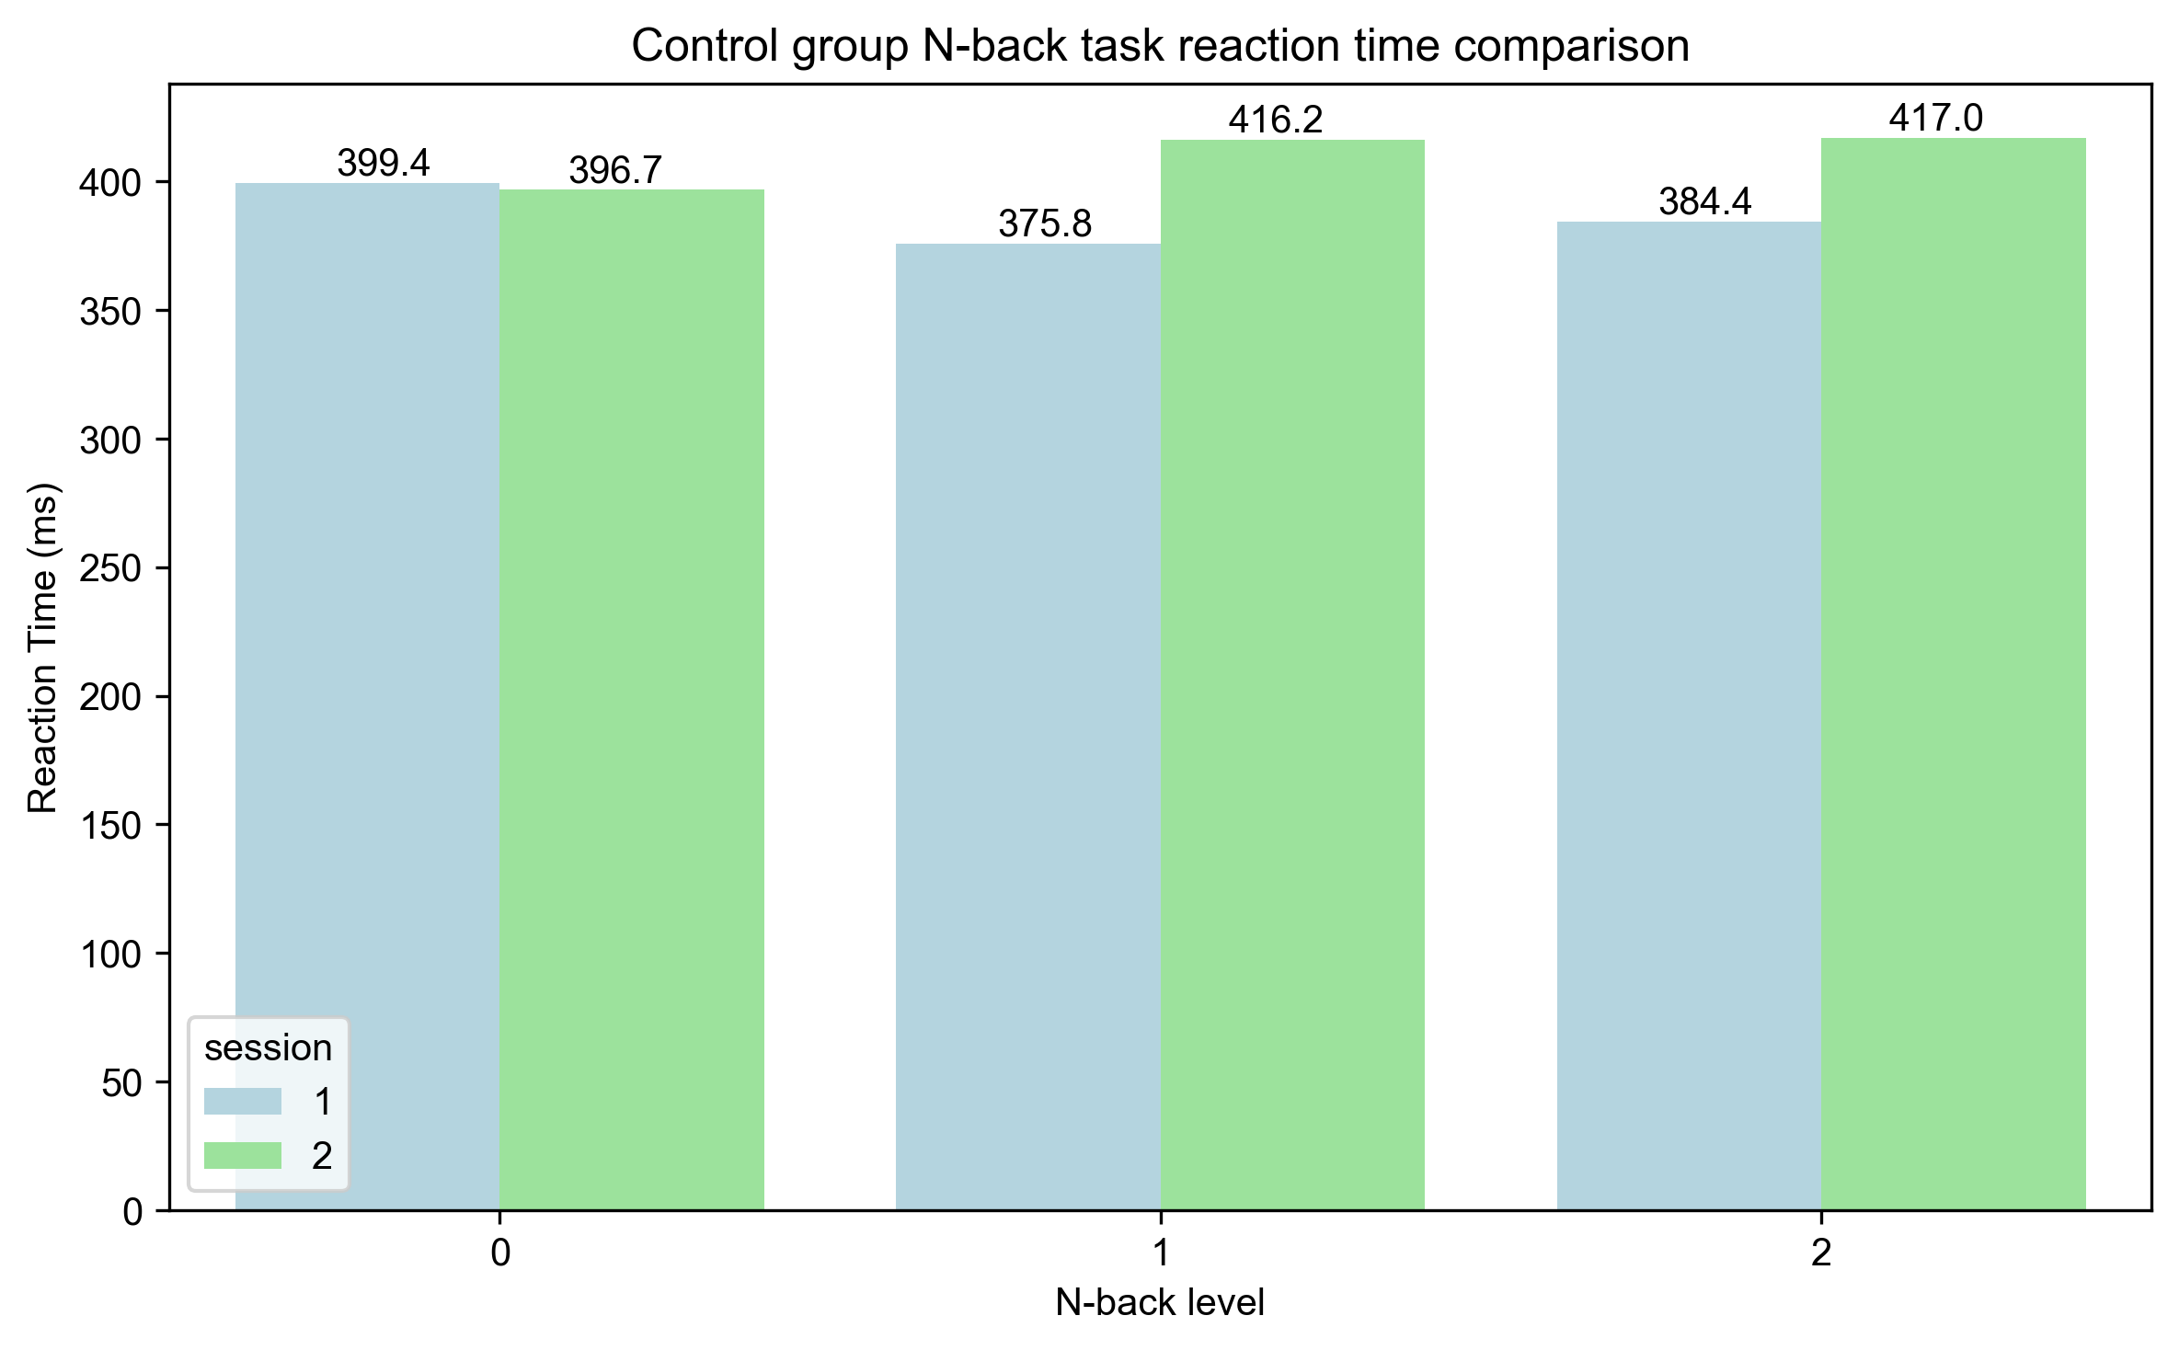
NBACK Task: Rt Comparison (Control)
nback_rt_comparison_control.png

Slide 26
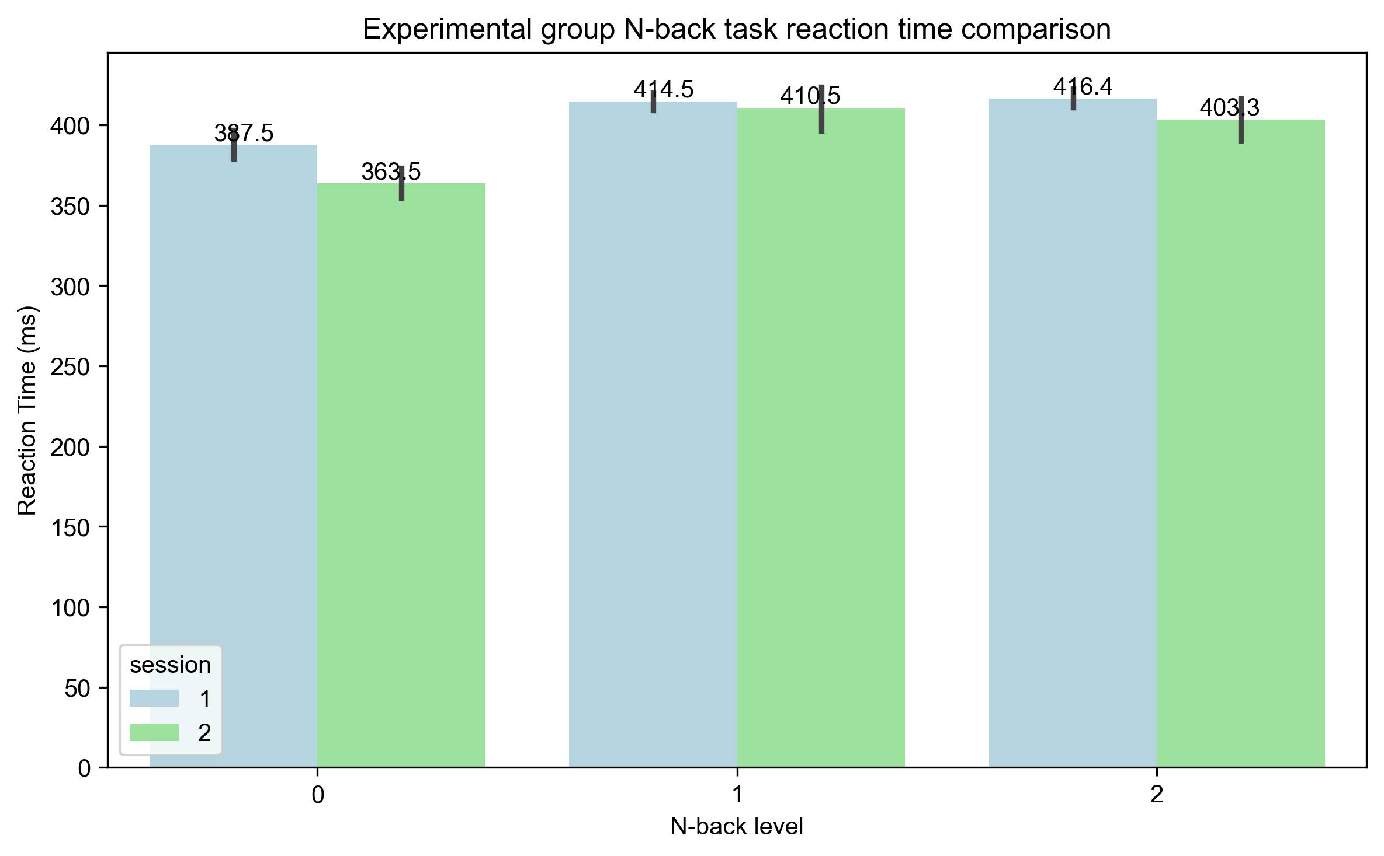
NBACK Task: Rt Comparison (Exp)
nback_rt_comparison_exp.png

Slide 27
EMOTION Task Results

Slide 28
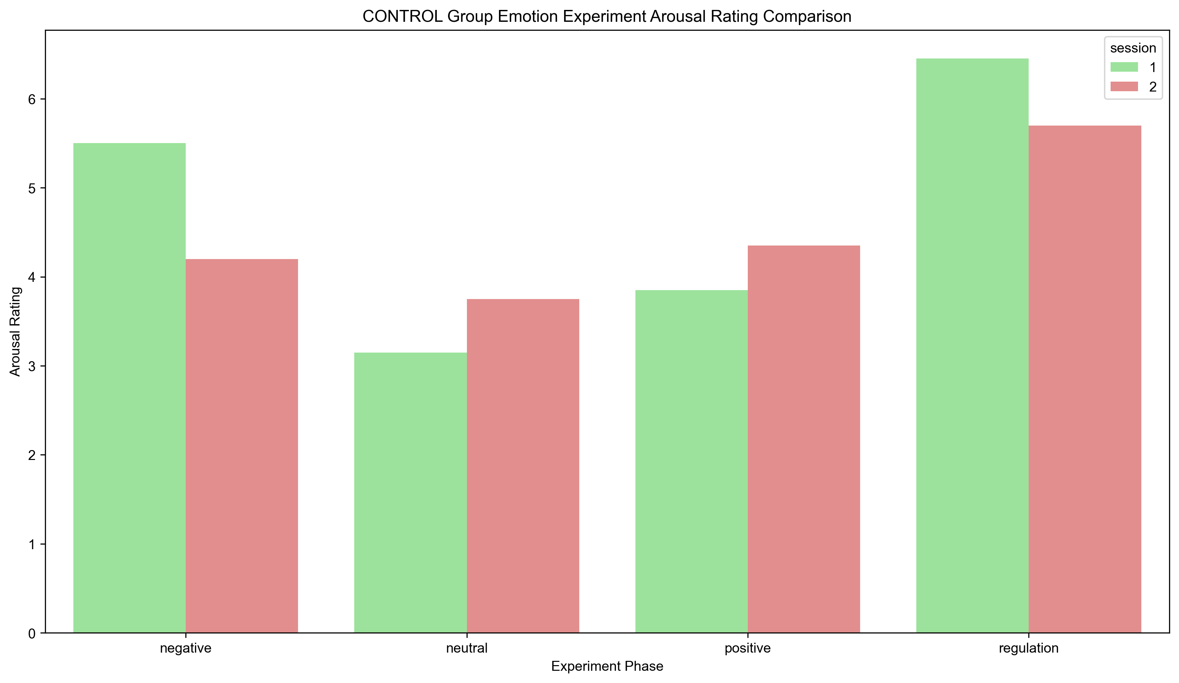
EMOTION Task: Mean Arousal (Control)
emotion_control_mean_arousal.png

Slide 29
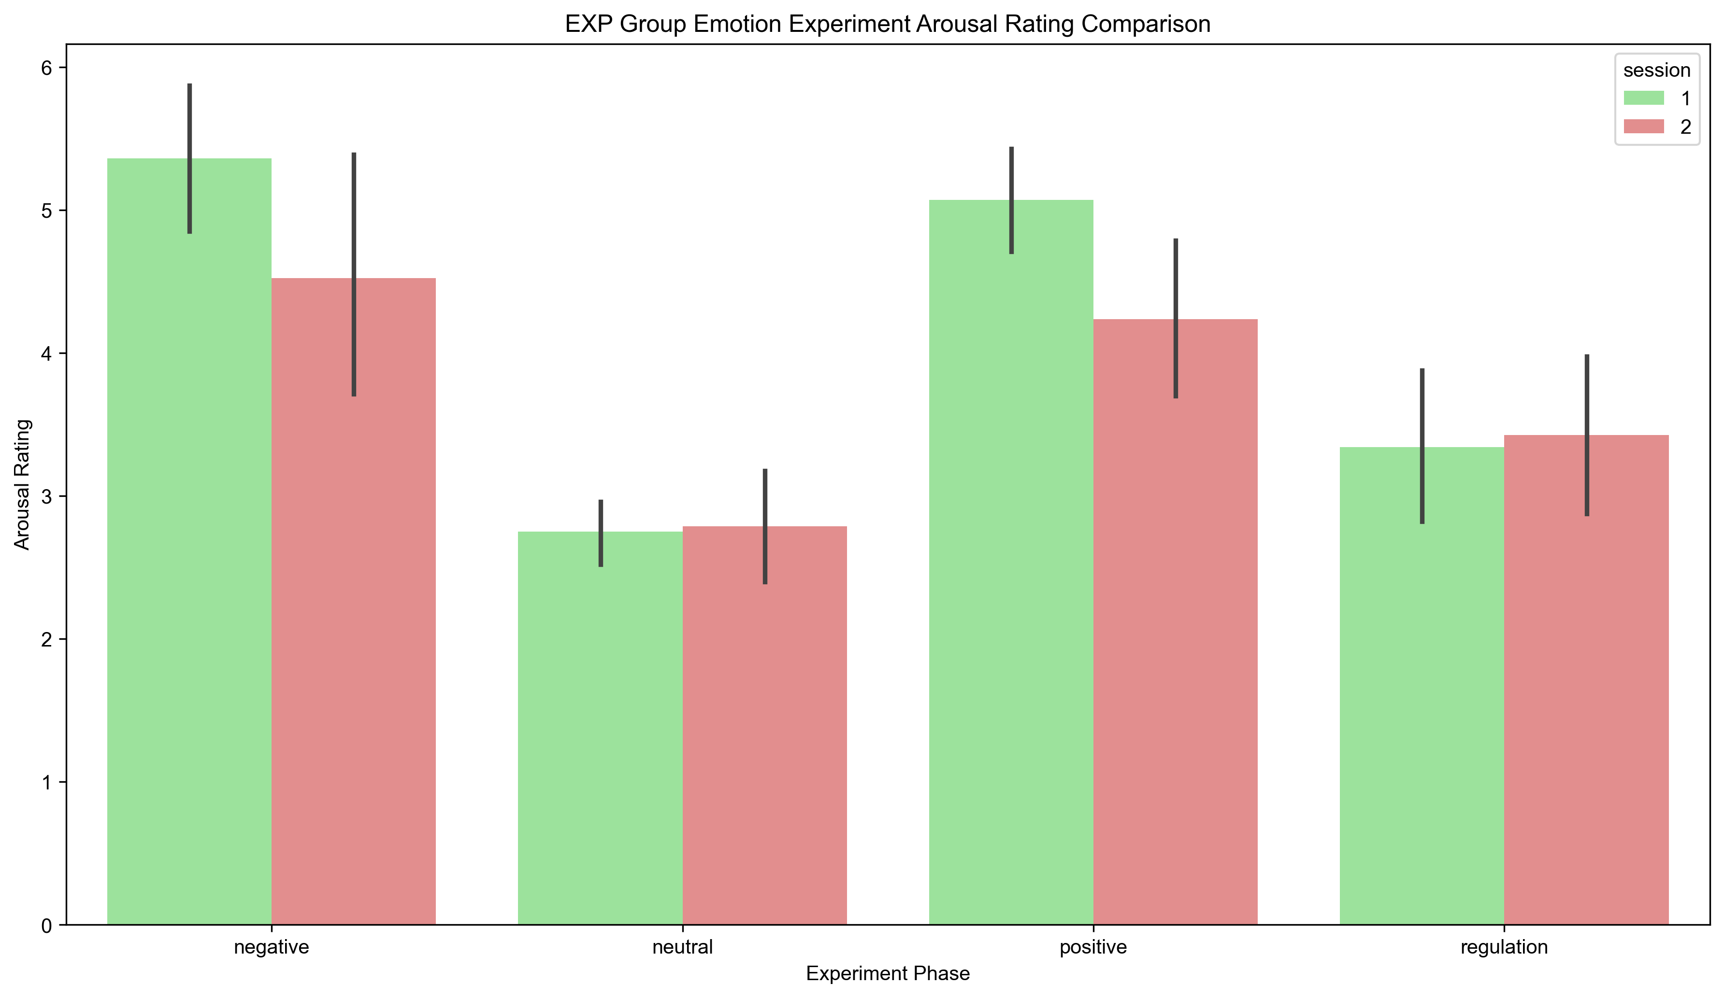
EMOTION Task: Mean Arousal (Exp)
emotion_exp_mean_arousal.png

Slide 30
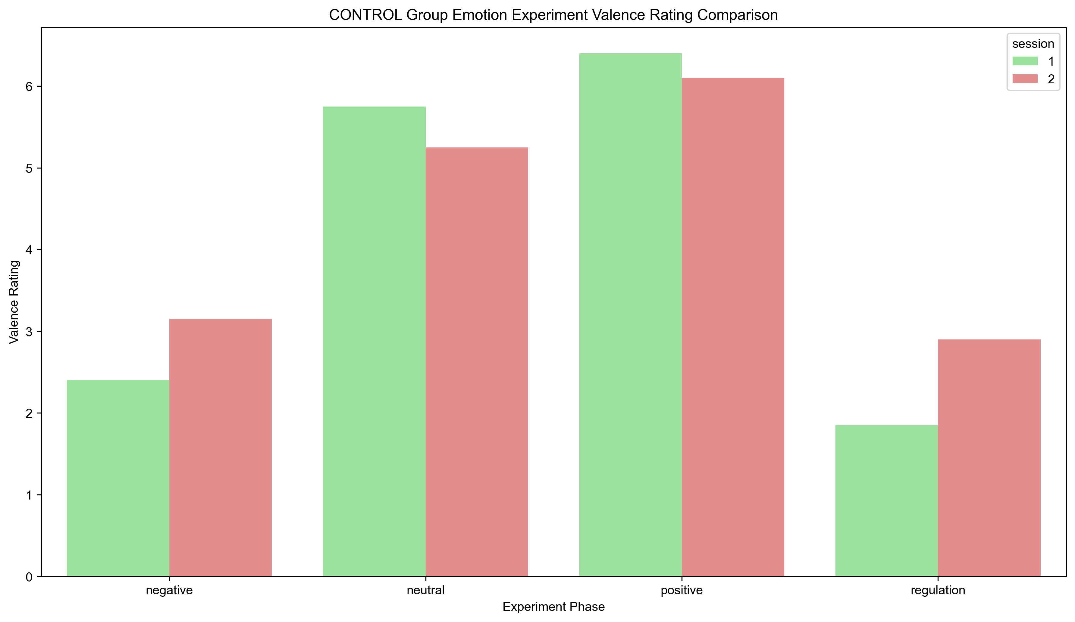
EMOTION Task: Mean Valence (Control)
emotion_control_mean_valence.png

Slide 31
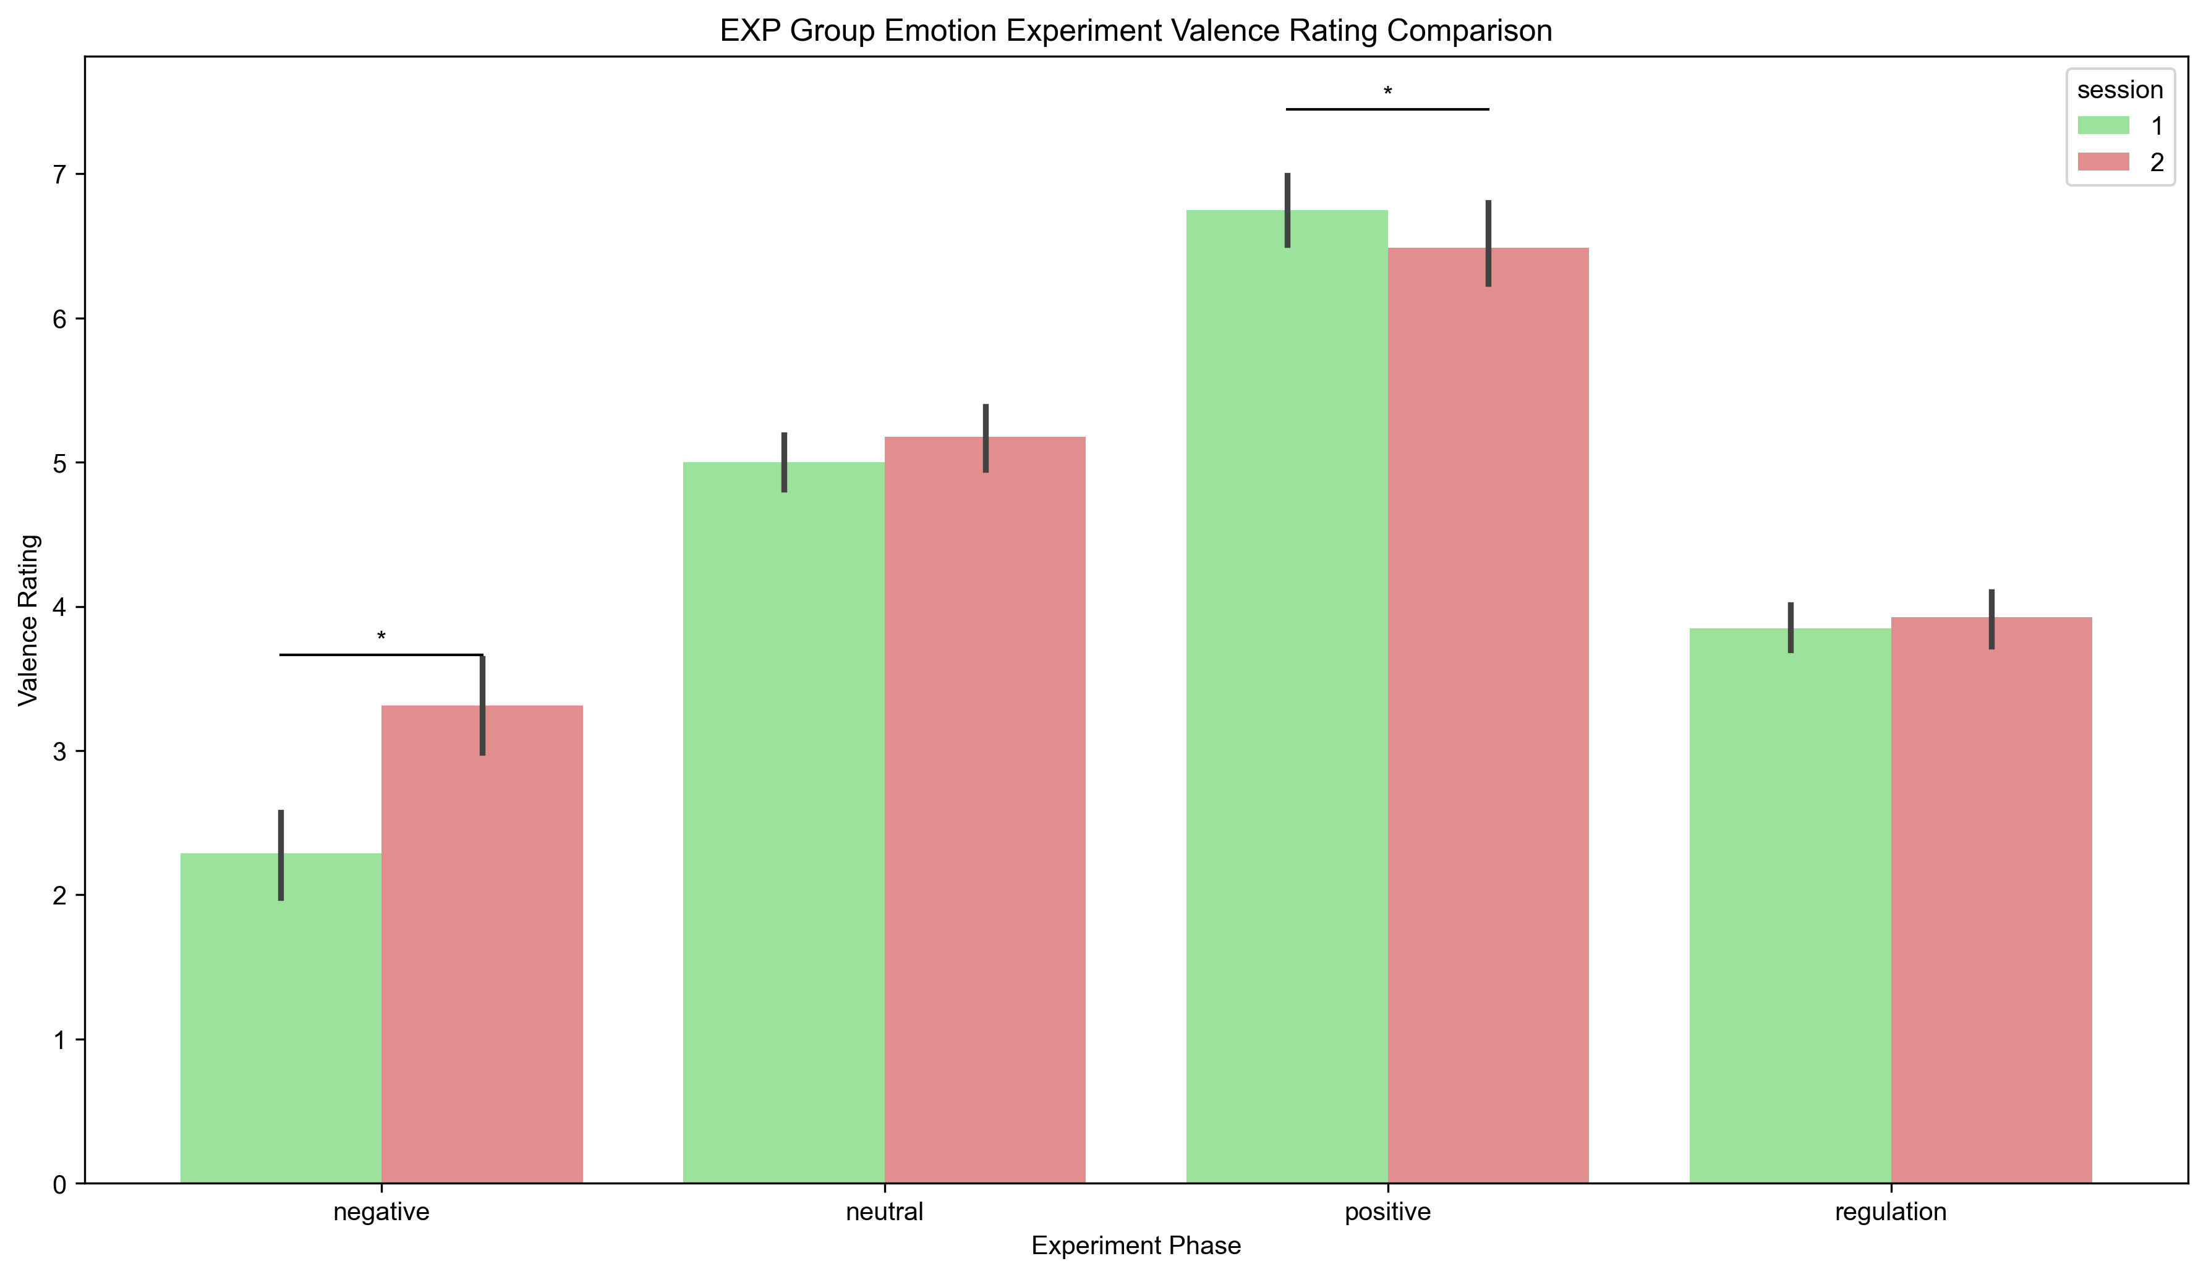
EMOTION Task: Mean Valence (Exp)
emotion_exp_mean_valence.png

