Slide 1

Population dynamics simulation
Modelling the Ecosystem of Rossumøya
Filip Rotnes & Sigve Sørensen

Slide 2
BioSim
BioSim
Upstream flow of information
Island
Island
Landscape
Animal

Slide 3
Structural example: The migration algorithm
BioSim
Island
Landscape
Animal
migrate_island()
get_random_landscapes()
neighbours = get_surrounding_landscapes(pos)
migrating()
is_herbivore()
new_grassland(neighbours)
is_carnivore()
new_hunting_land(neighbours)
migrate(neighbours)

Slide 4
General structure of decision-making
BioSim
Island
Landscape
Animal
Who
Where
If / how

Slide 5
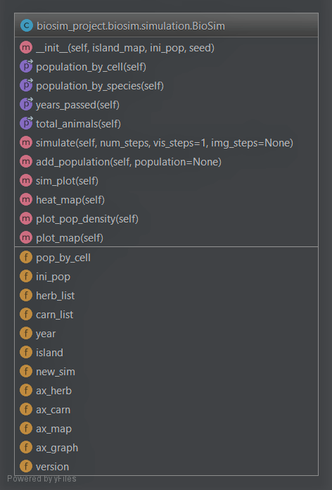
UML-diagrams

Slide 6
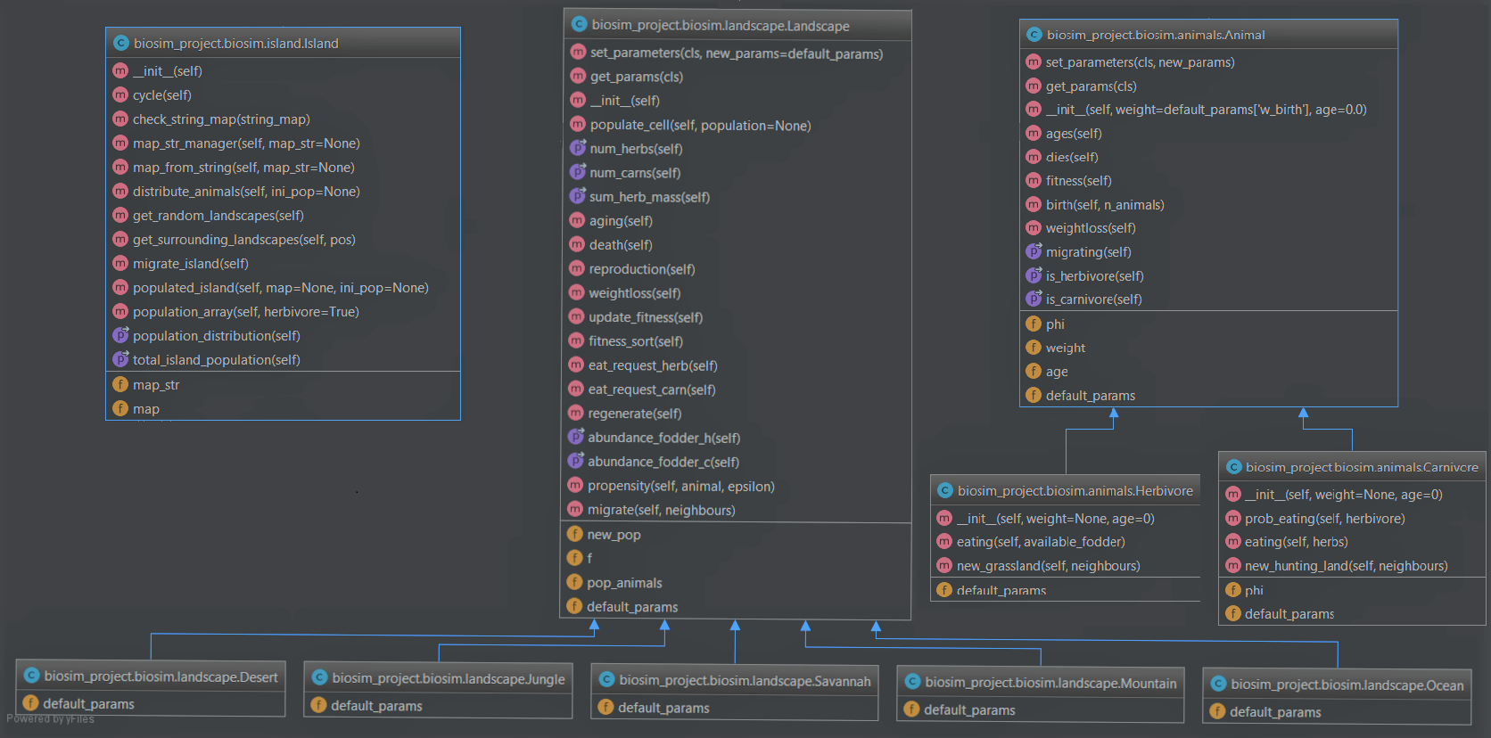

Slide 7
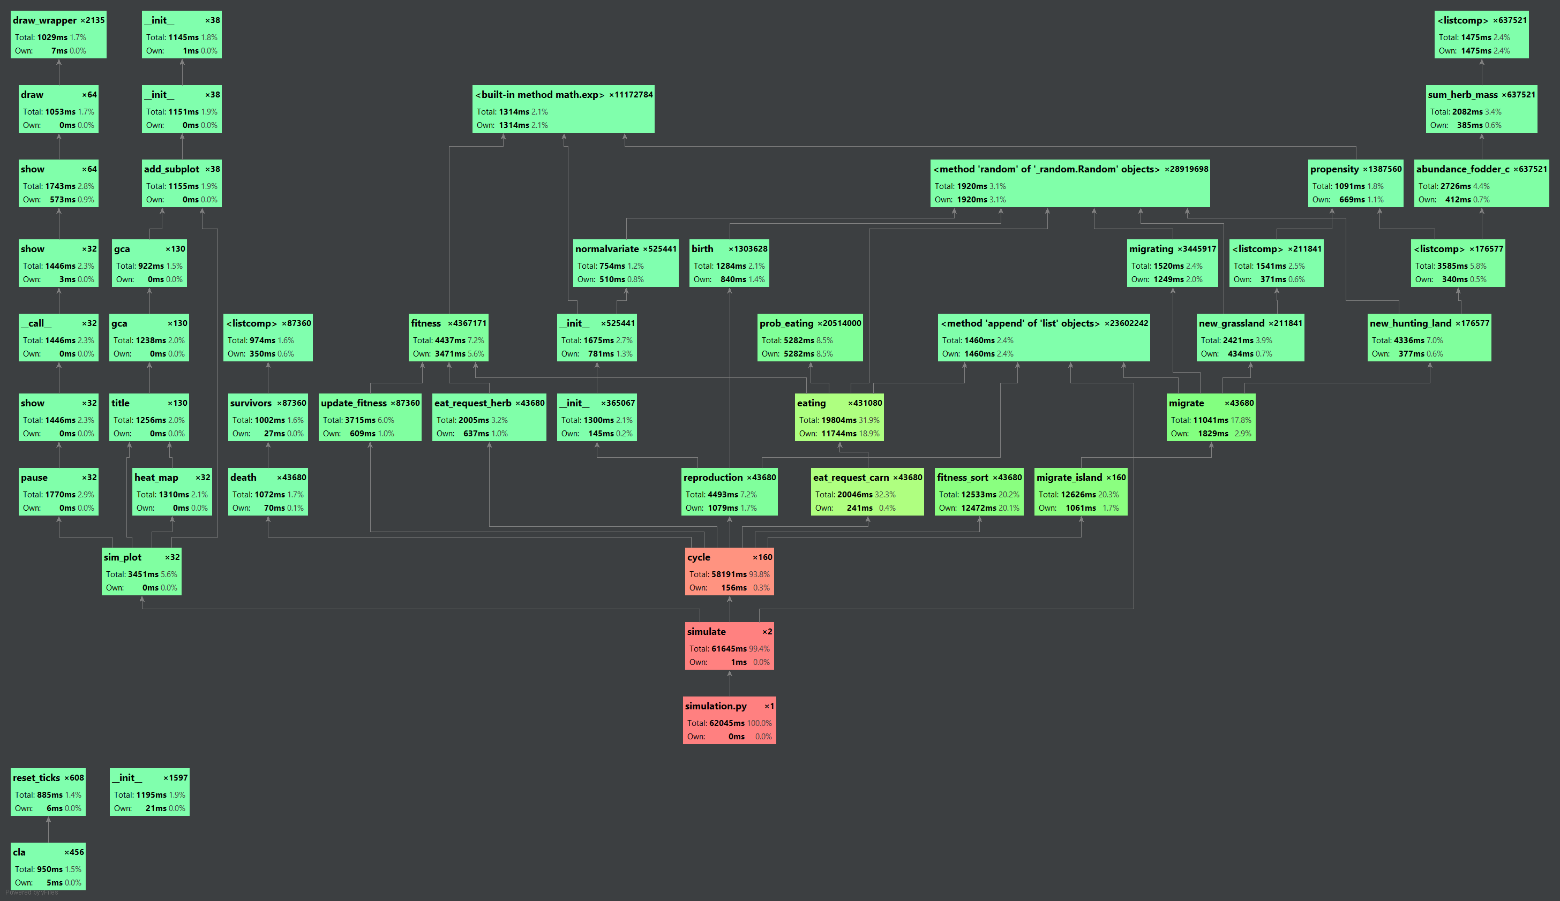

Slide 8
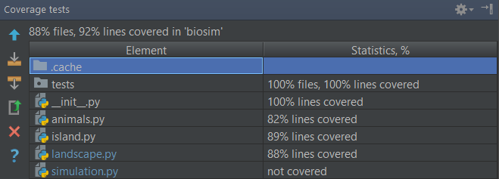
Test coverage
Notes:
Modulene ligger inni hverandre,
Prøver å gjøre ting på så lavt nivå som mulig

Slide 9
The code:
Tidy, categorical
Expandable
Focus on readability
Task specific functions
Benefits of the Numpy array

Slide 10
If we had better time:
Package completeness - Examples -> Model potential - User friendliness -> UI - Terminal -> GUI
Further statistical analysis
Optimization
Task specific functions
Diversify output data

