Slide 1
BioSim
BioSim
Upstream flow of information
Island
Island
Landscape
Animal

Slide 2
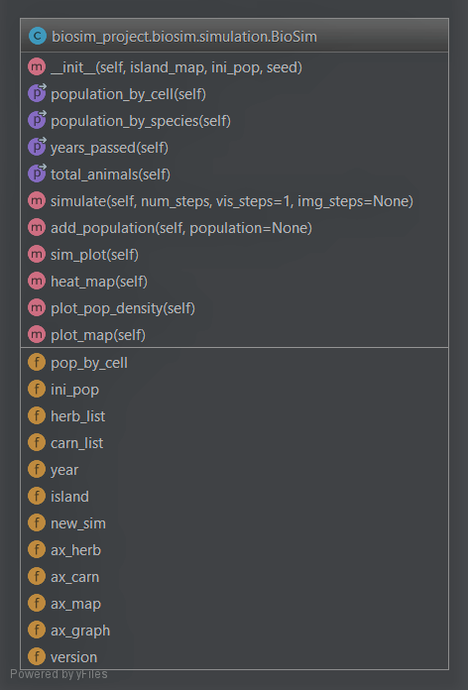
UML-diagram

Slide 3
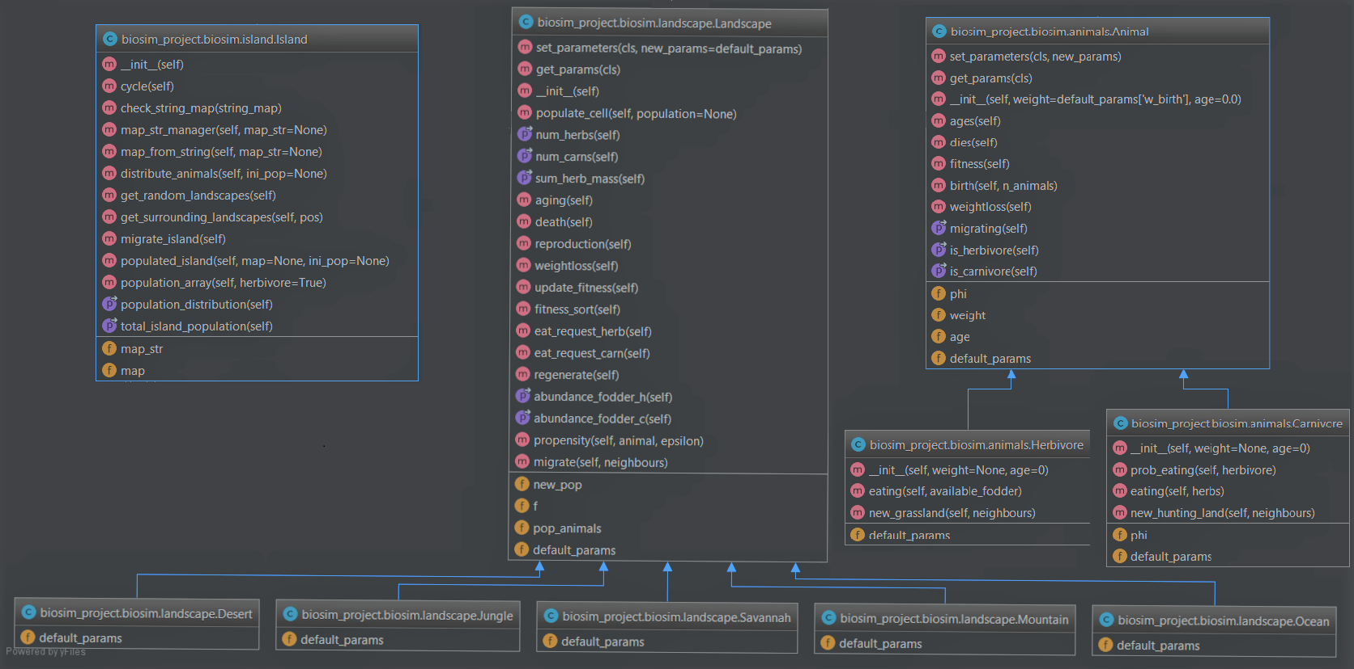

Slide 4
Structural example: The migration algorithm
BioSim
Island
Landscape
Animal
migrate_island()
get_random_landscapes()
neighbours = get_surrounding_landscapes(pos)
migrating()
is_herbivore()
new_grassland(neighbours)
is_carnivore()
new_hunting_land(neighbours)
migrate(neighbours)

Slide 5
General structure of decision-making
BioSim
Island
Landscape
Animal
Who
Where
If / how

Slide 6
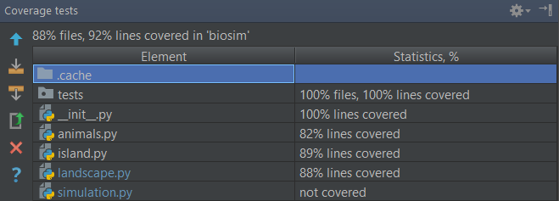
Test coverage
Notes:
Modulene ligger inni hverandre,
Prøver å gjøre ting på så lavt nivå som mulig

Slide 7
