Slide 1
07-10
손계원

Slide 2
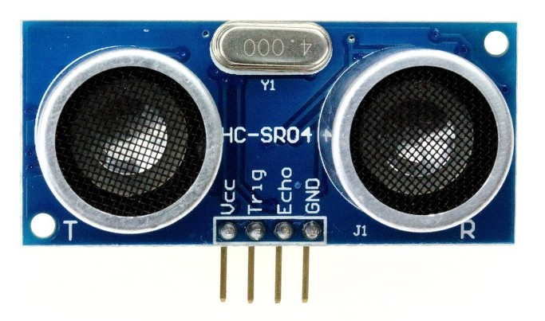
초음파 센서
초음파 입력
초음파 출력

Slide 3
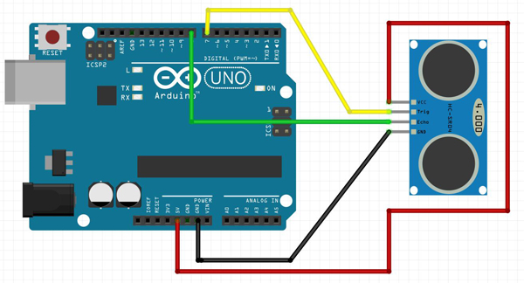
초음파 센서

Slide 4
초음파 센서
1 2 3 4 5 6 7 8 9 | #define TRIG 12 #define ECHO 13 void setup() { Serial.begin(9600); pinMode(TRIG,OUTPUT); pinMode(ECHO,INPUT); } | cs
1 2 3 4 5 6 7 8 9 10 11 12 13 | void loop() { int distance = 0; digitalWrite(TRIG,HIGH); delayMicroseconds(10); digitalWrite(TRIG,LOW); distance = pulseIn(ECHO,HIGH)/58.2; Serial.print("distance:"+(String)distance); Serial.println("cm"); } | cs

Slide 5

초음파 센서

Slide 6
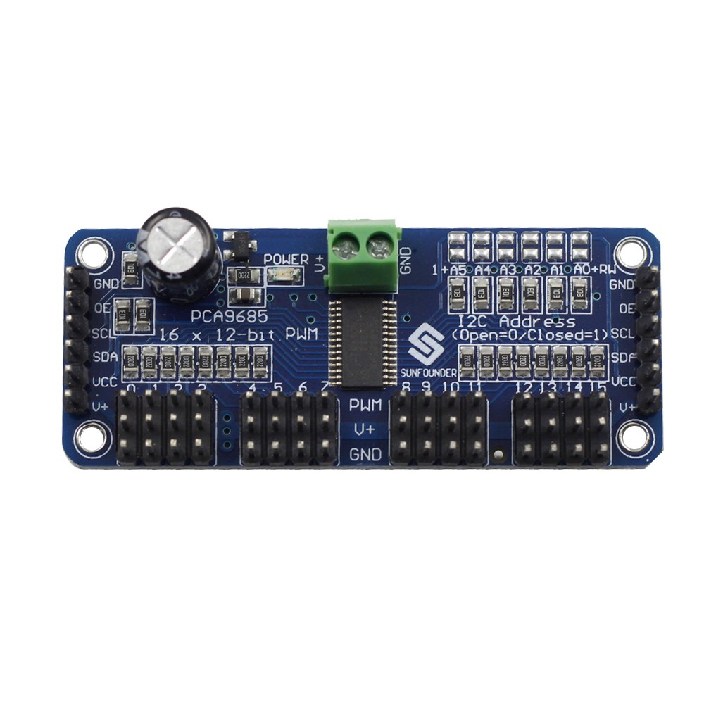
Servo driver
Adafruit_PWMServoDriver
pca9685

Slide 7
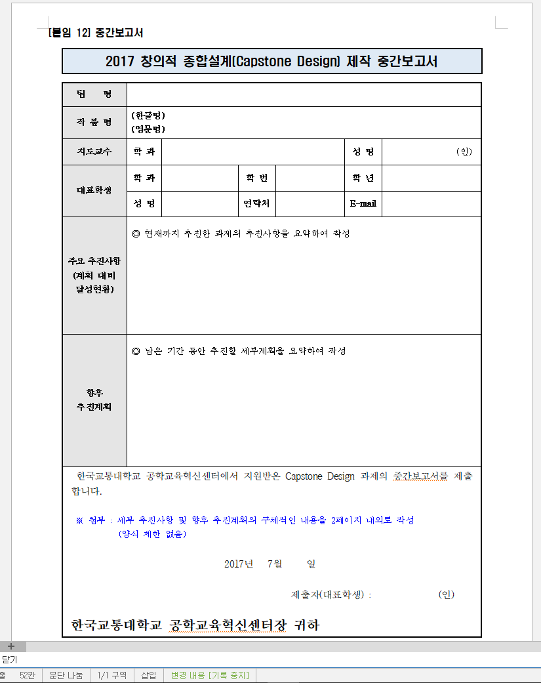
중간보고

