Slide 1
QCNN for Arbitrary Input Dimension
Team Peach IceTea
Members : Dong-Ha Kim, Si-Heon Park, Ju-Young Ryu, Jung-Han Lee
Mentor : Prof. Daniel K. Park

Slide 2
Table
Motivation
QCNN Models
QEC with QCNN
Future Works
Reference

Slide 3
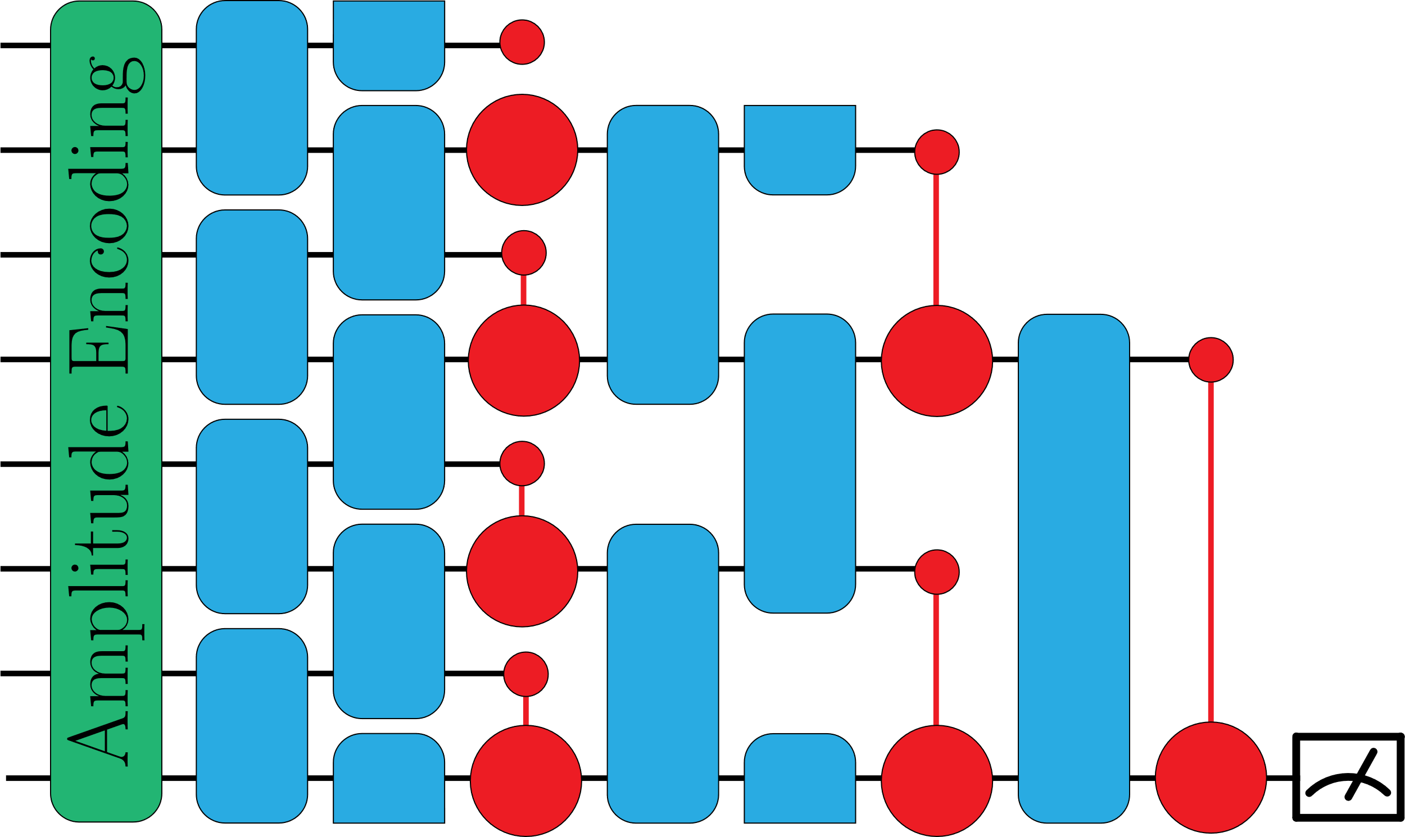
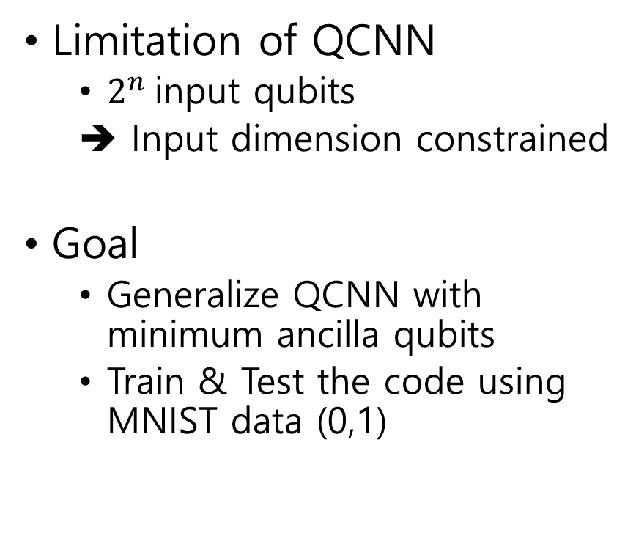
Motivation
Limitation of QCNN
$2^{n}$input qubits
➔ Input dimension constrained
Goal
Generalize QCNN with minimum ancilla qubits
Train & Test the code using MNIST data (0,1)

Slide 4
Structure of Our Code
Ansatz
code
QCNN Circuit
code
QCNN Train
code
MNIST
dataset
PCA
code

Slide 5
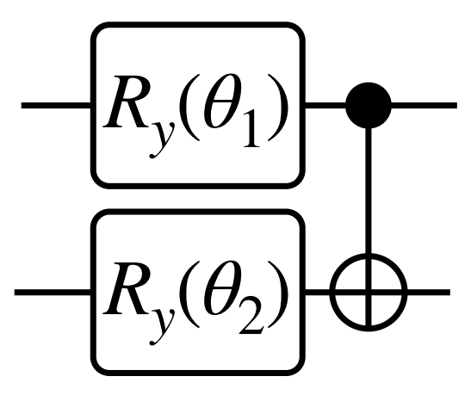
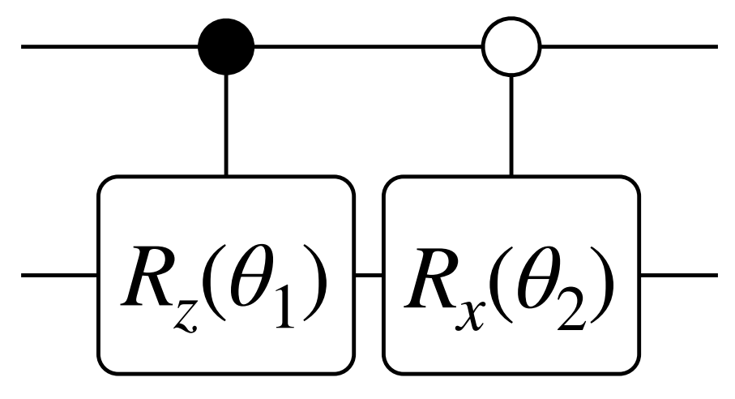
Ansatz
Short circuit, small # of parameters, decent accuracy
(a) Convolution layer ansatz
(b) Pooling layer ansatz
Ref. : Hur et al. Quantum Machine Intelligence, 2022

Slide 6

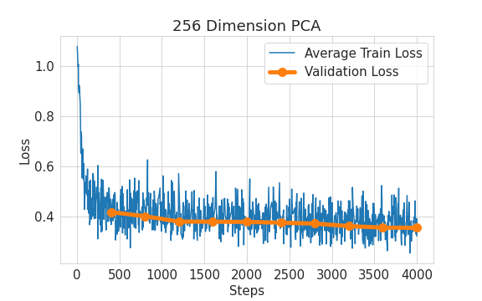
Conventional QCNN
Input data dimension : 256 (PCA)
Validation loss: No overfitting

Slide 7
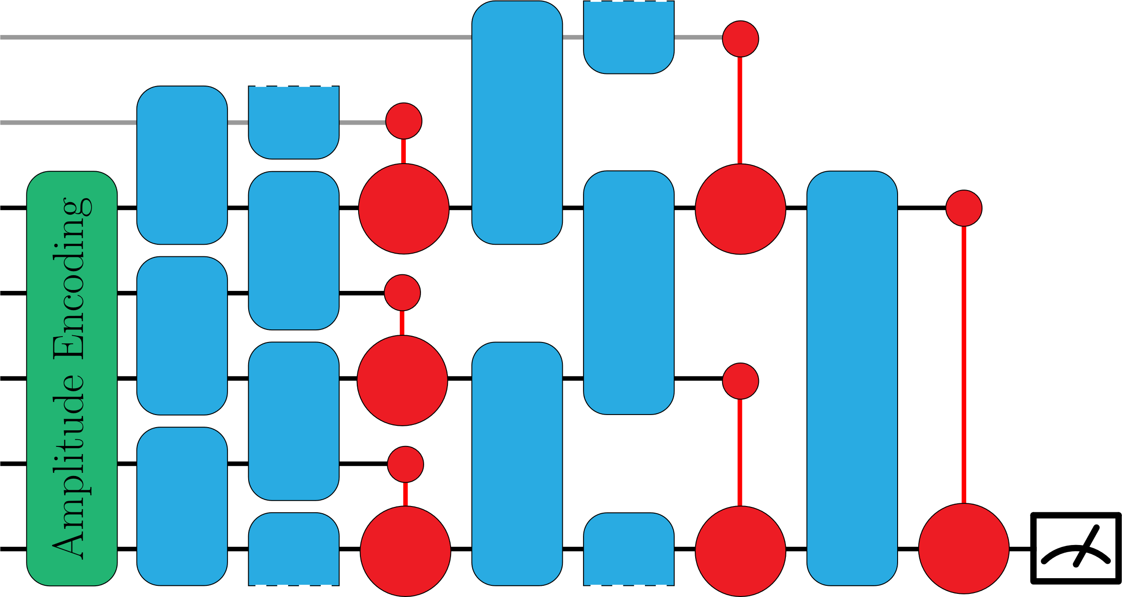
Custom QCNN models
Qubit-padding
Layer-wise padding
Add ancilla to odd qubit # layer
Single-ancilla padding
Add one ancilla & reuse
Data-padding
Zero-data padding
Add zeros to data
Periodic-data padding
Add original data
Layer-wise Padding

Slide 8
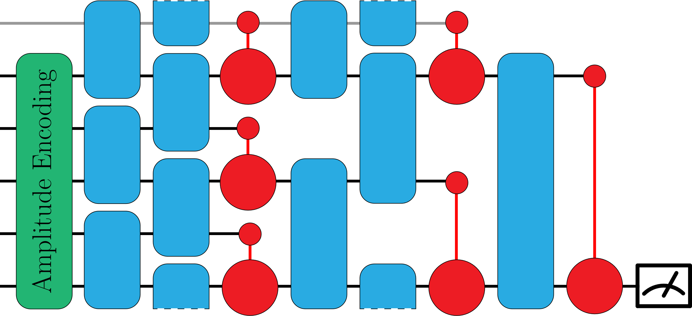
Custom QCNN models
Qubit-padding
Layer-wise padding
Add ancilla to odd qubit # layer
Single-ancilla padding
Add one ancilla & reuse
Data-padding
Zero-data padding
Add zeros to data
Periodic-data padding
Add original data
Single-ancilla Padding

Slide 9
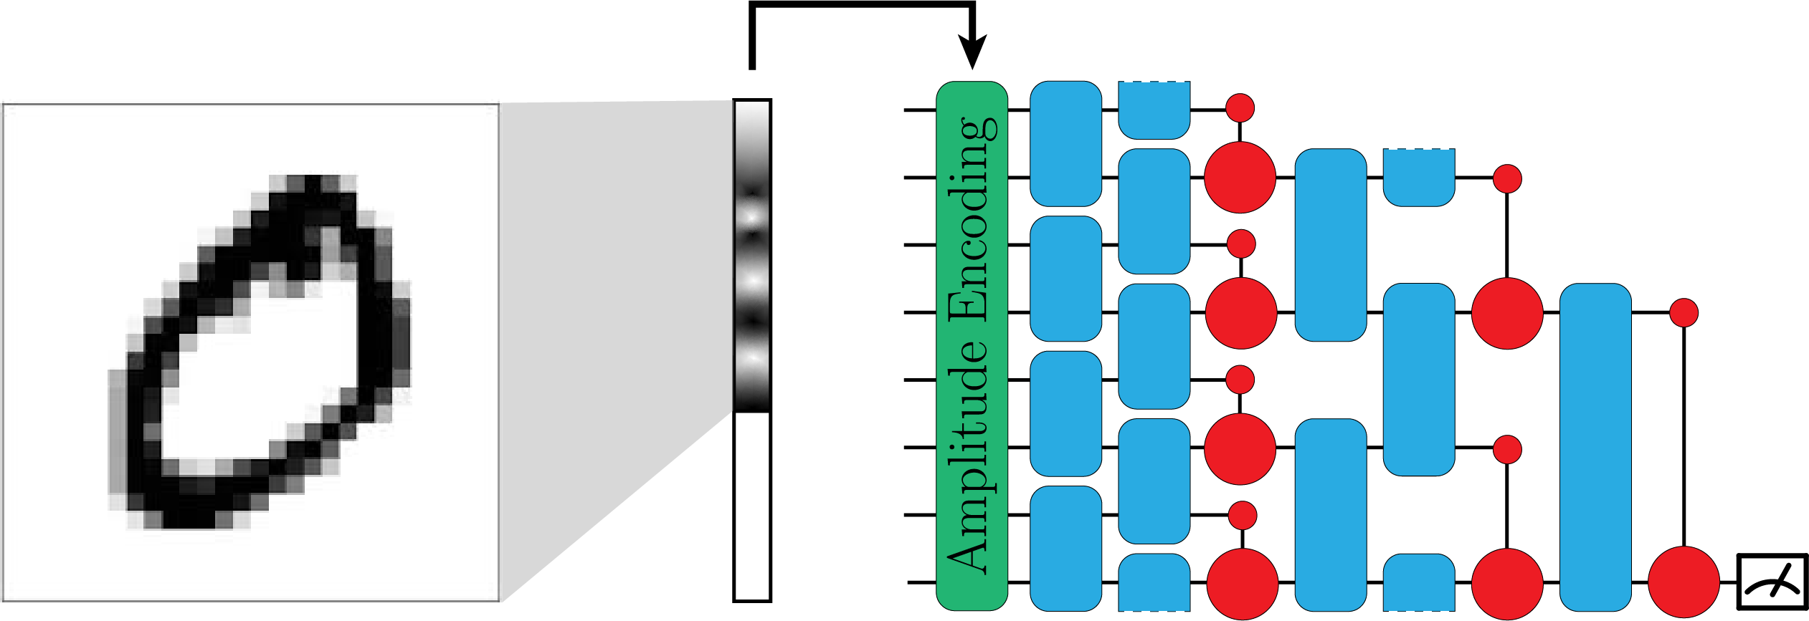
Custom QCNN models
Data-padding
Zero-data padding → Add zeros to data
Periodic-data padding → Add original data
Zero-data padding

Slide 10
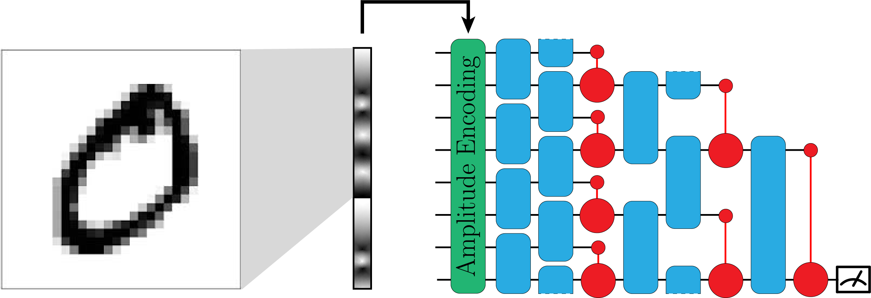
Custom QCNN models
Data-padding
Zero-data padding → Add zeros to data
Periodic-data padding → Add original data
Periodic-data padding

Slide 11
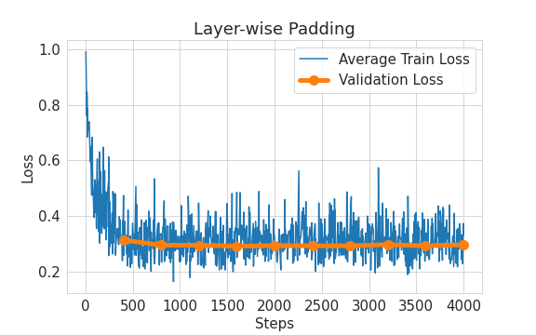
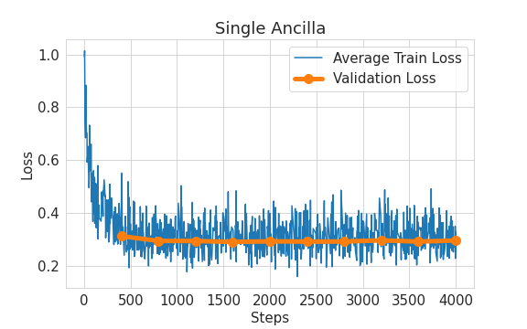
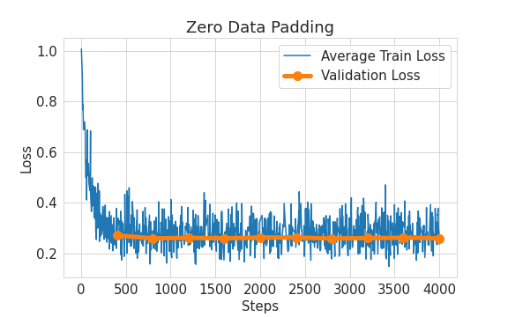
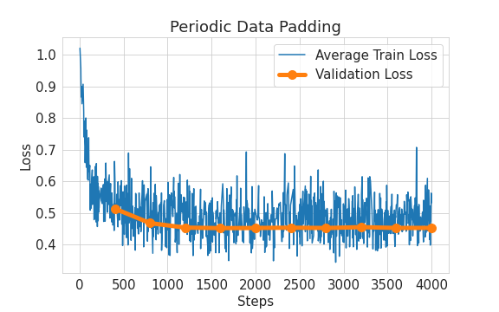
QCNN Models Results

Slide 12
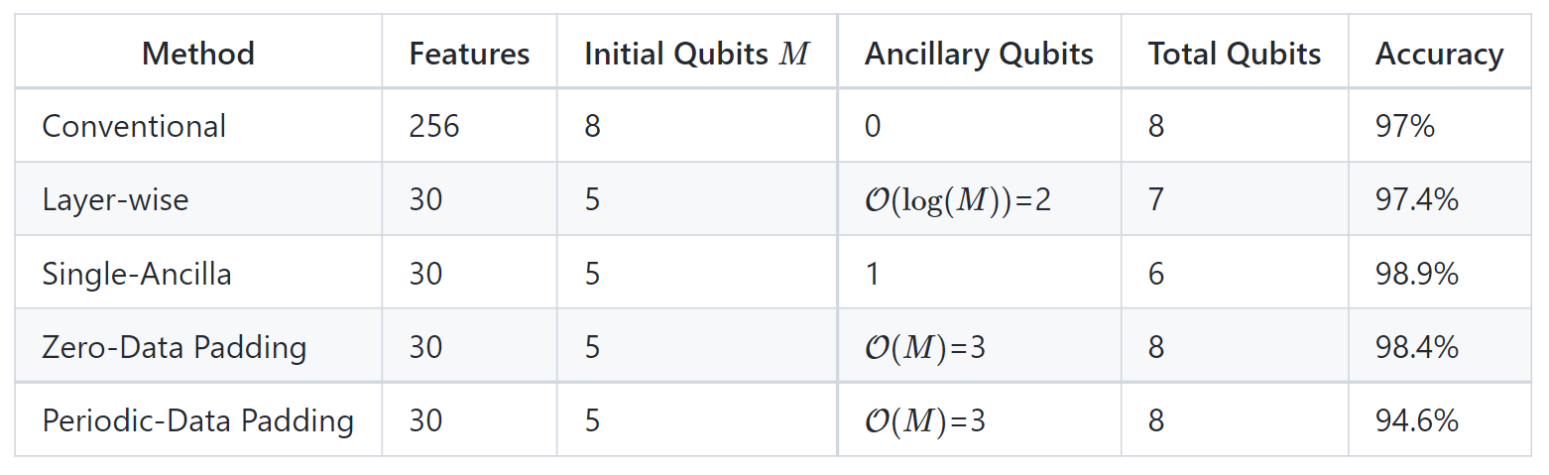
Results Summary

Slide 13
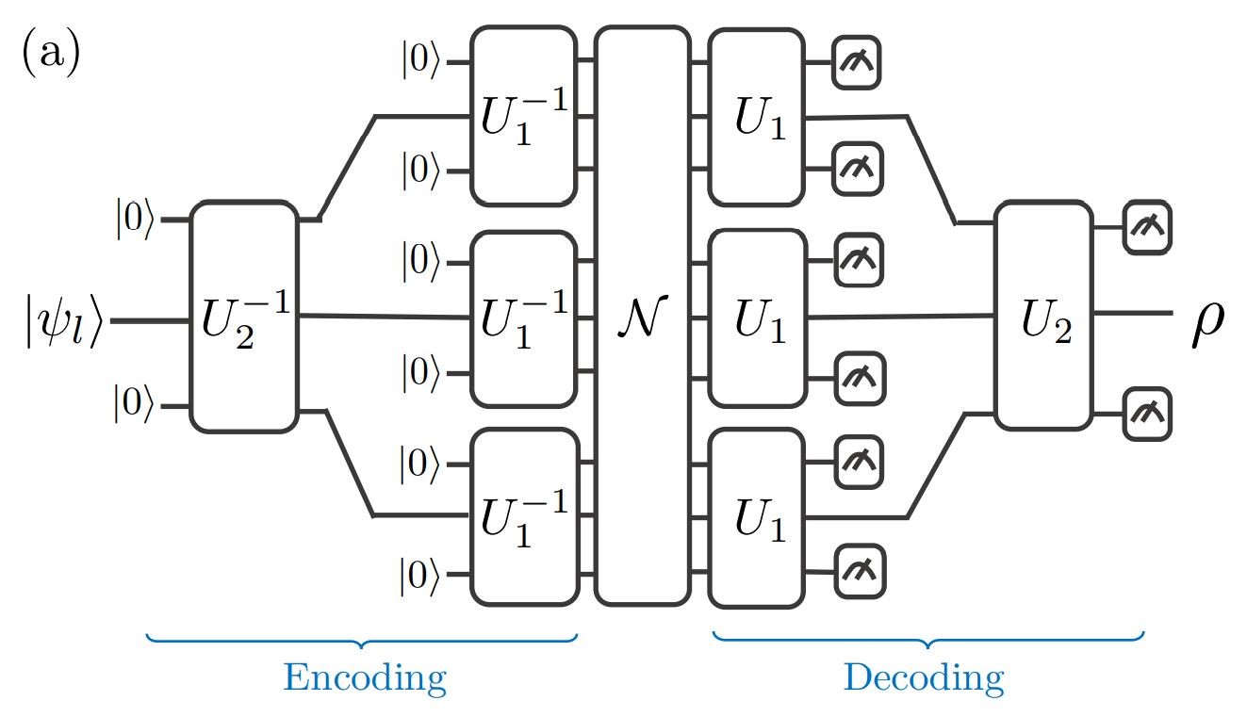
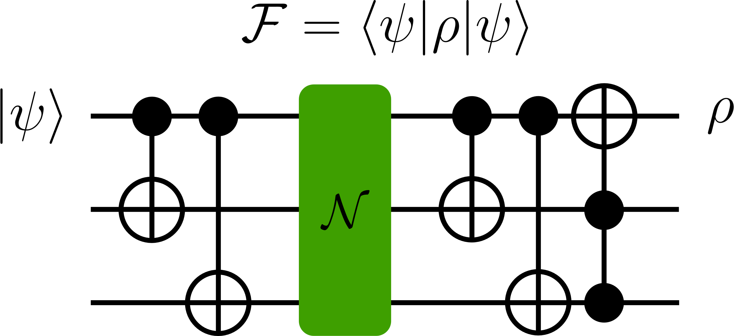
QEC Using QCNN
What if prime number of qubits are used in the encoding?
→ Try Single-ancilla padding!
Fig. ref. : Cong et al., Nature Physics, 2019

Slide 14
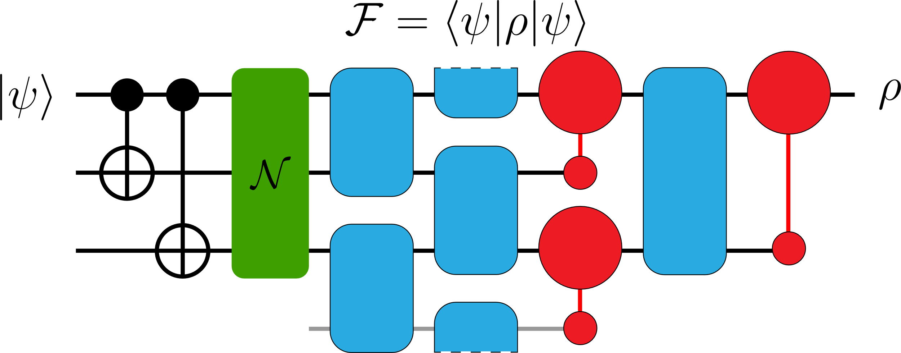
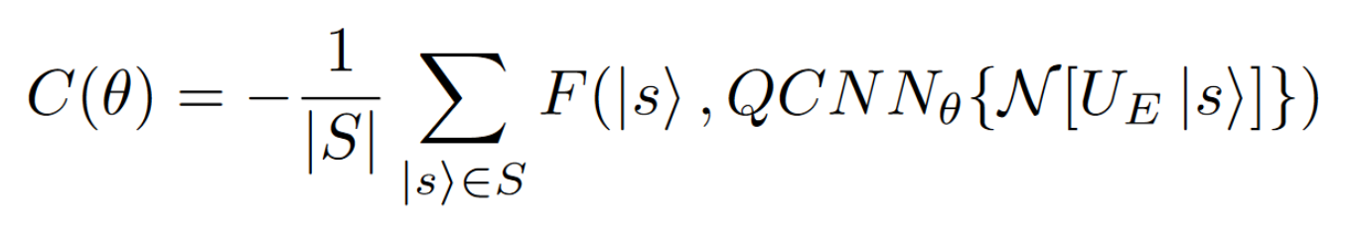
QEC Using QCNN

Slide 15
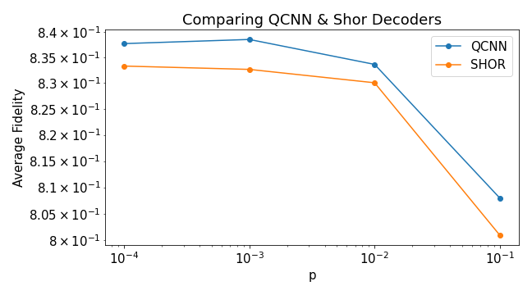
Results

Slide 16
Future Work
QCNN-wise
Different datasets (ex. Fashion MNIST)
Different ansatz
Different # of input qubits
QEC-wise
More qubits
Different error types?

Slide 17
Reference
T. Hur, L. Kim, and D. K. Park, “Quantum convolutional neural network for classical data classification,” Quantum Machine Intelligence, vol. 4, no. 1, pp. 1-18, 2022.
I. Cong, S. Choi, and M. D. Lukin, “Quantum convolutional neural networks,” Nature Physics, vol. 15, no. 12, pp. 1273-1278, 2019.

