Slide 1


AquaSolution
1.SIHLE MHLONGO 0656458602 6.ANTHONY SHISHOKI 0835533210
2.MAMELLO MOLEPO 0637256925 7.BATHABILE ZANDILE 0637234846 3.LUTENDO MATSHIDZE 0714368748
4.COVENANT THEMBA 0825123466 8.DIVINE MAKGOALE 0725440584
5.HAPPY MABENA 0829525292 9.LESEGO SETENA 0796464293

Slide 2
Problem Statement
Inadequate water sanitation can lead to the spread of waterborne diseases such as diarrhoea and cholera.
Contaminated water sources and inadequate sanitation practices can pollute water bodies leading to ecosystem degradation and harmful to aquatic life.

Slide 3
Solution
Data Analytics and algorithms
Pattern and Trends
Real-time update

Slide 4
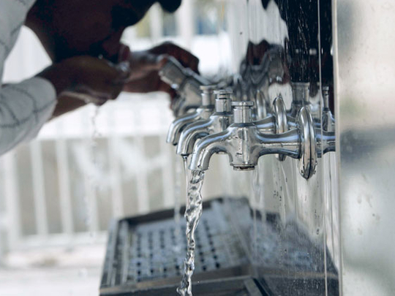
Commercialization
Marketing
Prototyping
Funding

Slide 5
Competitors
Non-profit organisation
Water utility companies

Slide 6
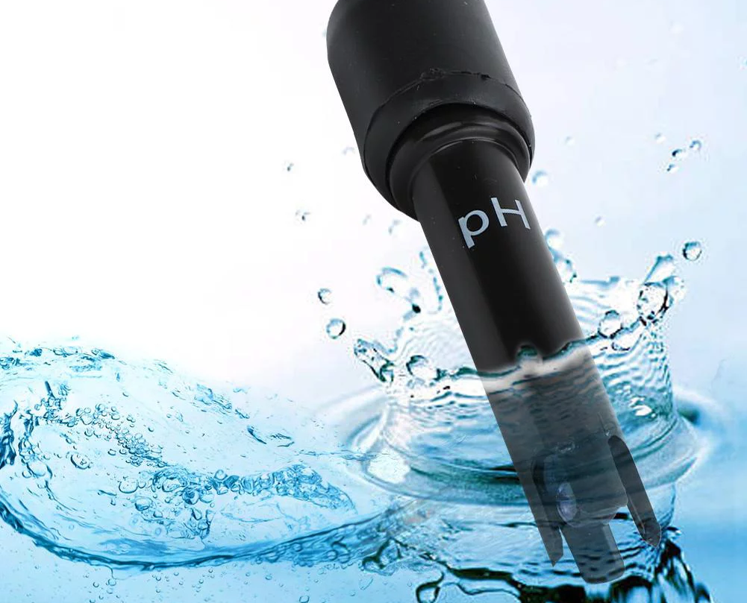
Uniqueness(Competitive Advantage)
pH sensor
Paper strip
Laboratories

Slide 7
Target Market
Communities and rural areas
Non-profit and humanitarian organization
Government agencies and policymakers
Individual and households

Slide 8
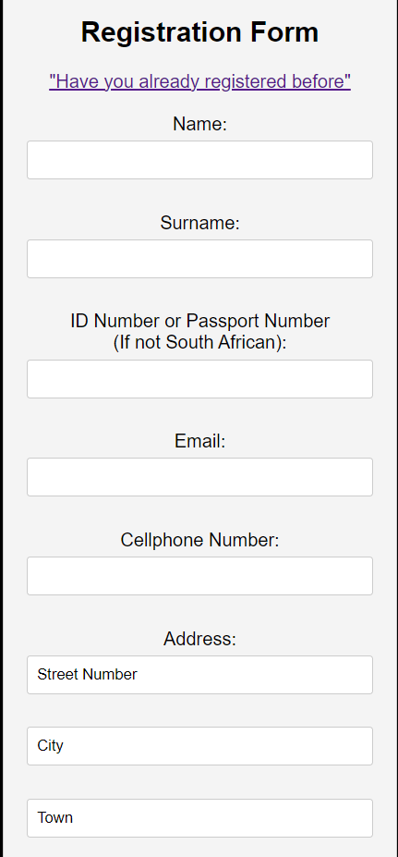
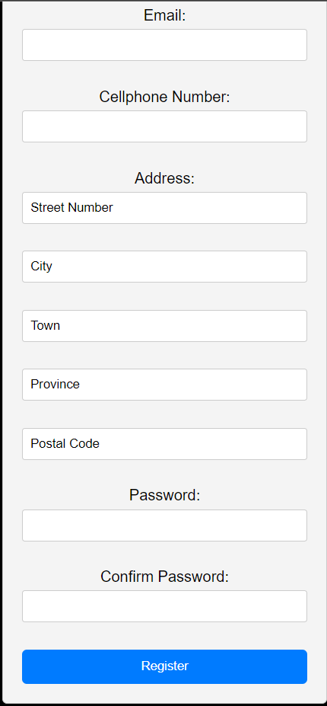
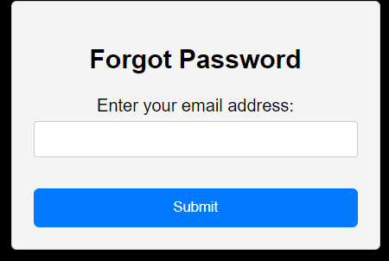
How our app looks like:

Slide 9
