Slide 1
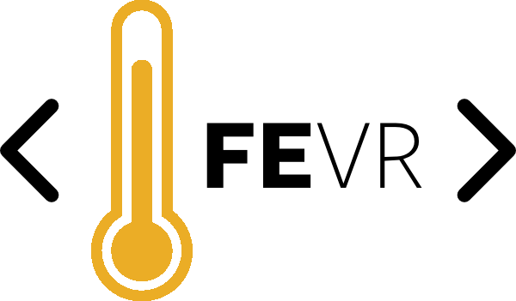
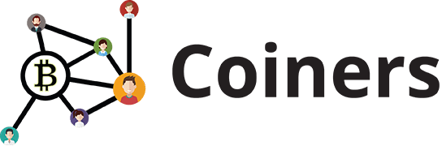

Blockchain
Javascript

Slide 2
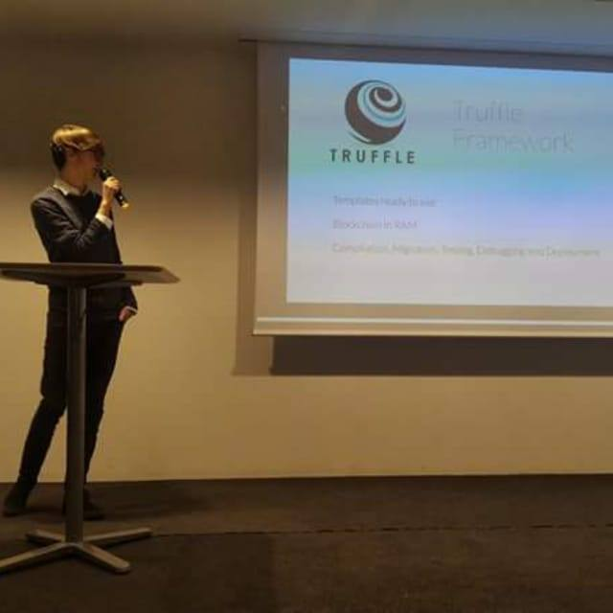

Simone Da Re
Full Stack Developer
Blockchain Enthusiast & Student
Follow me on LinkedIn

Slide 3
Blockchain
«
Blockchain is a distributed database that maintains a continuously-growing list of records called blocks secured from tampering and revision.
«

Slide 4
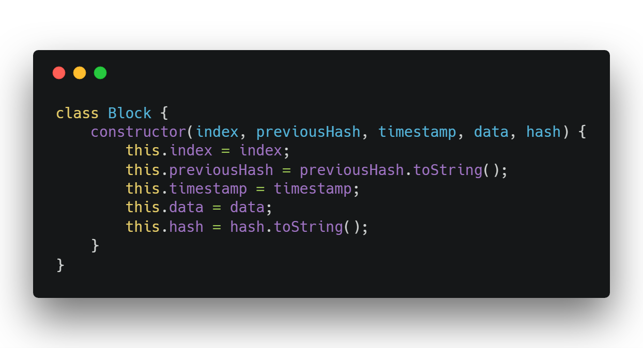
Blockchain in 200 lines of code

Slide 5
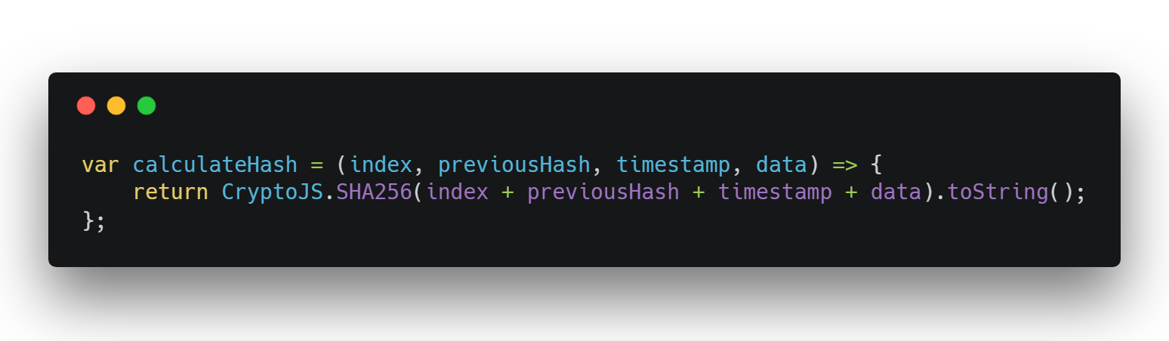
Ethash, POS soon?

Slide 6
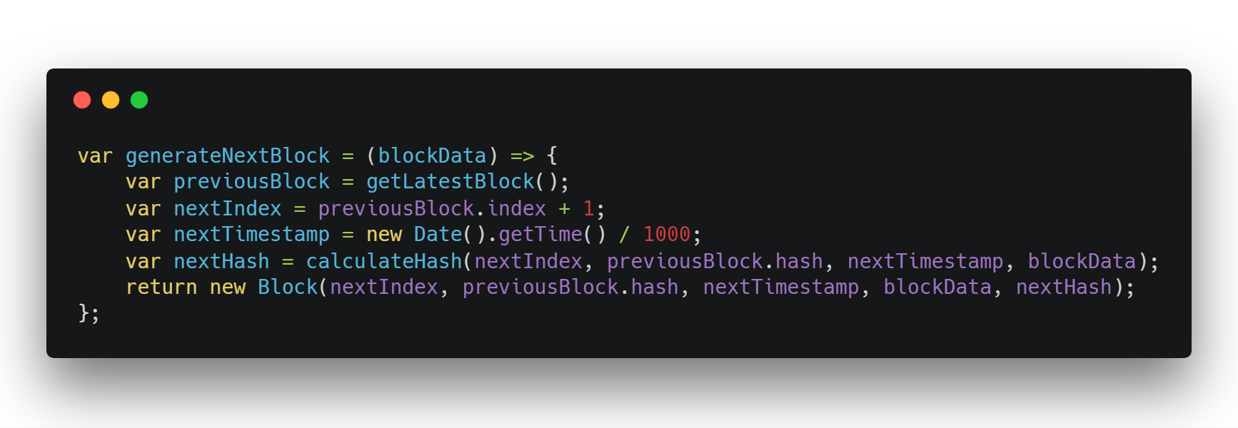
Ethereum Blocks

Slide 7
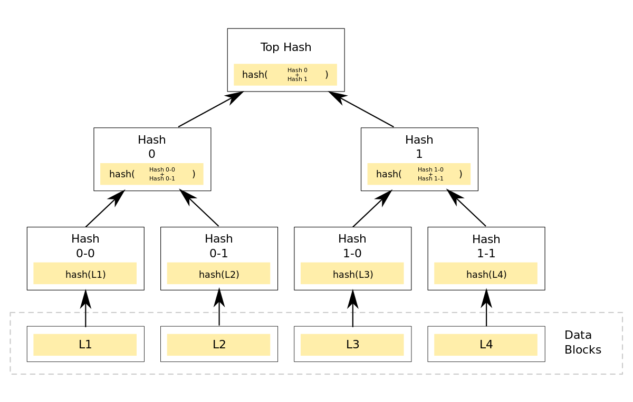
Merkle Tree

Slide 8
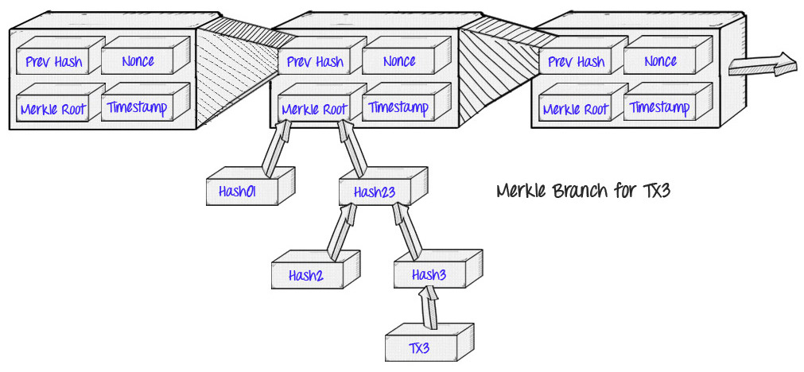
Complete structure of blocks

Slide 9
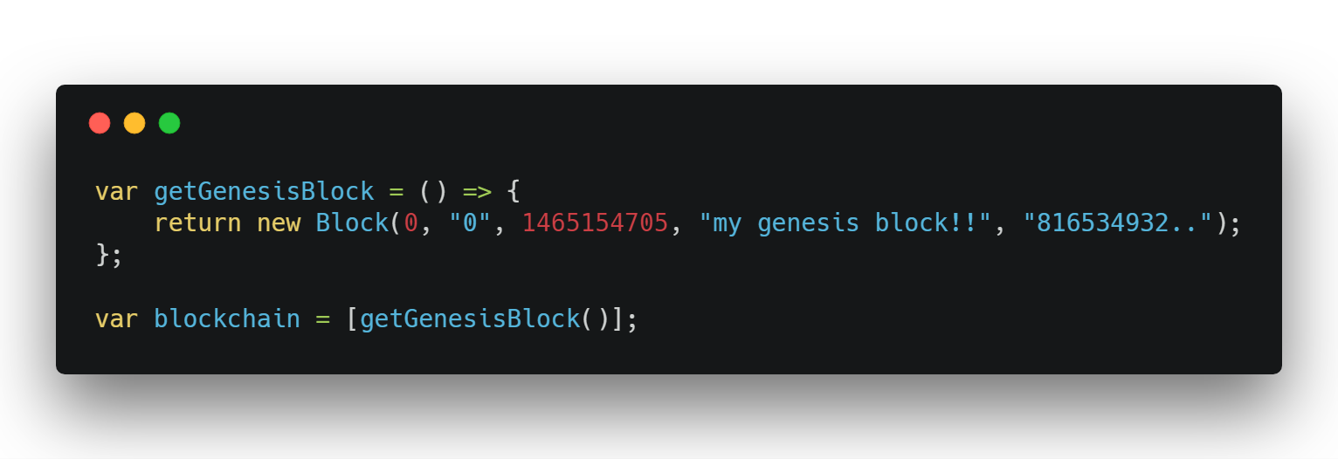
Blockchain Genesis Blocks

Slide 10
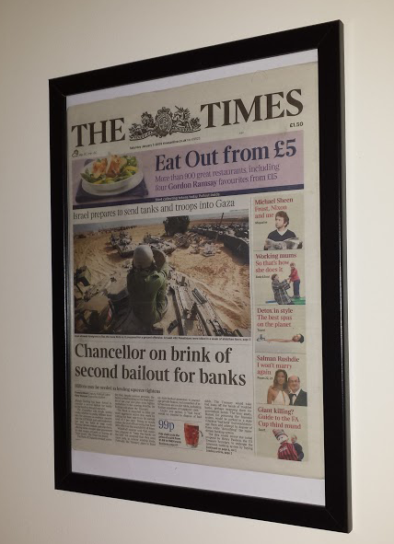
Bitcoin Genesis Block
«
The Times 03/Jan/2009
Chancellor on brink of
second bailout for banks
«

Slide 11

Ethereum Genesis Address
0x0000000000000000000000000000000000000000

Slide 12
Ethereum Virtual Machine
«
It is a quasi-Turing complete machine; the quasi qualification comes from the fact that the computation is intrinsically bounded through a parameter, gas, which limits the total amount of computation done.
«

Slide 13
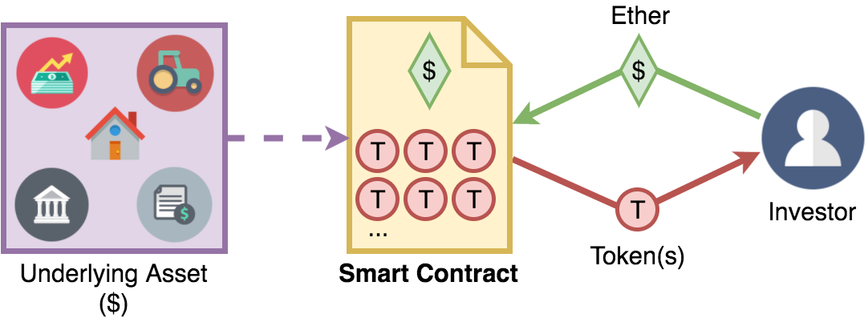
Smart Contract
Smart contracts help you exchange money, property, shares, or anything of value in a transparent,
conflict-free way while avoiding the services of a middleman.

Slide 14
The structure of DApps
smart contract
HTML/CSS
smart contract
Blockchain
Javascript
smart contract

Slide 15
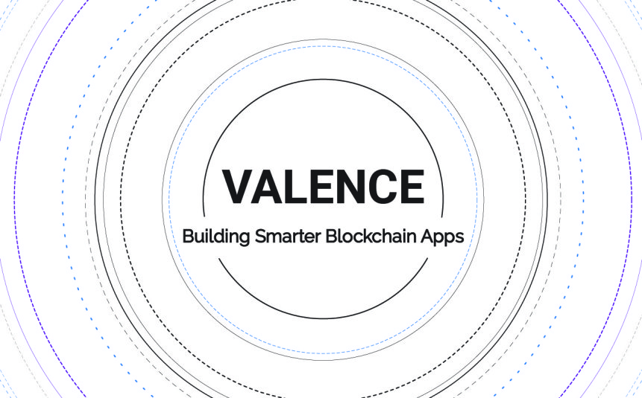

ADApps – Anonymous DApps

Slide 16
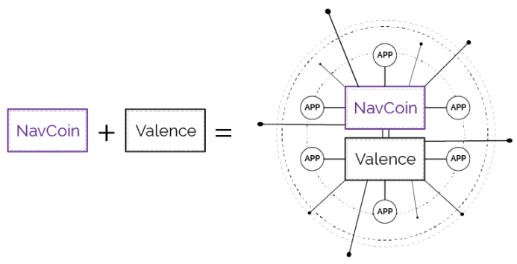
Valence Structure

Slide 17

Web3.js
Ethereum compatible JavaScript API which implements the Generic JSON RPC spec.

Slide 18
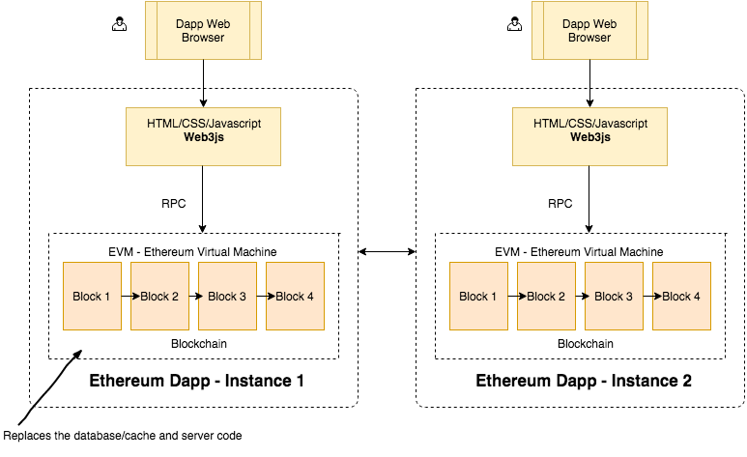
Dapps – Decentralized Applications

Slide 19

Truffle
Framework
Templates ready to use
Blockchain in RAM
Compilation, Migration, Testing, Debugging and Deployment

Slide 20

Metamask
Chrome and Firefox extension
Full Ethereum Node
Smart Contract Bridge

Slide 21




Vieni a trovarci sui social!

