Slide 1
Delay Discounting as a Latent Variable
- Md Allama Ikbal Sijan

Slide 2



Introduction
Introduction
Method
Data Analysis
Results
Discussion
Delay Discounting refers to the tendency of individuals to prefer immediate rewards/gratification over delayed/future rewards.

Slide 3

Introduction
Introduction
Method
Data Analysis
Results
Discussion
Delay Discounting refers to the tendency of individuals to prefer immediate rewards/gratification over delayed/future rewards.

Slide 4
Introduction
Introduction
Method
Data Analysis
Results
Discussion
Delay Discounting refers to the tendency of individuals to prefer immediate rewards/gratification over delayed/future rewards.

Slide 5
Introduction
Introduction
Method
Data Analysis
Results
Discussion
Delay Discounting refers to the tendency of individuals to prefer immediate rewards/gratification over delayed/future rewards.

Slide 6
Introduction
Introduction
Method
Data Analysis
Results
Discussion
Delay Discounting refers to the tendency of individuals to prefer immediate rewards/gratification over delayed/future rewards.
Notes:
Healthy eating (future health) vs. eating junk food (immediate pleasure).
Getting a job right after undergrad vs. staying broke for extra five years in hope for some future reward

Slide 7
Introduction
Introduction
Method
Data Analysis
Results
Discussion
Delay Discounting (human):
outcomes = {
"Gambling",
"Substance Abuse",
"Credit Card Debt",
"Impulsive Decision-Making",
"Poor Academic Performance"
}
return outcomes
Error `Inconsistent relationships` between delay discounting and outcome var across studies
Notes:
due to variation in operationalization methods.

Slide 8
Introduction
Introduction
Method
Data Analysis
Results
Discussion
Types of delay discounting task:
Binary Choice Task
Titration Task
Matching Task
Experiential Discounting Task
Monetary vs Non-Monetary Rewards
Hypothetical vs Non-hypothetical Rewards
Limited research exploring the latent factors
Notes:
Binary Choice Task: Participants choose between a smaller-sooner or larger-later monetary reward (e.g., $30 now or $50 in 1 month).
Titration Task: Similar to binary choice tasks, Rewards adjust based on participants’ previous responses.
Matching Task: Participants fill in the missing value to indicate indifference between two rewards (e.g., $30 now or $__ in 1 month).
Experiential Discounting Task: Participants make binary choices and experience the delays and rewards in real time.
Understanding the latent factors would be useful in determining the root cause of inconsistencies across different studies regarding the relationship with behavioral outcomes and even a more realistic understanding of these relationships.

Slide 9

Hypotheses & Research Question
Introduction
Method
Data Analysis
Results
Discussion
# Hypothesis 1: The delay discounting items will share enough common variance for a latent variable CFA to fit the data well.
# Hypothesis 2: Delay discounting will exhibit stronger correlations with associated constructs at the latent factor level compared to the observed level (e.g., scale scores).
# Research Question 1: Will a one-factor or multi-factor model provide the best fit to the data?

Slide 10
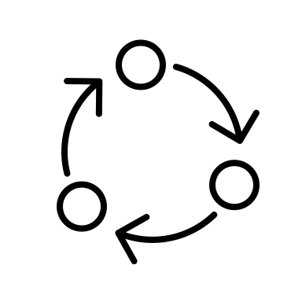
Method
# Sample:
500 Undergraduate SONA participants
# Procedure:
-> Qualtrics
-> Matching Task (12 delay-discounting items)
-> Academic Procrastination Scale (5 items)
-> Goal Setting Formative Questionnaire (19 items)
-> BIS (30 items)
-> AUDIT (10 items)
-> Discounting Inventory (12 items)
-> Demographic Variables
Introduction
Method
Data Analysis
Results
Discussion
How much (in dollars) would you need to receive to value the two rewards equally?
`Defer Task`: $40 today or $__ in 1 month
`Expedite Task`: $__ today or $40 in 1 month
Notes:
Age = 20.14, SD = 3.4
Male = 24%, Female = 73%
White = 51%, Black = 17%

Slide 11


Data Analysis
# Cleaning:
Character type ?
Removing `$`, comma(,), period(.) if at end
$__ + text responses -> NA
Convert to Numeric type
# Missing Data Analysis:
T-test (Age)
Chi-square test (Gender, Race)
# Discount Rate Conversion:
Introduction
Method
Data Analysis
Results
Discussion
r = $\frac{log⁡(\frac{X_{t+h}}{X_{t}})}{(\frac{h}{12})}$
Notes:
5 people had texts in their responses
X­_{t} is the magnitude of the smaller-sooner reward, X_{t+h} is the magnitude of the larger later reward and h is the additional delay associated with the larger later reward.

Slide 12

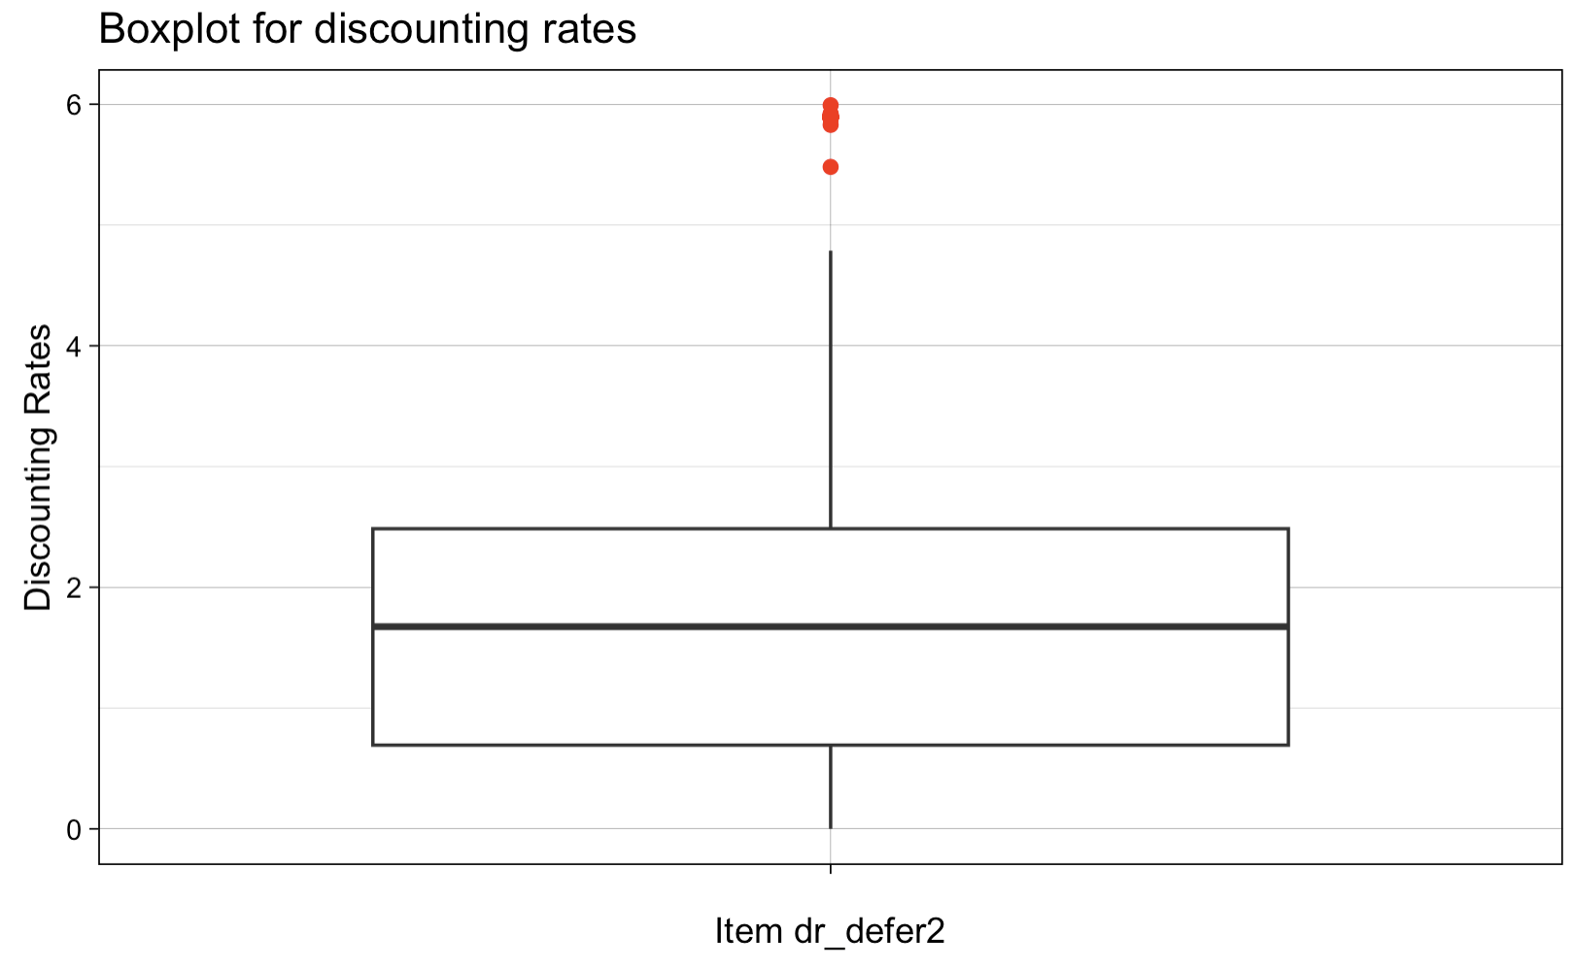
Data Analysis
# Outliers Identification
Convert Discount Rates (DR) -> Z-scores
DR with Z-scores > |3| -> NA
Negative Discount Rates (DR) -> NA
Introduction
Method
Data Analysis
Results
Discussion

Slide 13

Multivariate Analysis
# Assumptions Check
Sufficient Sample Size (n > 200)
Multivariate Outliers
No Multicollinearity
Linearity (Latent Factors ~ items)
# CFA Models
One Factor Model
Two Factor Model
Four-Factor Model
Introduction
Method
Data Analysis
Results
Discussion

Slide 14
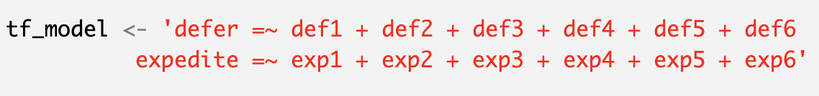
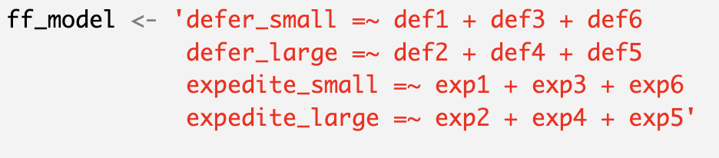
Multivariate Analysis
Introduction
Method
Data Analysis
Results
Discussion
# One Factor Model
# Two Factor Model
# Four Factor Model
Notes:
Missing Data were handled using (Full Information Maximum Likelihood) FIML Imputation

Slide 15



Results
# Missing Data Analysis
Age: t-test, t (6.41) = -0.17, p = 0.87
Gender: Chi-square test, χ² (4) = 0.65, p = 0.95
Race: Chi-square test, χ² (6) = 5.81, p = 0.44
# Assumption Checks
Sufficient Sample Size
Issues of Multicollinearity ("expedite3," "expedite4," "expedite6" )
Linearity
Introduction
Method
Data Analysis
Results
Discussion

Slide 16
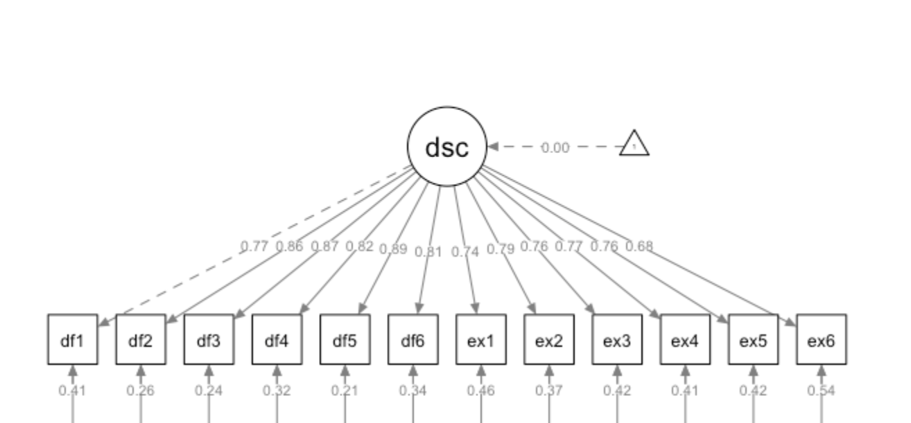
One Factor Model
dsc -> discount
df1 to df6 -> defer items
ex1 to ex6 -> expedite items
Latent Factor
Factor Loadings
CFI = .72
RMSEA = .24
SRMR = .109
Avg R² = .60
Error Variances
n = 497
Notes:
Error Variance – part of the total variance in an observed variable that is not explained by the underlying latent factor(s)

Slide 17
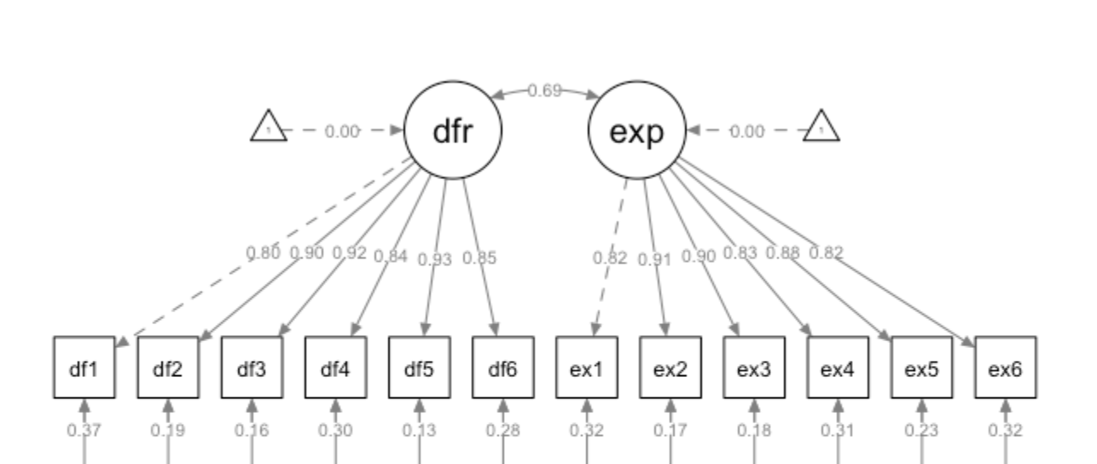
Two Factor Model
dfr -> defer
exp -> expedite
CFI = .94
RMSEA = .12
SRMR = .04
Avg R² = .69
n = 497
Notes:
Generally good factor loadings (over 0.7) but the fit indices suggest poor fit.

Slide 18
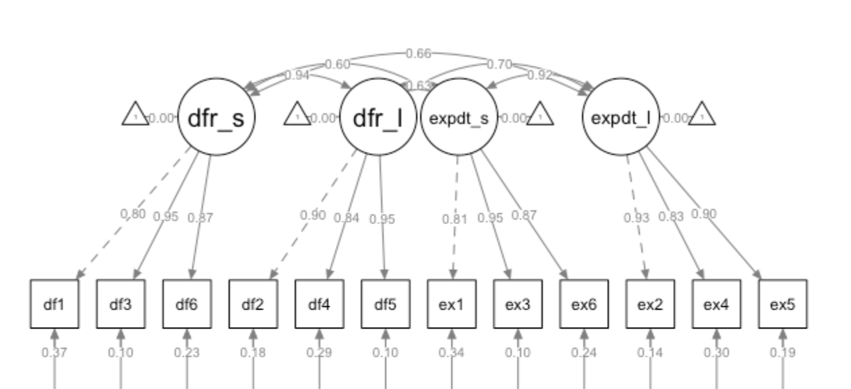
Four Factor Model
dfr_s -> defer_small
dfr_l -> defer_large
expdt_s -> expedite_small
expdt_l -> expedite_large
CFI = .96
RMSEA = .10
SRMR = .04
Avg R² = .69
n = 497
Notes:
Generally good factor loadings (over 0.7) but the fit indices suggest poor fit.

Slide 19
Results
# Likelihood Ratio Test
One vs. Two Factor: χ² (1) = 1180.6 , p < 0.001
Two vs. Four Factor: χ² (5) = 145.55, p < 0.001
Introduction
Method
Data Analysis
Results
Discussion

Slide 20
Discussion
# Hypothesis 1
Not Supported
# Research Question 1
Multifactor Model fits the data better
# Implications
Better understand the role of underlying factors in associated behavioral outcomes
Insights for refining reward structures, interventions or marketing strategies in organizations.
Introduction
Method
Data Analysis
Results
Discussion

Slide 21
Discussion
# Limitations
Multicollinearity
Low Internal Consistency for four factor model
# Future Directions
Use larger number of items
Different delay discounting tasks
Explore covariates to the latent factors
Validate four-factor model in different samples
Introduction
Method
Data Analysis
Results
Discussion

Slide 22
Thanks!
Do you have any questions?

