Slide 1
Animal Behaviour Prediction
Milestone 2

Slide 2
Introduction
Accelerometer data can provide valuable insights into how animals behave, offering applications in various fields.
Today, we will see how to test the hypothesis: "Accelerometer data affects animal behavior."

Slide 3
Accelerometer data is the measurement of acceleration along various axes (X, Y, Z) and is used extensively in human and animal monitoring.
Understanding animal behavior is crucial for wildlife conservation, agriculture, pet care, and more.
Accelerometer data has the potential to revolutionize the study of animal behavior.

Slide 4
Hypothesis: "Accelerometer data affects animal behavior."
This hypothesis is significant because it explores the potential relationship between sensor data and animal actions.
We aim to determine whether accelerometer data can provide valuable insights into animal behavior.

Slide 5
Data was collected using accelerometer sensors placed on animals.
Sensors recorded movements, orientation, and acceleration data.
Our study includes various animal types, such as wildlife, livestock, and pets.

Slide 6
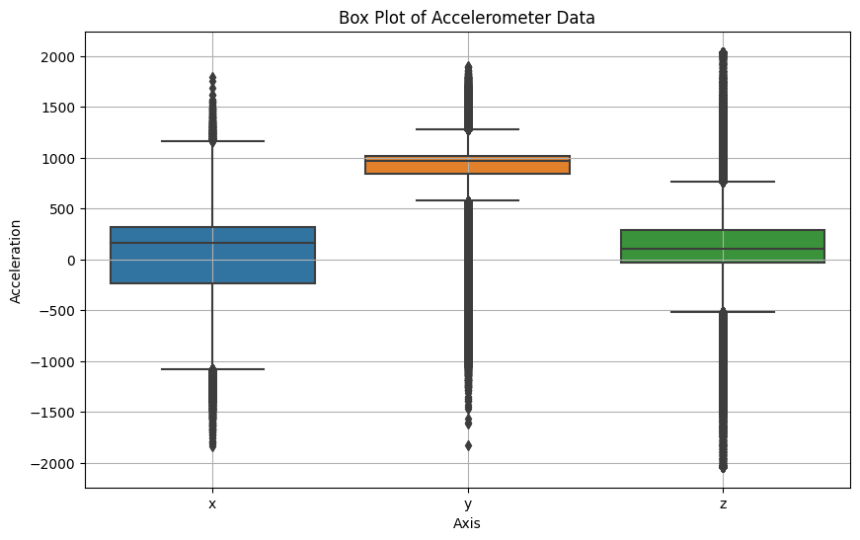
Data analysis
Performed various analysis measures to study the features
Boxplot
Result shows that majority of the data points are not along with central tendency whic shows data is not normally distributed.

Slide 7
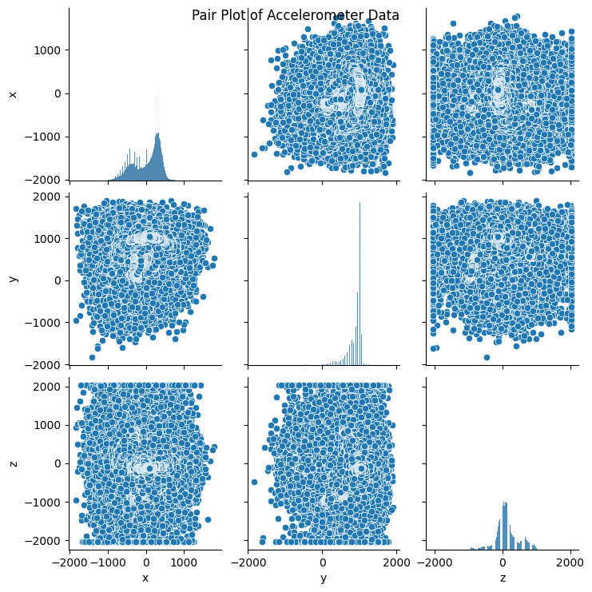
2. Pairplot
Its shows that features are not much related to each other

Slide 8
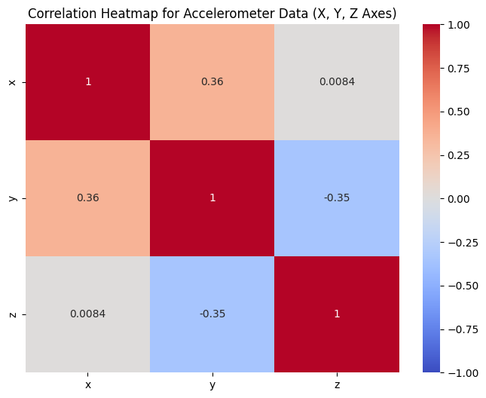
3. Heatmap

