Slide 1
Angular Data Binding

Slide 2
Data Flows in Angular 1
Input
Model
Directives
DOM
Directives
Directives
Model
Model

Slide 3
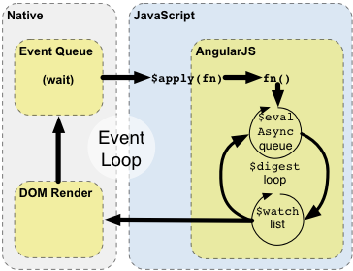
POJO two way data-binding?

Slide 4
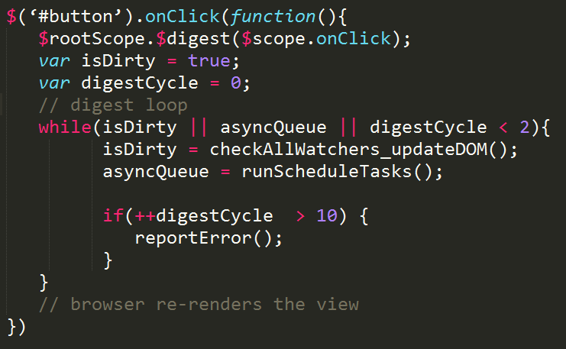
something easier to understand
$scope.onClick = function(){ clickNum++;}
<button id=“button” ng-click="onClick()"></button>

Slide 5
Cons and Pros
Pros
Easier syntax when using POJO
Cons
Unsuitable for high frequency callbacks/ large number of models.
two-way data bindings lead to cascading updates, where changing one data model led to another data model updating, making it very difficult to predict what would change as the result of a single user interaction.

Slide 6
Questions
What event will trigger $apply?
$timeout
ng-action ( ng-click, ng-keydown…)
input text element with ng-model
How to measure performance?
hard to predict, c * ?
When should we use $apply our self?
Different between digest and apply?

Slide 7
What about performance
AngularJs 1
Dirty checking on POJSO
EmberJs & BackboneJs
Accessors (getter and setter) on wrapped objects.
KnockoutJs
MVVM Observable pattern.

Slide 8
Demo
Use ng-stats and chrome profile to analyze performance.
Use one time binding in 1.3 higer, or use angular angular-once which is very powerful.

Slide 10
AngularJS remembers the value and compares it to previous value. This is basic dirty-checking. If there is a change in value, then it fires the change event.
The $apply() method, which is what you call when you are transitioning from a non-AngularJS world into an AngularJS world, calls $digest(). A digest is just plain old dirty-checking. It works on all browsers and is totally predictable.
To contrast dirty-checking (AngularJS) vs change listeners (KnockoutJS and Backbone.js): While dirty-checking may seem simple, and even inefficient (I will address that later), it turns out that it is semantically correct all the time, while change listeners have lots of weird corner cases and need things like dependency tracking to make it more semantically correct. KnockoutJS dependency tracking is a clever feature for a problem which AngularJS does not have.

Slide 11
Issues with change listeners
Syntax is atrocious, since browsers do not support it natively. Yes, there are proxies, but they are not semantically correct in all cases, and of course no proxies on old browsers. The bottom line is that dirty-checking allows you to do POJO, whereas KnockoutJS and Backbone.js force you to inherit from their classes, and access your data through accessors.
Change coalescence. Suppose you have an array of items. Say you want to add items into an array, as you are looping to add, each time you add you are firing events on change, which is rendering the UI. This is very bad for performance. What you want is to update the UI only once, at the end. The change events are too fine grained.
Change listeners fire immediately on a setter, which is a problem, since the change listener can further change data, which fires more change events. This is bad since on your stack you may have several change events happening at once. Suppose you have two arrays which need to be kept in sync for whatever reason. You can only add to one or the other, but each time you add you fire a change event, which now has an inconsistent view of the world. This is a very similar problem to thread locking, which JavaScript avoids since each callback executes exclusively and to completion. Change events break this since setters can have far reaching consequences which are not intended and non obvious, which creates the thread problem all over again. It turns out that what you want to do is to delay the listener execution, and guarantee, that only one listener runs at a time, hence any code is free to change data, and it knows that no other code runs while it is doing so.

Slide 12
What about performance?
So it may seem that we are slow, since dirty-checking is inefficient. This is where we need to look at real numbers rather than just have theoretical arguments, but first let's define some constraints.
Humans are:
Slow — Anything faster than 50 ms is imperceptible to humans and thus can be considered as "instant".
Limited — You can't really show more than about 2000 pieces of information to a human on a single page. Anything more than that is really bad UI, and humans can't process this anyway.
So the real question is this: How many comparisons can you do on a browser in 50 ms? This is a hard question to answer as many factors come into play, but here is a test case:http://jsperf.com/angularjs-digest/6 which creates 10,000 watchers. On a modern browser this takes just under 6 ms. On Internet Explorer 8 it takes about 40 ms. As you can see, this is not an issue even on slow browsers these days. There is a caveat: the comparisons need to be simple to fit into the time limit... Unfortunately it is way too easy to add a slow comparison into AngularJS, so it is easy to build slow applications when you don't know what you are doing. But we hope to have an answer by providing an instrumentation module, which would show you which are the slow comparisons.
It turns out that video games and GPUs use the dirty-checking approach, specifically because it is consistent. As long as they get over the monitor refresh rate (typically 50-60 hz, or every 16.6-20 ms), any performance over that is a waste, so you're better off drawing more stuff, than getting FPS higher.

Slide 13
One time binding is 1.3

Slide 14
KnockoutJs

Slide 15
Angular light

Slide 16
react

Slide 17
Ember.js

