Slide 1

INSTALLING UBUNTU O.S. VIA VIRTUALBOX AND BASIC COMMANDS.
SIJUMARY JOHNSON

Slide 2
STEPS FOR INSTALLATION.
1
2
Create a Virtualbox.
3
In the settings, go to storage tab and select the OS image i.e., Ubuntu.
4
Click on the Start button and the Ubuntu software will be readily installed.
Install Virtualbox and Ubuntu through the website.
(Make sure virtualization is enabled in Windows BIOS)

Slide 3
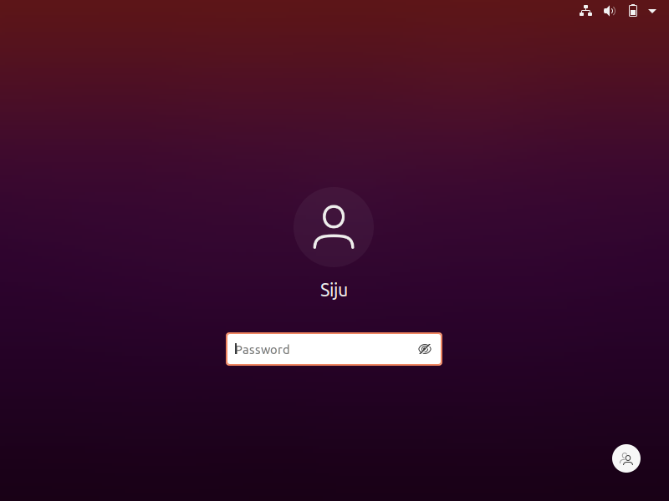
Screenshot of the O.S. after installation.

Slide 4
BASIC LINUX COMMANDS
1. pwd It shows the present working directory
2. ls It shows the files present in the working directory
3. cal It show the calendar
4. ls –l It shows the description of files
5. clear It clears the screen
6. history It shows the history of all the commands typed
7. ll It gives detailed description of files

Slide 5
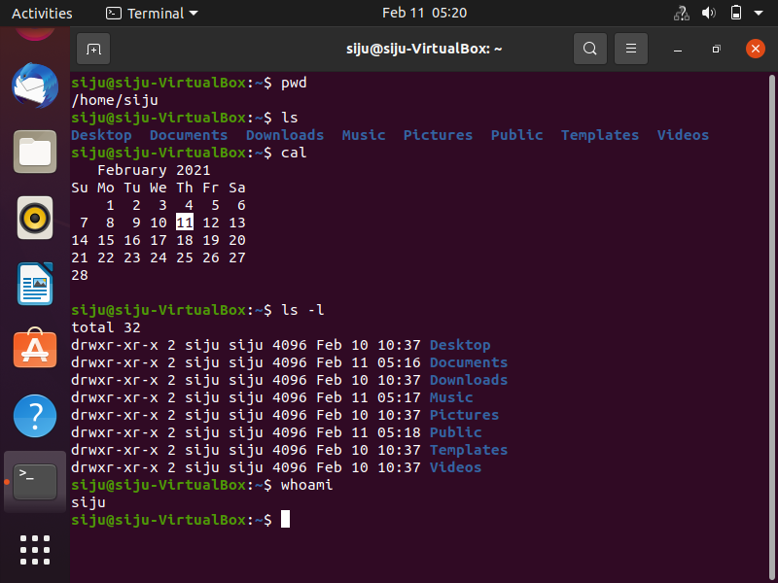
SCREENSHOT OF THE COMMANDS.

Slide 6
CONTD..
8. ls –a It shows the details of hidden files
9. touch <filename.ext> It creates file in the directory
10. cat <filename.ext> It shows the content of the file
11. nano <filename.ext> It opens the editor to type in content in the file
12. wc <filename.ext> It shows the lines, word count and character count of the file
13. cp <filename.ext> <filename.ext> It copies the file
14. mv <filename.ext><newfname.ext> It moves files and its contents to new file

Slide 7
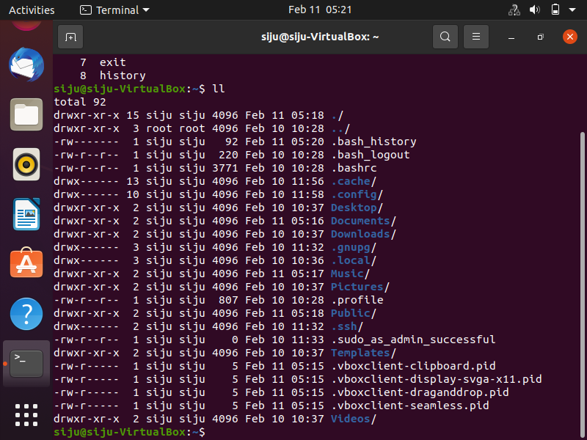
SCREENSHOT OF THE COMMANDS.

Slide 8
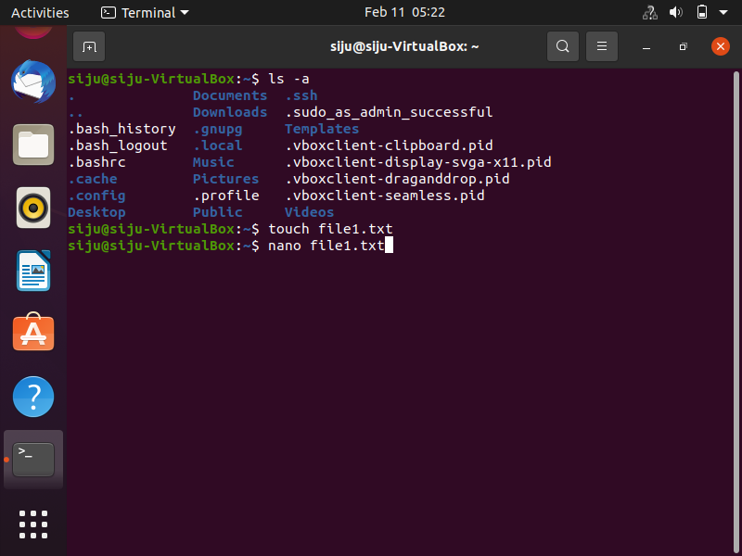
SCREENSHOT OF THE COMMANDS.

Slide 9
CONTD..
15. rm<filename.ext> It is used to remove the file
16. cd change directory
17. mkdir <directoryname> Creates a directory

Slide 10
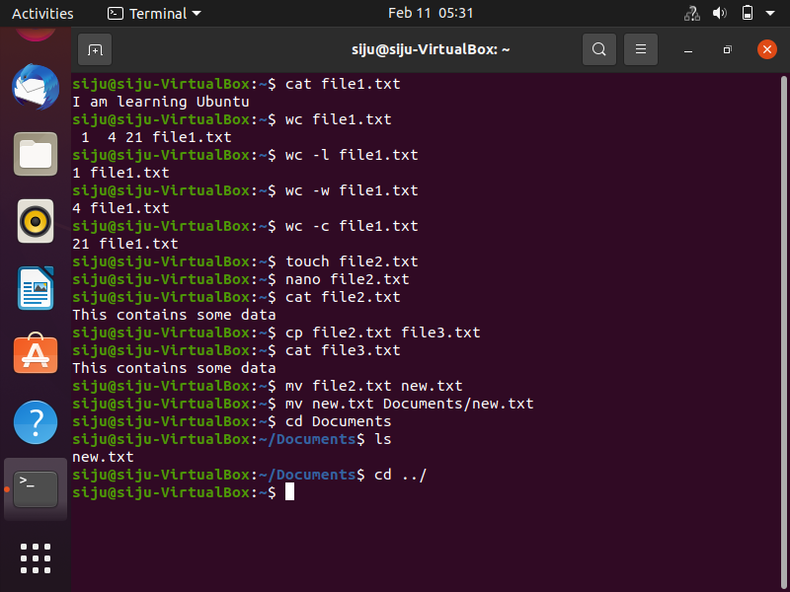
SCREENSHOTS OF THE COMMANDS.

Slide 11
PERMISSIONS
When we use any of the ‘ls’ commands we get the details of the file/directory.
The structure here is:
drwr –xr –x 2 siju siju 4096 <date and time> Desktop
Here, drwr –xr –x is the set of permissions.
2 is the memory block.
Siju siju is owner and group name respectively.
4096 is the size of the blocks.

Slide 12
CONTD..
There are 3 levels of permissions:
1. Owner permission
2. Group Permission
3. Other world permission
r: denotes read grant.
w: denotes write grant.
x: denotes executable grant.
Eg:- drwx r-x r-x.

Slide 13
CONTD..
There are 2 ways to change the mode of permissions.
1. Symbolic Method.
2. Absolute/Octal Method.

Slide 14
SYMBOLIC METHOD.
Symbolic method uses operators to change the mode of permissions.
+ adds permissions.
- removes permissions
= sets the permissions
Eg1: chmod u+x<file.ext>
u+x denotes that owner adds executable permission to the file
Eg2: chmod g-w<file.ext>
g-w denotes that group removes write permission to the file

Slide 15
OCTAL METHOD.
0 no permission - - - -
1 execute permission - - x
2 write permission -w-
3 execute and write -wr
4 read permission r- -
5 read and execute r-x
6 read and write rw-
7 all permissions rwx

Slide 16
Eg1: chmod 654 <directory/filename>
6: denotes owner permission
5: denotes group permission
4: denotes other permission

Slide 17
SCREENSHOTS.

Slide 18
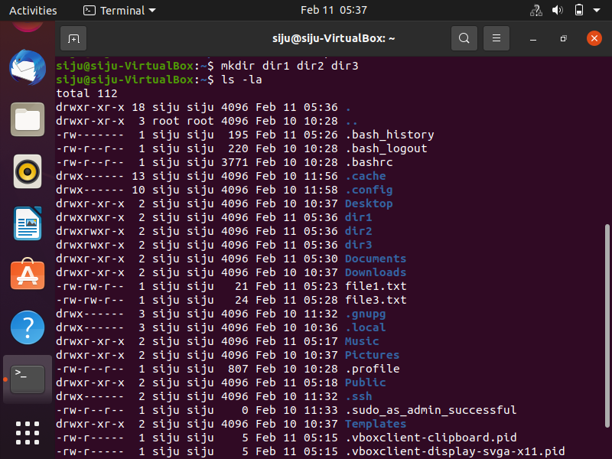
SCREENSHOTS.

Slide 19
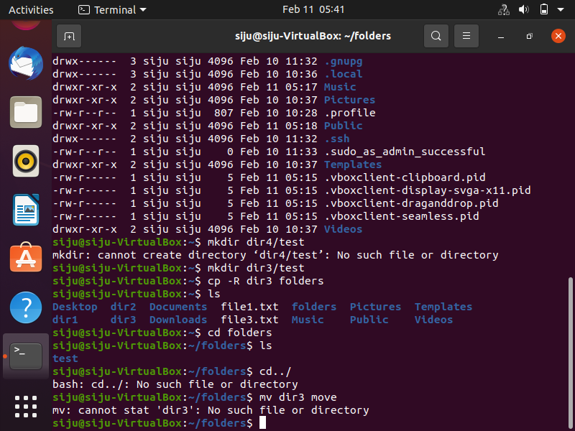
SCREENSHOTS.

Slide 20
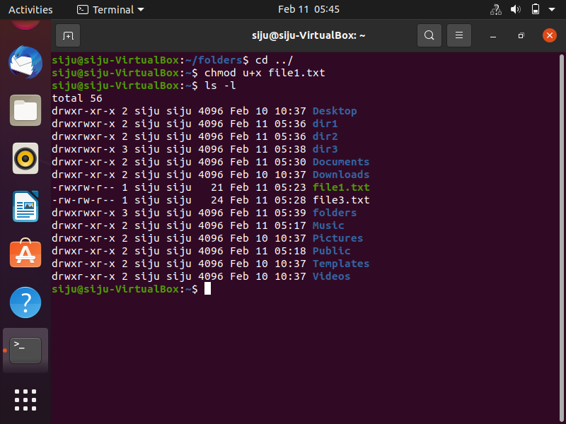
SCREENSHOTS.

Slide 21
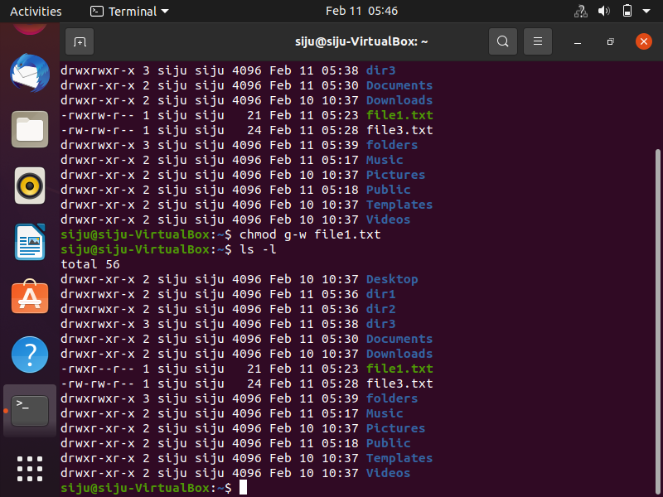
SCREENSHOTS.

Slide 22
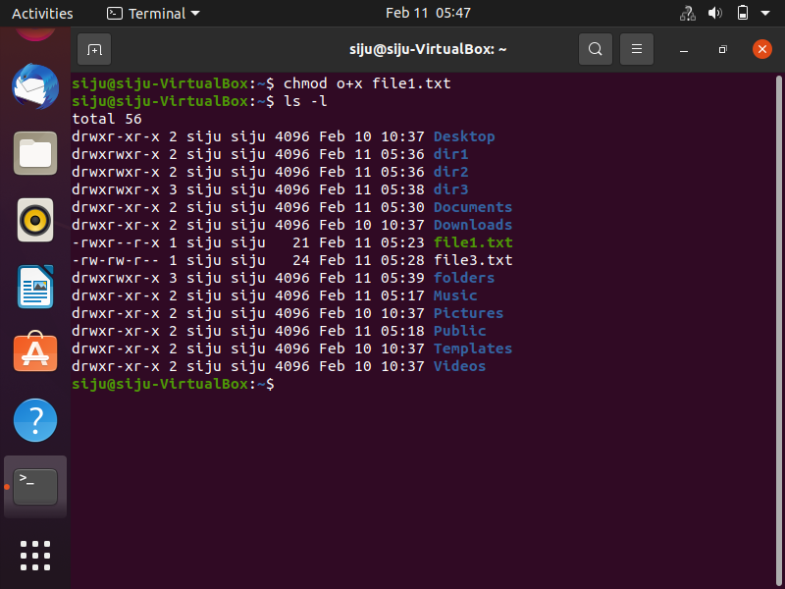
SCREENSHOTS.

Slide 23

SCREENSHOTS.

Slide 24
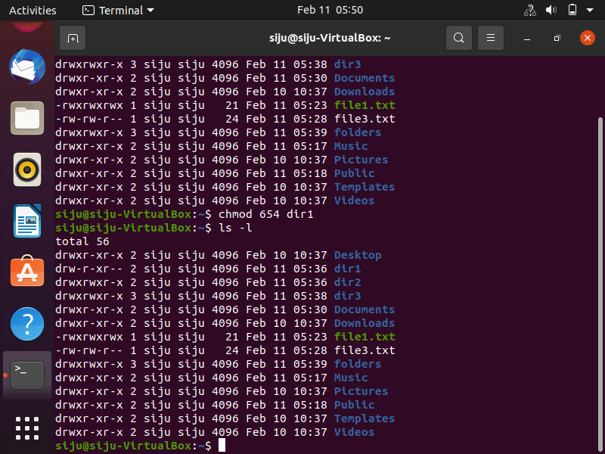
SCREENSHOTS.

Slide 25
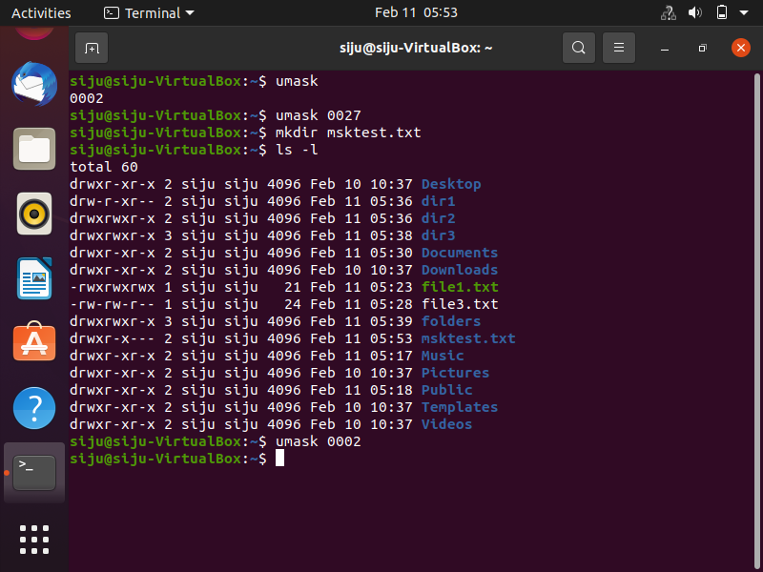
SCREENSHOTS.

