Slide 1
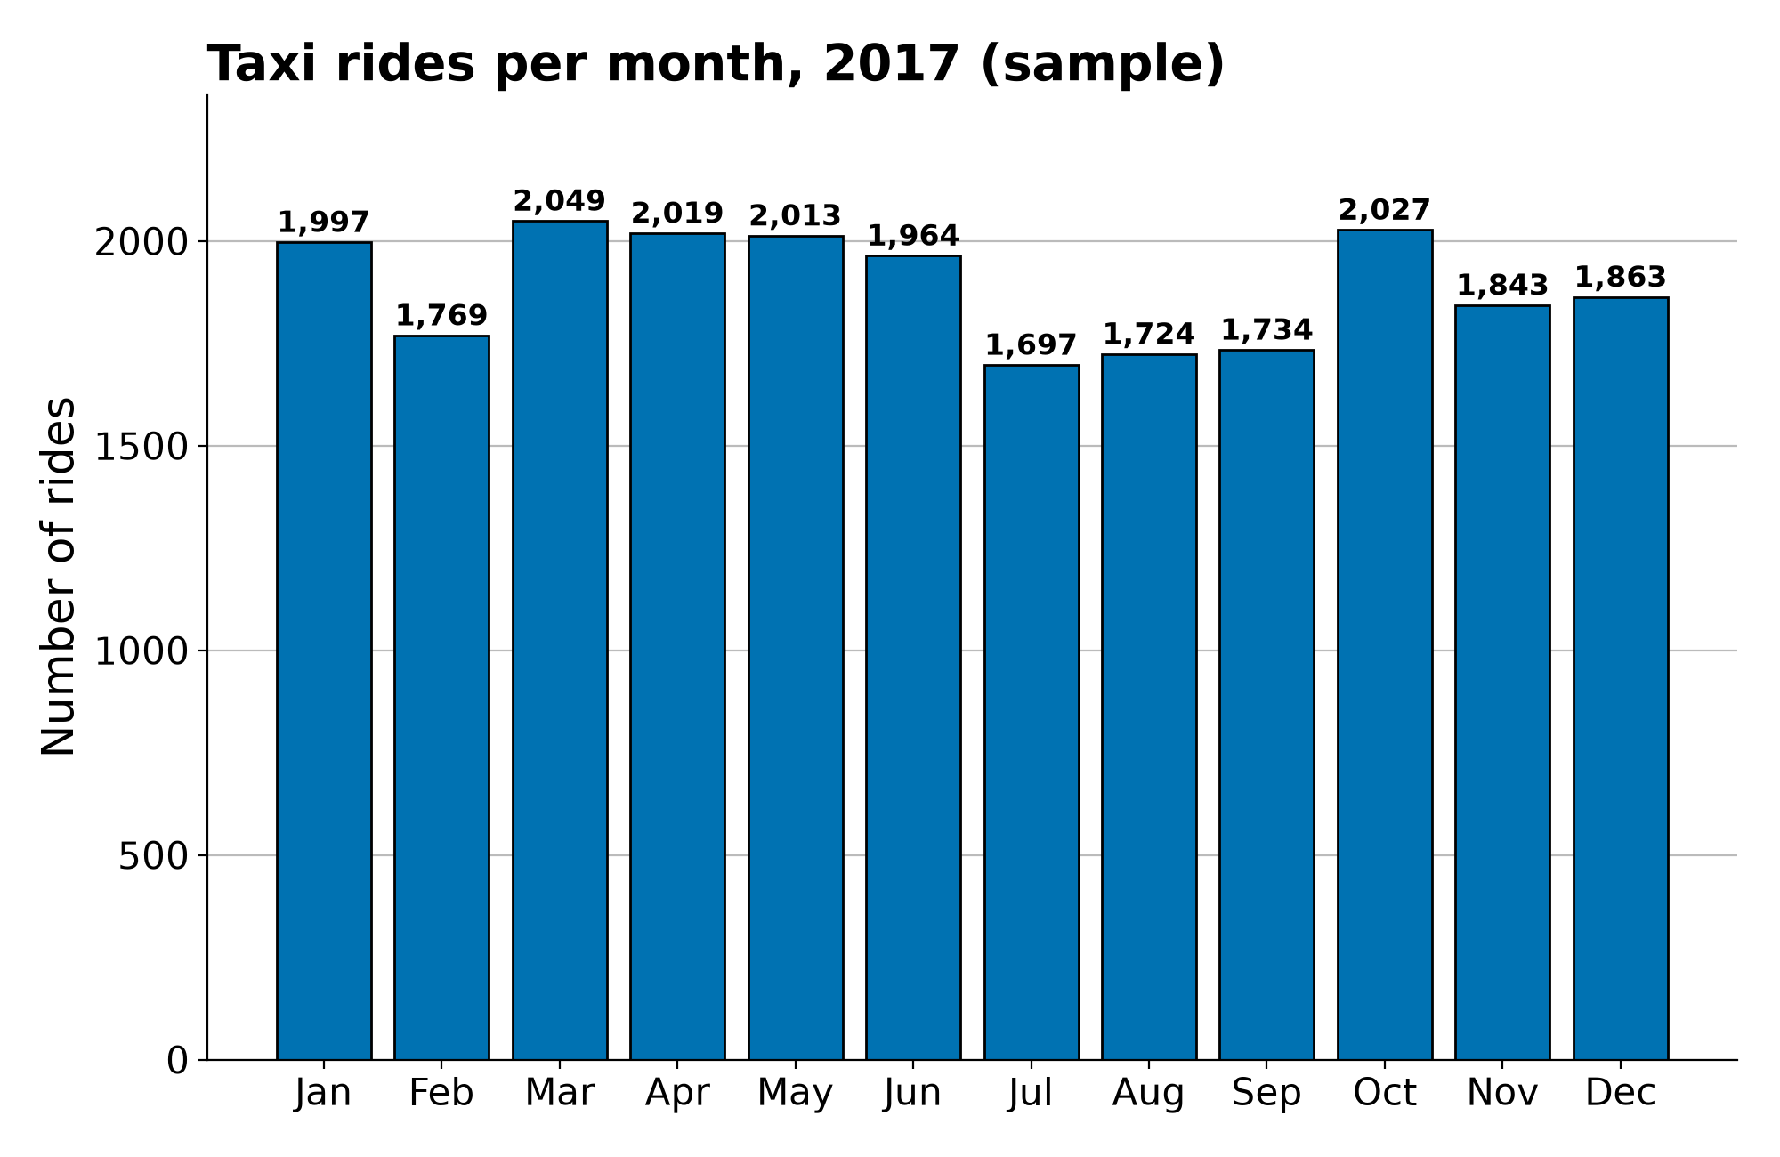
Automatidata: NYC taxi trip EDA
Executive summary for NYC TLC | Course 3 EDA
Project Overview
The NYC TLC asked Automatidata for an app that estimates taxi fares before a ride. Before modelling, we explored and cleaned a 2017 sample of 22,699 yellow-taxi trips to understand trip distance, duration, fares and demand over time.
Most trips are short. Median trip: 1.61 miles, 11 minutes, $9.50 fare. 75% of trips are under 3.1 miles.
Distance drives fare. Trip distance and fare are strongly linked (correlation 0.76), so distance is the key input for the fare model.
Demand dips in summer. July–September had the fewest rides (5,155) and lowest revenue ($82.6K) of any quarter; April–June was highest (5,996 rides, $98.8K).
Weekdays are busiest. Thursday and Friday had about 3,400 rides each; Monday (2,931) and Sunday (2,998) were quietest.
Data needs cleaning. No missing or duplicate rows, but 14 negative fares, 148 zero-distance trips, 27 zero/negative durations and extreme values (max fare $999.99).
Alt text: Bar chart of taxi rides per month in 2017. Rides are highest in March (2,049), October (2,027), April (2,019) and May (2,013), and lowest in July (1,697), August (1,724) and September (1,734).
Clean: remove or cap invalid and extreme trips; confirm outliers with TLC.
Model: build a regression fare model on distance, duration, rate code and time of day.
Explore: add taxi-zone names to explain long trips (e.g., zone 23 averages 24.3 miles) and test the summer dip with full-year data.

