Slide 1
Auricular Acupuncture
Prof.Dr.Murugeshbabu,M.SC,M.SC,M.PHIL,M.ACU,M.D,PH.D,,

Slide 2
Definition
Auricular Therapy – “deals with the diagnosis and treatment of diseases by the observation and use of the auricle.”

Slide 3
Introduction
Origin and Development
  Originally were recorded as early as 500-300 B.C. in Neijing
  Neijing: “The ear is not an independent organ. It is closely connected with zang fu and all over the body
  Miraculous Pivot: The 12 meridians, qi, and blood go to the ear to create hearing
  Of the 12 meridians, 6 Yang meridians pass through the auricle and 6 Yin are indirectly connected to the auricle through exterior and interior relationships

Slide 4
Characteristics
Indications are used for a variety of disorders
Easy insertion and manipulation of needles
Economical and convenient for patients
Few or no side effects
Used for diagnosis and differentiation of syndromes
Used for prevention of disease

Slide 5
Relationship of ear and organs, meridians
Ear and Organs：
As early as in the "Yellow Emperor" had documented the relationship between the ear and the internal organs ， both physiological and pathological aspects discussed quite detailed related organs including: Kidney, heart, liver, gall bladder, spleen, lung

Slide 6
Ear and Meridians:
Ear high in the head, through the meridians connect to internal organs, limbs forming a unified organic whole.
Meridians directly connect the ear : gall bladder, triple burner, small intestine, bladder, stomach meridians
Collaterals in the ear： Hand Yangming collaterals

Slide 7
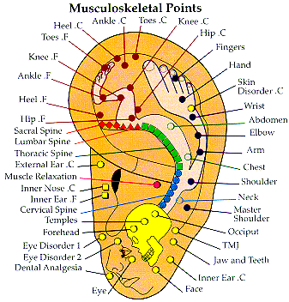
Auricular Anatomy
Auricle
  Resembles an inverted fetus

Slide 8
Structure
Mostly made of cartilage connective tissue and fat
Ample nerve, blood vessels, and lymph glands
Some muscle on the posterior to give ear some mobility

Slide 9
Nomenclature of Acupoints
Names related to the anatomy
  Shoulder, elbow, abdomen, etc.
Names related to the meridian and zang-fu
  Heart, spleen, liver, etc.
Names related to the nerves
  Sciatic nerve, etc.
Names related to the disease
  Hypertension, hepatitis, etc.

Slide 10
Nomenclature of Acupoint
Names related to their therapeutic properties
  Lower blood pressure point, flu point, etc.
Names related to the shape and location of the ear
  Apex of the ear, etc.
Names related to the system function
  Endocrine, sympathetic, etc.
Names according to the location of acupoints
  Face-cheek area, hunger point, etc.

Slide 11
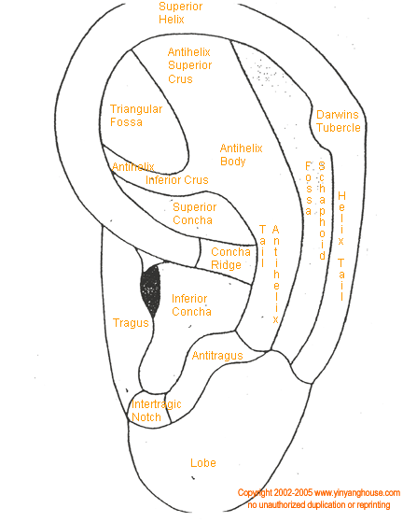
Distribution of Points
1. Ear lobe – Head and face
2. Antitragus – Head and brain
3. Notch between antihelix and antitragus – brain stem
4. Tragus – Throat, internal nose, and adrenal
5. Antihelix – Trunk
6. Inferior crus of the antihelix - Buttock
6
5
4
3
2
1

Slide 12
Distribution of Points
7. Superior crus of the antihelix – Lower limb
8. Scaphoid Fossa – Upper limb
9. Triangular Fossa – Pelvic cavity and internal organs
10. Helix crus – Diaphragm
11. Peripheral area of the Helix – Digestive tract
12. Cymba Conchae – Abdominal Cavity
13. Cavum Conchae – Thoracic Cavity
14. Intertragic Notch – Endocrine Gland
7
9
8
12
11
10
13
14

Slide 13
Triangular Fossa
1
General Location – Triangular depression between the upper and lower antihelix crus
Points
  1. Decrease blood pressure – Upper top part of the triangular fossa
    Headache, dizziness, hypertension
  2. Pelvis – Located at the corner of the triangular fossa where the upper and lower antihelix crus originate
    Pelvic inflammation, prostatitis, abdominal pain, dysmenorrhea
2

Slide 14
Triangular Fossa
Points
  3. Constipation – Draw a line from pelvis to the lower outer border of the triangular fossa. It is located in the second 1/3.
    Constipation
  4. Shenmen – Line from decrease blood pressure point to pelvis is divided into 3 parts. It is located at the top of the first lower part.
    Insomnia, dream disturbed sleep, stress, pain, hypertension, allergy, main point for anesthesia
4
3

Slide 15
Triangular Fossa
5
Points
  5. Hepatitis – Midpoint between decrease blood pressure and shenmen
    Jaundice, hepatitis symptoms
  6. Uterus/Genitals – Middle of the front edge of the depression in the triangular fossa
    Irregular menstruation, dysmenorrhea, uterus, impotence, infertility, seminal emission, decreased sexual function
  7. Groin
    Lower border of triangular fossa. Forms an equilateral triangle with the sciatic nerve and the buttock. Line from pelvis to the lower outer border of the triangular fossa, it is at the first 1/3.
6
7

Slide 16
Antihelix
Textbook page 101-102
General Location – Prominence opposite the helix
Divide trunk into 5 equal parts from the bottom of the antihelix to the fork of the superior and inferior antihelix crus
  1. Lower 1/5 – Cervical
  2. Middle 2/5, 3/5 – Thoracic
  3. Middle 4/5 – Lumbar
  4. Upper 1/5 – Sacral
  5. Coccyx is at the branching and inferior to the antihelix crus
5

Slide 17
Antihelix
Points
  Cervical vertebrae
    Neck trauma, degeneration in the cervical region
  Thoracic vertebrae
    Swelling and pain in the thoracic region
  Lumbar Sacral vertebrae
    Lumbo-sacral pain and dysfunction in the lower extremities
  Neck
    On the border of cavum concha of the cervical vertebrae
      Stiff neck, cervical vertebrae, upper extremity atrophy, paralysis, numbness
  Thyroid
    Between the neck and brain stem
      Thyroid disease, obesity
Neck
Brain Stem

Slide 18
Cavum Conchae
General Location – The part of the concha inferior to the helix crus
Points
  Heart – Center of the deepest portion of the cavum concha
    Heart diseases, palpitation, insomnia, mental disorders
  Lung – Upper and lower area adjacent to the heart. Upper is on the opposite lung.
    Respiratory problems, cough, asthma, skin diseases, profuse sweating

Slide 19
Cavum Conchae
Points
  Spleen – Midpoint between where the helix crus disappears (Stomach) and the antihelix-antitragus notch
    Digestive disorders, controlling blood, prolapse, edema due to nutrition problems
  Trachea – Midpoint of the horizontal line drawn between the heart and the hole of the external auditory canal
    Respiratory disorders, phlegm
  Tuberculosis – Formed by an equilateral triangle with the heart and lower lungs
    Tuberculosis

Slide 20
Lobe
General Location – Skin tag without cartilage on the lowest part of the auricle.
Create 9 areas
  Draw a horizontal line immediately below the intertragic notch.
  Drop 2 perpendicular lines to the bottom of the lobule dividing the lobe into 3 equal parts
  Draw 2 more lines dividing the ear horizontally into 3 sections.
  Number them from left to right, top to bottom (1-9)
1
2
3
4
5
6
7
8
9

Slide 21
Lobe
Points
  Eye
    Center of the 5th section of the ear lobe
      Eye diseases such as acute conjunctivitis, near sightedness
  Upper jaw
    In the middle of the 3rd section of the lobe
      Upper toothache, submandibular arthritis gingivitis
  Lower palate
    In the superior line, medial 1/3 of 2nd section of the lobe
      Trigeminal neuralgia, inflammation of the mouth muscle
1
2
3
4
5
6
7
8
9

Slide 22
Lobe
Points
  Upper palate
    In the posterior lateral line, lower ¼ of the 2nd section of the lobe
      Trigeminal neuralgia, inflammation of the mouth muscle
  Tooth
    Center of area 1
      Tooth disorders
  Internal Ear
    In the center of area 6
      Tinnitus, impaired hearing, auditory vertigo
  Neurasthenia
    Center of area 4
      Toothache, light sleep, awakening early, fatigue, weakness, loss of memory, aches
1
2
3
4
5
6
7
8
9

Slide 23
Cymba Conchae
General Location – The part of the concha superior to the helix crus
Points
  Liver – Lateral inferior area of the cymba concha
    Hepatitis, eye disorders, dizziness, convulsions, menstrual disorders, depression
  Kidney – Lateral superinterior corner of the cymba concha
    Nephritis, genitalia disorders, tinnitus, hair loss, bone disorders

Slide 24
Cymba Concha
Prostate – Upper (super-anterior) corner of cymba concha
  Prostate disorders
Ureter - Located in the posterior 1/3 of the line between kidney and prostate
  Urinary disorders, stones
Urinary Bladder – Located between the kidney and prostate, approximately medial 2/3
  Urinary disorders, urine frequency, sciatica, nephritis

Slide 25
Cymba Concha
Gallbladder and Pancreas – Midway between kidney and liver
  Note: Pancreas is on the left ear, gallbladder is on the right ear
  Jaundice, gall stones, hepatitis, migraine

Slide 26
Needle
Shortness of Breath
High Blood Pressure
Lower Back Pain radiating to the groin region
Infertility
Trigeminal Neuralgia
Anxiety and Insomnia
Depression
Enlarged Prostate/Cancer

Slide 27
Area Around the Helix Crus
General Location – Transverse prominence entering the cavum concha
Points
  Mouth – Located midway between upper 1/3 of the hole of the external auditory canal and the beginning of the Helix Crus.
    Digestive disorders, mouth ulcers, weight management

Slide 28
Area Around the Helix Crus
Points
  Large Intestine – Located at the beginning of the superior outer border of the helix crus.
    Dysentery, diarrhea, constipation, indigestion
  Stomach – In the concha where the helix crus disappears
    Stomach ulcer, gastritis, indigestion, vomiting, nausea

Slide 29
Area Around the Helix Crus
Points
  Small Intestine – It is located 1/3 of the way of the superior outer border of the helix crus
    Diarrhea, indigestion, abdominal distension, sore throat, infection of the mouth and tongue
  Esophagus – Inferior aspect of the helix crus directly below the small intestine
    Weight management, speech impairment, acid reflux

Slide 30
Tragus
General Location – Cartilaginous projection in front of the exterior meatus of the ear
Points
  Apex of the tragus – center of the upper part’s outer border
  Adrenal Gland – center of the lower part’s outer border
    Hyper/hypotension, capillary bleeding, temperature problems, anticough, antiasthma, inflammation

Slide 31
Tragus
Points
  External nose – Forms and equilateral triangle with the apex of the tragus and adrenal gland.
    Rhinitis, nose infection
  Thirst Point – Between tragus apex and external nose
    Diabetes, excessive thirst
  Hunger Point – Midpoint between external nose and adrenal gland
    Weight management, excessive hunger

Slide 32
Intertragic Notch
Location – Depression between the tragus and antitragus
Points
  Endocrine – Base of cavum concha in the intertragic notch
    Hyperthyroidism, obesity, irregular menstruation, dysmenorrhea, amenorrhea, allergy, skin diseases, impotence, endocrine system dysfunction
  Raise blood pressure – Inferior aspect of the intertragic notch
    Hypotension

Slide 33
Antitragus
Location – Protusion at the top of the earlobe opposite to the tragus
Points
  Brain – Antitragus midway between the apex of the antitragus and the antitragus-antihelix notch (inside)
    Pituitary dysfunctions, parkinson’s disease, loss of balance, paralysis, memory problems

Slide 34
Antitragus
Brain Stem
Points
  Temple
    Midpoint of the line placed at the lower border of the exterior antitragus
      Headaches
  Occiput (Dizziness Area)
    Midpoint of the line on the exterior antitragus going from temple to brain stem.
      Convulsion, stiff neck, insomnia, dizziness, nervousness, pain relief, sedation

Slide 35
Needle
Stroke
Migraine Headache
Acid Reflux
Chronic Diarrhea
Weight Management
Hepatitis
Urinary Infection
Peripheral Neuropathy
Knee Arthritis
Sciatica
Menopause

Slide 36
Superior Crus of Antihelix
General Location – The superior branch of antihelix
Points
  Toe
    Outer corner of the superior antihelix crus
      Trauma, pain, infection
  Sole
    Midpoint of the line from toe to heel
      Bottom of the foot pain
  Heel
    Inner corner of superior antihelix crus
      Heel pain

Slide 37
Superior Crus of Antihelix
Points
  Knee Joint
    Center of superior antihelix crus
      Trauma, arthritis, pain
  Ankle
    Midpoint of the line going from the heel to the knee joint
      Trauma, infection, pain, sprain
  Hip Joint
    Midpoint of the line where the superior antihelix crus originates
      Pain, arthritis

Slide 38
Inferior Crus of Antihelix
General Location – Inferior branch of the antihelix
Points
  Buttock
    Located at the beginning of the lower crus, in the center
      Hip pain, arthritis
  Sciatic
    Midpoint of the line from the beginning of the lower crus to the end
      Sciatic pain, atrophy, paralysis and numbness
  Sympathetic
    At the end of the upper edge of the lower crus
      Pain of internal organs, palpitation, spontaneous sweating, night sweating, autonomic nervous system

Slide 39
Scapha
General Location – Depression between helix and antihelix
Points
  Divide the scapha into 5 equal parts
  Clavicle
    On the scapha at the level of the heart
      Pain, cervical vertibrae degeneration, shoulder pain, neck pain

Slide 40
Scapha
Points
  Finger
    Top of Scaphoid fossa
      Pain, arthritis
  Wrist
    Top of the 2nd part
      Wrist pain, tendon pain
  Elbow
    Top of the 3rd part
      Tennis elbow, pain, joint trauma, paralysis, numbness
  Shoulder
    Top of the 4th part
      Shoulder pain, paralysis, motion issues
  Allergy
    Area in between finger and wrist
      Any allergy diseases, skin allergies, asthma

Slide 41
Needle
Finger Joint Pain
Hallucination
PMS
Morning Sickness
Frequency Urination
Frozen Shoulder
Attention Deficit Disorder
Excessive Sweating
Hair Loss

Slide 42
Helix Crus
Location - Transverse prominence entering cavum concha
Points
  Diaphragm – Located at the midpoint of the line from which the helix crus originates. Directly above the entrance to the external auditory canal.
    Hiccup and vomiting, hiccup due to gastrointestinal issues, respiratory issues

Slide 43
Helix
General Location – Lateral curling rim of the auricle
Points
  Ear Apex – Located at the top of the helix.
  When the ear is folded from the middle, the ear apex is the tip
    Any infections of the head, tonsillitis, facial nerve infection, analgesia, pacifying liver, hypertension

Slide 44
Helix
Points
  Rectum
    Located at the beginning of the helix crus and leveled with large intestine
      Constipation, diarrhea, prolapse of the anus, hemorrhoids, chronic colitis, dysentery, urgency
  External genitalia
    Located at the helix edge and leveled with superior edge of the inferior antihelix crus
      Eczema, impotence, urethritis
  Liver Yang
    On the auricular tubercle
      Pain symptoms, eye disease, dizziness, liver qi stagnation, liver yang hyperactive

Slide 45
Helix
Six parts of helix starting from the lower edge of the helix tubercle to the most inferior part of the helix
Helix 5 – At the central posterior part of the 6th section on the rim of the lobe
Helix 6 – At the bottom of the 8th section of the lobe
Points
  Helix 1-3 – Acute diseases or high fever
  Helix 4-6 – Chronic fever
  Mainly using blood letting to treat tonsillitis and hypertension

Slide 46
Categorization of Ear Points to Five Elements

Slide 47
What’s the chief complaint?

Slide 48
What’s the chief complaint?
Shenmen
Thoracic
Ankle
Lumbar/Sacral
Heart
Sciatica
Low Back/Sciatic Pain
Palpitation/Anxiety/Insomnia

Slide 49
What’s the chief complaint?

Slide 50
What’s the chief complaint?
Spleen
Large Intestine
Mouth
Stomach
Hunger
Constipation
Weight Management
Constipation

Slide 51
What’s the chief complaint?

Slide 52
What’s the chief complaint?
Spleen
Uterus
Spirit Gate
H7 Shenmen
Ear Apex
Liver
Decrease BP
Heart
High Blood Pressure
Infertility

Slide 53
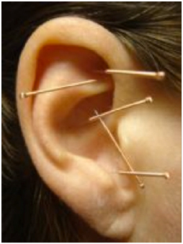
Needle
Impotence
Rectal Bleeding
Headaches/High Blood Pressure
Eye Pain
Eczema

Slide 54
Examination Methods
When internal organs or part of the body is diseased, it can be reflected on the ear.
  Electrical Computer Diagnosis
    Calculate numbers, resistance
  Electrical Detection – Auricular Detector
    Resistance is lower – 20 – 500 Kilo Ohms
  Pressing/Palpation
    Edema, depression
  Detecting tender spots
    Pressing, touching, painful areas
  Observing
    Discoloration, blisters, hard nodules, blood vessels

Slide 55
Color & Shape Changes
Color of the acupoint is different from its surroundings
  Bright Red – Acute or painful disease
  White – Chronic disease, deficiency
  Dark Gray – Associated with problems in that location. When pressed, the color fades
  Red, black, white center with red surroundings
  Brown – Chronic disease or indicate disease is cured
Shape such as protrusion or depression
  Nodules, spot-like cave or depression on the skin

Slide 56
Papule/Vascular/Desquamation
A spot that is aggregate in nature with papule surrounding the acupoint. Higher than normal skin such as blisters
A vessel on the point that is congested or dilated
Desquamation – white scaly exfoliation – skin diseases

Slide 57
Relationship between reaction and disorders
Spot, red papule – Mostly acute infectious diseases
White spot or piece-like, concave – Mostly chronic parenchyma diseases like chronic gastritis
Nodule like, black-gray spot – Tumor
Scaly exfoliative – Skin diseases
String fiber-like string, circular or semi-circular white or black gray scar – scar appears after operation or trauma

Slide 58
Tenderness Degree
No pain (-)
Saying “Painful” or “Ouch” (+)
Frowning (++)
Dodging (+++)
Refusing to be pressed (++++)
“Pain can be managed” – Degree I
“Painful” or “Ouch” – Degree II
“Pain is hard to bear” or dodging – Degree III

Slide 59
Significance of Observation
Help us in point selection
Analyze symptoms and increases our understanding of zang fu
Increase therapeutic results
New way for early diagnosis and detection

Slide 60
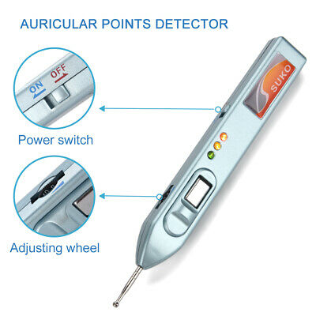
Electrical probe
Observing changes in electrical resistance, capacity, and potential and points
Disease creates lower resistance and higher conductivity of electrical currents
  Normal – about 5000-10,000 K Ohms
  Disease – about 20-500 K Ohms
Instruments can detect these higher conductivity by emitting different sounds

Slide 61
Method of operation
Needling: disinfection/needle/position(1-2mm)
Electricity needle(Pain / nervous system disease / asthma)
Seed,
Needle buried
Point injection
Bleeding(Skin diseases/sprain / acute inflammation) behind ear congestion vein)

Slide 62
Treatment
Point Selection
  According to disease location
  According to differentiation of syndromes and TCM theory
  According to modern medicine
  According to points function
  According to clinical experience
  Used on the affected side

Slide 63
Indications
Pain
  Trauma
  Infection
  Neuralgia
  After operation
  Tumor or Cancer
Infections
Allergies
Dysfunction of neurological system
Chronic diseases
Others
  Quit smoking
  Drug addiction
  Weight loss
  Prevention of motion sickness

Slide 64
Contraindication
Not good to use strong stimulation in patients with heart disease
Acupressure more appropriate for serious chronic diseases or serious anemia/blood clotting
Patient has external ear diseases such as eczema
Not good when patients feel fatigue, hunger, or weakness
Elderly patient with arteriosclerosis hypertension should rest ½ hour before therapy
Habitual abortion – Don’t use acupuncture for abdomen, uterus, ovary, endocrine
Don’t insert too deeply and don’t puncture through to the opposite side of the ear

Slide 65
Things to Know
Every patient is different
Same disease can have different symptoms
Different types of diseases may create similar symptoms
Needling method used will depend on patient’s situation
Patient’s position – lying down the safest
Utilize CNT procedures
Careful needle twisting
Utilize 30-36 mm gauge needles
Can use several (2-3) needles to puncture one point
Make sure you have a cotton ball during removal

Slide 66
Reaction
Common reaction – Ear feels hot, warm, numb, pain, distention, electric shock feeling, transmission of needle sensation.
Body felt warm and now cold
Involuntary movement of muscles
  Vibration of facial muscles
Channel Reaction – sensation of the targeted channels
Lightning Reaction – feeling of electric circuit is switched on a part or internal organ
Chain Reaction – Unexpected results. Relieving symptoms in addition to what was planned
Delayed Reaction – due to low reactivity, blockage of channels, severe state of illness, poor needle sensation
Dull or no Reaction – Auricular Detector needed
Adverse effect – deterioration of condition. May be due to stress, too many points, too much intensity or inappropriate manipulation
Fainting
  Possibilities – Too tired, too hungry, low blood pressure, too weak, after heavy exercise
  Take out the needles, keep warm, drink warm water

Slide 67
Other methods
Intradermal needle
  Chronic diseases or painful diseases
  Weak constitution
  Cannot tolerate other treatments for various reasons
Pressure method
  Examples include seeds, herb, pill of drug, magnets
  Used for the elderly, weak, and children
  Used for those who are afraid of pain
  Used for patients who cannot receive treatments frequently
Bleeding
  For reducing fever, inflammation, calming the mind, lowering blood pressure, relieving allergies, improve vision
  Bleeding liver yang to reduce dizziness, vertigo, tinnitus due to hyperactive liver yang
  Bleeding the apex to reduce fever, inflammation, calming the mind, common cold and fever.

Slide 68
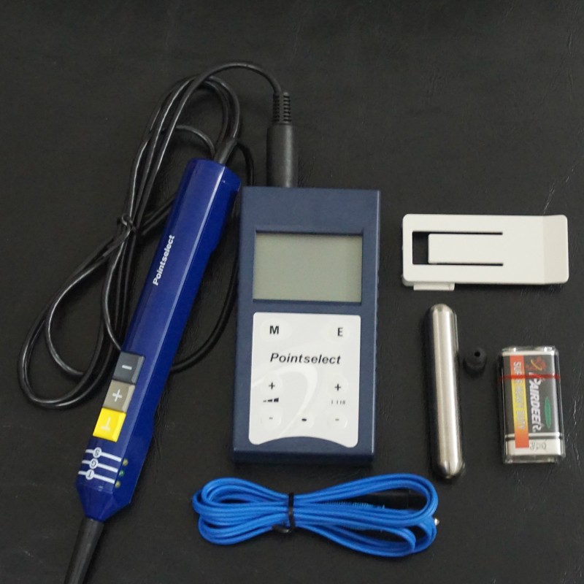
Electrical Auricular Acupuncture
Not all patients can take it
Two outlets of one pair should be connected to 2 needles on the same side
Explain that the electricity may produce warmness, sleepiness, heaviness, soreness or distension
Examine to make sure the needle is not dark or corroded before using electricity. It may break.

Slide 69
Common Disorders
Headache
  Ear apex, shenmen, neck
Migraine
  Temple, occiput, ear shenmen, neck, liver, heart
Acute Sprain
  Ear shenmen, brain, and sprained area
Low Back Pain/Sciatic
  Sciatic nerve, lumbar, shenmen
Stroke/Cancer
  Brain, ear shenmen
Hypertension
  Lower blood pressure, heart, ear shenmen, apex (bleeding)
Diarrhea
  Spleen, stomach, rectum, endocrine, large intestine

Slide 70
Disease Progression
(3 months, 6 months, 1 year, 5 years)
Stress
Anemia
HIV/AIDS
Nausea
Swelling/Edema
Stroke
Migraine Headache
Acid Reflux
Chronic Diarrhea
Weight Management
Hepatitis
Urinary Infection
Peripheral Neuropathy
Knee Arthritis
Sciatica
Menopause

Slide 71
Loss weight
One adjusting
Three increases
One directional blastng

Slide 72
Adjust the endocrine function
Acupoints: the hypothalamus, endocrine, edge (pituitary gland hole).
The endocrine secretion levels remained relatively stable, mainly through self-adjusting mechanism to achieve negative feedback. So that the body to adapt to environmental changes. Endocrine function to stabilize.

Slide 73
Weight loss
Three increases:
1. Enhance the excitability of the body:
Acupoints: the sympathetic, front head. (Obesity is often accompanied by the easy sleepy, sleepiness, sleep a long time, a small amount of body activity, energy consumption, protein synthesis is greater than the decomposition process, therefore the treatment of obesity to take excited auricular sympathetic, front head)

Slide 74


