Slide 1

Cryptographic Algorithms for Single-Instruction Processors
Supervisor: Dr. David Oswald
Presenter: Vasilis Sikkis
MSc Cyber Security, University of Birmingham

Slide 2
Presentation Outline.
Introduction
SLXS Language
SLXS toolchain
Experimental Evaluation
Demo

Slide 3
Introduction.
One instruction set computer, is an abstract machine that uses only one instruction. An OISC is capable of being a universal computer in the same manner as traditional computers that have multiple instructions.
The SLXS architecture is an OISC, that was developed for cryptographic applications in order to protect the implemented algorithm against SCA.

Slide 4
SLXS Architecture Definition.
slxs a,b,c,d
D = *b - *a, C = D ⊻ c, T = C >>1
If MSB(d) = 0: *b = C else if MSB(d) = 1: *b = T
If D <= 0: goto d else: goto PC+1

Slide 5
Goals.
01. Create and document the SLXS language.
02. Produce a well-written and well-documented implementation of the SLXS processor and its the corresponding macro assembler.
03. Implementation of cryptographic algorithms using the developed tools.
04. Analyze the results.

Slide 6
Used Material.
01. SLXS processor simulator in C.
02. AES algorithm implementation on address level.
03. PRESENT algorithm implementation in C.

Slide 7
Presentation Outline.
Introduction
SLXS Language
SLXS toolchain
Experimental Evaluation.
Demo

Slide 8
SLXS language.
Three type of operations:
01. Variables.
02. Instructions.
03. Comments.

Slide 9
Variables.
Recognizes decimal and hexadecimal values.
Decimal system as default.
Hexadecimal numbers start with the prefix "0x" or "0X".
Variables are 17 bit long.
17th bit for singed numbers.
Longer numbers are capped to 17 bits.

Slide 10
Variables Format.
01. Simple Initializes one single variable.
var: 0
02. Lists Initializes an array of variables.
list: [0,1,2,3,4]
03. Assignment Initializes the variable with the value of another variable.
var1 : 0x10
var2 : var1 //The var2 will hold the value 16.
04. Pointers Stores as a variable, the address of another variable.
var1 : 10 // stored in address 5
*var2: var1 // var2 = 5
var3 :var1 // var3 = 10

Slide 11
Instructions.
Each instruction has four parameters (a,b,c,d).
Each parameter is separated by “, ”.
End of instruction is denoted by “;”.
The parameters a and c can use decimal numbers or hexadecimal numbers instead of variables.

Slide 12
Instructions Format.
01. Simple use three variables.
Zero, x, y;
0, x, 0x5;
02. Functions have a label in front of the instruction.
foo : Zero, x, y;
03. Jumps have a label as a forth parameter.
Zero, x, y, foo;
04. Functions with Jumps
foo : Zero, x ,y ,foo1;

Slide 13
Instructions Format.
05. Label as Pointers for dynamically addressing instruction parameters.
foo : Zero, x, y;
Zero, foo(0), y; //foo(0) holds the address of x.
06. Shifts “_SH” is used as a last variable.
z, x, y, _SH;
/*With function and a jump:*/
foo: x, y, Zero, foo1,_SH;

Slide 14
Comments.
01. Whole line comments
//This is a comment
02. Boxed comments
S : /* This is a comment */ 10
x, y, temp(0) /*first variable inside the list temp*/, _SH;

Slide 15
Operators.
CLEAR: var, var, 0; //var = 0
JUMP: Zero, Zero, Zero, label; //Go to label
MOV: var, var, var1; // var = var1
LOOP: Zero, Zero , Zero ,Label; //current address | EOF
RSHIFT: Zero, var, Zero, _SH; // var >> 1
LSHIFT: var_r, var, Zero; // var = var + var = var << 1
XOR: Zero, var, var1; // var = var ⊻ var1
ADD: -1, var, Zero; // var = var + 1
SUB: 1, var, Zero; // var = var - 1

Slide 16
Operators.
Other operators are more complex:
AND: res, res, x; // res = x
y , my , Z; // my = -y
my , res, Z; // res = x + y
xor, xor, x; // xor = x
Z , xor, y; // xor = x ⊻ y
xor, res, Z,_SH; //res = (res - xor ) >> 1
And, Or, Multiplication, Division and Modulo can be created for all the other operators.

Slide 17
Macros.
Designed to make coding easier.
CLEAR: _CLR, val; //val = 0
MOV: _MOV, move1, move2; // move1 = move2
MUL: _MUL, mul1, mul2; //mul1 = mul1*mul2
DIV: _DIV, div, mod; // div = div/mod , mod= div%mod
ADD: _ADD, add1, add2; // add1 = add1 + add2
SUB: _SUB, sub1, sub2; // sub1 = sub1 – sub2
XOR: _XOR, xor1, xor2; // xor1 = xor1 ⊻ xor1
OR: _OR, or1, or2; // or1 = or1 | or1
AND: _AND, and1, and2; //and1=and1 & and2
RSHIFT: _RSHIFT, shift, rs; // shift = shift >> rs
LSHIFT: _LSHIFT, shift, ;s; // shift = shift << ls

Slide 18
Presentation Outline.
Introduction
SLXS Language
SLXS toolchain
Experimental Evaluation.
Demo

Slide 19
SLXS Stages.
Each SLXS code must go through three stages to provide the end result.

Slide 20
SLXS tool.
[ −i | −−input ] Takes a ﬁle with SLXS code as an argument and creates an output ﬁle with the memory addresses.
[ −f | −−intel hex ] creates four ﬁles in hex intel format that can be used in the simulator.
[ −s| −−simulator ] Simulates an SLXS processor. The four hex ﬁles created by the -f option are used.
[ −p ] Prints the variables before and after the emulator runs. All the previous options must be enabled. If the variable does not exist nothing is displayed.
[ −u ] Allows the programmer to use undeﬁned variables inside the code.
[ −help | −−help ] Prints the help menu.

Slide 21
Error Handling
Checks if the instruction contains correct number of arguments.
Checks if variable is a number.
Checks if a variable or a label have already been declared.
Checks if a variable or a label is not a system parameter.
If the option [-u] is enable it checks if the b parameter is not an undefined variable
If a variable or a label have the same name it will output an error.
Checks if the main function or the EOF are included.
Recognizes if the instruction is missing the ";" symbol.

Slide 22
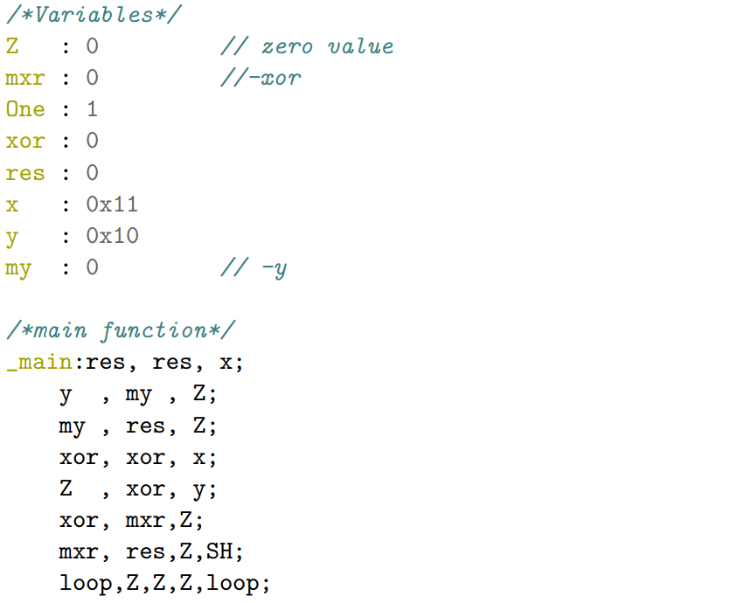
Code Example of Or Operator.

Slide 23
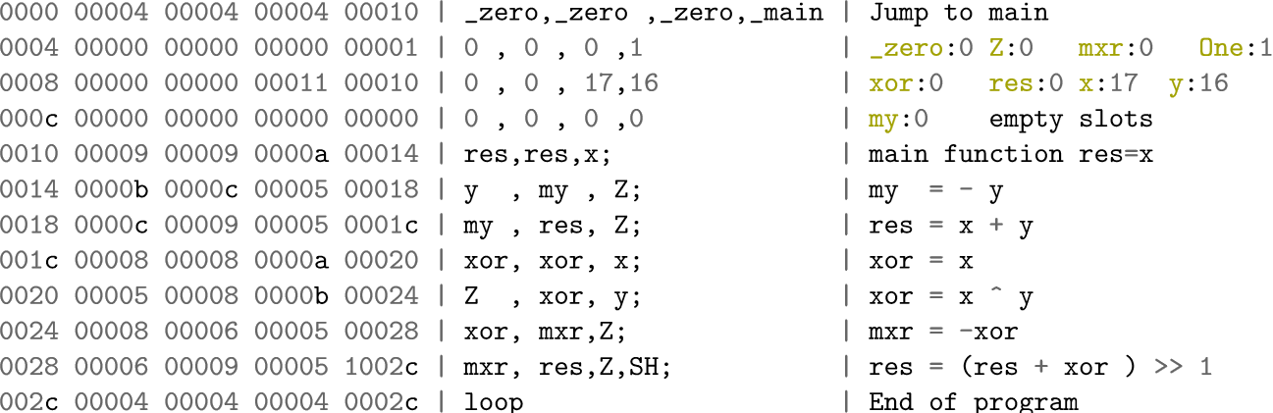
Memory Address.

Slide 24
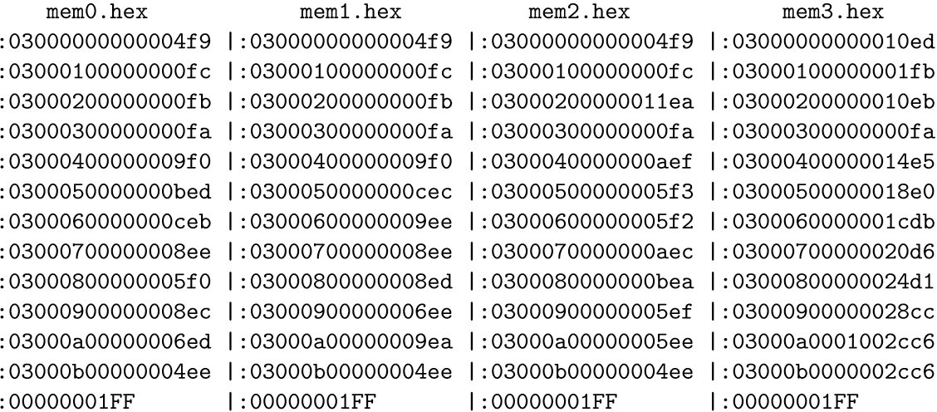
Intel Hex Format Files.

Slide 25
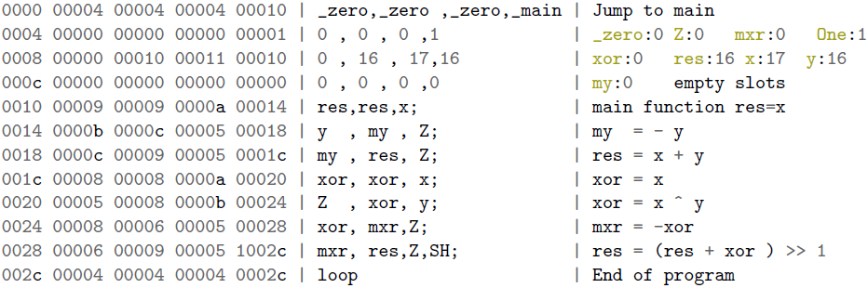
Output Address Files.

Slide 26
Presentation Outline.
Introduction
SLXS Language
SLXS toolchain
Experimental Evaluation
Demo

Slide 27
AES−128.
The Rijendael cipher with n = m = 128.
Developed in address level and translated to SLXS language.
 | Referenced Algorithm | Implemented Algorithm
Program Size | 1,836 bytes | 1,861 bytes
Variables Size | 1,011 bytes | 1,058 bytes
Instructions Size | 825 bytes | 837 bytes
SLXS | ~7,000 | 6,837
Clock Cycles | ~35,000 | 31,935

Slide 28
Present.
A lightweight block cypher with n = 64 and m = 80 or m =128.
 | Referenced Algorithm | Precomputed Pbox Values | MSP430 processor
Program Size | 2,618 bytes | 2,873 bytes | ~2000 bytes
Variables Size | 1,047 bytes | 1,462 bytes | -
Instructions Size | 1,570 bytes | 1,411 bytes | -
SLXS | 297,335 | 189,052 | -
Clock Cycles | 1,486,675 | 945,260 | ~200,000

Slide 29
Presentation Outline.
Introduction
SLXS Language
SLXS toolchain
Experimental Evalutation
Demo

Slide 30
Cryptographic Algorithms for Single-Instruction Processors
Questions?
Supervisor: Dr. David Oswald
Presenter: Vasilis Sikkis
MSc Cyber Security, University of Birmingham

