Slide 1
VictorVis
An Exploration of eSports Statistics

Slide 2
Preparation Phase

Slide 3

What is VictorVis?
VictorVis is a project utilizing Machine Learning through Supervised data. With this data we want to determine how well we can predict a player’s rating as our hypothesis is that higher rated players will help predict winners.
Hypothesis
‘We believe through the utilization of our large dataset, that we would successfully be able to predict whether or not a solo player can work well within a team for Counter-Strike competitions based off of their rating/predicted rating.’

Slide 4

The Dataset
Writing out a script, we accessed data held within HLTV.org player stats pages - a website that records the statistics of solo and team players in the environment of Counter-Strike.
Splicer Results
A total of 967+ players and their stats were gathered into one CSV file/Dataframe. Each player had 72 data points gathered.

Slide 5
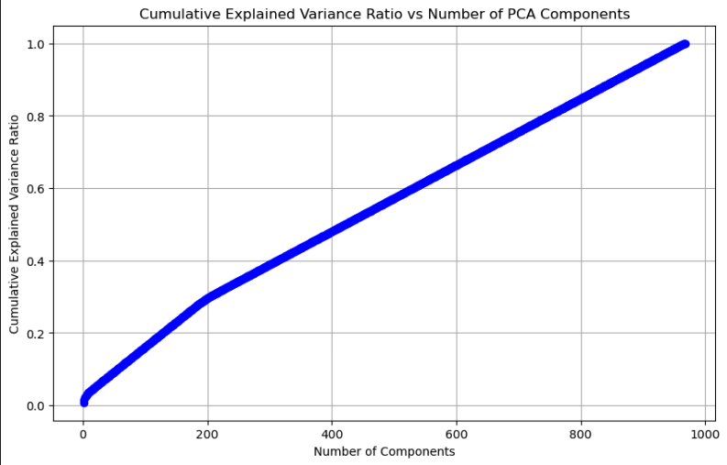
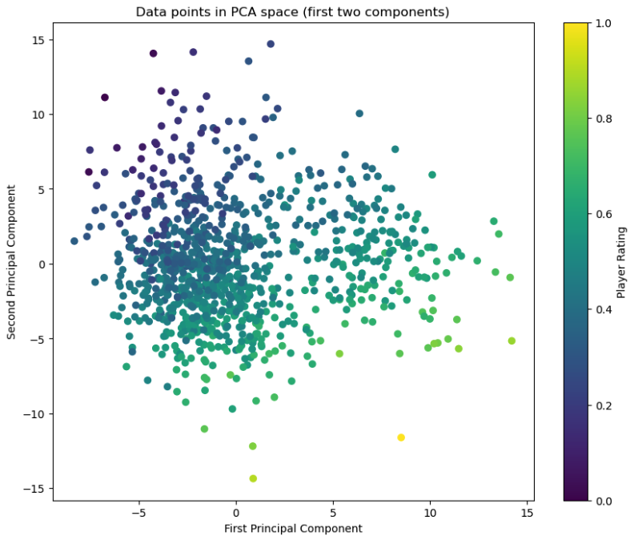
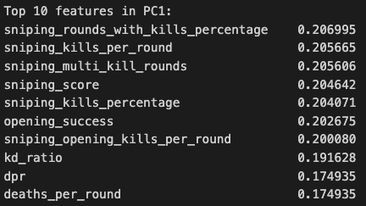
Explored Data
Through exploration of the data, we were able to determine that stats like kd_ratio,kills_per_round, and kast provided the best statistics to make rating predictions rather than utilizing all 75+ columns.

Slide 6
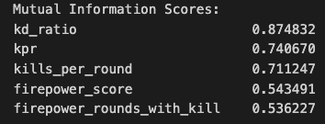
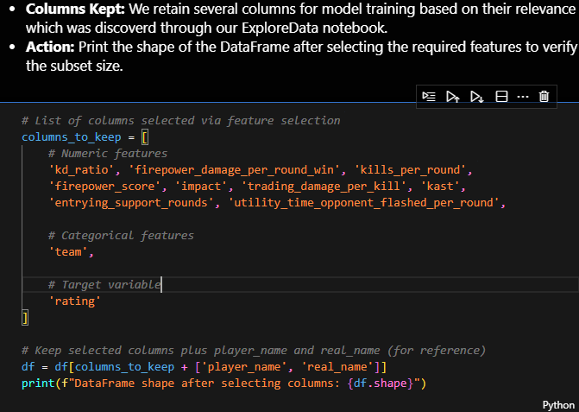
Feature Selection
Using various methods in feature selection, we were able to determine the best correlative features that interact with the rating to create robust models to predict player rating.

Slide 7
Model Phase

Slide 8
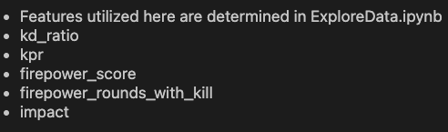
Model Results- LinearRegression
Features Used for the Model:
y:[‘rating’]
X:dataframename.drop(columns= ‘rating’)
The used dataframes: team_players_featured and solo_players_featured
Linear Regression Model: Shayne (linearregression.ipynb)

Slide 9
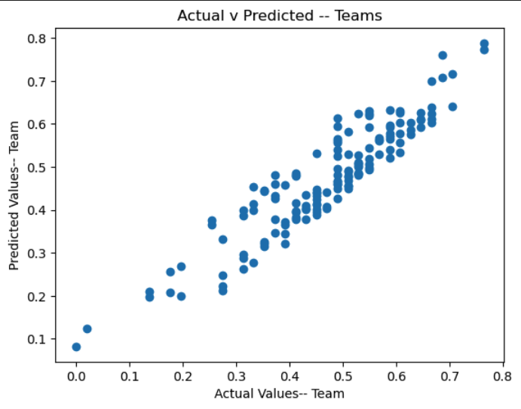
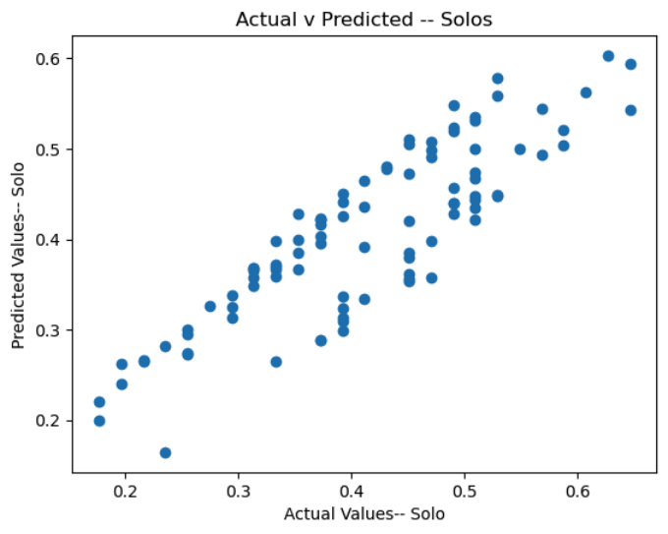
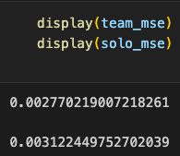
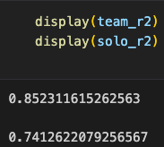
LinearRegression Cont.
According to the Linear Regression results. . .
The MSE for both the team players data and solo players data are relatively low.
The r2 data is also notable high.
Both factors determine Linear Regression could be a good model to use.

Slide 10
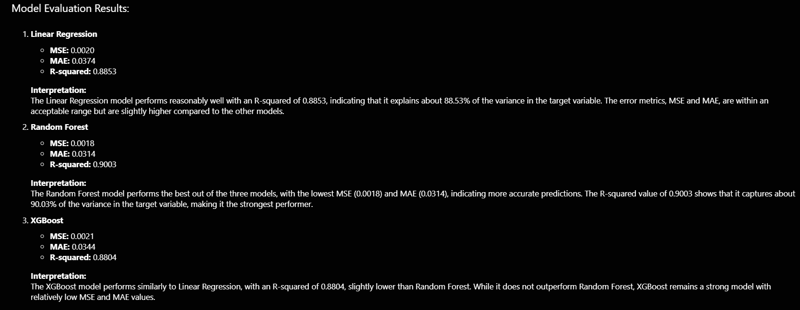
Model Selection

Slide 11
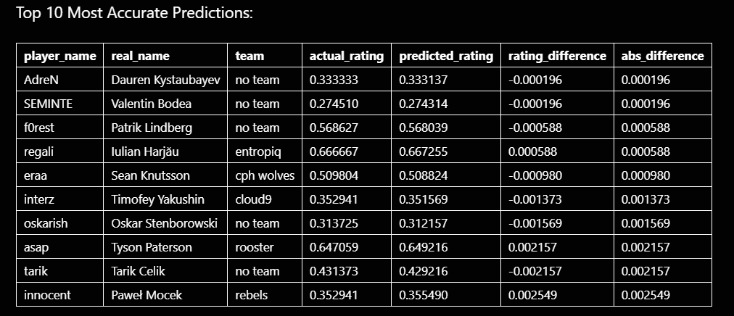
Prediction Results Before Optimization (Random Forest)

Slide 12
Optimization
We performed iterative optimization on both models:
Baseline Models:
Initial performance was strong, with Random Forest achieving an R² of 0.9003 and XGBoost achieving 0.8804 on the test set.
Basic Tuning:
We used RandomizedSearchCV to explore different hyperparameters.
This included tuning parameters like number of estimators, max depth, and learning rate.
Advanced Tuning:
We further refined the models with more specific hyperparameter ranges.
Additional parameters like min_samples_split, max_features, and subsample were tuned.

Slide 13
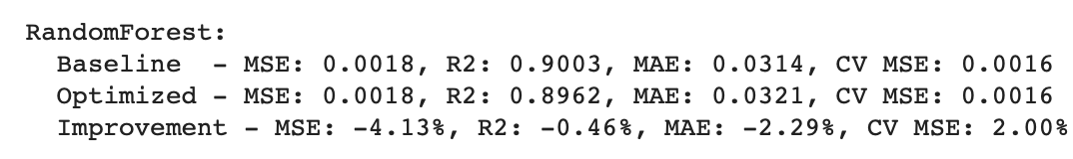
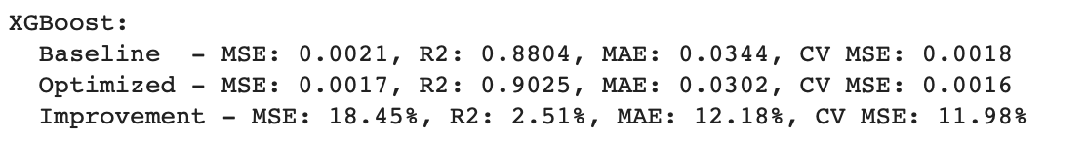
RandomForest/XGBoost cont.
After optimization:
Random Forest:
Slight decrease in performance (R² from 0.9003 to 0.8962)
This suggests the baseline model was already well-tuned for our data.
XGBoost:
Significant improvement (R² from 0.8804 to 0.9025)
18.45% reduction in Mean Squared Error
12.18% improvement in Mean Absolute Error
XGBoost emerged as our best-performing model after optimization.

Slide 14
Extra Phase

Slide 15
Encountered Challenges
We weren’t granted access to the API we originally desired.
We created scrapers to gather data instead.
We were granted access to the API on September 25th (4:29 AM), a full week after we requested access.
50%+ of data columns were objects.
We created a loop that would fix those columns to int/float values.
Age Value accidentally replaced by ‘23’for everyone without realizing until last minute
We removed this data column, it will be used in the future to help with further progress

Slide 16

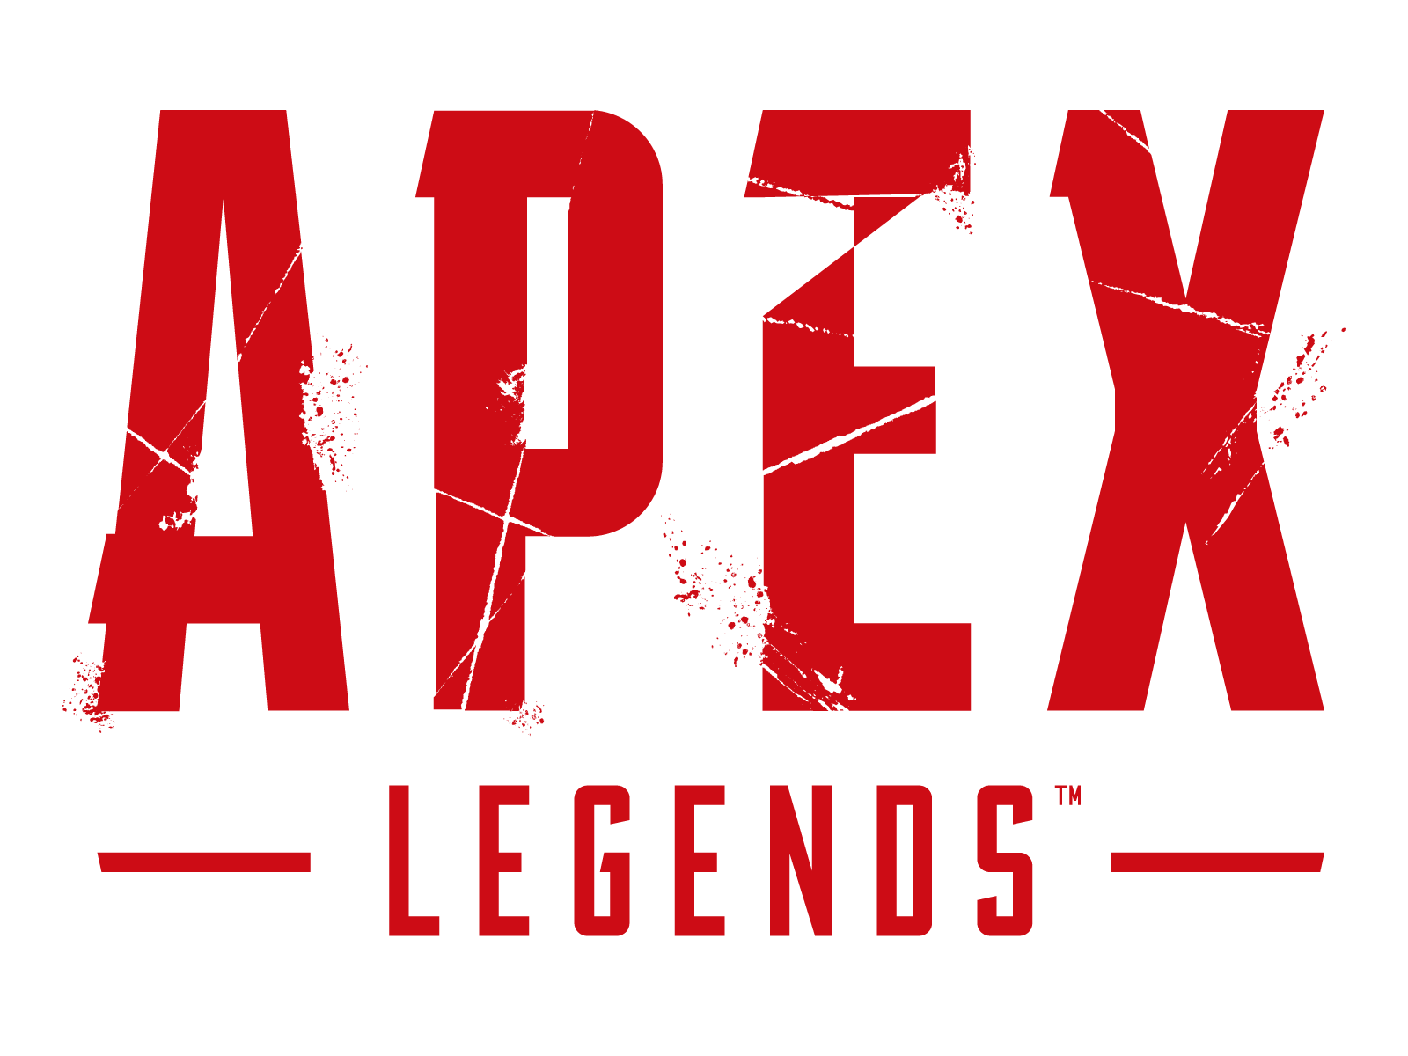


Future Plans pt.1
If provided more time we would likely be able to. . .
Create a Streamlit App where we could predict a player’s rating after inputting data.
Create an extension that could cobble together the best fantasy eSport team
Expand VictorVis into covering stats from games other than Counter-Strike

Slide 17

Future Plans pt.2
Utilizing the Age and Country columns for future interpretation/analysis.
Run Live Predictions in the model/future presentations.

Slide 18

Q U E S T I O N S ?

