Slide 1
Blocker
A Tale of Great Wonder

Slide 2

We’ve made a game, that integrates…
Basic A.I. (decision making)
Basic path finding
Map generating (random numbers)

Slide 3
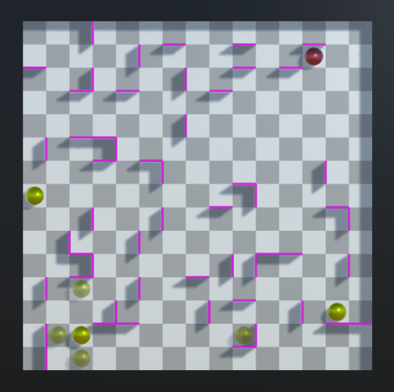
Our game
The Objective: To block John Sistine (the red player, controlled by the computer) so that he can't move anymore. He has more than deserved it!
Controlls: Your squad (green players) are rather easily maneuverable. All you need to do is click one and he'll tell you where he can go. If you want to move another one of your squad, just cancel the move by clicking the same squad member again.
Creators: Juha Sikstus, Topi Salonen and Konsta Sinisalo (though not one of them takes any responsibility).

