Slide 1
Blocker
A Tale of Great Wonder

Slide 2

We’ve made a game, that integrates…
Basic A.I. (decision making)
Basic path finding
Map generating (random numbers)

Slide 3
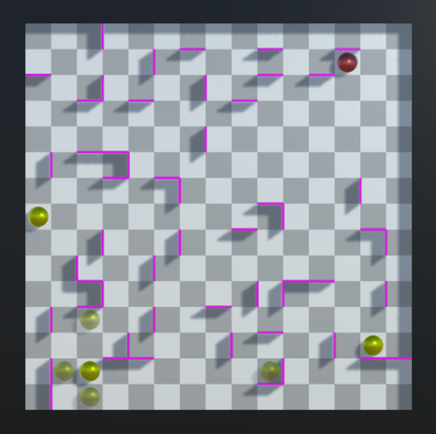
Our Game
The Objective: To catch John Sistine (the red player, controlled by the computer) so that he can't move anymore. He has more than deserved it!
Controlls: Your squad (green players) are rather easily maneuverable. All you need to do is click one and he'll tell you where he can go. If you want to move another one of your squad, just cancel the move by clicking the same squad member again.
Creators: Juha Sikstus, Topi Salonen and Konsta Sinisalo (though not one of them takes any responsibility).

Slide 4
Basic Components
Map Generation
Random maps and random start locations
The Squad (Players)
Controls and path finding
John Sistine(Opponent)
Most complex component in the game

Slide 5
Map Generation
Everything is generated: first the basic ”board” is created, then the walls, then players, with the opponent being the first to be created.
As the board consists of cubes, that mark spaces for players to move on, the walls are created ”in between” those spaces (27 horizontal & 27 vertical)
As the walls are created, it’s also checked none of them overlap
The opponent is the first player to be created with a random location and then the squad one by one, always checking that neither opponent or any member of the squad overlap with one another

Slide 6
The Squad
The squad is probably the simplest of game components involved
Every member of the squad knows the whereabouts of every wall and every other player on the board
The squad members also have a basic path finding algorithm i.e. they only move until they hit either a wall or another player on the board

Slide 7
John Sistine
John Sistine (the target/opponent) loses, when he is blocked so, that he can’t move anymore
Basic pathfinding and A.I.
Checks possible moves (as the other players)
Assigns values to movespots based on how easily John can get blocked on the spot (many adjacent walls, many players nearby)
Takes the least dangerous move
Basically a very simple influence map

