Slide 1
AIT Austrian Institute of Technology
PPT Master
Lecturer or Author

Slide 2

Alternative Cover (Image)
Subline

Slide 3
chapter marker
With smaller type size and reduced key visual

Slide 4
HEADLINE, Arial uppercase, 24PT two lines maximum
Dummy text on a ppt slide, a meaningless text, only for the visualization of the graphic concept (example 18pt, line spacing 1, spacing before paragraph 4pt)
Subtitle, single-line, 18 pt
This part of the text can be emphasized in black, if necessary. Dummy text on a ppt slide, a meaningless text, only for the visualization of the graphic concept.
A short dummy text
Second level
Only if absolutely necessary – a third level

Slide 5

Headline And image

Slide 6

Example for Info boxes
Headline Info Box
Listed item 1
Listed item 2
Listed item 3
Listed item 4

Slide 8
Small image
Dummy text on a ppt slide, a meaningless text, only for the visualization of the graphic concept. (18pt)
Dummy text on a ppt slide, a meaningless text, only for the visualization of the graphic concept.
Image caption

Slide 9
Text in 2 columns
Dummy text on a ppt slide, a meaningless text, only for the visualization of the graphic concept. (18pt)
Dummy text on a ppt slide, a meaningless text, only for the visualization of the graphic concept.
Dummy text on a ppt slide, a meaningless text, only for the visualization of the graphic concept. (18pt)
Dummy text on a ppt slide, a meaningless text, only for the visualization of the graphic concept.
Bulleted list
Bulleted list

Slide 10
Colour scale RGB Definition for Powerpoint
Bordeaux: RGB 121 | 11 | 26 Grey: RGB 93 | 108 | 116 Turquoise: RGB 64 | 170 | 155
Violet: RGB 51 | 0 | 64 Light grey: RGB 189 | 189 | 189 Black: RGB 0 | 0 | 0

Slide 11
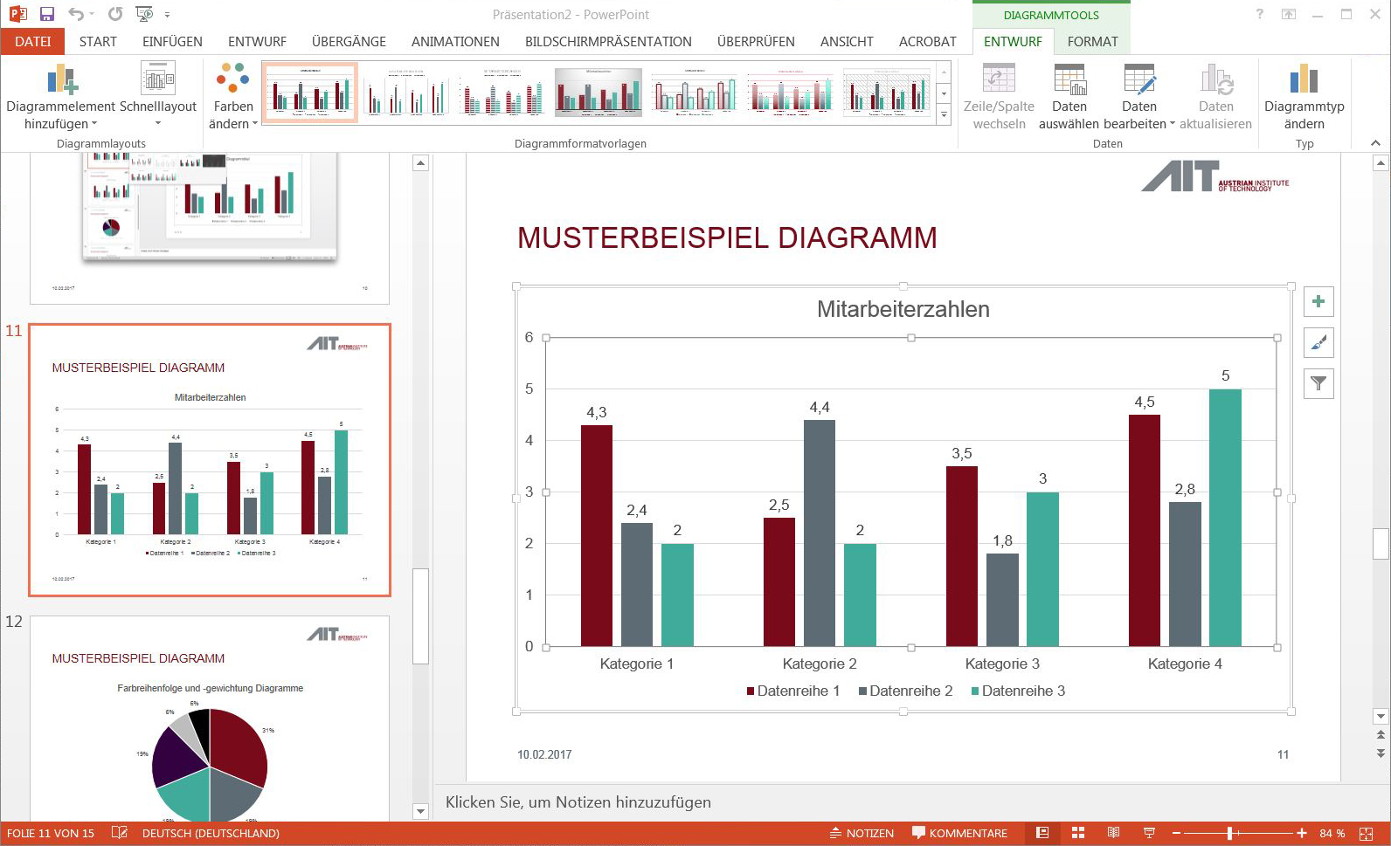
Chart style
1. Chart Template
Pure + clear
No shadows
No colour gradients

Slide 12
Example CHART

Slide 13
Example CHART

Slide 14
Example Chart

Slide 15
Example Spreadsheet
Category | 2014 | 2015 | 2016 | Forecast 2017
Text Dummy text | 000.000 | 000.000 | 000.000 0.000 | 000.000 0.000
Text | –000.000 | –000.000 | –000.000 | –000.000
Text | –0.000 | –0.000 | –0.000 | 0.000
Text | 000 | 000 | 000 | 000
Text | –0.000 | –0.000 | –0.000 | 0.000
Dummy text | 00 | –00 | –0 | 0
Dummy text (this is a dummy text) | 0.000 | 0.000 | 0 | 0
Text and dummy text | –00 | –0.000 | –0.000 | 0.000
Text and dummy text example | 0.000 | 000 | –000 | 0
Total sum | 0.000 | –0.000 | –0.000 | 0.000

Slide 16
Example block diagram
Process
Step 1
Step 2
Process
Step 3
Step 5
Result
Step 4
Process

Slide 17
Example mindmap
External factor
Term
Term
External factor
Term
Term
Central term
Term
Term

Slide 18
Example Process/Timeline
Start
Step 1
Step 2
Step 3
Results
Milestone 1 xx.xx.2018
Milestone 2 xx.xx.2018
Start
Step 1
Step 2
Step 3
Results
Milestone 1 xx.xx.2018
Milestone 2 xx.xx.2018

Slide 19












Example Partner logos

Slide 20
Logos on a white background should be scaled to the frame size of 4,5*3,2 cm, before placing them in the frame by clicking on the image (or right mouse click/change image).
Logos with a different size can be scaled to the frame width in PPT (by using Picture Tools/Format/Size.)

Slide 21
Thank you!
Lecturer, Date

