Slide 1
Final Project Progress
By: Brandon Connell & Noah Vanscoyoc

Slide 2
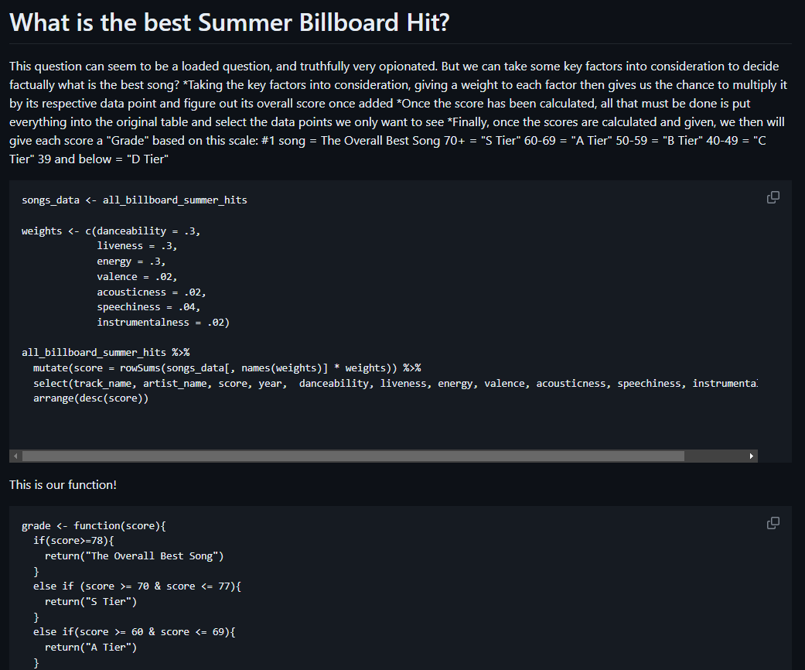
What do we have so far?
So far, we have an entire introductory section on our github as well as a lot of work into a bunch of very rudimentary graphs that need to be fleshed out and some beginning data points that we can use to find some interesting things about the data.
One of our first initial interests was an overall “grade” or score for each individual song based on important key factors to figure out which song is the best song (statistically)

Slide 3
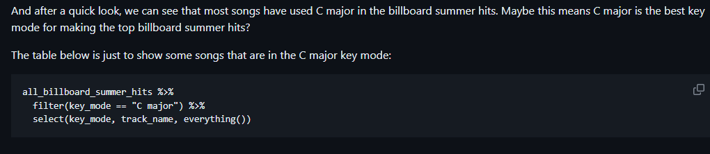
What else?
Well, currently we are pretty much complete for graphs and visualizations for the topics we were interested. Next plan is to work backwards from these data visualizations and find interesting tables and ways to use the things we learned from the lessons in the project.
This means we will be going through and finding certain things to possible mutate, or summarize and filter out what we want to see.
For instance, what is above, just something small to see extra into the dataset to see the songs that were only made in C major.

Slide 4
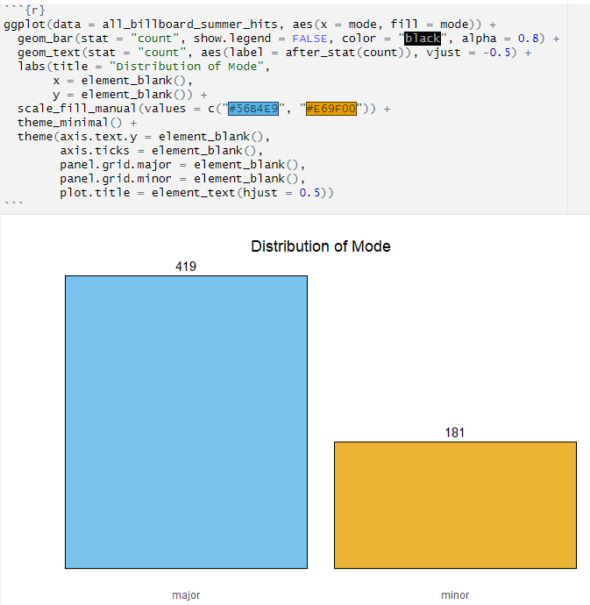
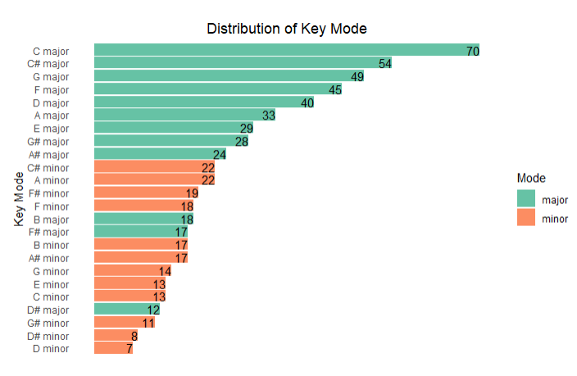
Some Graphs
The first data type we looked at was if a song was in major or minor
Secondly was the number of different key modes in every top hit

Slide 5
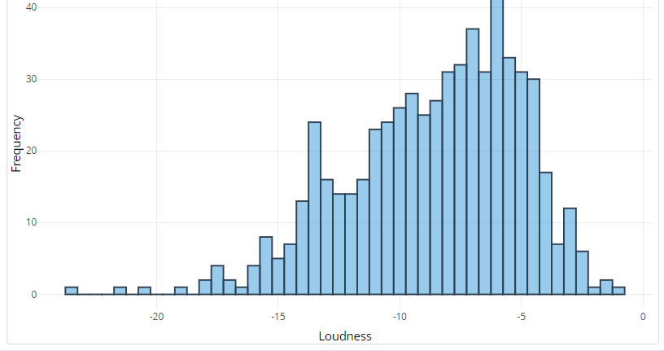
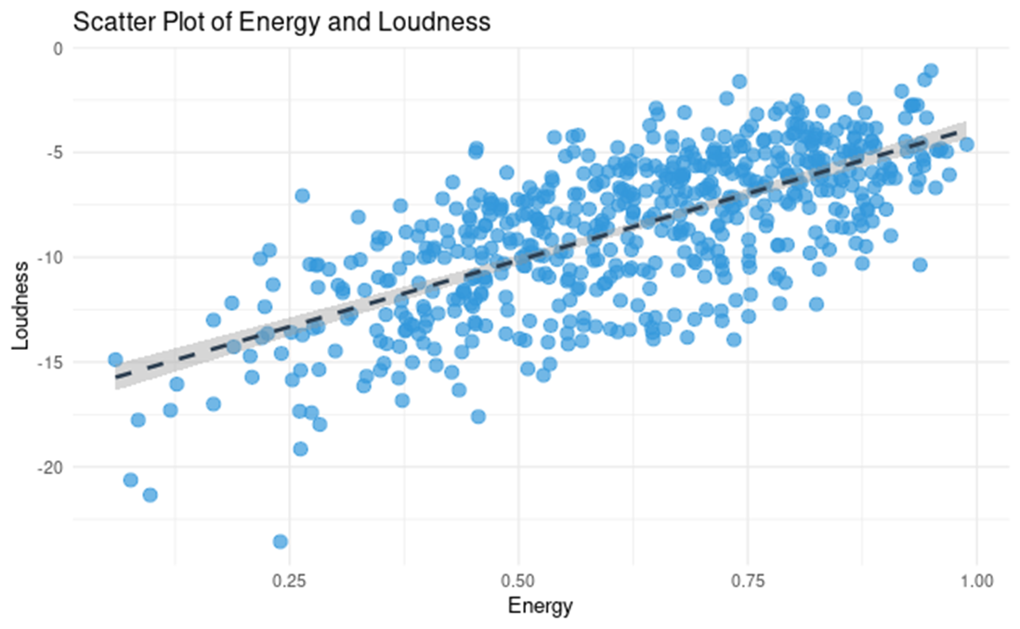
Loudness Graphs
Our third graph was to demonstrate loudness in the songs and count them out with a interactive graph with plotly
Alongside our initial loudness plot, we then decided to compare the songs to determine whether or not energy and loudness had any correlation over the years

Slide 6
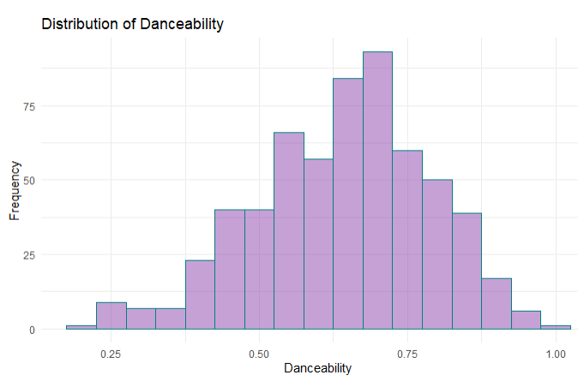
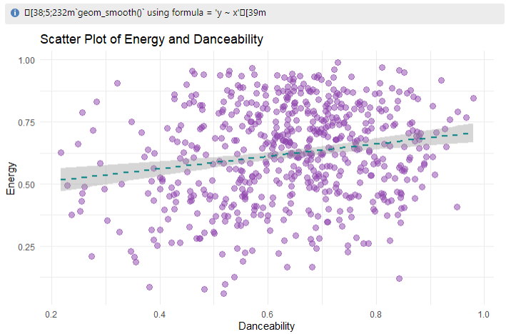
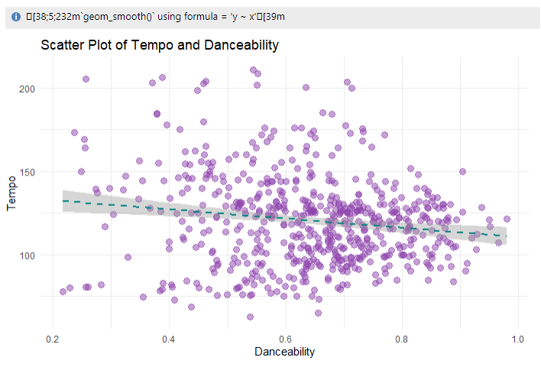
Danceability Graphs
For these couple graphs, we also wanted to find any correlation between different variables and danceability

Slide 7
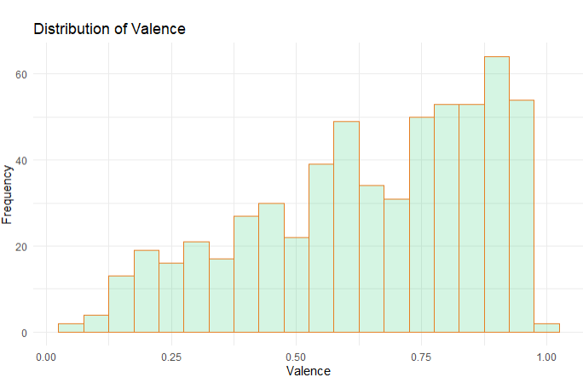
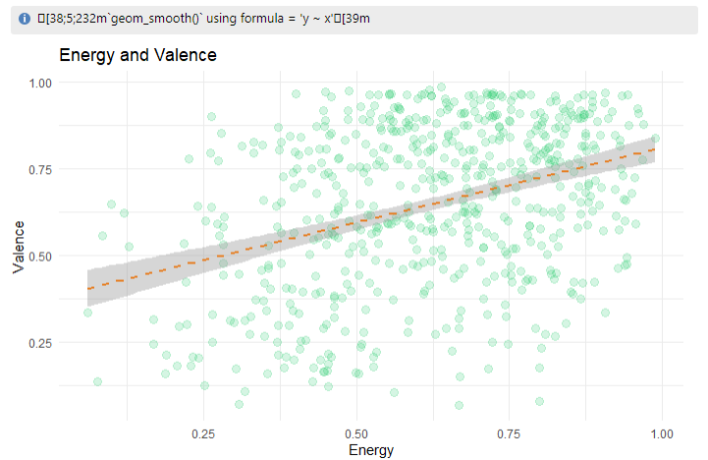
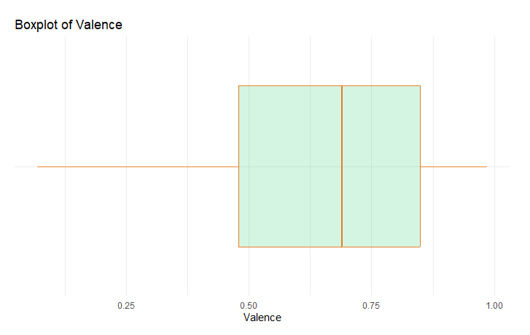
Valence Graphs
These graphs demonstrate valence and its numbers for the dataset. Alongside it is a comparison between Valence and Energy.

Slide 8
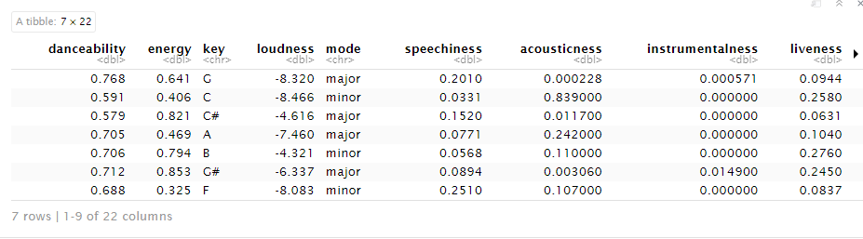
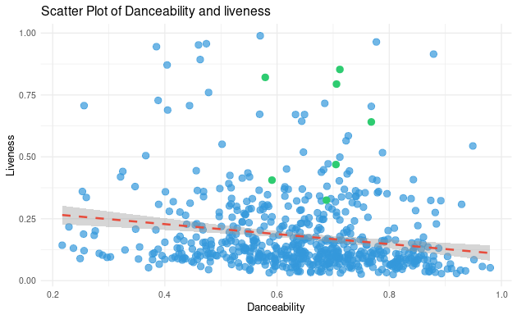
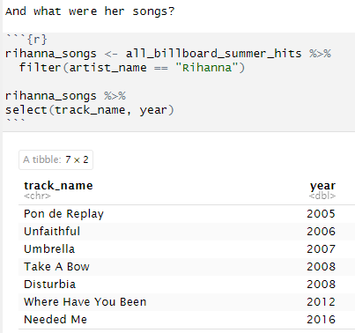
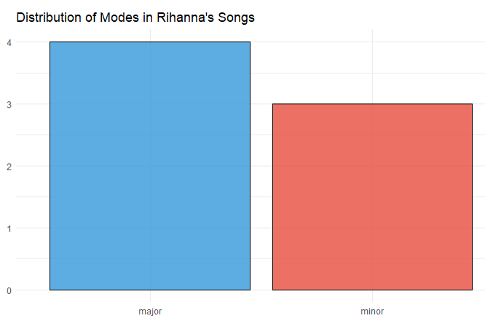
Rihanna
Lastly, we found the artist with the most summer billboard hits, This being Rihanna we then dug a bit deeper into some of her difference key statistics.

