Slide 1
Lip Reading

Slide 2
Introduction
Lip reading plays a significant role in human communication.
The technical can help the hearing loss people and can be applied in audio-visual speech recognition system.
It is a difficult and challenging task as phonemes cannot be detected by just looking at a speaker’s lips.

Slide 3
Literature Survey
Text Recognition from Silent Lip Movement Video
This paper proposes two network architectures, visual to audio feature and audio feature to text architecture for lip reading task.
Lip-Reading Driven Deep Learning Approach for Speech Enhancement
This paper proposes a novel lip-reading driven deep learning framework for speech enhancement

Slide 4
Proposed System
The proposed system aims at providing a lipreading model that uses a deep neural network for generation of text from silent lip movement videos.
The dataset is split into video and audio, then segmented according to the phonemes.
Video and audio are mapped to each other and used to train the model
The user data is processed, converted to text and refined.

Slide 5
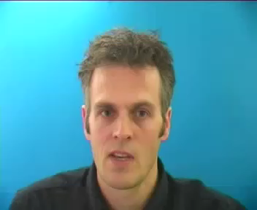
Sample Dataset

Slide 6
References
H. Akbari, H. Arora, L. Cao and N. Mesgarani, "Lip2Audspec: Speech Reconstruction from Silent Lip Movements Video," 2018 IEEE International Conference on Acoustics, Speech and Signal Processing (ICASSP), Calgary, AB, 2018, pp. 2516-2520.
Y. Wei and X. Hu, "Text Recognition from Silent Lip Movement Video," 2018 IEEE 3rd International Conference on Signal and Image Processing (ICSIP), Shenzhen, 2018, pp. 168-171.
Adeel, M. Gogate, A. Hussain and W. M. Whitmer, "Lip-Reading Driven Deep Learning Approach for Speech Enhancement," in IEEE Transactions on Emerging Topics in Computational Intelligence.

