Slide 1
Predicting Short-Term Bitcoin Price
Silan Liu

Slide 2
Table of contents
01
02
03
04
Overview
Models
Outcomes
Streamlit

Slide 3
01
Overview
Background & Objective

Slide 4
Motivation
What makes Bitcoin price prediction important?
Which is better, short-term or long-term direction prediction?
Can we predict short-term Bitcoin price?

Slide 5
Introduction
The goal is to predict short-term Bitcoin price direction (up/down) for minutes horizons compared with days horizons and price at 5-minute intervals .
Compare performance across traditional ML and deep learning models.

Slide 6
Dataset
Source: Kaggle
Data volume: 8 million rows of minute-level data (2017–2025) → 3 million rows(2020-2025)
Target variable: binary indicator of price increase within future h minutes and n days.
Features: price, volume, technical indicators
Target: future price direction (binary classification: up/down and log return)
Challenges: scale, stationarity, noise

Slide 7
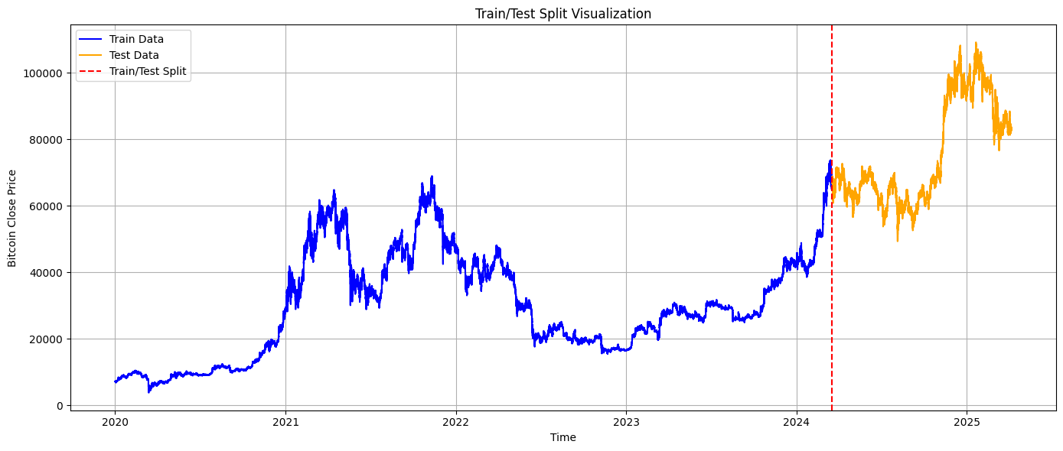

Slide 8
02
Models

Slide 9
Models
Model | Type | Why Chosen
Logistic Regression | Linear baseline | Easy to interpret, fast
LightGBM | Tree boosting | Fast + accurate
Stacking | Meta-model | Combines LR, LGBM, XGB
MLP | Neural net | Captures nonlinear interactions
BRNN | Bidirectional RNN | Price Regression (5-min)

Slide 10
Training Setup
80% training / 20% testing split (chronological)
Hardware:
Google Colab A100 GPU
Key hyperparameters:
MLP: 2 hidden layers (128 → 64), LeakyReLU activation, Dropout 0.3
LSTM: 10-minute input window, 1 layer with 64 units, Bidirectional, Dropout 0.3
LightGBM: 100 trees, max depth auto, learning_rate = 0.1

Slide 11
Technical Indicator
MACD and MACD difference – to capture short-term vs long-term momentum RSI (14-period) – to measure overbought or oversold conditions SMA (10-period) – a simple moving average for trend smoothing Bollinger Band ratio – showing how far the price is from its mean ATR (Average True Range) – a volatility measure OBV (On-Balance Volume) – to incorporate volume momentum Log-transformed volume, volume ratio, and rolling standard deviation

Slide 12
03
Outcomes
Classification and Price Prediction

Slide 13
Classification Result
Horizon | Logistic_AUC | LightGBM_AUC | Stacking_AUC | MLP_AUC
2min | 0.512866 | 0.516483 | 0.511477 | 0.518280
5min | 0.519275 | 0.519560 | 0.518597 | 0.521117
15min | 0.527192 | 0.514791 | 0.526502 | 0.527405
30min | 0.525188 | 0.512390 | 0.524613 | 0.519081
60min | 0.526081 | 0.509952 | 0.525375 | 0.523975

Slide 14
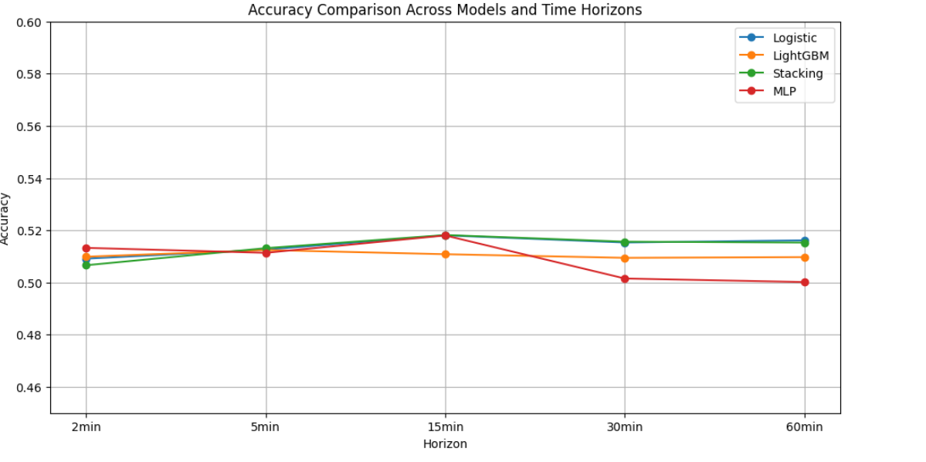

Slide 15
Classification Result
Horizon | Logistic_AUC | LightGBM_AUC | Stacking_AUC
1d | 0.539497 | 0.512736 | 0.506891
2d | 0.573944 | 0.561581 | 0.468798
5d | 0.611009 | 0.512701 | 0.581272
10d | 0.676960 | 0.538419 | 0.611633
20d | 0.722243 | 0.631681 | 0.541755

Slide 16
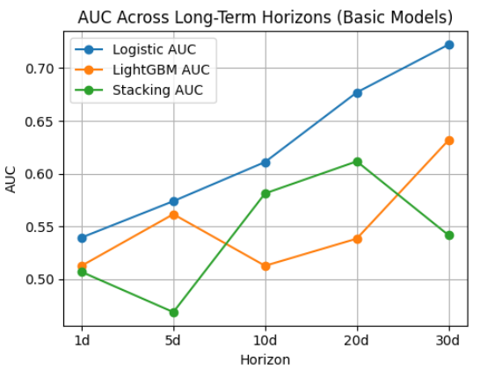
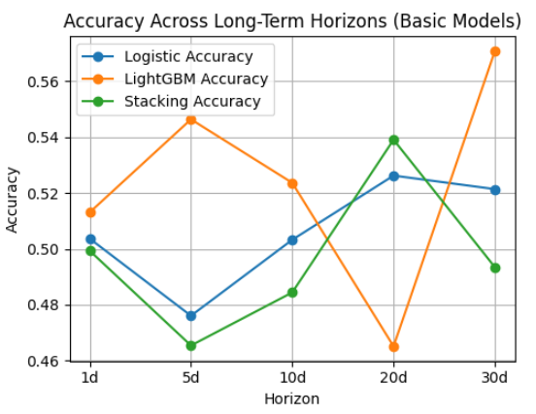
Classification Result

Slide 17
Price Prediction
LightGBM
LightGBM RMSE: 132.257541
LightGBM R²: 0.9999
BRNN
BRNN RMSE:131.547129
BRNN R²:0.9999

Slide 18
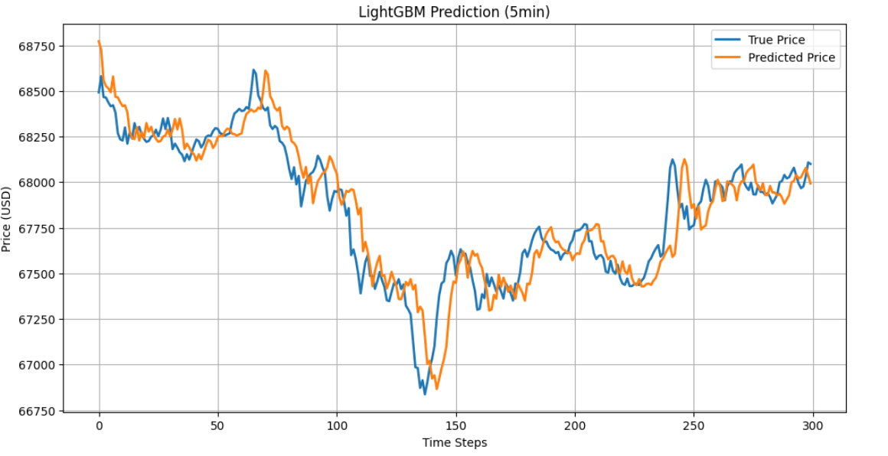

Slide 19
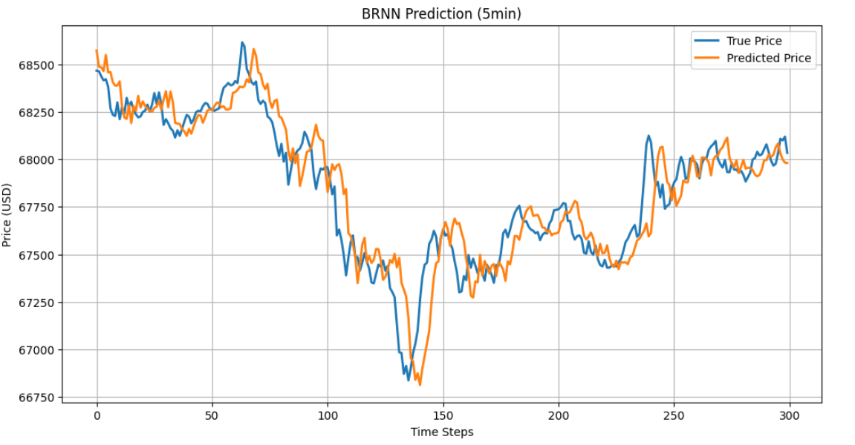

Slide 20
04
Streamlit
Streamlit App Link

Slide 21
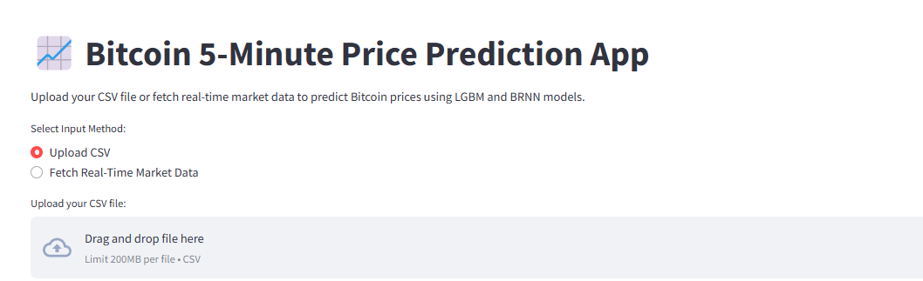
APP
50%
70%
Web3 platforms

Slide 22
Conclusions
Short-term direction is hard — all models were ~50% AUC
Long-term prediction improves dramatically — Logistic and MLP were most reliable
Price prediction via return modeling works well — BRNN slightly outperformed LightGBM
Simple models generalize better in long-term trends

Slide 23
Reference
Lahmiri, S., & Bekiros, S. (2019). Cryptocurrency forecasting with deep learning chaotic neural networks. Chaos, Solitons &amp; Fractals, 118, 35–40. https://doi.org/10.1016/j.chaos.2018.11.014
Lahmiri, S., & Bekiros, S. (2020). Intelligent forecasting with machine learning trading systems in chaotic intraday Bitcoin market. Chaos, Solitons &amp; Fractals, 133, 109641. https://doi.org/10.1016/j.chaos.2020.109641
PREDICTING THE PRICE OF BITCOIN USING MACHINE LEARNING. (2022). International Research Journal of Modernization in Engineering Technology and Science. https://doi.org/10.56726/irjmets30998
Sun, X., Liu, M., & Sima, Z. (2020). A novel cryptocurrency price trend forecasting model based on LightGBM. Finance Research Letters, 32, 101084. https://doi.org/10.1016/j.frl.2018.12.032

Slide 24
Thanks!

