Slide 1
OCT
Monthly report
Digital Marketing
Report: October 2026
Cohort 49 ads, the HR Summit push,
and what we change in November.
Silas Atuahene Appiah | Digital Marketing Officer | November 2026
Notes:
This is the digital marketing report for October. I'll cover what the ads delivered for Cohort 49, how the organic content went, the other work done this month, and what I plan to change in November before intake closes on 29 November.

Slide 2


October in four numbers
Cohort 49 ads are bringing in enrolments at about $29 each
Cohort 49 enrolments
Cohort 49 ad spend
Per enrolment
Leads and chats
34
$888
$29
1,603
so far, and more than 90% came through our ads
in October across Meta and LinkedIn
October spend against the 31 or more ad-sourced enrolments
214 LinkedIn leads, 146 Meta leads and 1,243 WhatsApp and Messenger chats
The 34 enrolments are worth at least GHC 265,200 in fees (if all were aPHRi at GHC 7,800). November's job is turning the leads we already have into enrolments.
Notes:
The headline: 34 people have enrolled for Cohort 49 so far, and more than 90% of them came through the ads. We spent $888 on Cohort 49 ads in October, which is about $29 per enrolment. The Meta campaign started on 27 September, so a few days of September spend aren't in that figure, and the true number is a little higher. At the lowest fee, aPHRi at GHC 7,800, those 34 enrolments are worth at least GHC 265,200. If asked: the $29 uses October spend only, set against at least 31 ad-sourced enrolments.

Slide 3
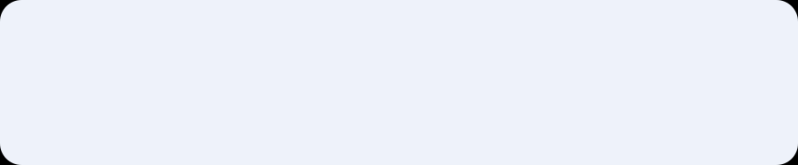



Where the ad money went
Three campaigns, $1,055.89 in total. Figures cover October only
Cohort 49, Meta
1,243 chats and 146 leads. About $0.44 per conversation
Cohort 49, LinkedIn (14 to 31 Oct)
214 leads at $1.57 each, from 53,844 impressions
HR Summit awareness, Meta
768,946 people reached for $0.22 per 1,000
Notes:
Total ad spend in October was $1,055.89. Most of it, $888, went to Cohort 49: $552 on Meta and $336 on LinkedIn. The LinkedIn campaign only ran from 14 October, so that's 18 days. The other $168 was the HR Summit awareness ad, which reached almost 769,000 people at 22 cents per thousand, the cheapest reach of the month.

Slide 4

LinkedIn brought in 214 leads in 18 days
Cohort 49 lead ad, 14 to 31 October, $335.82
214
$1.57
leads
per lead
2.06%
23%
click-through rate
finished the form
Most leads came from outside HR, which suits aPHRi. Functions with fewer than 3 leads are not shown.
Notes:
LinkedIn brought in 214 leads in 18 days, about 12 a day, at $1.57 per lead. That's close to the $1.35 our June Cohort 47 Meta ad achieved, and LinkedIn is usually more expensive. The surprise is who responded. Education, Administrative, Customer Success, Sales and Operations all brought in more leads than HR. That suits aPHRi, which needs no HR experience. About half of the 214 leads come from job functions too small for LinkedIn to report on their own.

Slide 5

HR professionals open the form, then stop
Share of people who finished the LinkedIn lead form after opening it
Human Resources
64
form opens,
the most of any group
9
finished it
(14%)
Our PHRi and SPHRi audience is interested. In November I'll test a shorter form and an HR-specific message.
Notes:
This is the main thing I learned from LinkedIn. HR professionals opened the lead form more than anyone else, 64 times, but only 9 finished it. That's 14%, against 46 to 48% for Education and Sales. These are the people we most want for PHRi and SPHRi. My guess is the form asks too much or the message is pitched at beginners. In November I'll test a shorter form with a PHRi and SPHRi message aimed at them.

Slide 6





Meta started 1,243 conversations
Cohort 49 Meta ads, 1 to 31 October, $552.38
313,744
people reached, each about twice
$0.44
per conversation
1,243
WhatsApp and Messenger conversations started
$0.82
per 1,000 impressions
1,106
of them with new contacts
Only 8 Apply clicks and 3 website registrations: people enrol through chats with Sales
Since 27 September: 1,461 chats and 176 leads
146
Meta leads
Notes:
Meta works differently. It's mainly a conversation ad. In October it reached about 314,000 people and started 1,243 WhatsApp and Messenger chats, at about 44 cents each, and produced 146 leads. Very few people went through the website: 8 Apply clicks and 3 registrations. So most enrolments happen in chats with Grace and the sales team. Counting from when the campaign started on 27 September, it's 1,461 chats and 176 leads. If asked about the 'orders' and 'purchases' Meta shows: those don't fit a lead campaign and look like a tracking setup issue, which I'm fixing.

Slide 7

181 posts, well past target on the main pages
Posts in October against the monthly target. TikTok and the blog fell short
What we posted about
HR Summit: about 30 pieces, speakers, partners and the Guess the Speaker challenge
Cohort 49: about 10 pieces, including the Get Ahead series
Consulting: HR & the Law, PDP, AI and HR Strategy masterclasses
Mentorship, HR Fix LIVE and staff celebrations
Messaging: 5 of 6 SMS and 2 of 3 email broadcasts
Notes:
On organic content, we published 181 posts, counting each platform separately. LinkedIn, Facebook and Instagram were all well above target. TikTok and the blog fell behind because the Summit took a lot of content time. The Summit was the biggest theme with about 30 pieces. Cohort 49 had about 10. We also sent 5 of 6 planned SMS broadcasts and 2 of 3 emails.

Slide 8







Beyond the feed
Partnerships, Summit preparation and support work in October
Sunny FM
New partners
Visits
Media partnership secured
Proposal to Altimate Advertising, arrangement sent to MTN MoMo
Mövenpick and Ghana Maritime Authority, plus GhIPSS HR team with a Summit invite
Summit toolkit
Birthday SMS
Video and events
Partner toolkit, panellist flyers with Raymond, invitation card samples
Automated birthday messages set up
Two HR Fix videos edited, AI Masterclass supported
Notes:
Outside the posts and ads: we secured Sunny FM as a media partner, sent proposals to Altimate Advertising and MTN MoMo, visited Mövenpick and the Ghana Maritime Authority, and hosted the GhIPSS HR team. For the Summit I built the partner toolkit, worked on panellist flyers with Raymond and produced invitation card samples. I also set up automatic birthday SMS messages and edited two HR Fix videos.

Slide 9





What held us back
Four issues to fix before intake closes on 29 November
Tracking gaps
HR professionals drop off
We can't yet link each enrolment to the ad or post behind it. Meta also shows 'orders' and 'purchases' that don't fit a lead campaign.
They open the LinkedIn form the most but finish it the least (14%).
Lead volume for Sales
Workload
1,243 chats in a month is a lot for one sales line open 8am to 5pm. Reply speed affects enrolments.
The Summit took much of the month's content time, so TikTok and the blog fell behind.
Notes:
Four things held us back. First, tracking: we can't yet say which ad or post brought in each enrolment, and Meta is reporting orders and purchases that don't fit a lead campaign, which points to a setup problem. Second, HR professionals dropping off at the LinkedIn form. Third, volume: over 1,200 chats is a lot for one sales line, and how fast those chats are answered affects enrolments. Fourth, workload: the Summit took a lot of content time.

Slide 10
Plan for November
Focus: turn the leads we have into enrolments before 29 November
01
Keep Cohort 49 ads running
02
Test an HR-focused LinkedIn ad
Final push in the last two weeks before intake closes
Shorter form and a PHRi or SPHRi message
03
Fix tracking
04
Run both Q4 innovations in full
Correct Meta conversion events and add UTM links to every campaign
Straight from the Classroom every weekend, ref-coded WhatsApp links for Sales
05
Weekly check with Grace
06
Get TikTok back on track
How many leads and chats became applications and enrolments
Short clips from the classroom interviews
Notes:
For November, everything points at one goal: turning the leads we have into enrolments before intake closes on 29 November. Keep the ads running with a final push. Test a LinkedIn ad aimed at HR professionals. Fix the tracking. Run both Q4 innovations in full. Set up a weekly check with Grace on what's converting. And get TikTok back on track using the classroom clips.

Slide 11

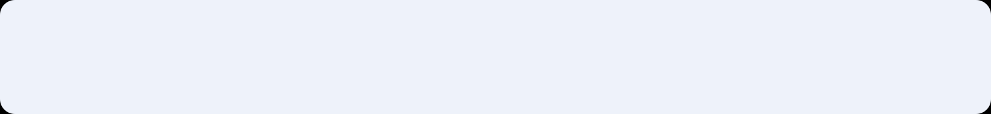


What I need
Two things that let us report cost per enrolment by channel
1
A weekly lead-source count from Sales
How many chats and leads came from Meta, LinkedIn and our pages, and how many enrolled.
2
Help checking the Meta pixel
Whoever manages the website, to fix the conversion events so the numbers are trustworthy.
29 NOV
Cohort 49 intake closes
5 DEC
Cohort 49 starts
Notes:
I need two things. A weekly lead-source count from Sales, so we can see which channel each enrolment came from and report cost per enrolment properly. And help from whoever manages the website to fix the Meta conversion events. With both in place, the November report will show exactly what each cedi of ad spend brings in.

Slide 12
34
Thank you
34 enrolled so far. Next stop: turning
October's leads into Cohort 49 seats.
Silas Atuahene Appiah | Digital Marketing Officer | November 2026
Notes:
Thank you. I'm happy to take questions.

