Slide 1


MUKUBA UniPod
ROOTLAB IGNITE PROGRAM
Name: Chalwe Silas
Project Name: AgroSpeak Connect
Stage:
Notes:
PLEASE DO NOT USE THIS TEMPLATE AS IT IS, THE HEADINGS AND NOTES CONTAINED INSIDE ARE TO GUIDE YOU, WE EXPECT YOU TO EDIT IT ACCORDINGLY, USE YOUR COLOURS, LOGO, DESIGN ETC.

Slide 2
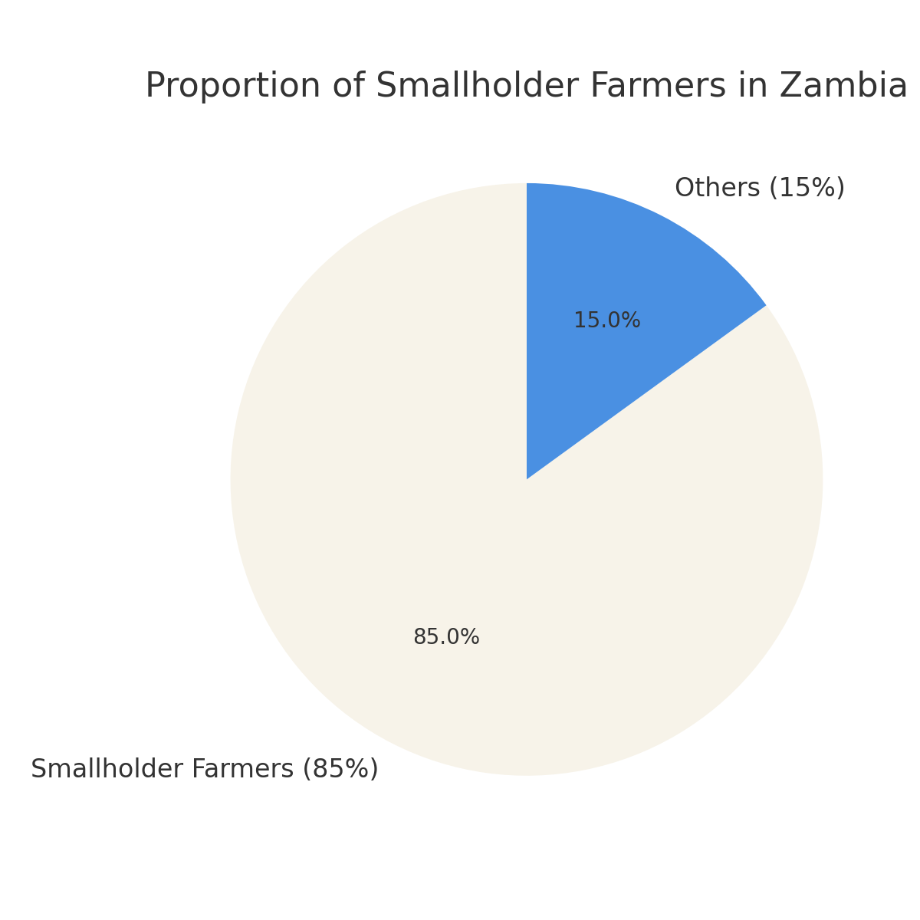
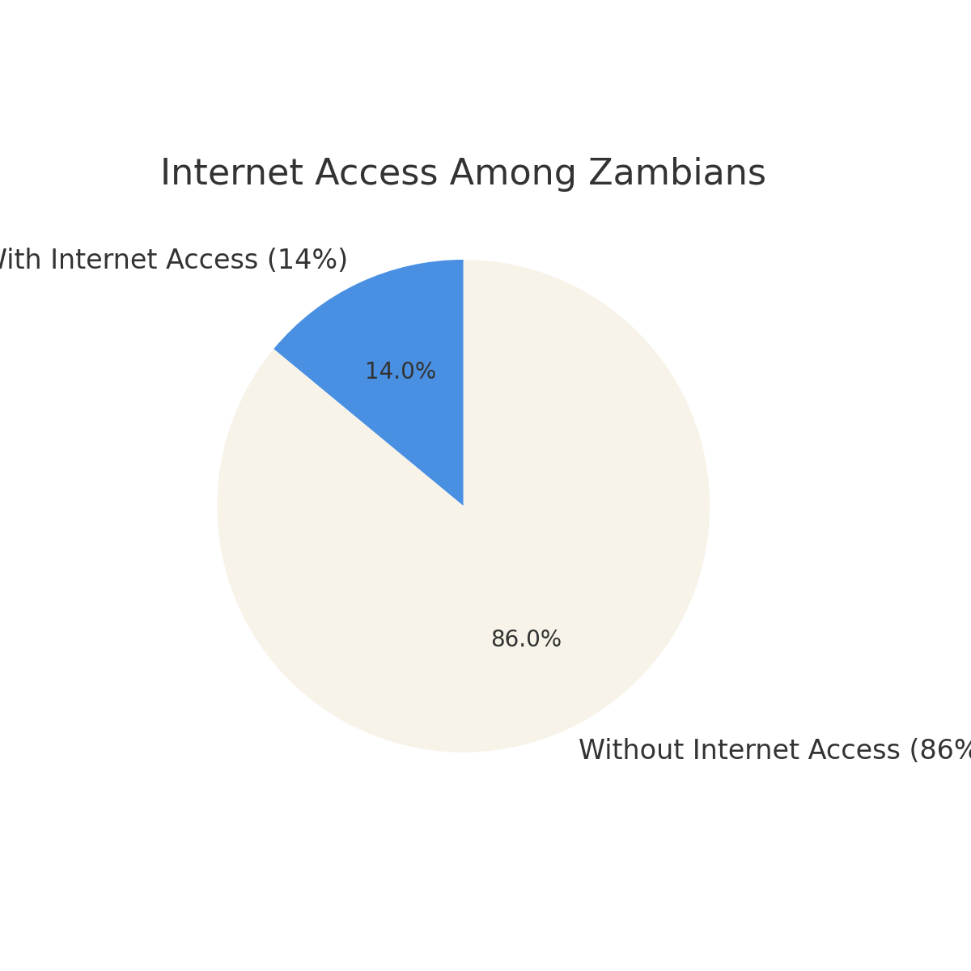
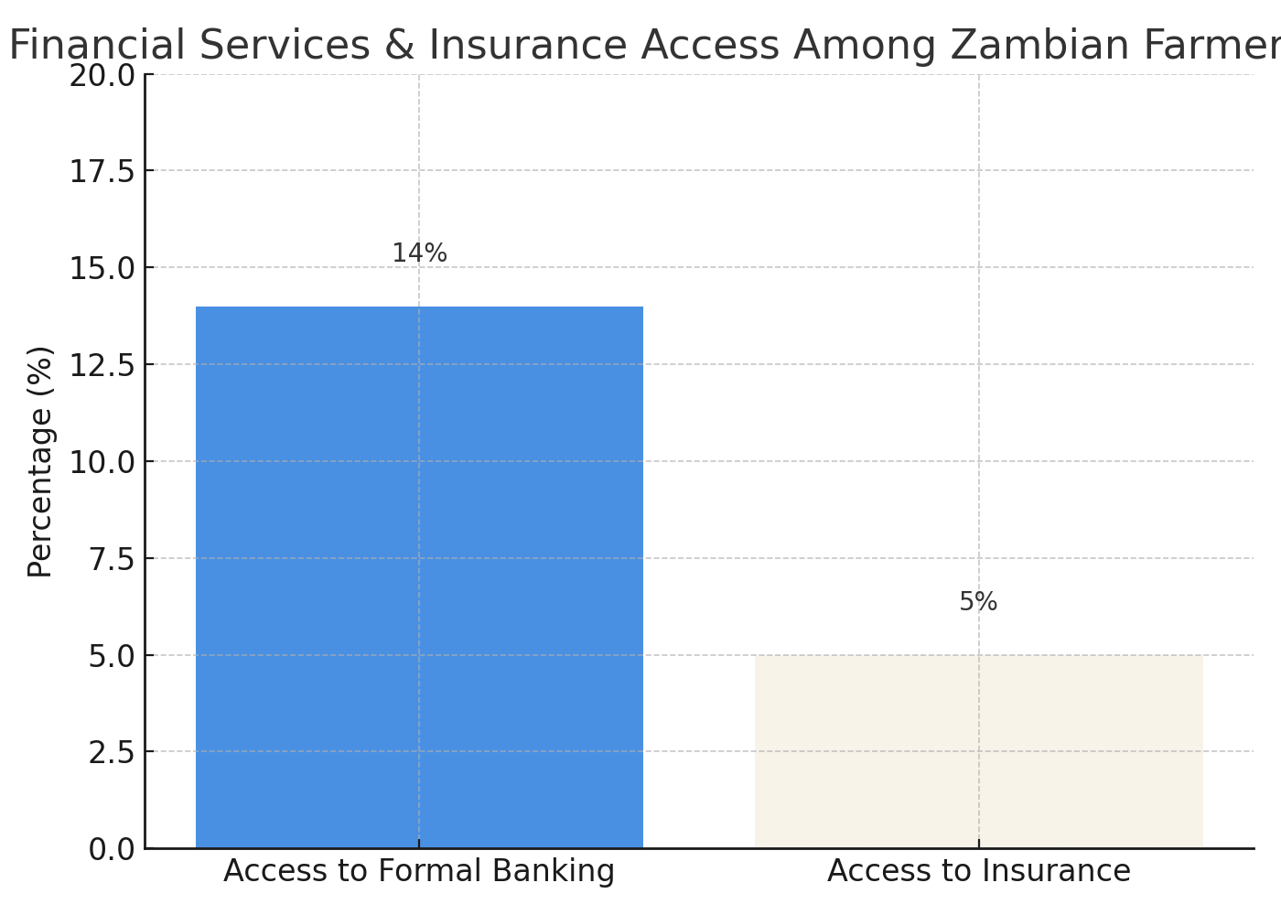
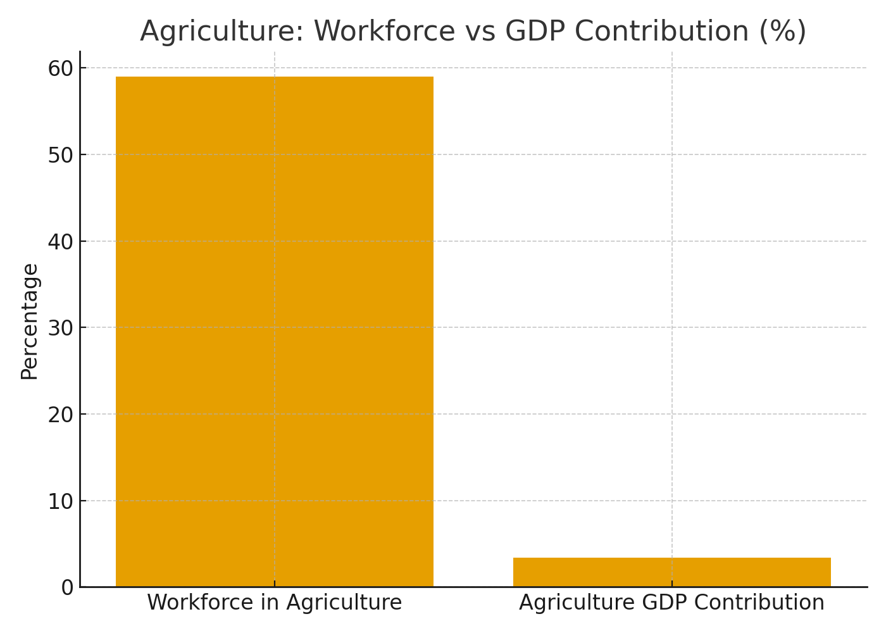
Background
Souce:
Food and Agriculture Organization (FAO) Zambia, Agricultural Sector Overview, 2023.
World Bank, World Development Indicators, 2023.
Zambia Central Statistical Office (CSO), Labour Force Survey, 2022.
World Bank, Zambia Economic Update, 2022.
UNESCO Institute for Statistics, Adult Literacy Rate – Zambia, 2021.

Slide 3
The Solution
01
Voice-first system that allows farmers to access services through phone calls in local languages no reading or internet required.
02
Mobile app version for smartphone users, providing the same agricultural, financial, and insurance services with an easy-to-use interface.
03
Real-time agricultural information such as weather forecasts, market prices, and farming tips to support better decision-making.
04
Integration with financial and insurance partners to give farmers access to digital payments, loans, and crop/livestock insurance
05
Inclusive digital platform designed to reach both literate and non-literate farmers across Zambia.

Slide 4
How it Works
(Germination and Sprout Stage)
Voice Access:
Farmers dial a toll-free number or receive automated voice messages in their preferred local language (e.g., Bemba, Nyanja, Tonga).
Voice Interaction:
The system uses a voice menu (IVR or speech recognition) where farmers can speak or choose options to get information for example:
“Press 1 for weather updates”
“Press 2 for market prices”
“Press 3 for financial or insurance services.”
Information Delivery:
AgroSpeake Connect provides real-time agricultural advice, weather forecasts, pest alerts, and market information directly through voice or SMS follow-up.
Financial & Insurance Services:
Through partnerships with banks and insurance providers, farmers can access digital loans, savings, or insurance via voice prompts or through the mobile app.
Mobile App Option:
Farmers with smartphones can download the AgroSpeake Connect app to access the same services with visuals, chat support, and digital records of transactions or advice received.
Data & Feedback:
The system collects anonymous user data and feedback to personalize services and improve recommendations for farmers over time.

Slide 5
UPLOAD A VIDEO
(Germination and Sprout Stage)

Slide 6
Traction
(Germination and Sprout Stage)
Custom AI Models
Developed custom TTS (Text-to-Speech) and STT (Speech-to-Text) models to support local languages and voice-first interactions.
Pilot Testing / Feedback
Conducted a pilot with 15 farmers using the mobile app.
Feedback highlighted the need to integrate financial services and insurance into the platform.
Partnerships / Stakeholder Engagement
Collaborating with UNIPOB, ZICTA Innovation 2025, and the Youth Team Up program to support development, testing, and scaling.

Slide 7
Value Proposition
01
Inclusive Access: Enables all farmers, including non-literate users, to access agricultural, financial, and insurance services via voice or app.
02
Timely Agricultural Information: Provides real-time weather updates, market prices, and farming advice in local languages.
03
Financial & Insurance Integration: Connects farmers with loans, savings, and crop/livestock insurance directly through the platform.
02

Slide 8
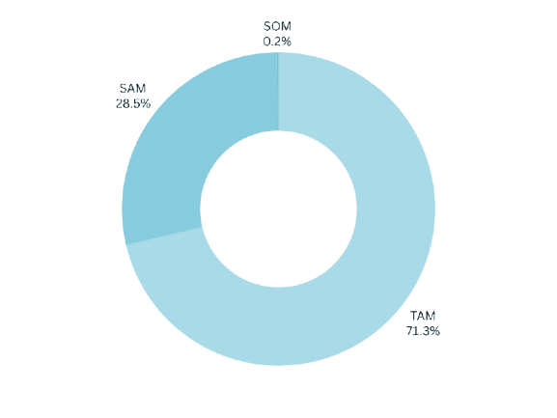
Market
Total Available Market (TAM)
Serviceable Available Market (SAM)
Serviceable Obtainable Market (SOM)

Slide 9
Competition
Here is our competitors list and what they are doing

Slide 10

Revenue Model

Slide 11
The Team (Optional)

Slide 12
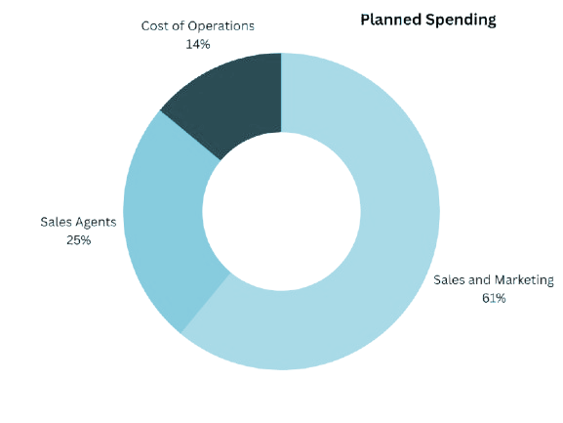
Our Ask?
Open to partnerships, mentorships, and introductions to potential clients

Slide 13
Thank You
Telephone
Address
Website

